Slide 1
September 2023 PS Admin Monthly Webinar

Slide 2

AGENDA
Introduction
Break Out Sessions
Announcements & Reminders
Wrap-Up

Slide 3
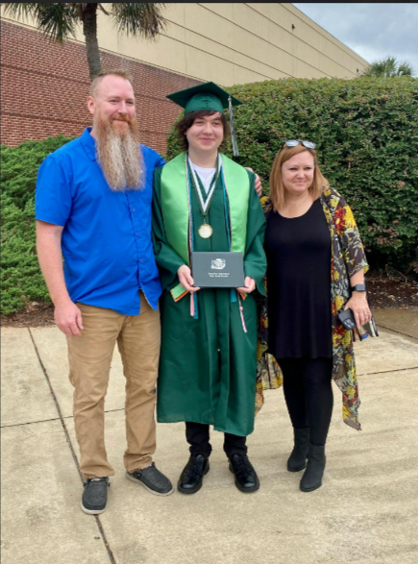
Celebrations
Rachel Williamson of SCVCS:
My youngest, Peyton, graduated Spring of this year!

Slide 4
Celebrations
Lauren Cafaro of Odyssey Online Learning says…
Only 4 No Show withdrawals to date for the 23/24 school year 🎉🎊🎉

Slide 5
Shout Out
Cricket Trubey at Oceanside Collegiate Academy says…
Want to send a shout out to Cantey for all your help. It sure is nice doing School Life with y'all!

Slide 6
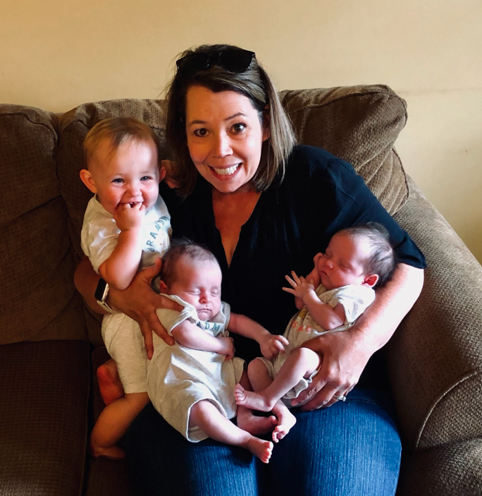
Celebrations
Jennifer Jackson at Gray Collegiate Academy says…
We welcomed twin grandbabies into our ever-growing family. Cohen and Cooper Jackson. Born June 18, 2023. They join Everleigh Kelly, our oldest grandchild, who turned one in June.

Slide 7
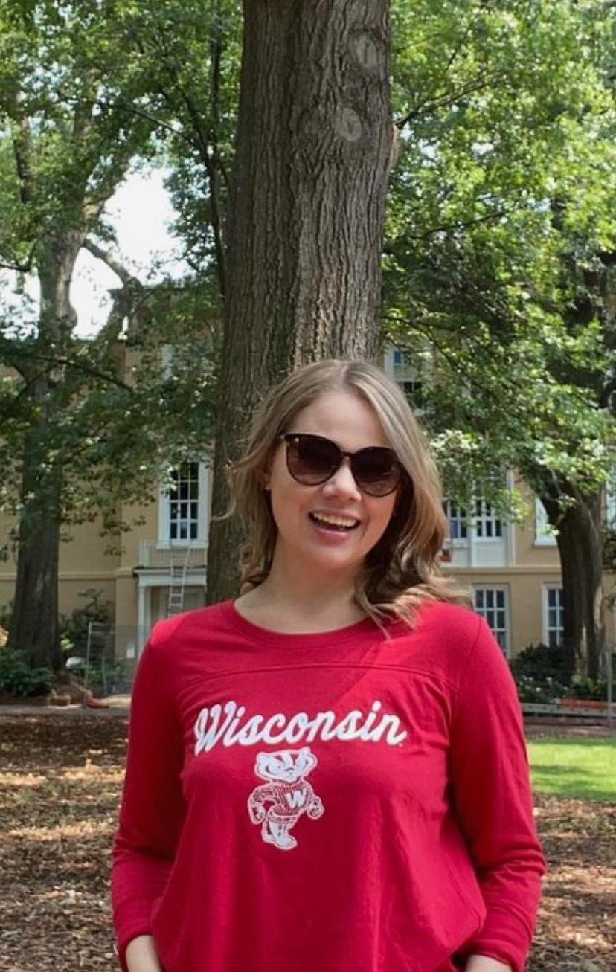
Celebrations
Patti Rubenzer of Odyssey Online:
My daughter, Grace, started grad school last week to become a School Psychologist. We are super proud of her.
(She is a product of charter schools)

Slide 8

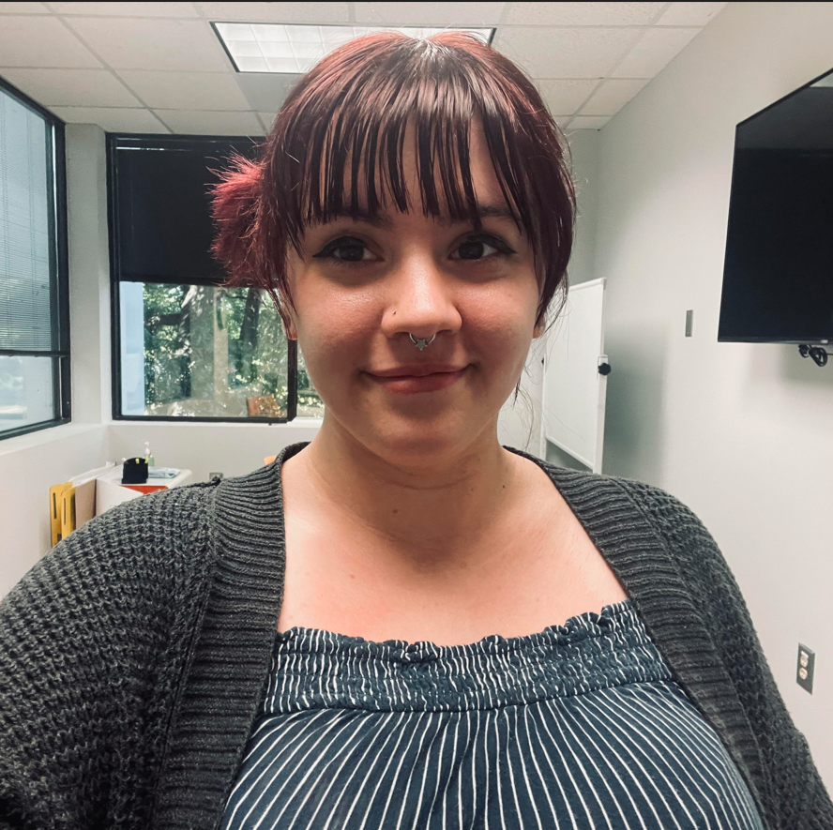
Celebrations: New PowerSchool Admin!
My name is Ellie Maxwell. I have been with SCCA for a couple of months, and I am excited to have the opportunity to work in Powerschool, as I have always had a great interest in all things computer science and data. I plan to pursue a career in Cybersecurity and work on learning coding as well. I look forward to working with the team!

Slide 9

Jason says: "Jessica will be presenting at new SC Student Data Conference @ EdTech in October! Be sure to mention this training opportunity to your school leaders.
www.scaet.org
Oct. 24-27"

Slide 10

Training & Event Opportunities

Slide 11
SC Ed Tech Conference
October 24-27, 2023
Link to Conference Page: https://edtech.scaet.org/
To Register: https://edtech.scaet.org/index.cfm/register/

Slide 12
PowerSchool Master Schedule Building Workshop
Two-Day Interactive Workshop
In-Person Option ($1000 per person)
Online Option ($600 per person)
Multiple Dates (starting October)
Hands-on, comprehensive training
Manual Construction methods for all levels of users
Link to Page: https://support.powerschool.com/msbw/main.action
Link to Register: https://support.powerschool.com/msbw/register/step1.action

Slide 13
SCDE Upcoming Training Date
September 26, 2023 1:00 pm to 2:30 pm | Webinar 6: Improving Student Engagement - Lessons Learned and Success Stories from Two South Carolina Districts This learning session will feature panel discussions by teams from two South Carolina school districts that have successfully improved student engagement to reduce learning loss and to improve student outcomes. These districts will be identified in consultation with the SC DoE and each separate panel discussion will be moderated by NDPC staff. Each district panel will share lessons learned and success strategies for 25-minute periods followed by 15-minute periods for participant questions and feedback. | September 2023

Slide 14
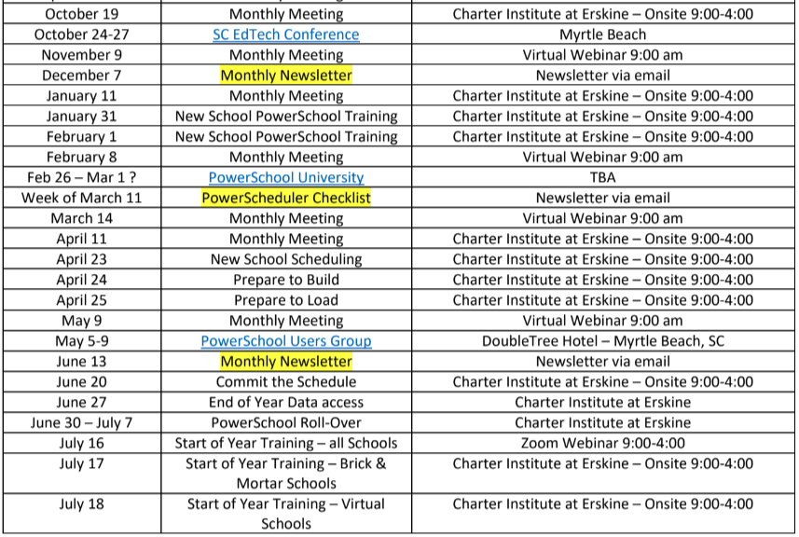
2023-2024 PowerSchool Trainings Calendar
Please remember, webinars are mandatory.
If you will not be able to attend the webinar, please send me or Jason Jones an email with the reason.
Be sure to let me know you are present by putting your name and school in the chat box. This will guarantee you are counted as present.
Training Schedule (Live Link): https://www.dropbox.com/scl/fi/nqvwzqyu2op3dbqkl93ff/23-24-PowerSchool-Trainings-Calendar.docx?rlkey=igtgt32q1f3frbs8r1ooe7seq&dl=0

Slide 15

September 26-27, 2023
Columbia Metropolitan Convention Center
Register Here

Slide 16
Announcements & Reminders

Slide 17
Upcoming School Data Collection Deadlines
Data Being Collected | Charter Institute at Erskine Deadline | SCDE Deadline
Current Year Dropout Data | September 22, 2023 | September 5-22, 2023 @ 9 AM
Precode: Spring NAEP | September 20, 2023 | September 20, 2023 @ 4 PM
Confirm IGP Setup for Schools | October 20, 2023 | N/A
QDC1 (district’s 45th day) IM, Dropout | October 27, 2023 | September 20-October 27, 2023 @ 9 AM
Precode Fall EOCEP | October 13, 2023 | October 23, 2023 @ 5 PM
45 Day Funding Reports | November 1, 2023 | November 7, 2023 @ 4 PM
Resources:
Charter Institute PS Admin Handbook
SCDE Data Collection Schedule
Student Information System (SIS) Data Entry Manual

Slide 18
English Proficiency (MLP) Reminder
Start Page > Student Selection > Compliance > South Carolina Student Information
Every student should have a value for English Proficiency, even if it is “AW” – Awaiting testing results.
Work closely with your Multi-language/ESOL coordinator to ensure coding of proper values
Most will be defaulted to “9,” which is Native Speaker (English)
To find blank values: S_SC_STU_X.Engl_Prof=
Level Data > MLP (**new name**) Tab
AW – Awaiting will throw an error in Level Data, but it’s there to alert coordinators to get the correct value into PowerSchool once a student is tested
30 Day Window!

Slide 19
Overlapping Section Enrollments & Invalid Courses
Overlapping Sections
See Level Data: Enrollment Tab, Page 2
Invalid Course Codes
See SAS/DQR Reports (starting September 20 – QDC1)
See Activity Course Database
If you do not have access, please send an email to Jason Jones or Jessica Crowe to obtain access to SCDE DQR Reports.
Segment towards end on how to correct.

Slide 20
EFA Best Practices
When transferring your student out of school (withdrawing), close out your EFA (Home > Student Selection > Compliance> EFA/EIA Classification > EFA History Tab)
The end date should be your school exit date
Make sure that you are aware of the next school’s entry/start date so that these dates do not overlap
If you receive a student record where your enrollment dates will overlap, they will error out.
In the event this happens, contact the school. If you cannot resolve, put in a help ticket.
Make sure when you receive a records request, you are paying attention to the next school’s start date for the student before exiting.
Communication is key!
DO NOT DELETE EFAs unless it is a NO SHOW EFA!

Slide 21
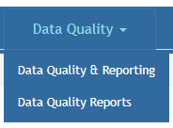

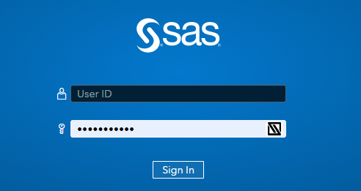
Validation Reminders
Please check Level Data and SAS Reports no less than one time a week and clear errors.
Reach out to Cantey for assistance if needed; we can help clear or answer questions.
SAS Reports
To login, visit: https://appportal.ed.sc.gov/my.policy > Click Report Portal > Login to SAS > Hover over Data Quality > Click Data Quality & Reporting > Errors by Validation Type (Student, Activity Code, Teacher, State ID, PowerSchool Setup)

Slide 22
Section and School Enrollment Audits
From your Home Page > System Reports > Under Membership and Enrollment Header, click School Enrollment Audit or Section Enrollment Audit
01
Errors need to be cleared
02
If you have trouble clearing, let Cantey know
03

Slide 23
Fall Precode

Slide 24
Fall Precode
Precode is assessment-related student information available for testing contractors to pre-populate online testing systems, pre-assign answer documents and test booklets, and generate scannable documents/labels.
SCDE Precode Guide - https://ed.sc.gov/data/information-systems/power-school/sis-documents/precode-guide/

Slide 25
Fall Precode
Fall EOCEP Data:
Due October 13, 2023
For online and paper test-takers, Precode data should be populated in PowerSchool for any Customized Material and Oral Administration Fields.
Precode data is used to populate online test sessions for all students
Students coded as paper testers in Precode data will be assigned the “Online-Transcription Form” accommodation in DRC INSIGHT Portal Student Management.
For EOCEP English 2, all parts must be taken via the same mode
The PowerSchool fields for customized test form and oral/signed administration in the subject area are used across testing programs.
Contact the SCDE for further instructions if the values for these fields should not apply to both testing programs for a student.

Slide 26
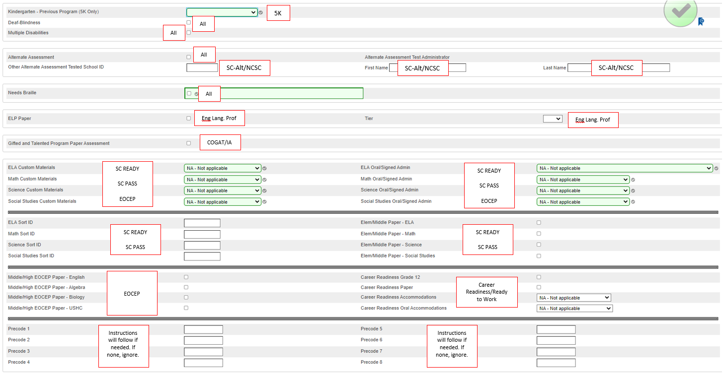
PS Home > Student Selection > Compliance > Precode:

Slide 27
Fall EOC Precode Fields Collected
Display Name | PS Field Name
School Number | SchoolID
N/A | District
School Name | School Name
Grade Level | Grade_Level
True Grade | S_SC_STU_X.TrueGrade
State ID | State_StudentNumber
Student Number | Student_Number
Name | StudentCoreFields.PSCORE_LEGAL_LAST_NAME
Name | StudentCoreFields.PSCORE_LEGAL_FIRST_NAME
Name | StudentCoreFields.PSCORE_LEGAL_MIDDLE_NAME
Gen (Jr., III, etc.) | S_SC_STU_X.StudentGeneration
DOB | DOB

Slide 28
Fall EOC Precode Fields Collected
Display Name | PS Field Name
Gender | StudentCoreFields.PSCORE_LEGAL_GENDER
Ethnicity | FedEthnicity
Race | Search: Racecode not in B, W, I, A, P
EFA Code Entry | EFA Primary-EFA10
Deaf-Blindness | S_SC_STU_X.DeafBlindInd
Multiple Disabilities | S_SC_STU_X.MultiDisabInd
504 Plan | S_SC_STU_X.Plan504Code
Instructional Setting | S_SC_STU_X.InstrSetting
Gifted & Talented Status | S_SC_STU_X.GT_Qualified
Migrant | S_SC_STU_X.Migrant
Engl Prof | S_SC_STU_X.Engl_Prof
Alternate Assessment | AtlAssess - S_SC_STU_X.AltAssess

Slide 29
EOCEP Course & Teacher Info Collected
Section ID
Term ID
Tested School ID
Start Date
End Date
Teacher Number
Teacher Certificate Number
Teacher Last, First, Middle Name
Educator ID
VSP Teacher Name
VSP Certificate Number

Slide 30
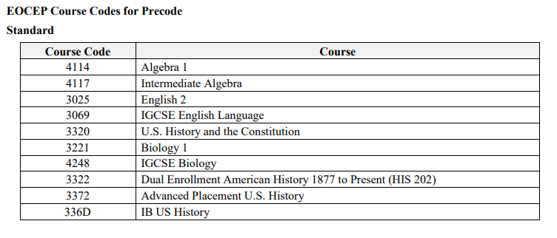
EOCEP Course Codes Only courses that appear in the following table will be precoded
The English I EOCEP is no longer administered, effective 2020-21.

Slide 31
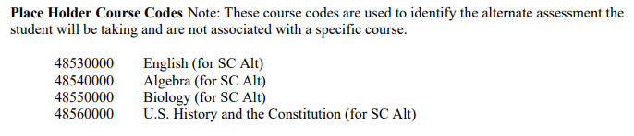
Alternate Assessment EOCEP Course Codes Only courses that appear in the following table will be precoded
Use the following PowerSchool codes to precode for students taking Alternate Assessments in high school (grade 9 or above). Students must take all four assessments prior to their third year of high school according to their 9GR.

Slide 32
Fall EOC Precode: Note About Algebra
Students must not enroll in Foundations in Algebra (4116) prior to ninth grade. A school that offers Foundations in Algebra (4116) must subsequently offer Intermediate Algebra (4117). Students who successfully complete Foundations in Algebra (4116) must subsequently enroll in Intermediate Algebra (4117). Upon completion of this two-course sequence, students must take the state-mandated Algebra 1 End-of-Course assessment (Algebra 1 EOCEP) administered at the completion of the second course, Intermediate Algebra (4117).
Students may not receive mathematics credits for both Foundations in Algebra (4116) and Algebra 1 (4114). In that case, one course will receive mathematics credit; the other will receive elective credit.
Students who have a final average of D in Algebra 1 (4114) may subsequently enroll in Intermediate Algebra (4117). Students who complete Intermediate Algebra (4117) after Algebra 1 (4114) must re-take the state-mandated Algebra 1 End-of-Course assessment (Algebra 1 EOCEP) administered at the completion of Intermediate Algebra (4117). In that case, one course counts as mathematics graduation credit and the other is an elective credit.

Slide 33
Tips for Preventing Violations
Collaboration between Special Education, Coordinators/504 Coordinators, and PS Admin
Early Planning
Organized system & process in place
Be aware of your school testing calendar

Slide 34
Fall Precode Recap
Pages:
Student Demographics – Select a student > Demographics
Teacher Information – Select a teacher > Information
SC Student Information - Select a student > Compliance > South Carolina Student Information
Precode - Select a student > Compliance > Precode

Slide 35
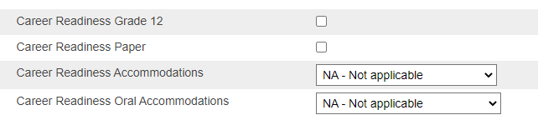
Fall Precode Reminder: R2W
Fall Ready to Work (R2W)
All 9GR21 Students from Spring who did not earn Career Readiness may retake in the Fall
Be sure to interface with Student Testing Coordinator on those who will test so they are coded in PowerSchool
Career Readiness Grade 12 Checkbox must be checked for those 12th graders taking or retaking the test.
If the student needs paper or accommodations, that data must be filled in as well.
Found on Precode page in student record: Home > Student Selection > Compliance > Precode

Slide 36

Current Year Drop-Out Data

Slide 37
Current Year Dropout Data
Dropout: The State Board of Education defines dropout as a student who leaves school for any reason, other than death, prior to graduation or completion of a course of studies and without transferring to another school or institution.
Current Year Dropout Data (School Deadline) – runs through September
Dropout data should be reported for grade levels seven through twelve (7-12).
2023 Dropout Policies and Procedures Manual: https://ed.sc.gov/districts-schools/school-safety/discipline-related-reports/dropout-data/2023-dropout-policies-and-procedures-manual/
The dropout date must fall between October 1, 2022 – September 30, 2023.

Slide 38
Current Year Dropout Data
grade level [Grade_Level]
full legal name [Last_Name, First_Name]
student’s number [Student_Number]
State ID number [State_StudentNumber]
Ethnicity [FedEthnicity]
gender [Gender]
date of birth [DOB]
Free / Reduced Lunch [LunchStatus]
English proficiency [Engl_Prof]
migrant status [Migrant]
Homeless [Night_Residence]
EFA codes
exit code [ExitCode]
dropout reason code [Dropout_Reason]
dropout date [Dropout_Date]

Slide 39
Dropout Resources
Aveene Coleman Padlet: https://padlet.com/arc5coleman/2022-training-materials-e1tlfinf8fp7g4zj
Dropout Webinar (2022, 2023 is not available yet): https://www.youtube.com/watch?v=etHUsPpQ18w
Dropout Webinar 2023 PowerPoint: Powerpoint Link

Slide 40
Clever Presentation

Slide 41

What is Clever?
PowerSchool and Clever.
Applications.
Purchasing Applications.
How is the district here to help?
Application Set-up.
Data Analytics maintenance.
Troubleshooting.

Slide 42
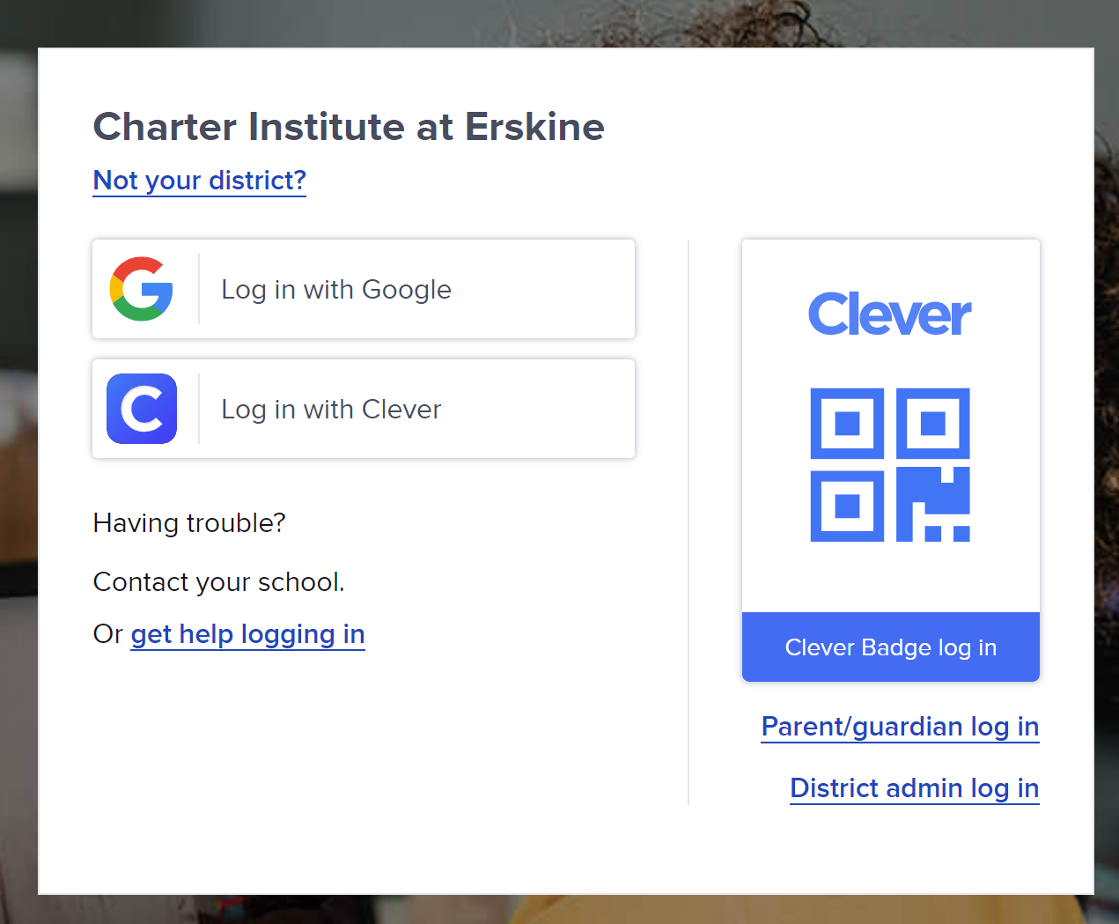
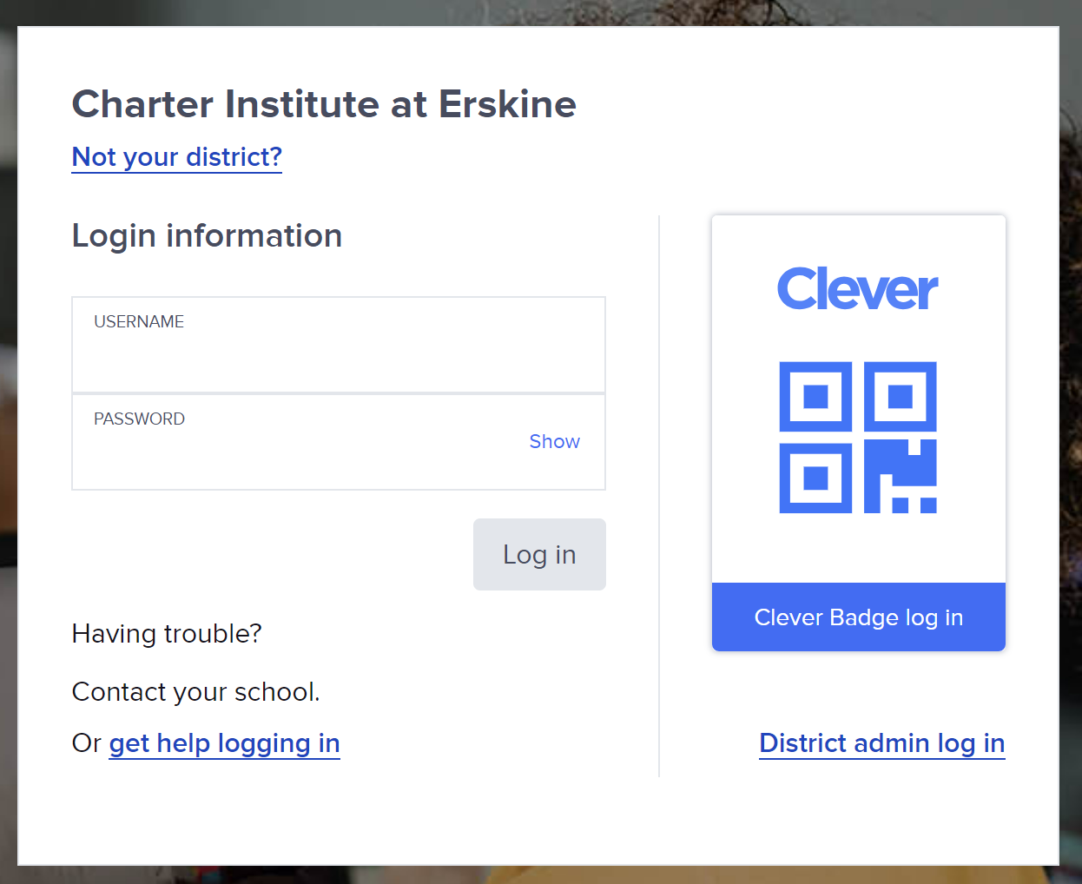
Login Information:
Login Information:
Student Information:
Student Username: SIS ID
Student Password: Birthday in MM/DD/YYYY
Teacher Information:
Teacher Username: Email
Teacher Password: Charter@Erskine

Slide 43
Roles Explanation:
As the district, Charter Institute at Erskine, we will request applications per the school’s request; monitor for potential data sync issues; troubleshoot any matters pertaining to login issues, application errors, or syncing problems;
The STL role holds the ability at the school level to: Request applications; reset passwords for both student and teachers; see data analytics for applications; Assign and Print badges for teachers; and access “Portal as” for teachers and students for any troubleshooting needs.
Teachers can: access applications via Clever; create and share teacher pages; mange and print Clever badges for their classroom; reset student passwords; log a class of students out of Clever; view login status for students; Lastly, add and review exisisting Clever Library applications.
Admin Role: (District)
School Tech Lead (STL), aka “Staff”
Teacher Role

Slide 44



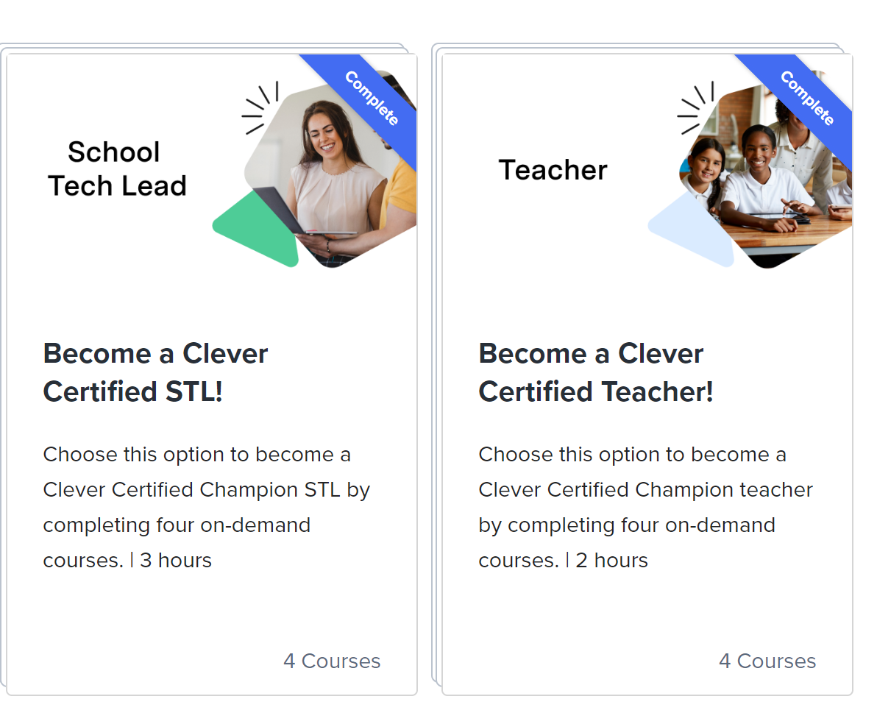
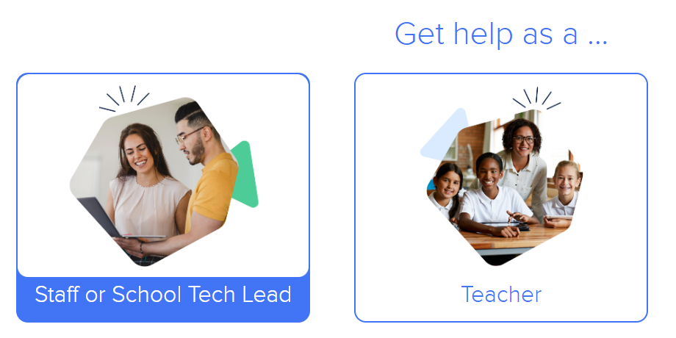
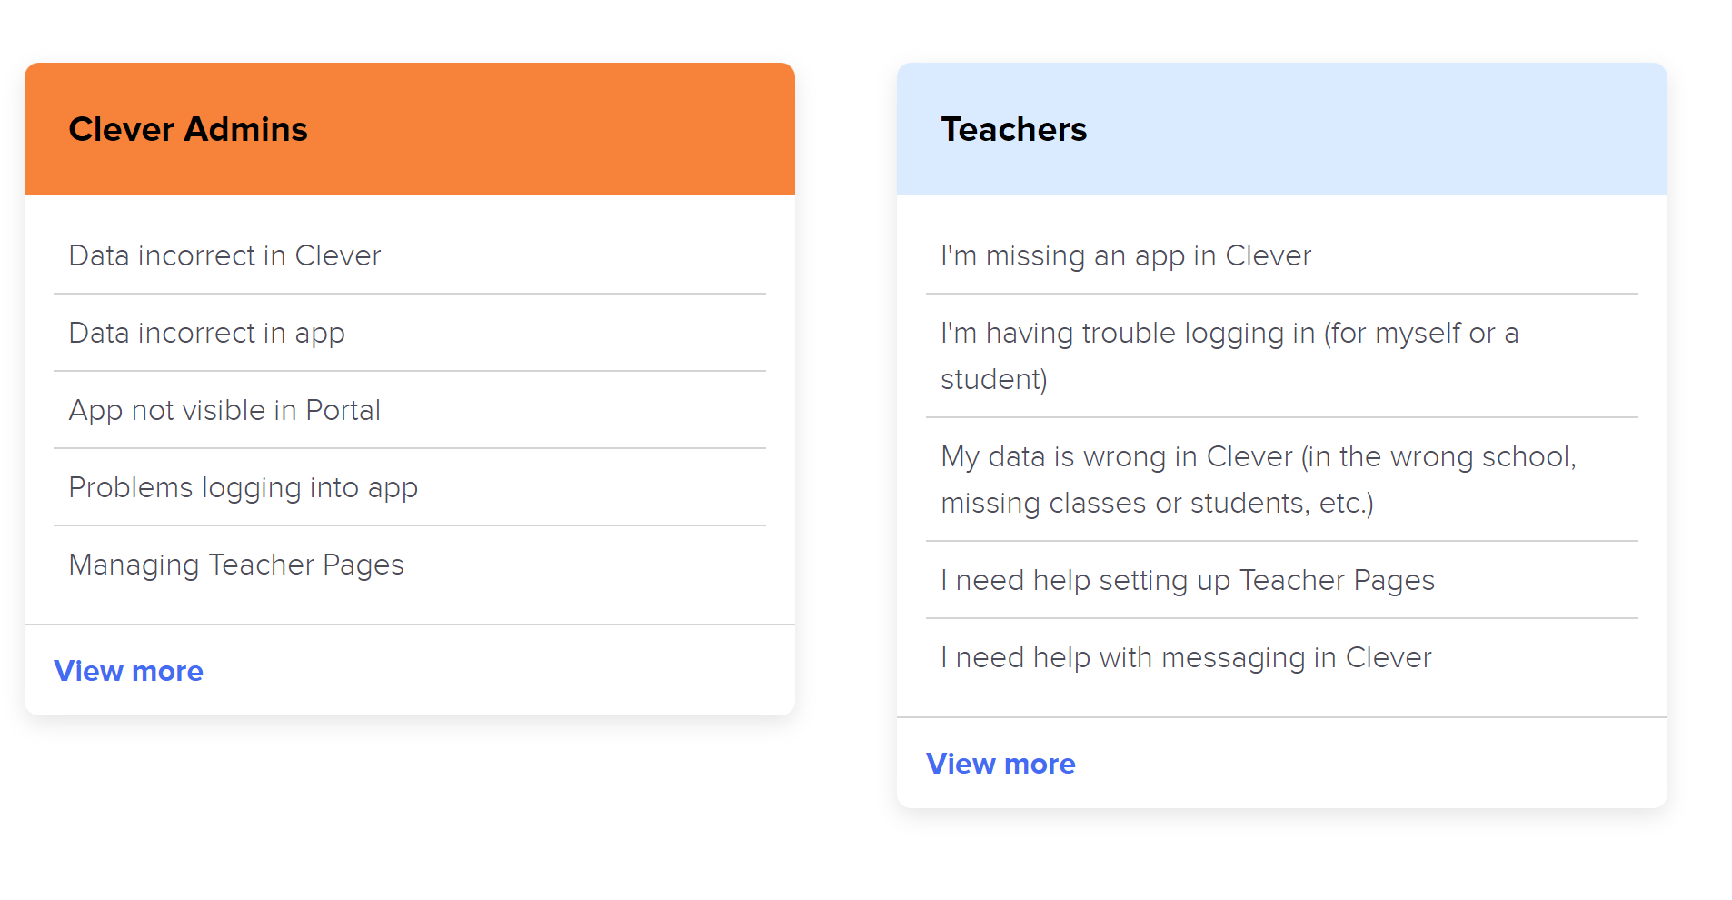
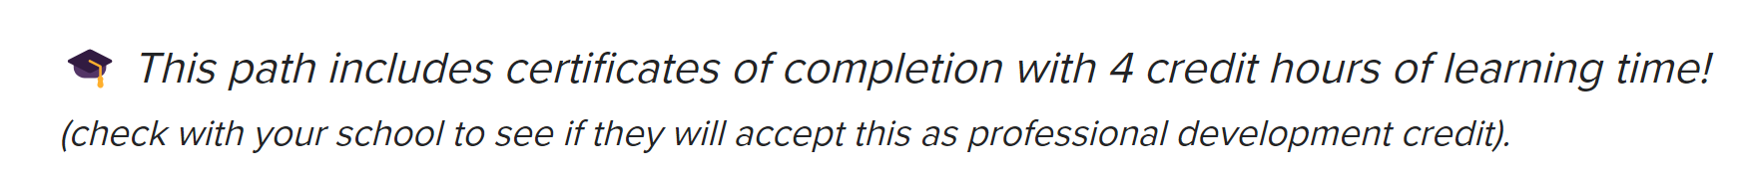
Resources:
Clever Academy:
https://clever.academy/
Clever Support: https://support.clever.com/s/?language=en_US

Slide 45

https://brightarrow.com/
Bright Arrow Who are they?
BrightArrow allows schools to send voice, text and email messages, created and launched from within PowerSchool. Here are some benefits of using BrightArrow within your PowerSchool pages:
Entirely embedded into PowerSchool
Unlimited Voice, Text, Email and Social Media Posts
Report Card Emailing
Integrates into PowerSchool Parent Portal
Fully supports PowerSchool’s New Contacts module that was introduced in PowerSchool 12
Unlimited Users
PowerTeacher Pro Integration
“Panic Button” and Anonymous Tip Line
Two-Way Direct Chat Portal
How does the district play a part?
The Charter Institute at Erskine (CIE) will accompany any demonstration per the request of the school.
After school’s purchase of the BrightArrow application, CIE will then set up the application within PowerSchool to sync all data information necessary for the program to run.
CIE will assist in answering any questions as needed by the school on the functionality of the program.

Slide 46
Breakout Sessions
Jason:
Q & A
Leticia:
IGP Set-Up
Jenn:
Teacher Comment on Report Card
Blythe:
Photo Management

Slide 47
Wrap-Up

Slide 48
Correcting Invalid Sections: Overview
Best Practices to Consider:
Before completing these steps, you should have the teacher or PS Admin (PT Pro Adminstrator) in the invalid course code section print a copy of the students' assignments and grades.
The report that can be ran: Individual Student Report.
Once the teacher or PS Admin has printed out the student assignments and grades, a hard copy of student attendance should be printed out also.
These reports will help teachers/staff re-enter assignment, grade, and attendance data back into PowerSchool.
Once these reports have been completed, you may proceed.

Slide 49
Correcting Invalid Sections: Process
1. Review the SCDE Activity Coding Database to find the proper course code: SCDE Activity Coding Database
2. Ensure that the course code is available in the PS SIS
School Management > Courses and Programs > Courses > Manage Courses for this School: Available and Unavailable Tab
See Available Tab first. If not found on that tab, select unavailable tab.
Best practices are to have first 4 of course code match the ACD, and the 5 & 6th position of course code be “00” (i. e. 302400CW vs. 302401CW)
Click the box to check the course code and hit submit.
If you cannot locate the proper course code, send email to create ticket with Cantey: help@canteytech.com

Slide 50
Correcting Invalid Sections: Process
3. Create New Section
School Management > Courses and Programs > Course Sections
Find Course Code and Select
Click “New”
Fill out all relevant Course Data including, but not limited to:
Expression
Term
Teacher – Section Lead & Additional Staff (if applicable)
Gradebook Type = PowerTeacher Pro
Section Number
Grade Level
Maximum Enrollment
Grade Scale
Instruction Type
Click Submit to Save New Section

Slide 51
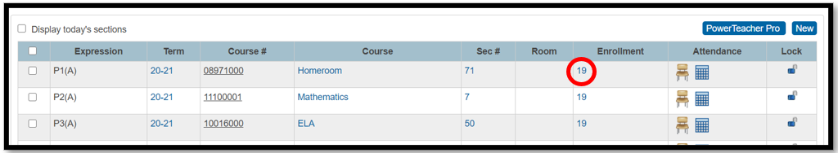
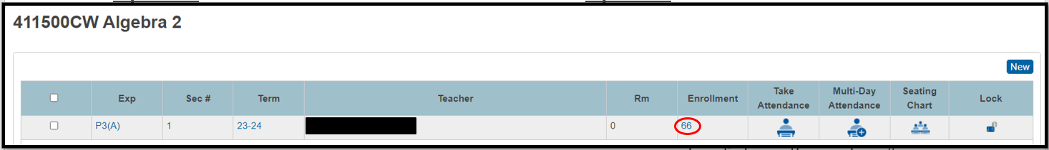
Option 1:
4. Go back to Start Page and Click People > Staff > Teacher Schedules
5. Select Teacher Name that you must drop students from
6. On the row with the invalid course code click on the value # under the Enrollment heading to display the section’s class roster.
Option 2:
4. While still in the Course Sections page, Find the Course Number/Course that is in error and Click on the Course
5. On the row with the invalid course code click on the value # under the Enrollment heading to display the section’s class roster.

Slide 52
Correcting Invalid Sections: Process
6. Notice that the following buttons are available:
• Make Current Student Selection
• Add to Current Student Selection
• Enroll into Different Class
• Recommended - Click Drop from this Class
When completing this task, the exit date must be the first day the student(s) were enrolled in that section/class just like you would do for a No Show.
Note: You can either keep Select All checked or select individual student(s) by checking and unchecking students.

Slide 53
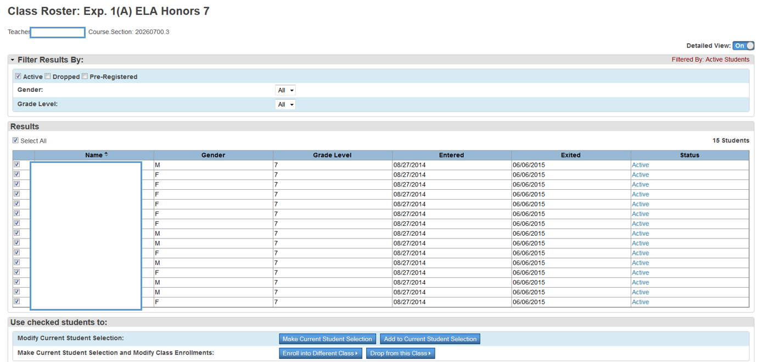
Correcting Invalid Sections: Process

Slide 54
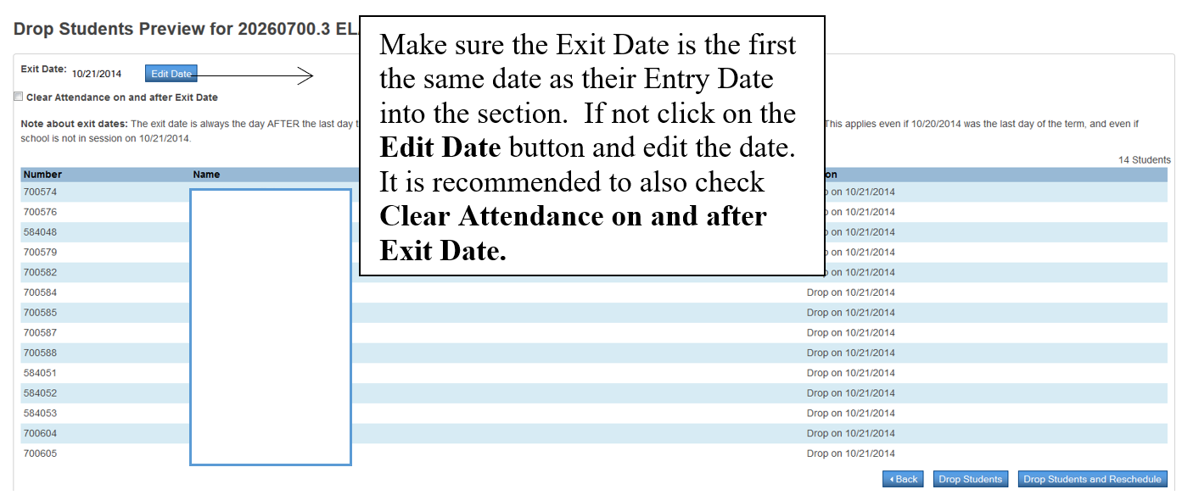
Correcting Invalid Sections: Process
7. After Clicking Drop from this Class:

Slide 55
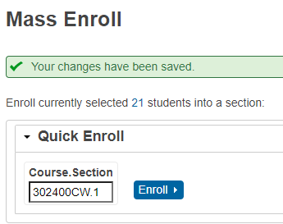
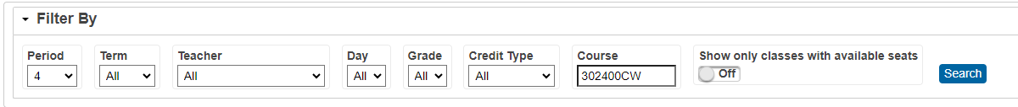
Correcting Invalid Sections: Process
8. Click either Drop Students or Drop Students and Reschedule.
You can Select Drop Students and Reschedule if you have created the new section already.
9. Reschedule the student in the valid section course code by using the first day (the students' first day) of school as their entry date in the class.
Quick Enroll
Will need Course. Section (i. e. 30240CW.1)
You can filter and search for your newly created section by using the Filters

Slide 56
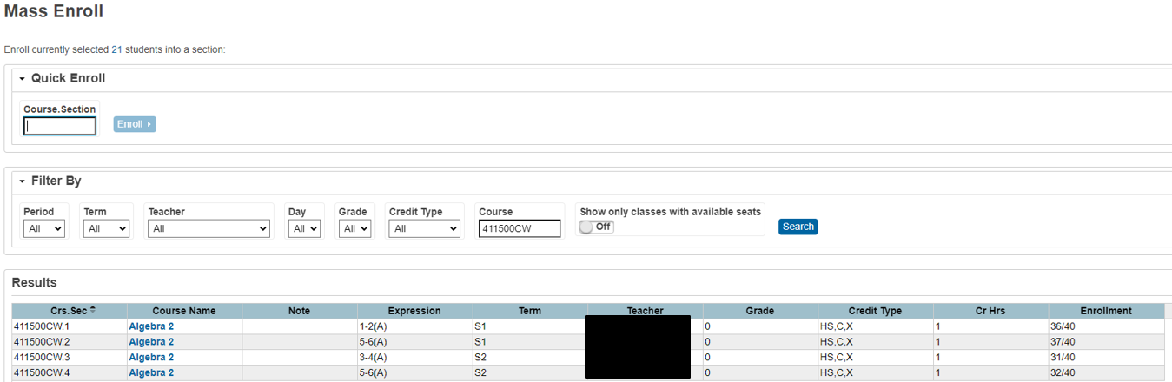
Correcting Invalid Sections: Process
9. (cont) Filter Function: Select Course Section from List:

Slide 57
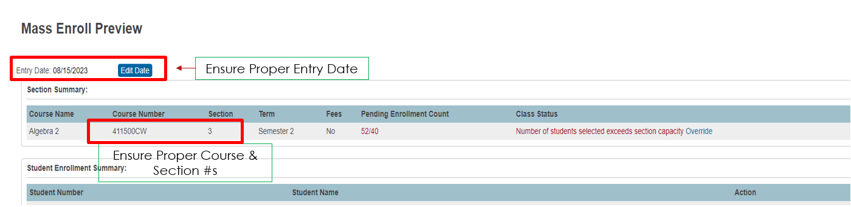

Correcting Invalid Sections: Process
10. Mass Enroll Preview
11. Click Enroll Students

Slide 58
Correcting Invalid Sections: Old Section Data
Remove the Expression Data
Change Teacher of Record to Staff that does not use PTP
Enter “DNU” or Similar Into Room and/or Section Number Info
Set Maximum Enrollment to “Zero/0”

Slide 59
Parent and Student Portal Access

Slide 60
Parent and Student Portal Access
All students and parents should have an account created so they have access to their data and any eCollect forms the SCDE may put out
Biggest Changes are with Student Portal Accounts
Parent and Student Portal Access:
https://cie.powerschool.com/public/
Both Parent and Student Accounts Created
Student Selection > Student Profile > User Access: Guardian and Student Account Access

Slide 61
Student Portal Access
**New** Student Password Requirements
Be at least 8 characters long
Contain at least one letter and one number
Contain at least one uppercase and one lowercase letter
Contain at least one special character
School to create uniform Username and Password format
Examples:
First initial caps + last initial lower +DOB (mmddyyy) + !
First name with initial in caps + DOB (mmddyyyy) + !
First initial caps with second letter of first name lower + Last initial lower + mmddyyy+!
You can use the Auto-Assign IDs and Passwords for this Student, but you will have to edit the password field. “Canned” Student Letters will no longer report password.

Slide 62
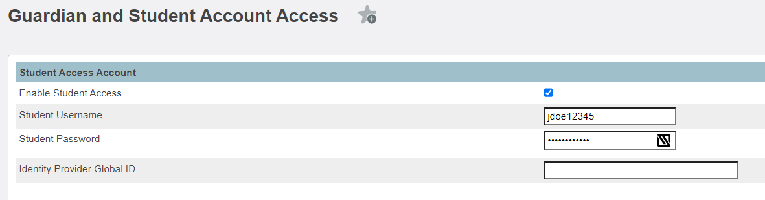
Student Portal Access
Required Fields:
Select “Enable Student Access”
Student Username
Student Password
Must Submit to Save.

Slide 63
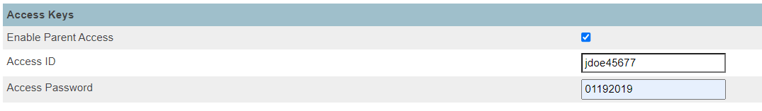
Parent Portal Access
Required Fields:
Select “Enable Parent Access”
Access ID
Access Password (no requirements on this page)
Must Submit to Save.

Slide 64
Parent and Student Portal Access
Once parent or student logs in, they will be prompted to create a new password with the following requirements:
Be at least 8 characters long
Contain at least one letter and one number
Contain at least one uppercase and one lowercase letter
Contain at least one special character

Slide 65
Missing Parent and Student Portal Data
Using Search Function on Home Page:
Student Portal
Student_Web_ID=
Will bring up Blank Student Usernames
Parent Portal
Web_ID=
Will bring up Blank Parent Usernames
Can export list using Quick Export

Slide 66
Student Quick Export Fields & Import Fields
Student:
Student_Web_ID
Student_Web_Password
Student_AllowWebAccess = 1 for Enabled Access
Parent:
Web_ID
Web_Password
AllowWebAccess = 1 for Enabled Access

Slide 67
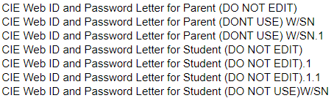
Parent & Student Portal Access Letters
You can print a report for the parent and/or student with their access information and directions to create an account.
Go to: Print a Report & Choose one of the below

Slide 68
Update Student Portal Letter
Recommendation: Update the Student Letter to include the details for the hard-coded values for the Student Password. Remember, this value will only appear as ***** so should change your school letter to reflect the exact formula for the student to use for their initial password at login.
You may also want to consider adding a statement about Student Passwords now requiring a change during initial login and the new password they create must follow the character requirements of one (1) capital letter, one (1) lowercase letter, one (1) number, one (1) special character, and must be at least 8-digits long.

Slide 69
Go to System Management in Left-Hand Menu (from PowerSchool Admin Home Page)
Click Reports
Select Object Reports under System Reports Header
Click the Name of the Object Report that you want to edit (this goes for new object reports that you have created)
Click Edit the main report parameters. The Edit Object Report page appears.
We will go over how to edit details of Object Report before import in the “Export an Object Report section
Editing Current Object Reports

Slide 70
Use the following table to edit information in the fields:
Field | Description
Title of this Report | Enter/Edit the title of the report. The Table pop-up menu displays the table used for the report.
Default Font | Choose the font in which you want the report to print from the pop-up menu. The report prints in this font unless you include an HTML tag to specify another font within an object of the report.
Default Font Size | Choose the size in which you want the text of the report to print from the pop-up menu. The report prints in this font size unless you include an HTML tag to specify a different font size within an object of the report.
Default Text Line Height | Enter the default height of each line of text on the report. The line height determines the amount of space for each line of text in the object. Increasing the line height creates more space between each line of text.
Page Size | Choose from the pop-up menu the size of the paper on which you want to print this report. To enter a custom size, enter the horizontal and vertical page measurements in the Custom Size fields.
Margins (Inches) | Enter the size, in inches, of the left, top, right, and bottom margins for this report.
Orientation | To indicate the paper orientation of this report, use the pop-up menu to choose one of the following: Vertical (portrait) Horizontal (landscape)
Scale | Edit the percentage to scale the object report. The lower the percentage, the smaller the form letter scales relative to the size of the page.
This report available to | Select one of the following options to determine who can use this report: users at all schools on this PowerSchool system only users at [the selected school]
Teachers can print? | If you want teachers to be able to print this report, select the checkbox. Otherwise, deselect the checkbox.
Override Course Exclude Setting? | Select the checkbox to override the setting on the Course Setup page to exclude courses from inclusion in reports.

Slide 71
Exporting an Object Report

Slide 72

Before Exporting an Object Report
Ensure
Ensure that you are allowed to use the report you are exporting
Make
Make sure it is a quality report!
Test
You can test this by running the report for a student to see how it looks: Student Selection > Click Printer Icon at Top of Page > Select Report > Submit

Slide 73
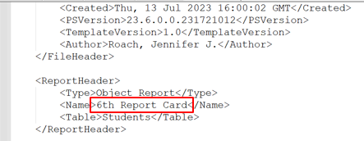
How to Export an Object Report
Find the report you would like to export: To do this, Go to System Management in Left-Hand Menu (from PowerSchool Admin Home Page)
Click Reports
Select Object Reports under System Reports Header
Find Report that you would like to Export and Select
Click Export this report as a template
The template should be in your Downloads folder
You can open in Notepad/Notepad++ or Similar and Edit Fields
Recommendation: Edit Title of Document before Import. It will be in the Report Header section of the document, see example:
Recommendation 2: Title should have your School Initials/Name and Year (i. e. “Hogwarts Student Portal Letter”)

Slide 74
Importing an Object Report

Slide 75
Before Importing an Object Report
Be sure that your file is a .txt file or it will fail
Make sure it is a quality report!
Make sure you have edited and entered a new title within the report (see previous slides)

Slide 76
How to Import an Object Report
Find the report you would like to import: This can be a pre-saved or new report you have obtained (canned report)
Click Data and Reporting > Imports > Import Existing Report Template
Once imported, to find your report, go to Reports > Select Object Reports under System Reports Header > Find Report that you would like to Edit/Review and Select

Slide 77
Next Steps: Test Your New Report
Go to student and hit the printer button
1
Print your new letter and review
2

Slide 78
Questions?

