Slide 1

August 2023 PS Admin Webinar
Cantey Tech

Slide 2


Welcome

Slide 3

Agenda
Part I: Introduction
        Welcome, New Schools, Celebrations
      Training Opportunities
      Upcoming School Data Collection Deadlines
      No Shows
Part II: Break Out Sessions
  Truancy & Chronic Absenteeism with Chryse
  Fall Precode with Jenn
  5th Day Reporting with Leticia
  Updates from CIE with Jason
Part III: Middle/High Schools
  Current Year Dropout Data
  Historical Grade Entry and Demo
  Summer Graduation Process Demo
  Coding Civil Rights Data

Slide 4
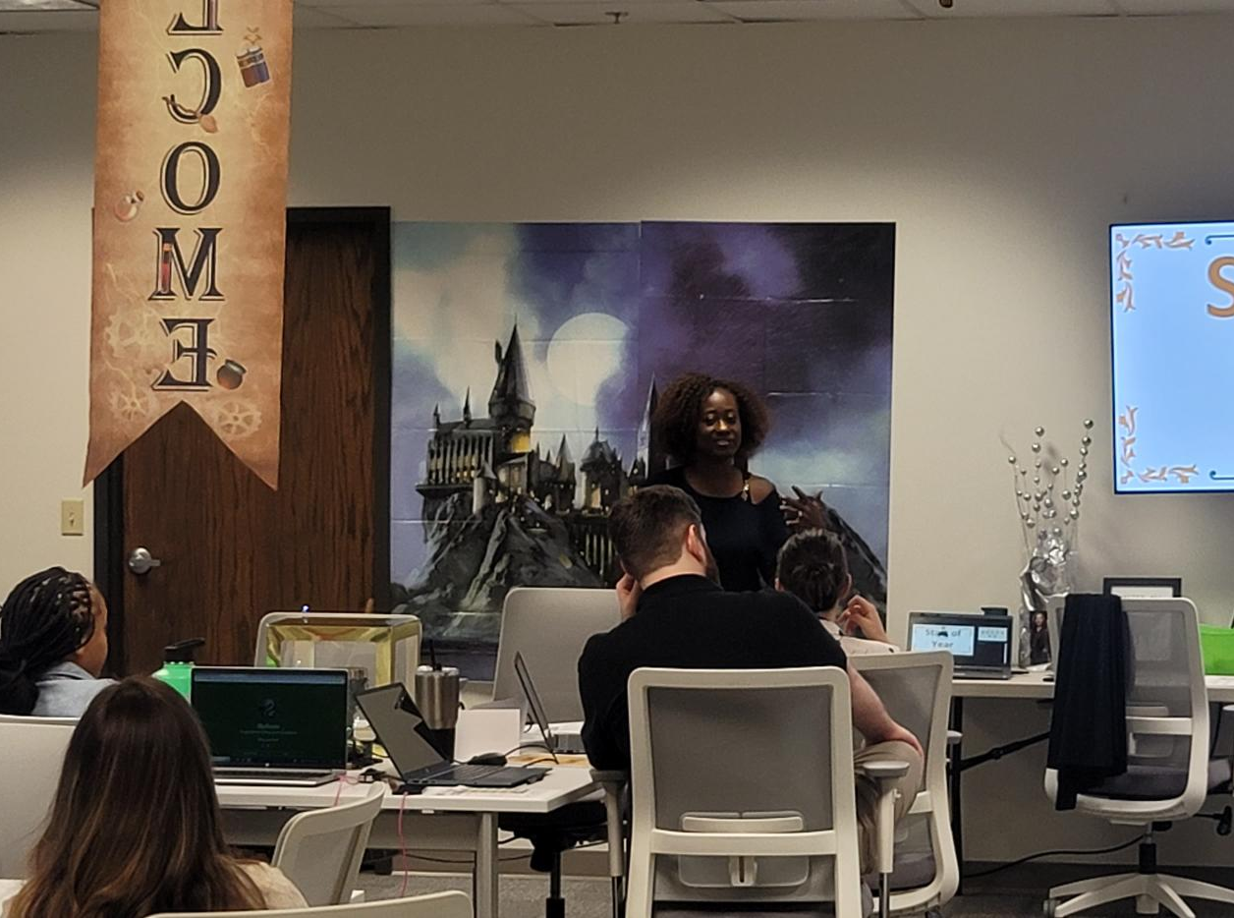
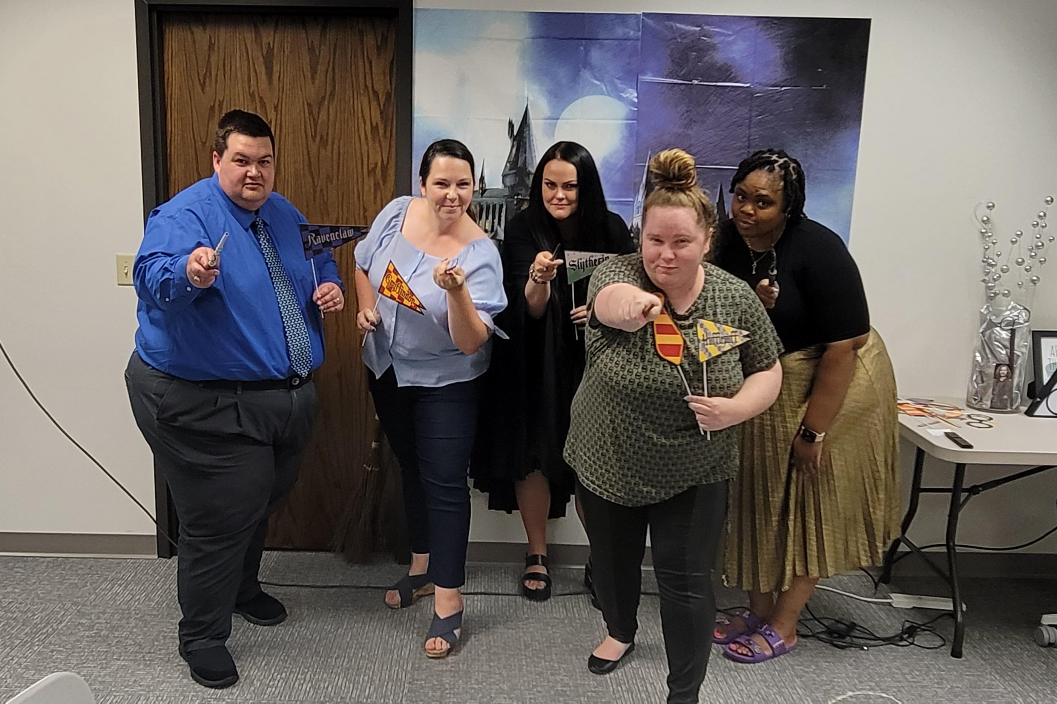
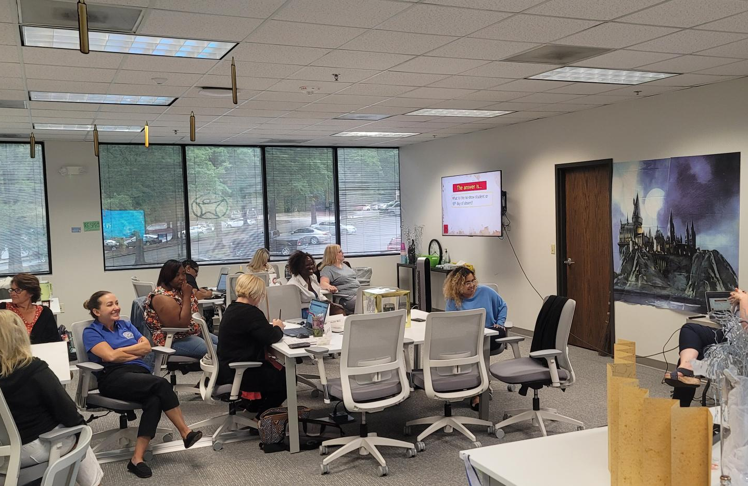
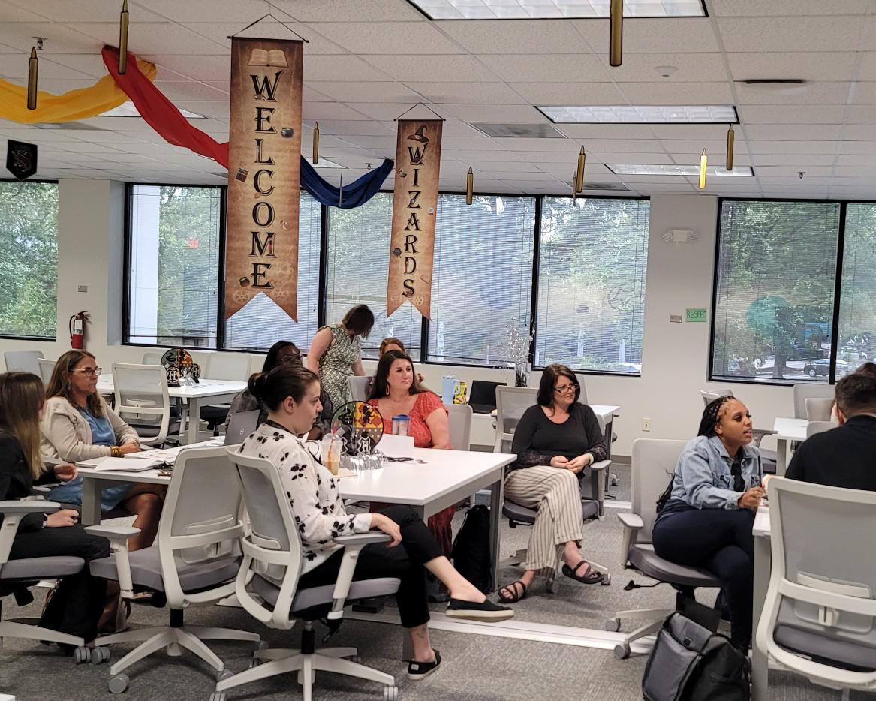
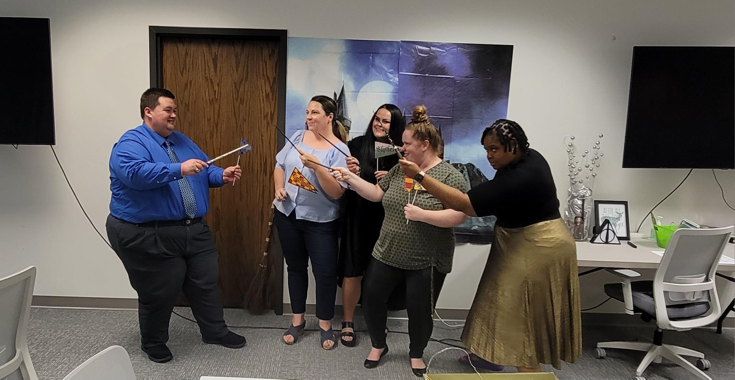
Thank you for a wonderful summer training!

Slide 5

Celebration!
Bailey Weikel-Feekes of SC Connections Academy got married in Yosemite, CA!

Slide 6
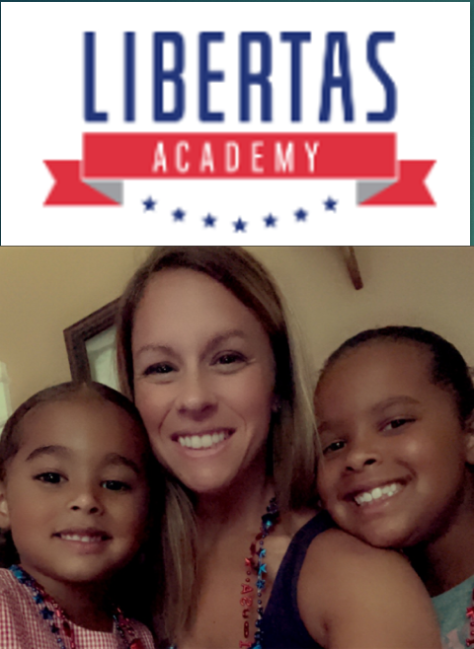
Noelle Gregoire
My name is Noelle Gregoire. I am the PowerSchool Coordinator at Libertas Academy in Boiling Springs! I am brand new to all of this and I’m super excited to learn all the things!
I love shopping, working out, and hanging with my 3-year-old and 8-year-old! I hope you all have the best school year yet!

Slide 7


Malissa Brock
I have worked in State Reporting / PowerSchool for 17 years.

Slide 8
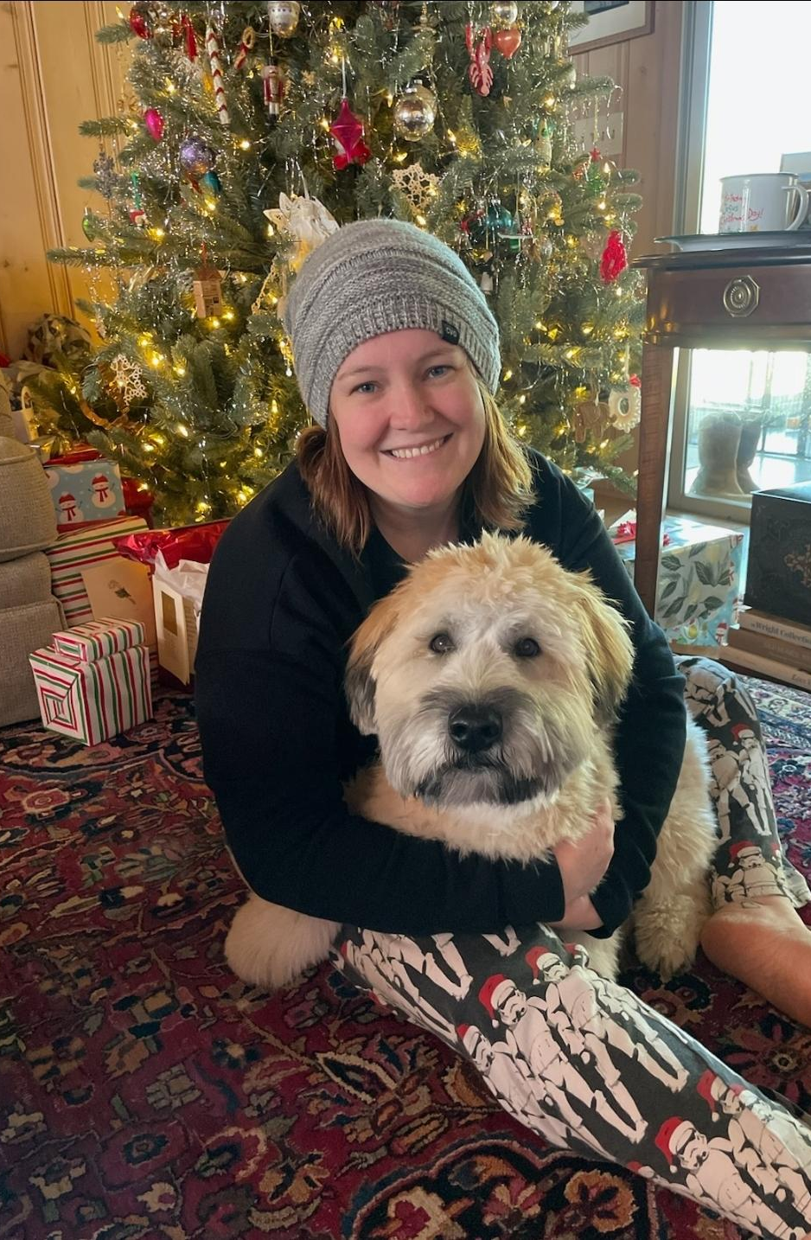





Alice Bankson, Registrar
Alice and her dog, Lupin

Slide 9



Cyber Academy of South Carolina
Tara Bell, Middle School Registrar
Christine Kellett, Elementary School Registrar

Slide 10

Training Opportunities

Slide 11
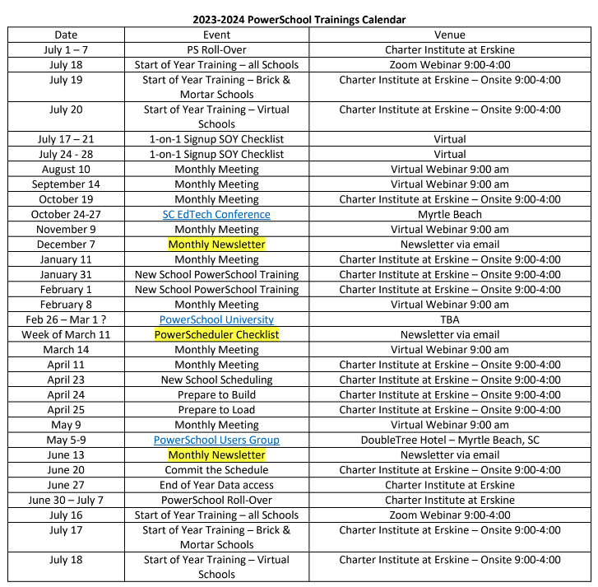
2023-2024 PowerSchool Trainings Calendar
Please remember, webinars are mandatory.
  If you will not be able to attend the webinar, please send me or Jason Jones an email with the reason.
  Be sure to let me know you are present by putting your name and school in the chat box. This will guarantee you are counted as present.
Training Schedule (Live Link): https://www.dropbox.com/scl/fi/nqvwzqyu2op3dbqkl93ff/23-24-PowerSchool-Trainings-Calendar.docx?rlkey=igtgt32q1f3frbs8r1ooe7seq&dl=0

Slide 12
Upcoming School Data Collection Deadlines
Data Being Collected | Charter Institute at Erskine Deadline | SCDE Deadline
Summer Graduates/Transcripts in LWS | August 12, 2023 | N/A
Summer School Data: CERDEP and Read to Succeed | August 12, 2023 | September 1, 2023
Precode: 4K and 5K Second File Precode: SC Career Readiness (WIN) | August 12, 2023 | August 18, 2023
5th Day Enrollment Count Submission in LWS | August 29, 2023 | N/A
Current Year Dropout Data | September 8, 2023 | September 5-22, 2023
Grade 2 Testing Precode Data (CogAT/IA) | August 26, 2023 | August 17 & September 8, 2023
Resources:
Charter Institute PS Admin Handbook
SCDE Data Collection Schedule

Slide 13
No Shows

Slide 14

Types of No- Show Students
No Show Student – This is a student that was expected to attend your school for the current school year and was not a student at the end of the previous school year, but never shows up.
Returning Student No-Show: This student attended the school in the previous year, was enrolled on the last day of school before summer and was expected to return after summer but does not show up for the current school year.
New Student No-Show: This student went through the school’s enrollment process as a new student, but never shows up. This student has no prior enrollment history at the school.

Slide 15

No-Show Students
When coding a No-Show student:
For the first 10-Days enter an absent code for the student attendance.
3 Consecutive absences you should start the process to follow Truancy regulation.
  Truancy will only be implemented if the student attends schools at some point within the first 10-Days.
If a student does not show by the 11th Day, remove all absent codes back to the first day of school. Set them back to present.
If student is enrolled in section(s), drop them.

Slide 16
No-Show Students
Transfer the Student Out of School
Entry Date and Exit Date are the same. It will be the first day the student was supposed to start school.
Exit Code: NS (No-Show/Never Enrolled)
Exit Comment: Enter “No Show”
Populate “No Show Reason” on the SC Student Information page
Possible Drop Out (Grade 7 – 12). If status of student is “unknown.”

Slide 17
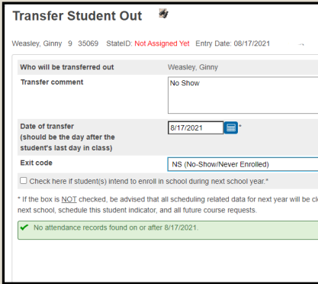
No-Show Students
School Enrollment > Transfer Out Of School
Entry Date and Exit Date are the same. It will be the first day the student was supposed to start school.
Exit Code: NS (No-Show/Never Enrolled)
Exit Comment: Enter “No Show”

Slide 18
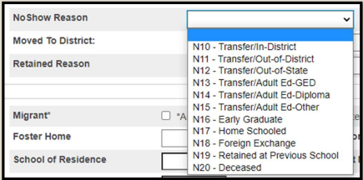
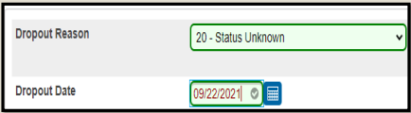
No-Show Students
Populate “No Show Reason” on the SC Student Information page (Select Student >Compliance > South Carolina Student Information Page)
Possible Drop Out (Grade 7 – 12). If status of student is “unknown”.
Populate: Dropout Reason & Dropout Date

Slide 19

No-Show Student: Scenario 1
Students transferring after the End of Year Process before the new school year starts & Records request from out-of-district school has been received:
No Show the student as of the first day of school.
Populate “No Show Reason Transferred” and populate school transfer information or out of state transfer.
Keep all supporting documentation (records request or transcript request or withdrawal form) i.e. for drop-out, grad rate, etc. reporting purposes.

Slide 20
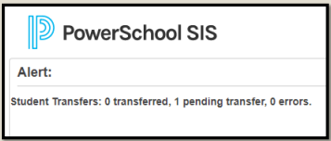

No-Show Student: Scenario 1
For this scenario because school has not started yet:
If entering the first day of school as the Exit Date, understand the student will be placed into Transfer Pending mode and will not completely transfer out of the school until midnight of the first day of school.

Slide 21
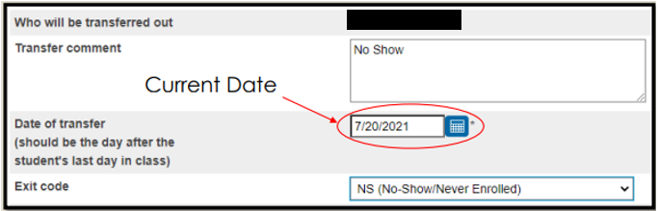
No-Show Student: Scenario 1
Recommendation:
When transferring a student out for the Exit Date use the Current Date.

Slide 22
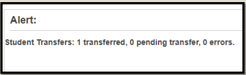
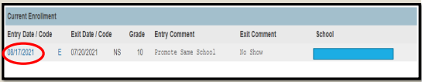
No-Show Student: Scenario 1
Recommendation (cont.):
Once the student is transferred out, go back to the Transfer Info page, Click Entry Date

Slide 23
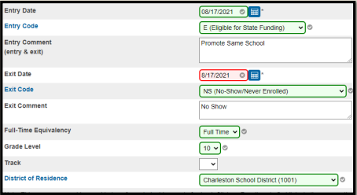
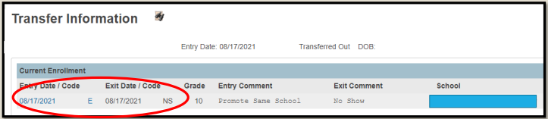
No-Show Student: Scenario 1
Recommendation (cont.):
Change the Exit Date to the first day of school & Submit to save.

Slide 24
No-Show Student: Scenario 2
Students who rolled over who never showed up.
  Mark the student absent for the first 10 days of school
  Parent contact should be made during those 10 days
  On the 11th day, the student is withdrawn as a No-Show
    All attendance should be removed
    Entry Date and Exit Date should be the first day of school
  Students in grades levels 7-12 will be reported as dropouts
  Populate the Dropout Reason and Dropout Date (dropout date should be the first day of school)

Slide 25
No-Show Student: Scenario 3
Students who missed up to the first 9 days of schools
  The student is enrolled as of the first day of school
  Attendance should be taken as of day 1
  Absences should be coded excused or unexcused
  Truancy notification should be made, and a Truancy intervention plan developed if the student missed 3 consecutive unexcused absences or a total of 5 unexcused absences
  No attendance should be removed

Slide 26
No-Show Student: Scenario 4
Students who missed 10 days but show up on day 11
  The student is enrolled as of the first day of school
  Attendance should be taken as of day 1
  Absences should be coded excused or unexcused
  Truancy notification should be made, and a Truancy intervention plan developed if the student missed 3 consecutive unexcused absences or a total of 5 unexcused absences
  No attendance should be removed

Slide 27
Withdrawal Reminders
Drop Schedules
Drop student schedules on the date of enrollment for No Show students
This will delete the enrollment in their courses
Entry/Exit Dates
No Shows must have matching entry and exit dates that is your school’s first day of school
Previous Enrollment
DO NOT edit another school’s “Previous Enrollment” in the student’s transfer info screen (dates/comments/exit codes)
EFAs
DO NOT edit another’s school’s EFA codes; Close out EFAs every time you withdraw a student; If a student is a NS, please delete initial EFA.

Slide 28
Breakout Sessions
9:30 AM – 10:10 AM

Slide 29
Truancy and Chronic Absenteeism

Slide 30
Truancy

Slide 31
When is a Student Classified as Truant?
A child (student) ages 6 to 17 years meets the definition of a truant when the child (student) has three consecutive unlawful absences or a total of five unlawful absences (within a school year).
Only full-day unlawful absences contribute to truancy.
Lawful absences including Out-of-School Suspensions do not impact truancy.

Slide 32
REGULATIONS & LAWS GOVERNING TRUANCY
State Board Regulation:
  Student Attendance R.43-274
  https://ed.sc.gov/index.cfm?LinkServID=C27C05BB-0716-7048-590443881932F1A6
SC Code of Laws:
  Attendance of Pupils: 59-65-10 to 59-65-280
  https://www.scstatehouse.gov/code/t59c065.php

Slide 33
Lawful & Unlawful Absence Types
Lawful Absences include but are not limited to: | Unlawful Absences include but are not limited to:
Absences caused by a student’s own illness Absences due to an illness or death in the student’s immediate family Absences due to a recognized religious holiday of the student’s faith Absences due to activities that are approved in advance by the principal Suspension is not to be counted as an unlawful absence for Truancy purposes | Absences of a student without the knowledge of his or her parents Absences of a student without acceptable cause with the knowledge of his or her parent

Slide 34
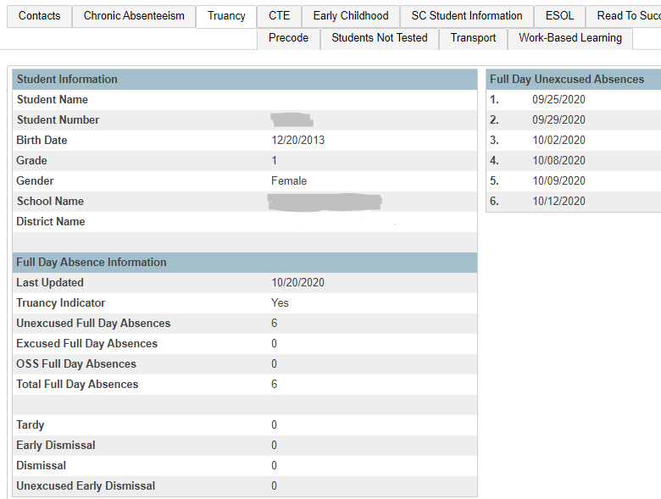
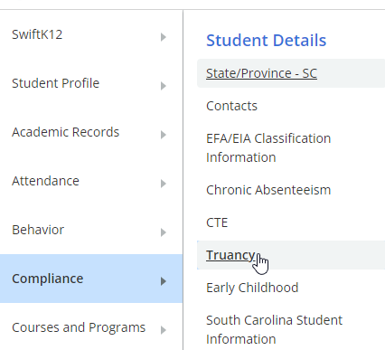
Student Truancy Page
PS Start Page > Search and Select Student > Compliance > Truancy
List of the student’s unlawful absences
Section contains:
Total full day unlawful absences
Truancy Indicator (Is the student flagged as truant?)

Slide 35
School Level Truancy Reports
SC40 Truancy Reports by Student
SC41 Truancy School Detail Report

Slide 36
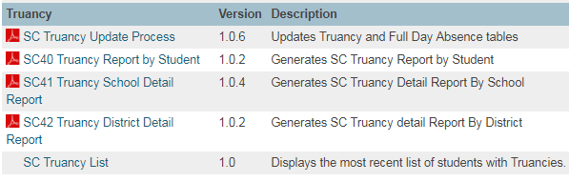
School Level Truancy Reports
PS Start Page > Data and Reporting > Reports > Compliance Reports
SC40 Truancy Report by Student
SC41 Truancy School Detail Report

Slide 37
School Level Truancy Reports
SC40 Truancy Report by Student
  All students meeting the unlawful absences criteria populate on this report – even students who do not meet the age criteria populate when the unlawful absences are met.
  Recommended to use this report when meeting with Parents/Guardians for Attendance Intervention Meetings.
  Report lists all FULL DAY UNLAWFUL ABSENCES.
  Present Attendance Codes and Lawful Attendance Codes do not contribute to full Day Unlawful Absences.
  Report lists other schools within your district at which the student was previously truant.
  Report does not list full day unlawful absences from previous schools. Full Day Unlawful Absences are listed for the current school only.
Where in PowerSchool:
PS Start Page > Data and Reporting > Reports > Compliance Reports > SC40 Truancy Report by Student
Bookmark the Link: Reg. 43-274: Student Attendance

Slide 38
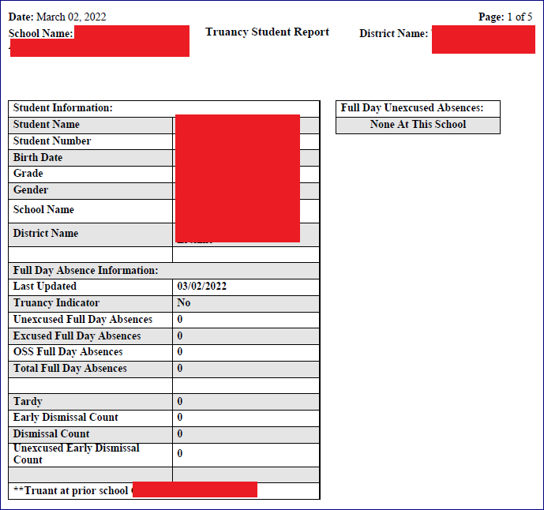
Truancy Reports: SC40
  View Truancy Reports
  SC40 Truancy Report by Student: In this example, this student is not truant at the current school but was truant at previous school.

Slide 39
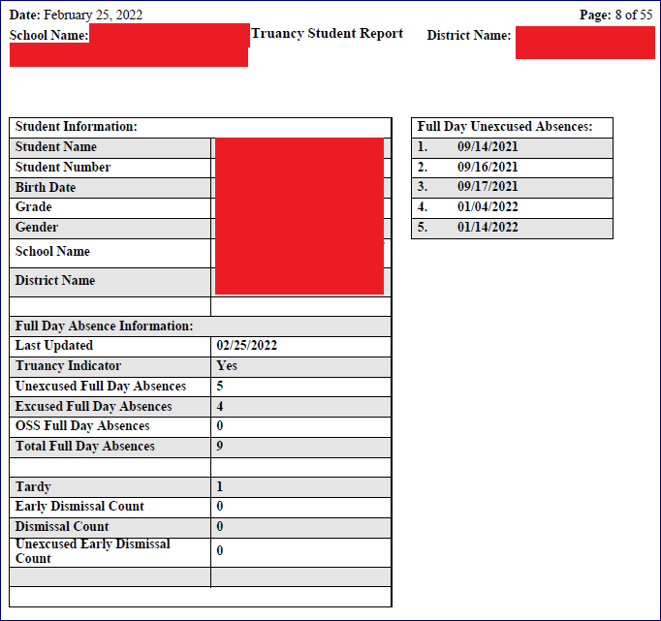
Truancy Reports: SC40
  View Truancy Reports
  SC40 Truancy Report by Student with truancies at current school but with no truancies at previous school.

Slide 40
School Level Truancy Reports
SC41 Truancy Report by School
  All students meeting the unlawful absences criteria AND age criteria populate on this report.
  Recommended to use this report when coding Truancy incidents in PowerSchool Incident Management.
  Report lists a count for FULL DAY UNLAWFUL ABSENCES in multiple Truancy Categories.
    3 consecutive full day unlawful absences
    5 non-consecutive full day unlawful absences
    7 non-consecutive full day unlawful absences
    10 or more non-consecutive full day unlawful absences
  Present Attendance Codes and Lawful Attendance Codes do not contribute to full Day Unlawful Absences.
  Parenthesis around a student name is your visual indicator that the student is inactive at your school AND truant prior to withdrawal. NOTE: Withdrawing a student does not negate the requirement for a Truancy Incident in Incident Management.
Where in PowerSchool:
PS Start Page > Data and Reporting > Reports > Compliance Reports > SC41 Truancy Report by School
Bookmark the Link: Reg. 43-274: Student Attendance
Notes:
Attendance Conversions set up with the 50% of the minutes in the day (Time to Day) is for Average Daily Attendance
Being absent from ALL meetings where attendance is required contributes to full day absences for Truancy
- must be excluded from section and must be excluded from ADA in the bell schedule

Slide 41
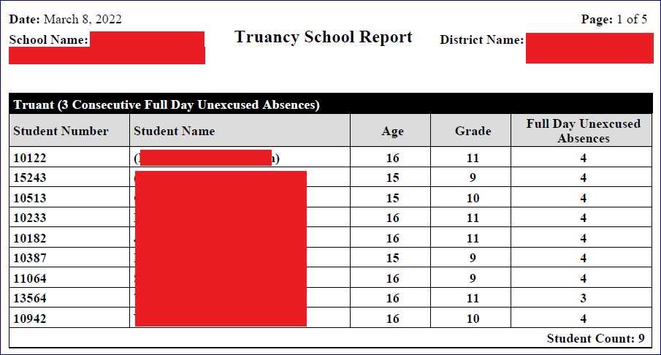
Truancy Reports: SC41
  View Truancy Reports
  SC41 Truancy Report by School. Truant students in transferred-out status appear with parenthesis around their name.

Slide 42
Chronic Absenteeism

Slide 43
What is Chronic Absenteeism?
A student is Chronically Absent when:
Any student in grades K-12 who misses 50 percent or more of the instructional day for any reason for 10 percent (or more) of the enrollment period
A student is Absent when:
He/she is not physically on school grounds and is not participating in instruction or instruction-related activities at an approved off-grounds location for the school day

Slide 44
Example A
Chronically absent: Any student in grades K-12 who misses 50 percent or more of the instructional day for any reason for 10 percent (or more) of the enrollment period.
  Example: Student has been enrolled for 30 days
    The student has missed 2 half days of instruction
    The student has missed 1 full day of instruction

Slide 45
Example B
The 10 percent is based on the individual student’s enrollment.
Calculation:
Total Days Absent ÷ Current Membership days × 100 = Absent Percentage
4 days absent ÷ 37 days enrolled × 100 = 10.81% Chronically Absent
4 days absent ÷ 41 days enrolled × 100 = 9.76% Not Chronically Absent
21 days absent ÷ 180 days enrolled × 100 = 11.66% Chronically Absent

Slide 46

How Students are Flagged as Chronically Absent
A student must be enrolled at a school for at least 10 membership days to be included in the calculation
A student will be flagged as a ‘Y’ (chronically absent) if attendance recorded in PowerSchool reaches or exceeds the 10 percent threshold of absent membership days. Absences will include excused, unexcused and/or out of school suspensions
A student is considered absent if not present 50% or more of the school day

Slide 47
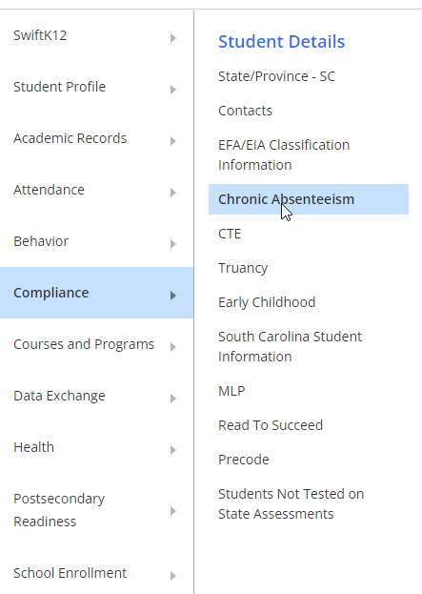
Chronic Absenteeism Tab
PS Start Page > Search and Select Student > Compliance > Chronic Absenteeism

Slide 48
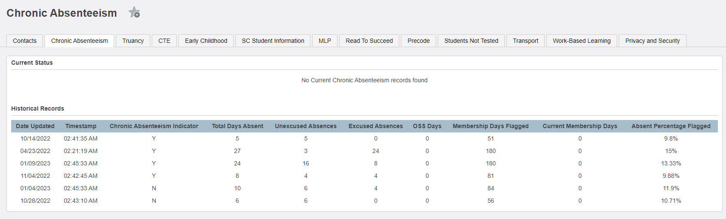
Chronic Absenteeism Page
Total Days Absent ÷ Current Membership days × 100 = Absent Percentage
27 ÷ 180 × 100 = 15%

Slide 49

How to Access the Chronic Absenteeism Reports
PS Start Page > Data and Reporting > Reports > Compliance Reports
SC 38 Chronic Absenteeism Report

Slide 50
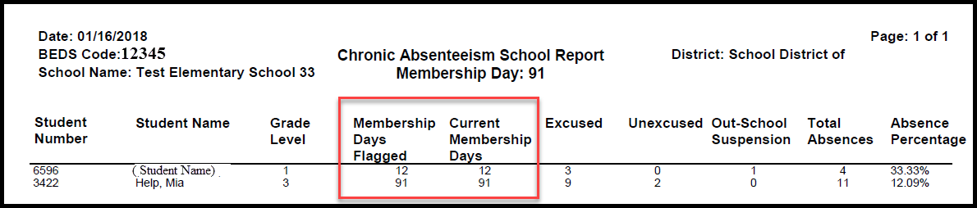
SC 38 Chronic Absenteeism Report

Slide 51
SC 38 Chronic Absenteeism Report
The Chronic Absenteeism School Report displays the total number of absences per student broken down by attendance code category.
The student’s name, student number, membership days, absence categories, total number of absences and absence percentage will be listed on the report.
This report will only include students who were flagged at one point in the current school year as chronically absent.
Note: Inactive students will still display on the report, but their names will be enclosed inside parentheses.

Slide 52

Questions

Slide 53
Incident Management: General Information
The SCDE provides several live trainings each school year on coding incidents in Incident Management.
These trainings are provided by Aveene Coleman who subsequently emails - to training attendees - live recordings, PowerPoint presentations, and supporting resources for schools to know exactly how to code incidents without error in PowerSchool’s Incident Management System.
Monthly CIE PowerSchool Webinars reiterate SCDE Incident Management coding requirements through supporting slides that include links to and screenshots from the live recordings, PowerPoint presentations, and resources.
Supporting the coding requirements of the SCDE are Validation Rules in Level Data that are designed to help PowerSchool users know when coding errors exist in Incident Management.
Further PS User support is available within Level Data for each Validation Rule in the green text box and the blue Additional Information text box which contains the Conditions to Resolve the coding errors.

Slide 54
Incident Management: General Information
Some schools use alternate discipline management systems to track incidents. Some schools use approved plugins to document incidents. All schools are required to code each incident of discipline and truancy in PowerSchool’s Incident Management System.
Incident Management data from all schools is collected by the SCDE as outlined in the annual Data Collection Schedule.
Your schools collected Incident Management data impacts your school on your State Report Card but also impacts your District - positively or negatively – depending on the quality of the coding in the collected data.
Because data from Incident Management will be used to compile state and federal reports, it is critical that all data entered be reviewed and verified for accuracy.

Slide 55
Purpose
Within Incident Management there are two sections:
  Incident Description: The Incident Description includes fields that are required for ALL incidents and fields that are optional.
  Incident Builder: The Incident Builder includes fields that are required for ALL incidents and fields that are only required for specific incidents.
The purpose of this training is to provide an overview of the Incident Builder coding requirements in PowerSchool’s Incident Management system.
The overview includes:
  the Participant
  the order in which the Incident Elements must be added
  how to associate – in the correct order - the Incident Elements with the Participant
  tools and resources

Slide 56
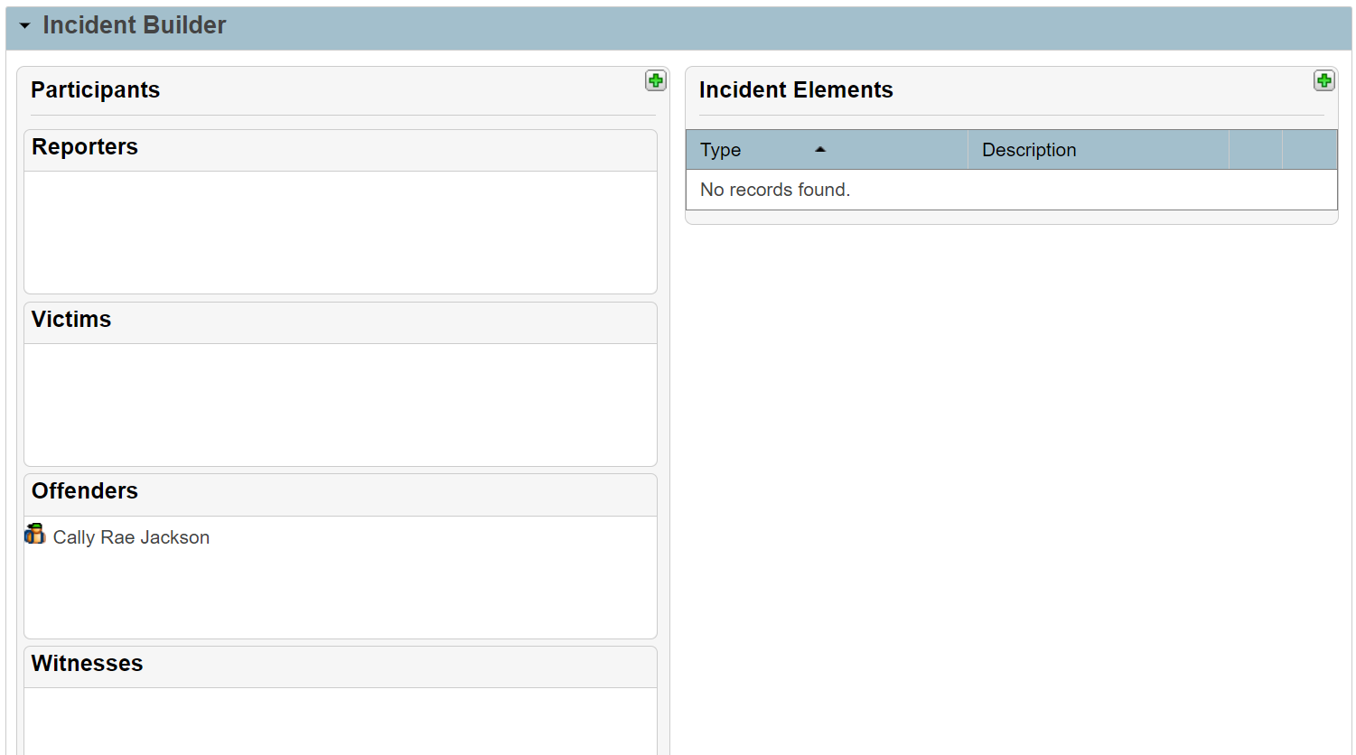
Incident Builder: Participant - Offender
The Incident Builder must include a Participant that is the Offender. This is required for ALL incidents.
Add Participant:
Click the green plus opposite the Participants header.
Populate the required values in the Search.
Click the Participants name under the Results.
Click Add.
Click the green plus opposite the Attributes header and make your selections.
From the dropdown under the Select Role(s) header, select Offender.
Click Add Participant Attributes.
VERIFY the Participants Name appears under Offenders.
  If the Participants Name appears under Reporter, Victims, or Witnesses, hover over the Participants name to expose the editing tools.
  Click the red minus to remove the value (name) and start over with step 1.
Correctly added Participant Offender.

Slide 57
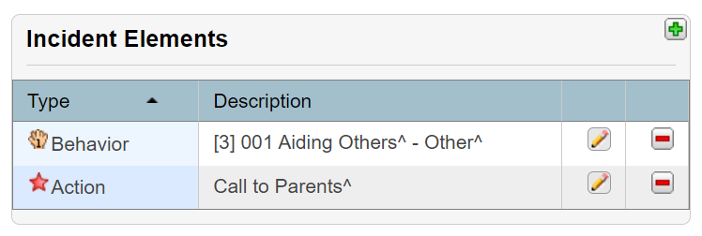
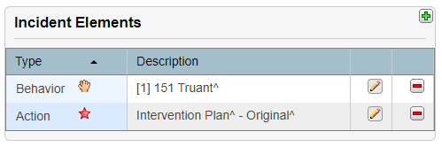
Incident Builder: Order of Adding Elements
The Incident Builder must include two Incident Elements: Behavior and Action. This is required for ALL incidents.
Add Incident Elements:
Click the green plus opposite the Incident Elements header.
From, the pop out, select Add Behavior.
Populate the required values. Click Add Behavior. The Behavior will appear under the Incident Elements.
Click the green plus opposite the Incident Elements header.
From the pop out, select Add Action.
Populate the required values. Click Add Action. The Action will appear under the Incident Elements.
VERFIY the Incident Elements appear with the Behavior listed first and the Action listed second, just below the Behavior.
  If the Incident Elements appear in the wrong order, one at a time hover over the Elements name to expose the editing tools.
  Click the red minus to remove the value (name) and start over with step 1.
Correct Order of Adding Elements.

Slide 58
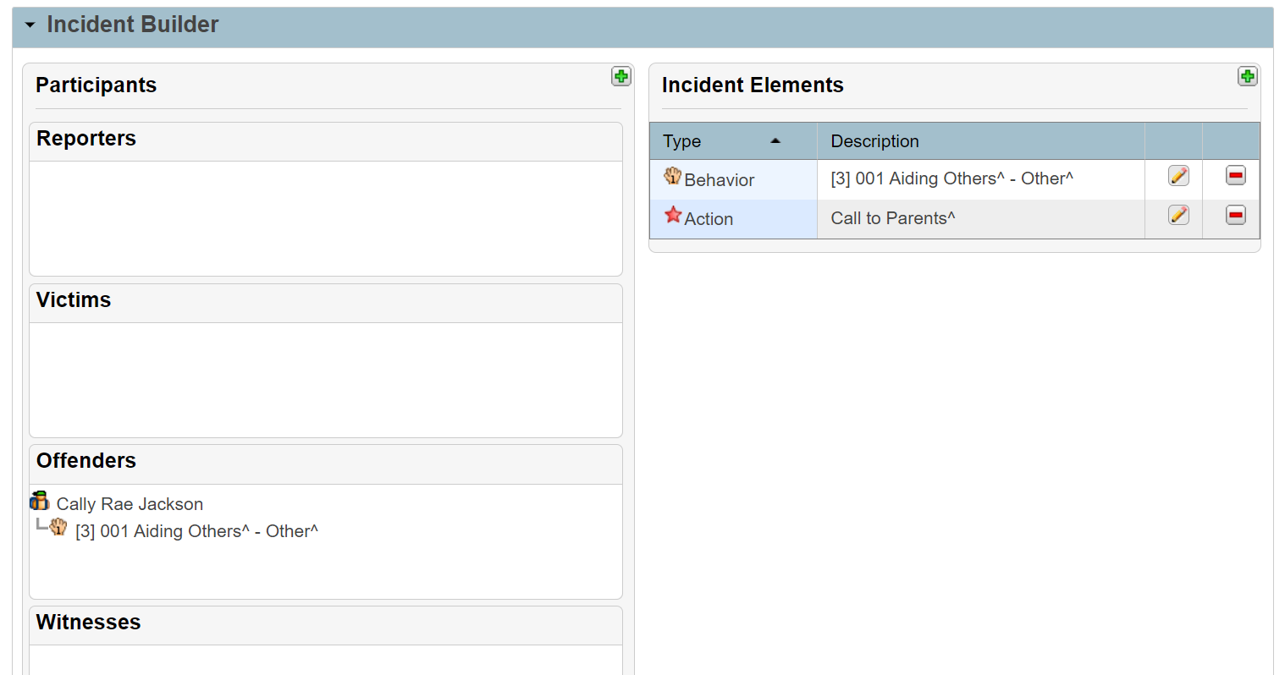
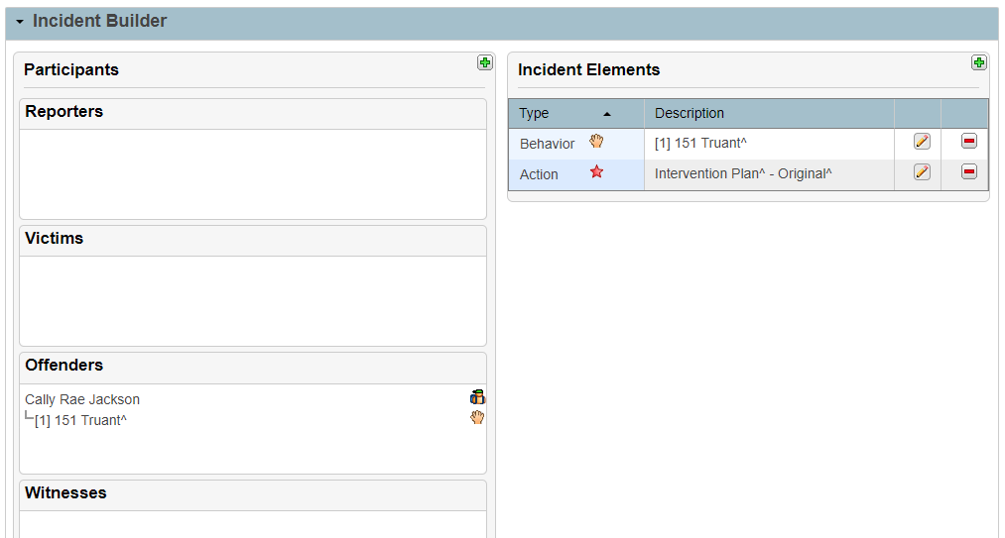
Incident Builder: Order and Association
The Incident Elements must be associated with the Offender in a specific order in a specific way. This is required for ALL incidents.
Associate the Behavior FIRST:
Hover your mouse over the word “Behavior”, click on the word “Behavior” and hold. When you move your mouse, a gray rectangle will move with it. If that does not happen, you did not successfully click and hold.
Drag the Behavior across the screen so it is ON TOP of the Offenders NAME.
Release the mouse to associate the Behavior with the Offender. This process is called “Drag and Drop” and the association creates a visible stair step linking the Offender with the Behavior’s Name.
Correctly added Behavior. Behavior’s Name is stair stepped to the Offenders Name and remains under the Incident Elements.
VERIFY the stair step.
  The Incident Builder will not allow you to release the Behavior any where except on top of the Offender’s NAME (pending there are no other Participants in your Incident Builder).
  If you release the Behavior anywhere other than on top of the Offender’s Name, no association will occur. Start over with Step 1.

Slide 59
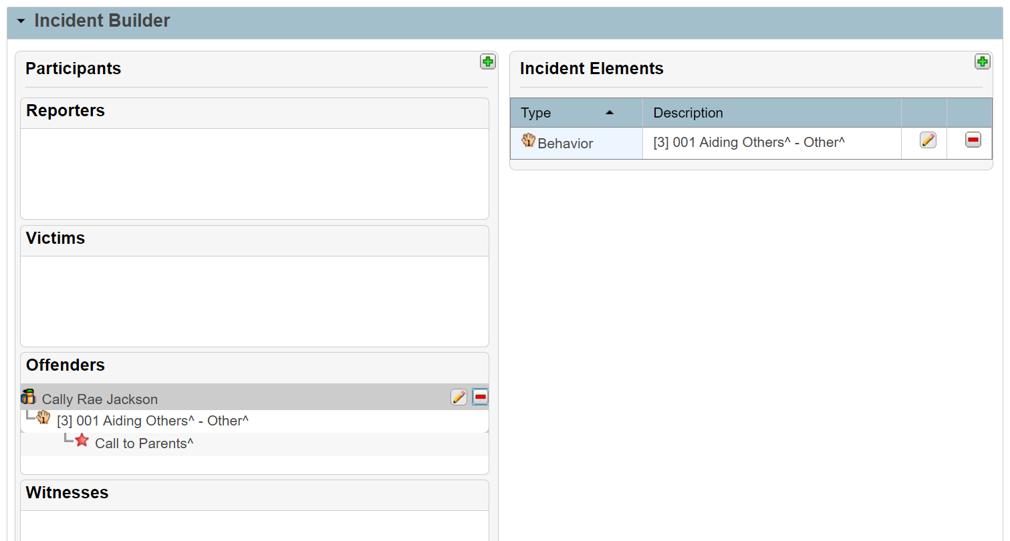
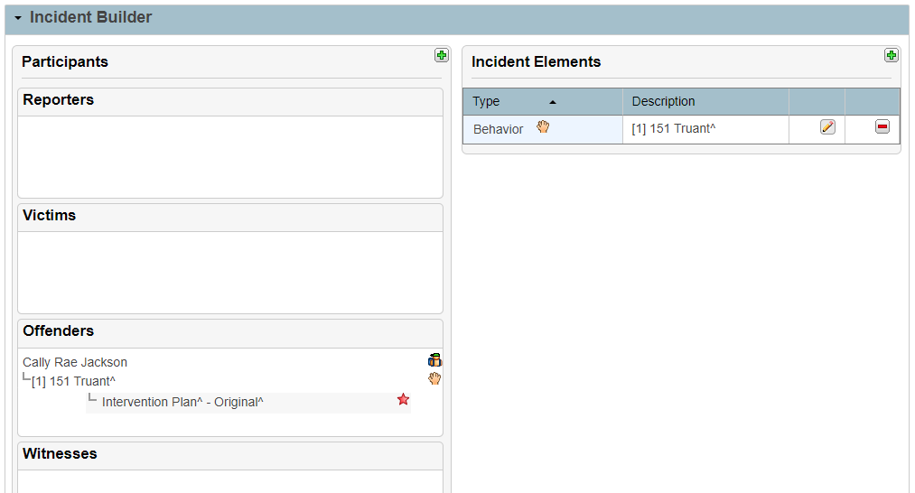
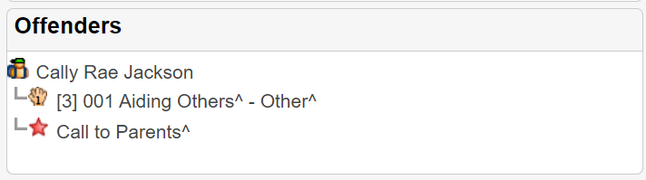
Incident Builder: Order and Association
The Incident Elements must be associated with the Offender in a specific order in a specific way. This is required for ALL incidents.
Associate the Action SECOND:
Hover your mouse over the word “Action”, click on the word “Action” and hold. When you move your mouse, a gray rectangle will move with it. If that does not happen, you did not successfully click and hold.
Drag the Action across the screen so it is ON TOP of the stair stepped Behavior’s Name.
Release the mouse to associate the Action with the Behavior. This process is called “Drag and Drop” and the association creates a visible stair step (not a list) linking the Behavior with the Action and the Action with the Offender.
Correctly added Action. Action’s Name is stair stepped to the Behavior’s name and remains under the Incident Elements.
VERIFY the stair step. The Incident Builder allows you to release the Action on top of the Offender’s NAME – creating a list - which is wrong.
  If you cannot verify the stair step, hover over the Action’s Name to expose the editing tools.
  Click the red minus to remove the Action’s name and start over with step 1.
Incorrectly added Action. Action appears in list linked to the Offender’s Name instead of the Behavior’s Name.

Slide 60
Tools and Resources
  SCDE Incident Management Resources:
  SCDE PowerSchool Incident Management
  SCDE PowerSchool Incident Management Frequently Asked Questions
  SCDE PowerSchool Incident Management‐discipline Incidents Step By Step Guide
  SCDE PowerSchool Incident Management-truancy Incident Step By Step Guide
  Incident Management Webinar Recording - February 2023
  Incident Management Webinar PowerPoint - February 2023
PowerSchool Tools:
Level Data
RealTime Reports

Slide 61
Updates from the
Charter Institute at Erskine

Slide 62
Table of Contents
01
02
03
Lunch_Status
PowerSchool Roles-Based Certifications
Safari Montage and the Learning Object Repository

Slide 63
Lunch Status
01

Slide 64
Lunch_Status
The SCDE is still collecting information populated to this field.
Direct certified schools or CEP schools do not need to populate this field; however see items all below. CEP schools should not collect any lunch forms.
Only schools participating in the National School Lunch Program are to use the official school lunch form.
Schools may choose to utilize an alternate income form to populate this field for internal needs at the school level such as reduced tech fees, or reduced fees for sports, etc. PowerSchool administrators should check with their building administrators if a need exists for their school. The Pupils in Poverty field may also be used for this purpose.
The field should be reset to “Full Pay” annually and updated if you choose to populate.

Slide 65
PowerSchool Roles-Based Certifications
02

Slide 66
PowerSchool
Roles-Based Certifications

Slide 67
“
School Principals, front office staff, school counselors, and school health care professionals are all encouraged to consider this learning opportunity.
Each course will span three workdays and include several hours of live, online training led by PowerSchool staff each day followed by a final exam for potential certification.
Sponsored by SCDE, full attendance each day of training and participation in the exam are expected of each participant.
Dates will be removed from signups as sessions become full
Below is a link to sign up: https://erskinecharters.formstack.com/forms/2023_2024_powerschool_role_based_certification_signup_copy
“

Slide 68
Safari Montage
03
Learning Object Repository
(Lesson Plans and etc. for teachers)

Slide 69
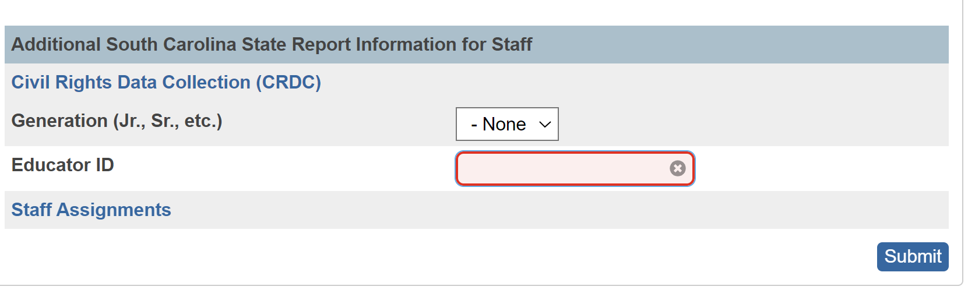
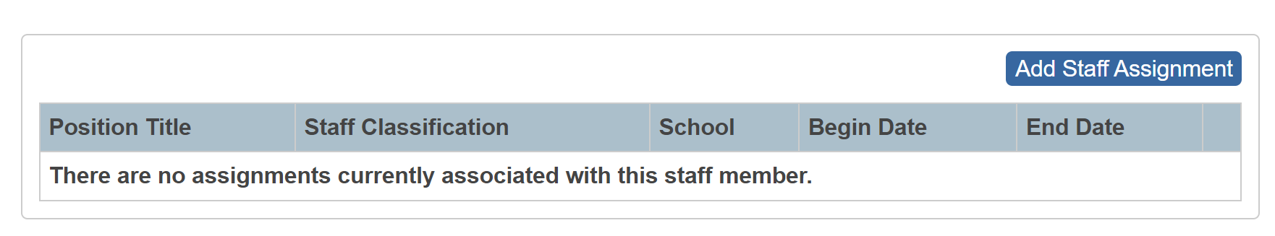
Staff Assignment Page – Safari Montage LOR
All Staff need to have the following:
  Name (Last & First)
  Email Address
  Title (I.e. “Teacher”, “Counselor”,
  “Principal”, “Staff”, etc.)
  Gender
  Ethnicity
  Reporting Ethnicity
  Phone
  Address (validated)
  Educator ID
  Certificate # (if applicable)
  CRDC info updated annually

Slide 70
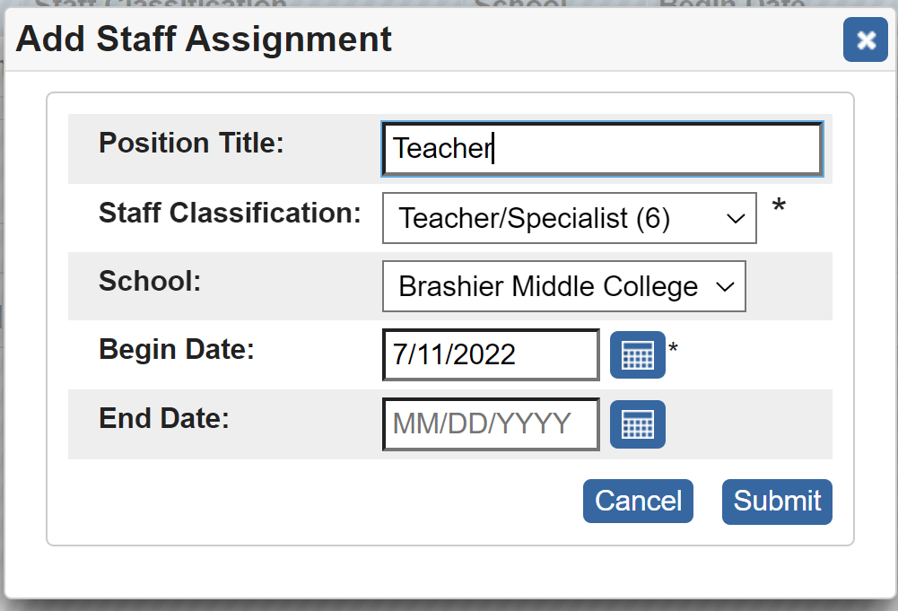
Safari Montage - LOR
All Staff need to have a Staff Assignment added.

Slide 71
Staff Assignment
Include Position Title
Classification options:
  System Administrator (1) – Do Not assign
  Superintendent (2) = Curriculum Admin
  Principal (3) = Principal
  Administration (4) = School Admin
  Leader (5) - Teacher with Upload
  Teacher/Specialist (6) – Teacher with Upload
  Staff (7) – Read only permissions
Select school
Begin Date can be July 1, 2022
No need to set End Date

Slide 72
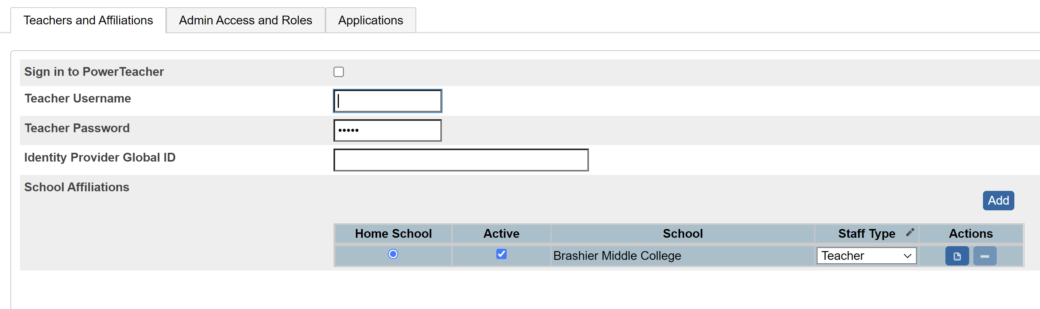
Admin Access to LOR
All admins and staff must have an email on their information page as well as a teacher login information on the system security page for staff.
This includes any administrative staff needing access to the LOR.

Slide 73
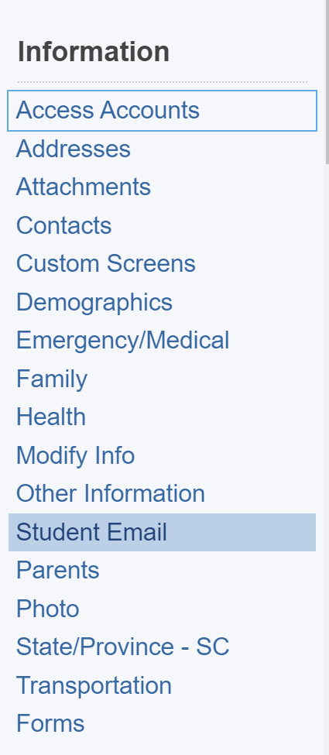
Student Access to LOR
All students must have an email in the “Student Email” page in PowerSchool as well as their Access ID being populated on the Access Accounts page.
            Part 1 →
            Part 2 →

Slide 74

LOR – Next Steps
New Schools will need to reach out to Betsy Masters to begin the process!
Complete LWS Submission for Needs Assessment
Submit roster of students and staff to Safari Montage
Work with school integration team for access
  May need to reach out to Safari Montage to review how to access for each school.
  https://ed.sc.gov/instruction/instruction-hub/
  Betsy Masters bmasters@safarimontage.com
Train teachers and students on access

Slide 76
5th Day Funding

Slide 77
Agenda
General Overview
Required Fields
PowerSchool Searches
Membership Reporting

Slide 78
5th Day : General Overview
Your District will require reports for 5th Day Data. Both reports are based data in PowerSchool on your school’s 5th in-session day.
What is the 5th Day? The 5th Day refers to YOUR school’s 5th in-session school day. The 5th in-session day at YOUR school may differ from the 5th in-session day at another school. YOUR school’s 5th Day Data is based on YOUR school’s 5th in –session day of school – not another school and not the district.
What is the 5th Day Count? Data from specific fields in PowerSchool is collected for 5th Day Reports. Membership Reports for Average Daily Membership (ADM) and Add-on Weightings are also included in the 5th Day Count.
The district does not have to turn in the final count for 5th day funding until all schools have passed their 5th in-session day; however, your school is responsible for your 5th day data on your school’s 5th day.
If it’s not in PowerSchool, it doesn’t Count. If it’s in PowerSchool wrong, then it’s wrong.

Slide 79
5th Day : General Overview
Lunch Forms and District of Residence Documents
Lunch Forms:
Each school issues, collects, and reviews Lunch Forms annually.
Lunch Forms are collected based on each school’s needs and Policies
The reviewing team at your school determines which students qualify for Free, Reduced, or Full Pay meals at your school (even if no meals are provided). The PowerSchool values – Free, Reduced, Full Pay – for each student are provided by the school’s review team to the PS Admin to code in PowerSchool in the LunchStatus field. This data is part of the collection for 5th Day Reporting.
Free and Reduced-Price School Meals Income Guidelines:
  https://ed.sc.gov/scdoe/assets/file/programs-services/177/documents/FREEANDREDUCEDPRICESCHOOLMEALSFAMILYAPPLICATIONBI-MON-BI-WK.pdf
District of Residence Documents:
All schools should require and collect District of Residence (DOR) documentation annually. DOR documentation must have the student’s home address listed (not a PO Box or alternate address).
Check with your District Office for allowable DOR documentation. Some acceptable documents include copies of phone and water bills, lease agreements, and affidavits. Sometimes this documentation is referred to as “Proof of Residency”.

Slide 80
5th Day : General Overview
Lunch Forms and District of Residence Documents
FAQ’s:
What if a family does not turn in a Lunch Form?
Code the LunchStatus field for all students residing in that household with Full Pay (P).
Do not carry over LunchStatus from the previous year. Remove the value (if not already blanked out) and select P for Full Pay.
What if a family does not provide District of Residence documents?
Ask again. Proof of Residence is required for student enrollment per the SCDE
No Excuses:
5th Day Reporting – be prepared for an audit by your district office.
Common School Excuses for missing or wrong data – These are not accepted!
  Not understanding how important the 5th day is and having each field correctly coded by then.
  Not going through all enrolled students and only going through the ones that turned in lunch forms and District of Residence documents.
  Not knowing fields are updated annually.
  Not understanding the State’s requirement to utilize PowerSchool.

Slide 81
5th Day : Required Fields
Several PowerSchool Fields are Pulled/Reported on for 5th Day
Student Number [Student_Number]
This is the student’s PowerSchool number. The number is unique to a district’s PowerSchool database. When a student is enrolled in PowerSchool, PowerSchool assigns that student a Student Number. Never change, edit or delete it. Never create your own student number.
If a Student Number were modified, that action could overwrite another student record from another school within the district.
The Student Number displays at the top of most student screens and on the Demographics page in the Student Number field.
Jackson, Chryse
655723
1357024680

Slide 82
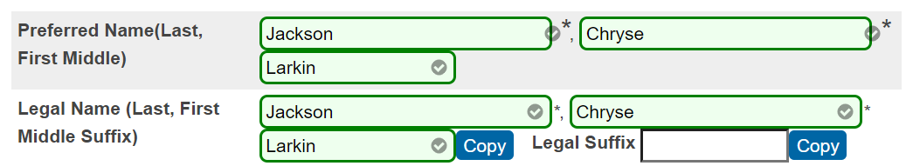

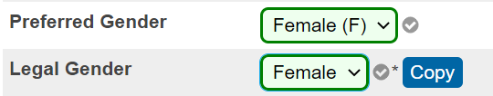
5th Day : Required Fields
Several PowerSchool Fields are Pulled/Reported on for 5th Day
Fields on the Student Demographic’s Page: Each field MUST be populated.
Preferred Last Name [Last_Name]
Preferred First Name [First_Name]
Preferred Middle Name optional [Middle_Name]
Legal Last Name* [StudentCoreFields.PSCORE_LEGAL_LAST_NAME]
Legal First Name* [StudentCoreFields.PSCORE_LEGAL_FIRST_NAME]
Legal Middle Name* optional [StudentCoreFields.PSCORE_LEGAL_MIDDLE_NAME]
Date of Birth* [DOB]
Preferred Gender [Gender]
Legal Gender* [StudentCoreFields.PSCORE_LEGAL_GENDER]
* MUST be exactly as listed on the Birth Certificate.

Slide 83
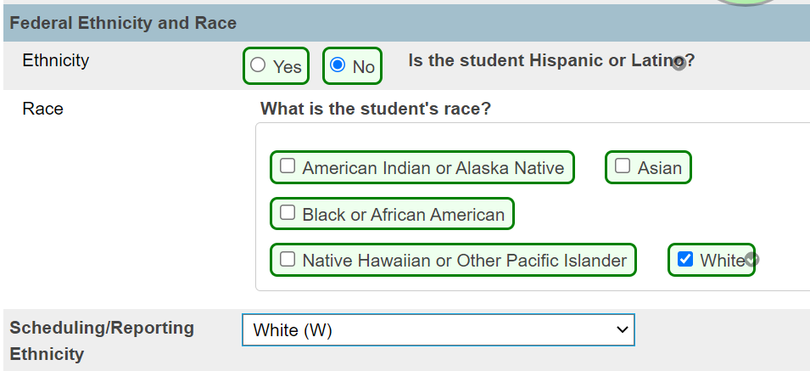
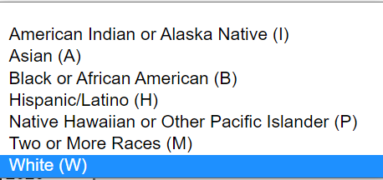
5th Day: Required Fields
Several PowerSchool Fields are Pulled/Reported on for 5th Day
Fields on the Student Demographic’s Page: Each field MUST be populated.
Ethnicity [FedEthnicity] – Select Yes or No
Scheduling/Reporting Ethnicity [Ethnicity] – Select from dropdown
Race [RaceCode] Check each appliable option including students reporting as Hispanic or Latino.

Slide 84
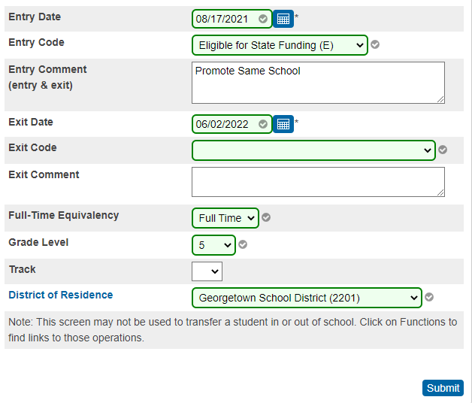
5th Day: Required Fields
Several PowerSchool Fields are Pulled/Reported on for 5th Day
Fields on the Student Transfer Info Edit Page: Each field MUST be populated.
Entry Date [EntryDate] - The first day the student is supposed to attend school.
Entry Code [EntryCode] - States if the student is or is not eligible for South Carolina state funding.
Exit Date [ExitDate] - The last day the student is enrolled at the school for the current year.
Exit Code* [ExitCode] - Identifies the reasoning behind a student withdraw from school.
*Exit Codes for actively enrolled students remain blank until auto-populated during the Roll Over. Exit Codes for No Shows and students who withdraw during the school year are populated by you.
Full Time Equivalences [FTEID] - The FTE determines the daily attendance value a student receives for a scheduled day. The FTE value directly influences the attendance and membership results for all students.
Grade Level [Grade_Level]
District of Residence [DistrictOfResidence] - Select from the dropdown the school district in which the student currently resides. Do not select the Charter District – do not use 4701. No student resides in a charter district. Be accurate – this impacts funding!

Slide 85

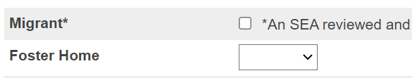
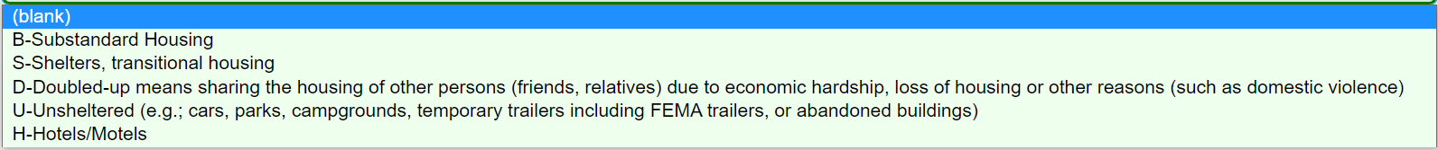

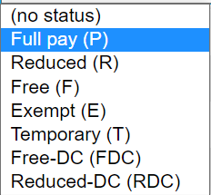
5th Day: Required Fields
Several PowerSchool Fields are Pulled/Reported on for 5th Day
Fields from the State/Province-SC Pages:
State Student Number/StateID/SUNS [State_StudentNumber] – Cannot be blank and is a unique state ID number that is assigned to all students throughout the state of South Carolina.
Migrant* [S_SC_STU_X.Migrant]- A migrant student is a student who is, or whose parent, spouse, or guardian is, a migrant agricultural worker.
Foster Home* [S_SC_STU_X.Foster_Home] - Indicate if a student resides in a foster home.
Primary Nighttime Residence* [S_SC_STU_X.Night_Residence] - To indicate if a student homeless.
* Only populate when applicable.
Field from the Lunch Student page:
Lunch Status [LunchStatus] – Update annually – do not use previous years’ status. Only use Full Pay, Reduced, or Free.

Slide 86
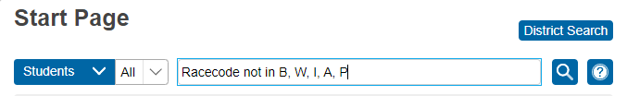
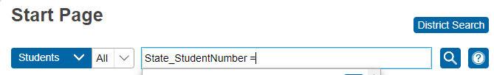

5th Day: PowerSchool Searches
Useful searches to help locate missing values for 5th Day
Searchable Fields and Codes:
Active Student with a blank Race value:
  Racecode not in B, W, I, A, P
  Race.FedCode not in B, W, I, A, P
StateID number is blank: State_StudentNumber =
Lunch Status is blank: LunchStatus =

Slide 87
5th Day: Membership Reporting
Membership Data for EFA/EIA and Add-on Weightings must be coded.
EFA/EIA and Add-on Weighting Coding for Membership Reporting DIRECTLY impact funding.
Students coded with one of the Exceptional Program values in the EFA Primary field must have an Individualized Education Plan (IEP) and be at least 5 years old before September 2nd of the current school year (with an exception for 4 year olds receiving visual- and/or hearing-related services). PreK3 students are not eligible for Exceptional Program funding.
Verify EFA/EIA Codes:
EIA Codes are for PreK 3 and 4 only. All PreK 3 and 4 must have an EIA code (EC3 or EC4).
All students in grades K5 – 12 must have a Primary EFA Code. PreK4 student may have an EFA code only when they are receiving IEP services for visual and/or hearing related services.
EFA/EIA Initializations are performed prior to the start of the school year and set all EFA/EIA codes to the grade level default.
  AFTER the EFA/EIA Initialization is complete, newly enrolled students will have blank EFA/EIA values which mean you must manually populate the applicable values.
  NO EFA/EIA codes automatically populate after the EFA/EIA Initialization is run.
Some students qualify for multiple EFA codes. This includes students with IEP’s, students enrolled in CTE course sections, and students receiving Home-based services. Primary EFA codes and applicable EFA Codes 2-10 must be manually updated for those students.
Verify with your schools SPED Coordinator, CTE Coordinator, and Homebound Coordinator that students qualifying for multiple EFA classifications have the highest weighted EFA as the Primary.
When applicable, use the EFA History and EIA History tabs to:
  Enter EFA/EIA stop/start dates as applicable for students who transfer out of school, who experience changes to their instructional setting, who have CTE schedule changes, and who are placed on or removed from Homebound.
  Delete EFA values for No Show students. No Show must have EFA values deleted.

Slide 88
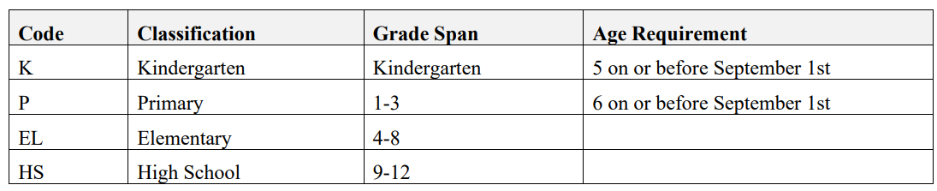

5th Day: Membership Reporting
Membership Data for EFA/EIA and Add-on Weightings must be coded.
EFA and Add-on Weighting Coding for Membership Reporting:
EFA Codes and Weightings:
Default Grade Level EFA Codes are funded at 1:1
All Acceptable EFA Codes and Weightings.
The information provided for EFA Codes and Weight is from the SCDE Student Information System Data Entry Manual, updated May of 2023. PowerSchool coding guidance has not changed as of this date and time. Questions about leveling SPED EFA Code weighting can be directed to your district office.

Slide 89


5th Day: Membership Reporting
Membership Data for EFA/EIA and Add-on Weightings must be coded.
EFA and Add-on Weighting Coding for Membership Reporting:
Verify CTE Section Enrollment:
CTE Course Codes:
  Must be Valid - Follow the Activity Coding System
  Begin with the number 5 or 6
  Are not Transfer Course Codes: Transfer Course Codes contain “97” for the 3rd and 4th digits
  Are not LBA Course Codes: LBA Course Codes contain “99” for the 3rd and 4th digits (only exception is 0899 Study Hall)
  End in alpha characters: 7th and 8th digit must be credit bearing
Students with IEP’s who are also enrolled in a CTE Course Section must have the highest weighted EFA as the Primary. To clarify, in some cases, the CTE EFA “VOC” may be a secondary EFA.
CTE Section Enrollments must be for the current term to use a CTE EFA. Schools on block 4x4 cannot use a CTE EFA during Semester 1 when the student is not enrolled in CTE courses until Semester 2.
Verify CTE Section Enrollment using the All Enrollments student page.

Slide 90


5th Day: Running Reports
Reports to Run for the 5th Day. Information from the 5th Day Reports provide base line data for the beginning of the school year.
Start Page > System Reports > State
When all EFA codes are populated, on your 5th in-session day for your school, run reports. All schools run the SC01 and SC06.
First run the SC01 Data Verification Report. If errors report, fix those errors and rerun the SC01 until it reports error free. This report must be error free before running other reports.
Run the SC06 Membership and Attendance Report. DO NOT CREATE AN EXTRACT when you run this report for 5th day funding.
  Day: enter the number 5
  Self-Contained Only: select No from the dropdown
  Output Type: Report Only (default)
  Submit

Slide 91

5th Day: Membership Reporting
Reports to Run for the 5th Day. Information from the 5th Day Reports provide base line data for the beginning of the school year.
When the SC06 Report is complete, view the report, and review the ADM data.
Data in the grade level columns contain the total number of in-session school days per EFA Classification per grade level.
Data in the EFA Code Rows contain the total number of in-session school days per EFA Classification per grade level.
Data in the ADM column contains the total number of in-session school days per EFA Classification divided by the school day for which this report was run; in this case, the school day is the 5th day or 5.
Verify the ADM is correct and have the Principal/School Leader sign the SC06.

Slide 92

5th Day: Membership Reporting
Reports to Run for the 5th Day. Information from the 5th Day Reports provide base line data for the beginning of the school year.
Schools that serve PK-3 & PK-4 students must also run the SC02 Cumulative Class Report. Only run the SC02 after the SC01 Data Verification has zero errors.
DO NOT CREATE AN EXTRACT when you run this report for 5th day funding.
  Day: enter the number 5
  Output Type: Report Only (default)
  Submit

Slide 93

5th Day: Membership Reporting
Reports to Run for the 5th Day. Information from the 5th Day Reports provide base line data for the beginning of the school year.
When to Run Reports for the 5th Day.
When the SC02 Report is complete, view the report, and review the ADM data.
SC02 should only be run by schools that serve grades PK3 –PK4
Data in the grade level columns contain the total number of in-session school days per EIA Code per grade level.
Data in the EIA Code Rows contain the overall number of students enrolled with EIA values per EIA Classification per grade level.
Verify the Totals are correct and have the Principal/School Leader sign the SC02.

Slide 94


5th Day : Membership Reporting
Reports to Run for the 5th Day. Information from the 5th Day Reports provide base line data for the beginning of the school year.
When to Run Reports for the 5th Day.
All schools must populate Add-on Weighting data.
Academic Assistance: Academic Assistance Add-On Weighting is based on student performance on previous year state standardized tests. Schools receive additional funding for students whose scores indicate not meeting the grade level learning objectives on the assessments.
High Achieving: Students coded as High Achieving must be classified as academically or artistically gifted and talented, served in a gifted and talented class, and in grade levels three through twelve. Students coded as Advanced Placement (AP) and/or International Baccalaureate (IB) must be in grade levels nine through twelve and enrolled in an AP and/or IB course. Schools receive additional funding for students meeting these qualifications.
  Schools manually code this data in PowerSchool.
  Select a student > State / Province – SC > EFA/EIA Classification Information > High Achieving (tab) > Add (add the HA Codes).

Slide 95

5th Day: Membership Reporting
Reports to Run for the 5th Day. Information from the 5th Day Reports provide base line data for the beginning of the school year.
When to Run Reports for the 5th Day.
All schools must populate Add-on Weighting data.
LEP: Schools receive Add-On Weighting funding for students with values of 1.0 - 5.9, 6.0, or W. All proficiency codes for LEP students must be entered into the SIS within the first forty-five days of each school year. Schools manually code this data in PowerSchool. Select a student > State / Province – SC > SC Student Info > English Proficiency Levels (PL) and PL Progression.
Dual Credit: Students must be enrolled for at least 30 days in course section using an approved Dual Enrollment course code where ‘E’ is the 7th character. Because it’s the 5th day this number maybe zero.
Pupils in Poverty (PIP): The identification methodology incorporates a number socioeconomic related data elements from several sources, including National School Lunch Program, Social Economic Indicator (SEI), Supplemental Nutrition Assistance Program (SNAP), Temporary Assistance for Needy Families (TANF), Medicaid, and Direct Certification. SIS data in the following areas are incorporated as well: Migrant, Homeless (Primary Nighttime Residence), Foster_Home.

Slide 96

5th Day: Membership Reporting
Reports to Run for the 5th Day. Information from the 5th Day Reports provide base line data for the beginning of the school year.
When to Run Reports for the 5th Day.
When all Add-on-Weighting data are populated, on your 5th in-session day for your school, run reports. All schools run the SC24 and SC28.
First run the SC24 Add-On Weightings Update, leave all default values and submit.
After the SC24 is complete, run the SC28 Add-On Weightings Report as of Day 5. DO NOT CREATE AN EXTRACT when you run the SC28 Report for 5th day funding.
  Data in the grade level columns contain the total number of in-session school days per Add-on Weighting per grade level.
  Data in the Add-on Weighting rows contains the total number of in-session school days per add-on weighting per grade level.
  Data in the ADM column contains the total number of in-session school days per add-on weighting divided by the school day for which this report was run; in this case, the school day is the 5th day or 5.
  Verify the Totals are correct and have the Principal/School Leader sign the SC28.

Slide 97
5th Day: Membership Reporting
Reports to Run for the 5th Day. Information from the 5th Day Reports provide base line data for the beginning of the school year.
When to Run Reports for the 5th Day.
In addition to the SC01, SC02, SC06, SC24, and SC28 all schools should run, review, and archive the reports below. All reports are run as of your school’s 5th day.
SC03 Cumulative Class List (PreK 3 & 4 only): This report is helpful in troubleshooting SC02 EIA Code issues.
SC08 Master Classification: This report is helpful in troubleshooting SC06 EFA ADM issues.
SC27 Add-on Weightings List: This report is helpful in troubleshooting SC28 Add-on Weighting issues.
SC31 High Achieving List: This report is helpful in troubleshooting SC34 High Achieving issues.
SC34 High Achieving Report: This report provides totals by Classification and Grade for the school selected.
Best Practice is to run and archive the reports above. District Office may not require for all these reports to be submitted via LWS-Lets Work Smart

Slide 98
Any Questions?

Slide 99



Break-Out Session: Precode
Cantey Tech

Slide 100
Precode
Precode Manual: https://ed.sc.gov/data/information-systems/power-school/sis-documents/precode-guide/
Correct student’s name – Legal and Preferred (Last Name, First Name, Middle Name [if applicable])
DOB – this is very important for CogAT because results are based on age. An incorrect birthdate could produce an incorrect score, which can adversely affect gifted-and-talented identification. Students are excluded from CogAT/IA precoding if they have grossly incorrect birthdates (i.e., birth year is 1900 or 2019).
Gender
Race – at least one race must be checked.

Slide 101
Precode
EFA Primary Code – this field should not be blank. If the student has an IEP you should work with SPED coordinator at school to select the correct EFA disability code.
Instructional Setting – if a student has an IEP. Work with SPED coordinator at school to enter data.
English Proficiency – this cannot be blank.
1st Language Spoken
Homeroom - Be careful what you are entering here.

Slide 102
Precode
Alternate Assessment – enter data if this applies to the student. Work with SPED coordinator at school to enter data.
Teacher Name
Teacher Emails
Teacher Educator ID – you can either work with your Human Resource staff at the school or go to this link to find the teachers Educator ID. https://cert.ed.sc.gov/
  To search for Certification Numbers, See the public lookup: https://ed.sc.gov/educators/public-lookup/

Slide 103
Precode
2nd Grader – Student’s must be enrolled in a Homeroom course code that begin with 0896 or 0897 in PowerSchool before the deadline.
4K students – must be enrolled in either a Half a Day course code starting with 1750, Full Day course code beginning with 1751, or a Homeroom course beginning with either 0896 or 0897.
5K students – Full Day course code beginning with 1761, or a Homeroom course beginning with either 0896 or 0897.
The recommendation is to have students enrolled in a Homeroom Course (0896 or 0897).

Slide 104
Precode
Course Codes in PowerSchool:
17500000 Half-Day PK
17510000 Full-Day PK
17610000 Full-Day K
08960000 Homeroom
08970000 Homeroom

Slide 105
Precode
PS Student Data Field Names:
Student name [Last_Name, First_Name, Middle_Name, StudentCoreFields.PSCORE_LEGAL_FIRST_NAME, StudentCoreFields.PSCORE_LEGAL_LAST_NAME, StudentCoreFields.PSCORE_LEGAL_MIDDLE_NAME, S_SC_STU_X.StudentGeneration & StudentCoreFields.PSCORE_LEGAL_SUFFIX]
Student date of birth (DOB). This is important for 4K/5K as it will be used to match to 90th day demographic data collected later in the year. [DOB]
Student State ID [State_StudentNumber]
  The State ID should be generated in PowerSchool for new students. Please contact your PowerSchool support if the State ID is not auto-populating.
Student gender [Gender, StudentCoreFields.PSCORE_LEGAL_GENDER]
Teacher Name [Last_Name, First_Name]
Teacher Email [Email_Addr]
Teacher Educator ID [Tchr_ID] - https://ed.sc.gov/educators/teaching-in-south-carolina/current-south-carolina-teachers/view-certification-status/

Slide 106

Precode Recap
Pages:
Student Demographics – Select a student > Student Profile > Demographics
Precode - Select a student > Compliance > Precode
SC Student Information - Select a student >Student Profile > South Carolina Student Information
Teacher Information – Select a teacher > Staff Profile > Demographics

Slide 107


Precode Recap
4K, 5K, & 2nd Grade Assessments starting on page 6 of Precode Manual
4K and 5K Precode
Must be scheduled with a homeroom teacher
Teacher must have certification # & educator ID + all relevant demographic data
5K must have a state ID associated; CIE uses IGDIs for 4K
2nd Grade COGAT (pages 6, 11, & 16 in Precode Manual)

Slide 108


Upcoming Precode Reminders
Fall Ready to Work (R2W)
  All 9GR21 Students from Spring who did not earn Career Readiness may retake in the Fall
  Be sure to interface with Student Testing Coordinator on those who will test so they are coded in PowerSchool
  Career Readiness Grade 12 Checkbox must be checked for those 12th graders taking or retaking the test.
  If the student needs paper or accommodations, that data must be filled in as well.
  Found on Precode page in student record:
  Home > Student Selection > Compliance > Precode

Slide 109
Questions?

Slide 110
Current Year Drop-Out Data

Slide 111
Current Year Dropout Data
Dropout: The State Board of Education defines dropout as a student who leaves school for any reason, other than death, prior to graduation or completion of a course of studies and without transferring to another school or institution.
Current Year Dropout Data (School Deadline) – runs through September
Dropout data should be reported for grade levels seven through twelve (7-12).
2022 Dropout Policies and Procedures Manual: https://ed.sc.gov/districts-schools/school-safety/discipline-related-reports/dropout-data/2022-dropout-policies-and-procedures-manual/
The dropout date must fall between October 1, 2022 – September 30, 2023.

Slide 112
Current Year Dropout Data
grade level [Grade_Level]
full legal name [Last_Name, First_Name]
student’s number [Student_Number]
State ID number [State_StudentNumber]
Ethnicity [FedEthnicity]
gender [Gender]
date of birth [DOB]
Free / Reduced Lunch [LunchStatus]
English proficiency [Engl_Prof]
migrant status [Migrant]
Homeless [Night_Residence]
EFA codes
exit code [ExitCode]
dropout reason code [Dropout_Reason]
dropout date [Dropout_Date]

Slide 113
Historical Grade Entry

Slide 114
Historical Grade Entry
Resources:
Administrative Procedures SC Uniform Grading Policy: https://ed.sc.gov/districts-schools/school-safety/state-regulations/ugp-administrative-procedures/
SC Uniform Grading Policy: https://ed.sc.gov/tests/tests-files/eocep-files/uniform-grading-policy-february-2018/
SCDE Activity Coding Database: https://view.officeapps.live.com/op/view.aspx?src=https%3A%2F%2Fed.sc.gov%2Fdata%2Finformation-systems%2Fdata-dictionaries%2Fcourse-activity-codes%2F&wdOrigin=BROWSELINK
Full Directions on How to Enter Historical Grades: historical grades documentation.docx

Slide 115

Historical Grade Entry
Things to keep in mind when entering historical grades:
Credit Type & Format
Credit Type for HS | Subject Area
HS,A | English/Language Arts
HS,C | Mathematics
HS,E | Science
HS,H | US History and Constitution
HS,J | Economics
HS,K | US Government
HS,L | Other Social Studies
HS,P | Physical Education or JROTC
HS,R | Computer Science/Keyboard
HS,T | Foreign Language or CTE
HS,X | Electives

Slide 116

Historical Grade Entry
Things to keep in mind when entering historical grades:
Grade Point Average (GPA) Values Based on Course Weighting & Grade Earned
Store Code = F1 – must be F1 to print on transcripts

Slide 117
Historical Grade Entry
Live Demo: Student, Test

Slide 118

Summer Graduate Process

Slide 119

Summer Graduate Process
Things to Remember:
  1. Enter any summer school & external grades in Historical Grades
  2. Exclude student from Class Rank
    Home > Student Selection > Student Profile > Other Infor (under Student Details) > Check the Exclude from Class Ranking Box
  3. Run Class Rank (to update)
    Home > School Management > Academics > Under Class Rank: Recalculation Frequency > Recalculate Now
    Wait for this to complete before proceeding
  4. Print Final Transcripts

Slide 120

Summer Graduate Process
Select students or choose your graduate
Click School Enrollment > Summer Graduate Process

Slide 121

Summer Graduate Process
Enter the Graduation Date in the Exit Date Box & Hit Submit

Slide 122

Summer Graduate Process
This will populate a list at the bottom of your graduates and their info
Click “Perform Summer Graduate Process”

Slide 123

Summer Graduate Process
This will populate another button, “Begin Graduate Process.” Click this button.
Once you click that, it will run the process and give you a confirmation box that looks like this:
Press Ok.
At the bottom, it will show you what student was processed, their grade level and school (Graduated Students)

Slide 124

Coding Civil Rights Data

Slide 125
Civil Rights Data Collection
Best Practice is to code as you go.
Student Data
Teacher Data
Section Data

Slide 126

Civil Rights Collection
Student Data that should be populated and accurate for CRDC
  Basic Demographic Information
  Incidents in Incident Management
  All Enrollments
  Transfer Info to include entry and exit dates, exit code and grade level.
  Was the student retained – Retained Reason
  Make sure Race, Ethnicity and Scheduling/Reporting Ethnicity are populated correctly.
  Instructional Setting needs to populated correctly.
Compliance > Civil Rights Data Collection (CRDC)
  Populate the CRDC page with “Yes” if the statement applies to the student for those enrolled in the course sections that CRDC asks about.
Distance education courses must meet all of the following criteria: (1) be credit-granting; (2) be technology delivered via audio, video (live or prerecorded), the Internet, or other computer-based technology (e.g., via district network); and (3) have either (a) the instructor in a different location than the students and//or (b) the course content developed in, or delivered from, a different location than that of the students.

Slide 127


Civil Rights Data Collection
Teachers – Scroll to the bottom of the teacher’s Information page and click Civil Rights Data Collection (CRDC)
Check a box if it applies to the teacher.

Slide 128

Civil Rights Data Collection
Sections that should have CRDC fields populated:
  Algebra I, Algebra II, Biology, Calculus, Chemistry, Computer Science, Geometry, Physics, General Mathematics, Advanced Mathematics, Advanced Placement and single-sex sections.
Start Page > School Management > Courses and Programs > Course Sections > if teaching one of the courses above, click the course name > scroll to the bottom of the page and click Civil Rights Data Collection (CRDC) > Populate School Questions

Slide 129

Questions?
help@canteytech.com

