Slide 1
Welcome to
Charter Institute at Erskine
Start of Year PowerSchool Training
July 18, 2023

Slide 2
The Charter Institute at Erskine
PowerSchool
Start of Year Training
2023-2024

Slide 3
Agenda
Introduction
PowerSchool Support Model
Education Regulations & Laws
FTE Requirements
Navigating PowerSchool, User Access, and Logins
Basic Searches
CIE Program Offices Session
Break
Enrolling Students
EFA/EIA & High Achieving Coding
Withdrawals and No-Shows/Transferring Students
Truancy/Chronic Absenteeism
5th Day
Early Childhood Data
Clean-Up & Data Validation
Resources
Open Floor/Questions

Slide 4

Cantey EDU Introduction

Slide 5

Cantey EDU Introduction
Cantey Tech provides technology and PowerSchool support for school districts and charter schools.
Cantey Tech Provides:
  PowerSchool support
    help@canteytech.com
    24 – 48 initial response time
    Monday – Friday 8:00AM – 5:00PM
  PowerSchool Monthly Training Webinar
    District Office Reports
    State Report Reports
    School Level Reports

Slide 6
Cantey EDU Introduction
PowerSchool Face to Face Trainings
  New PowerSchool Admin Training
  Start of Year Training
Any additional district-wide training
PowerSchool Knowledgebase Documentation
  State Manuals
  How-To’s
  Day-to-Day Activities
  State Reporting
Preventative Data Analysis
  State Reporting Requirements
    State Funding
    Dropout Data
    VOC Funding
    Dual Enrollment
    Teacher Certifications

Slide 7
To Contact Cantey:
Submit PowerSchool questions to help@canteytech.com and include all details necessary for The Cantey Team to identify, troubleshoot, and respond to your request for help. Please consult your District for questions specific to SCDE policies, manuals, and resources.

Slide 8
Meet Our Team!

Slide 9

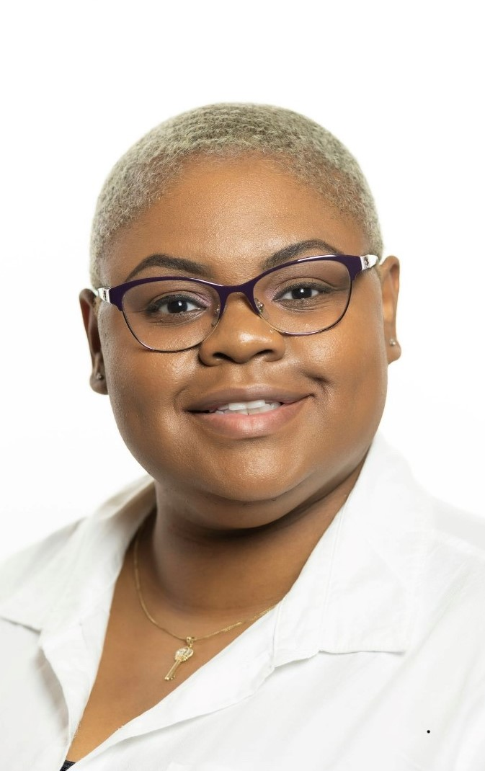
Cantey Tech Team Member Leticia Mcilwain
Lead SIS Engineer
19 Years in Educational Technology/Support
District Level PowerSchool Administrator Experience
SC State -Enrich Product Support (IEP, Medicaid, 504, Enrich Access, Enrich Data Collection Tool)
State Level PowerSchool Support and Data Monitoring
I enjoy empowering others through technical support and training.
Joined Cantey October 2020

Slide 10
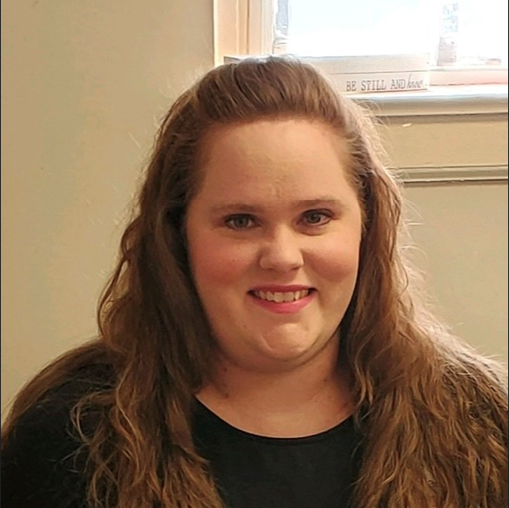
Cantey Tech Team Member
Blythe Branham
SIS Administrator
10+ Years Experience in PowerSchool including School, District, and State Level
In CIE Office with Jason Jones
Joined Cantey in January 2023

Slide 11

Cantey Tech Team Member
Jenn Roach
SIS Administrator
Specialization in Virtual Schools
12 Years Combined School & District-Level PowerSchool Experience
I like bats.
Joined Cantey in September 2020

Slide 12

Cantey Tech Team Member
Chryse Jackson
SIS Administrator
10+ Years Combined: District and School-Level PowerSchool Experience
Joined Cantey Team in July 2021

Slide 13

Cantey Tech Team Member
Tina Scott
SIS Administrator
12+ Years of Combined School & District-Level PowerSchool Experience
Joined Cantey in March 2021

Slide 14

Cantey Tech Team Member
Ryan Rose
SIS Administrator
20 Years Technology Support K-12
8 Years District Technology Coordinator & PowerSchool Administrator for K-12
Joined Cantey in July 2022

Slide 15

Cantey Tech Team Member
Rebecca Hill
SIS Administrator/PowerSchool Project Management
2 Year District-Level PowerSchool Admin
4+ Years in Middle School Education
Joined Cantey Team in November 2021

Slide 16
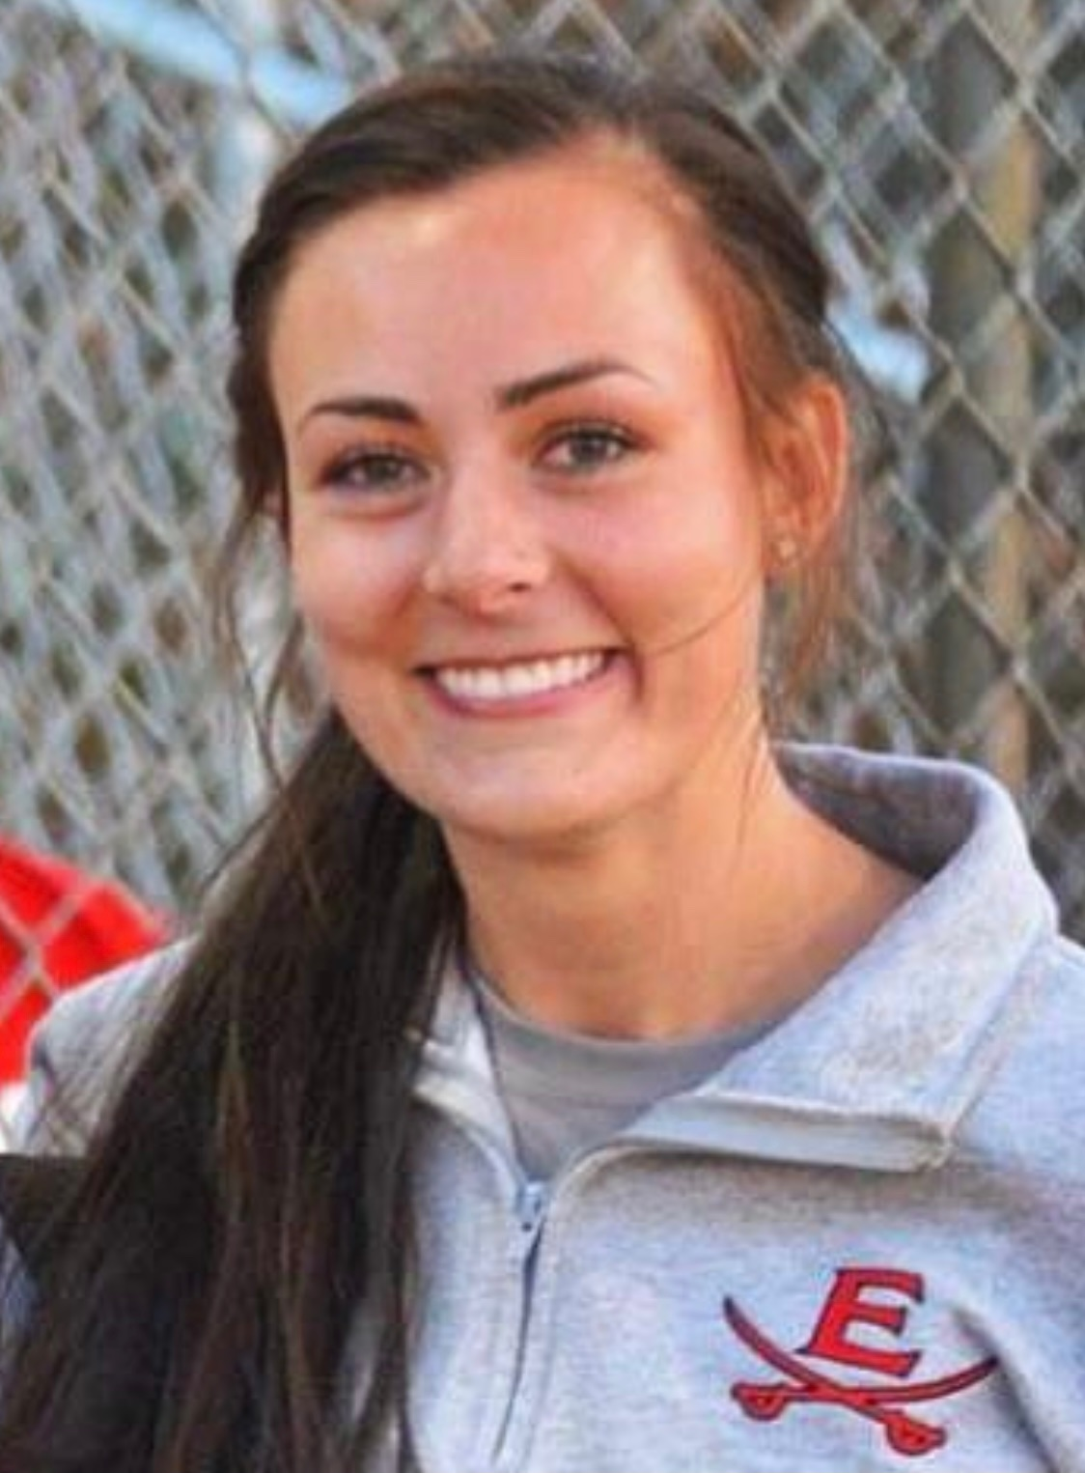
Cantey Tech Team Member
Sally Harrill
SIS Engineer
6 Years PowerSchool Experience
MS in Information Technology
Joined Cantey in December 2020

Slide 17
PowerSchool Support Model

Slide 18





PowerSchool Support Model
Charter Institute at Erskine is ultimately responsible for the schools and their data in PowerSchool.
If it is not in PowerSchool; it didn’t happen. Student enrollment, attendance/chronic absenteeism, etc. must be accounted for in PowerSchool along with Incident details for truancy/discipline issues.

Slide 19
Roles and Responsibilities
Erskine’s Responsibilities:
Attendance Setup
Course Enrollment
EFA / EIA Coding
GPA Calculations
Graduation Audits
State Reporting
SUNS - State Student ID
Start of Year Initializations
Drop-Out Reporting
Class Size Ratio Audit
Students Not Tested Audit
Transcripts Audit
Database Archiving
Grad Rate Reporting
Grade Scales
Maintenance/Updates
PowerSchool Security Roles
Server Security
Summer School Auditing
Civil Rights Data Reporting
CTE Completer Status Reporting
Employability Credential Audit
End of Year Processing
Teacher Certifications
Funding and Add-on Weightings
EFA / EIA Coding
SPED Audit
ESOL / Universal Screener
Individualized Graduation Plan Setup
Chronic Absentee / Truancy
TRAINING

Slide 20
Cantey’s Responsibilities
Roles and Responsibilities
As contracted by Erskine: (things we have asked them to do)
TRAINING
Funding
FTE Audit
Start of Year Initializations
Data Collections (QDC)
Attendance Setup
Course Enrollment
EFA / EIA Coding
GPA Calculations
Historical Grades
State Student ID
Grade Calculation Formulas
Drop-Out Data
Precode
Add-on Weighting Coding
Periods/Days
Start of Year Prep
PowerSchool Security Roles
Bell Schedules
Reporting - June 15th Transcripts
Add-on Weighting Coding
EFA / EIA Coding
IEP/EFA Audit
End of Year Prep
IGP Setup (Majors and Clusters)
Chronic Absentee Update Process
Staff Entry/Security Roles
Truancy Update Process
Uniform Grading Policy
PIP & SEI Status
Locked Accounts
Migrant/Foster Home/Homeless Audit
Reporting
Preventive
SUPPORT

Slide 21
Education Regulations and Laws Impacting PowerSchool

Slide 22
Regulations and Laws
R43-172. Accounting and Reporting
R43-274. Student Attendance
R43-231. Defined Program Grades K-5
R43-232. Defined Program Grades 6-8
R43-234. Defined Program, Grades 9–12 and Graduation Requirements

Slide 23
Introduction
Familiarizing your school staff with SCDE Regulations will aid in understanding why certain tasks must be coded in PowerSchool.
We are only highlighting parts from the regulations and laws that may have an impact on PowerSchool.
It is the responsibility of the entire school administration and staff to understand and adhere to SCDE Regulations.
Not knowing a regulation or law is not an excuse. Failure to adhere to Laws and Regulations could negatively impact the student(s).

Slide 24
R43-172. Accounting and Reporting
Impacts student/school funding
A pupil will be counted in membership on the first day of entrance in an instructional program either through original entry, reentry, or transfer.
Cumulative average daily membership (ADM) is the aggregate number of days in membership divided by the total number of days the school is in session
To be eligible for membership a pupil must not be more than twenty-one years old (or in a graduating class and becomes twenty-one before graduation) before September 1 of the current school year.

Slide 25
R43-172 Accounting and Reporting
A pupil shall be dropped from membership on the day when the number of unlawful days absent exceeds ten consecutive days or when the pupil leaves school because of transfer, death, expulsion, graduation, legal withdrawal, or for any other reason.
Notwithstanding any other provision, students with disabilities who have been expelled and continue to receive educational services pursuant to Regulation 43-279 (Section V, Part D) shall not be dropped from membership.

Slide 26
R43-172. Accounting and Reporting
A pupil shall be five years old or older on or before September 1 of the current school year to be admitted in a kindergarten program.
A kindergarten pupil shall maintain membership in a minimum of 150 minutes of daily instruction or its equivalency for an annual accumulation of 27,000 minutes.
A pupil shall be six years old or older on or before September 1 of the current school year to be admitted to the first grade.
A pupil in grade 1 - 12 shall maintain membership in a minimum of 200 minutes of daily instruction or its equivalency for an annual accumulation of 36,000 minutes.
Regulation Link: https://ed.sc.gov/index.cfm?LinkServID=5EE8F22E-A320-0278-30FE4E1D59320B4E

Slide 27
R43-274. Student Attendance
School (charter schools) must adopt policies to define and list lawful and unlawful absences.
There are lawful and unlawful absences, these will be defined by the school attendance policy.

Slide 28

R43-274. Student Attendance
Unlawful Absences:
absences of a student without the knowledge of his or her parents, or
absences of a student without acceptable cause with the knowledge of his or her parents.
Lawful Absences:
Note: Suspension (OSS) is not to be counted as an unlawful absence for truancy purposes.
absences caused by a student’s own illness and whose attendance in school would endanger his or her health or the health of others,
absences due to an illness or death in the student’s immediate family,
absences due to a recognized religious holiday of the student’s faith, and
absences due to activities that are approved in advance by the principal.

Slide 29
R43-274. Student Attendance
  Truant: A child ages 6 to 17 years meets the definition of a truant when the child has three consecutive unlawful absences or a total of five unlawful absences.
  Habitual Truant: A child ages 12 to 17 years who fails to comply with the intervention plan developed by the school, the child, and the parent(s) or guardian(s) and who accumulates two or more additional unlawful absences. This child may need court intervention and an initial truancy petition may be filed. The written intervention plan, and documentation of non-compliance, must be attached to the truancy petition asking for court intervention.
  Chronic Truant: A child ages 12 to 17 years who has been through the school intervention process, has reached the level of a “habitual” truant, has been referred to Family Court and placed on an order to attend school, and continues to accumulate unlawful absences. Should other community alternatives and referrals fail to remedy the attendance problem, the “chronic” truant may be referred to the Family Court for violation of a previous court order. All school intervention plans existing to this point for this child and family must accompany the Contempt of Court petition as well as a written recommendation from the school to the court on action the court should take.

Slide 30
R43-274. Student Attendance
  Intervention Plan: Each school must develop a policy relating to requirements for intervention. The school plan for improving students’ attendance must be in accordance with any applicable statutes.
High School Credit: In order to receive one Carnegie unit of credit, a student must be in attendance at least 120 hours, per unit, regardless of the number of days missed, or must demonstrate proficiency as determined by the local school district.
Regulation Link: https://ed.sc.gov/scdoe/assets/File/stateboard/documents/274.pdf

Slide 31
R43-231. Defined Program Grades K-5
The curriculum for children PreK-K shall consist of experiences and activities which will enhance their physical, emotional, social, and intellectual growth and development and help each child attain, at his own rate of speed, the educational goals set for the primary school.
Basic Program/Curriculum, Grades 1-5:
  The school day must be at least six hours including lunch, or its equivalent weekly.

Slide 32
R43-231. Defined Program Grades K-5
The subjects shall include, but not be limited to:
  English/Language Arts - shall include reading, writing, listening and speaking.
  Mathematics
  Science
  Social Studies
  Health and Safety - shall include components as outlined in the Comprehensive Health Education Act.

Slide 33
R43-231. Defined Program Grades K-5
Basic Program/Curriculum, Grades 1-5:
    Physical Education - Students who are physically or mentally unable to take the physical education course provided for the regular student shall take a suitably modified course in physical education.
    Visual and Performing Arts - shall include, but not be limited to, music and art.
    Foreign Language - as a separate course is recommended but not required. If a separate course is not offered, foreign languages should be incorporated in the basic curriculum

Slide 34
R43-231. Defined Program Grades K-5
Class-Size: The average pupil-teacher ratio in any school shall not exceed 28 to 1 based on average daily membership. The total number of teachers shall include all regular, special area, and resource teachers whose pupils are counted in the regular membership.
Each school shall have an appropriate means of reporting academic achievement to parents.
Full days missed because of weather or other circumstances must be made up.
Regulation Link: https://ed.sc.gov/index.cfm?LinkServID=600A9A82-F9EC-1DCA-88BDAF20428CA255

Slide 35
R43-232. Defined Program Grades 6-8
The school day must be at least six hours including lunch, or its equivalent weekly.
Subject Areas:
  English/Language Arts - These courses shall include skill development in reading, writing, listening and speaking.
  Mathematics
  Sciences - Environmental education is required as an integral part of the science curriculum.
  Social Studies - Environmental education is required as part of the social studies curriculum; eighth grade social studies must include South Carolina history.
  Health - This includes components as outlined in the Comprehensive Health Education Act, which includes a minimum of 250 minutes of comprehensive health instruction for at least nine (9) weeks annually.
  Physical Education - Students who are physically or mentally unable to take the physical education course provided for students shall take a suitably modified course in physical education. If a student is unable to complete the physical education course then the course shall be modified to meet the educational ability of the student. §59- 29-80
  Visual/Performing Arts - These courses shall include, but may not be limited to, music and art.
  Exploratory Programs - At least one elective in an occupational or exploratory program shall be scheduled. Programs should include key concepts in areas of digital literacy; computing systems; networks and the internet; and data and analysis.
  Foreign Language - A separate course is recommended, but not required. If a separate course is not offered, foreign languages should be incorporated in the basic curriculum.

Slide 36
R43-232. Defined Program Grades 6-8
High School Credit: When approved by the principal and the parents, a student promoted to the seventh or eighth grade may take units of ninth grade or higher work for high school credit. The high school courses offered must be limited to courses that are currently in the 9–12 section of the Activity Coding System for the Student Information System with the exception of physical education and health education courses.
It is expected that students taking courses for high school credit have been taught and mastered the middle school level standards prior to taking the courses for high school credit. The number of high school credits permitted at the middle school or junior high school level must be determined by the local school district.

Slide 37
R43-232. Defined Program Grades 6-8
The maximum teacher load shall not exceed 150 students daily. Maximum class size shall not exceed the following:
  Grade 6:
    30:1 (English/language arts and math)
    35:1 (other subjects)
  Grades 7 – 8:
    35:1 (all academic and exploratory subjects)
No class shall exceed 35 students in membership
Exception is Physical Education and Music:
  40:1
Each school shall have an appropriate means of reporting academic achievement to parents.
Full days missed because of weather or other circumstances must be made up.
Regulation Link: https://ed.sc.gov/index.cfm?LinkServID=5FF25362-F5C8-29C3-F6843BC097C273FA

Slide 38
R43-234. Defined Program, Grades 9–12 and Graduation Requirements
Requirements for Earning a South Carolina High School Diploma:
  The student must earn a total of twenty-four units of credit to graduate high school.
Subject | Unit Requirement
English Language Arts | 4.0
Mathematics | 4.0
Science | 3.0
U.S. History and Constitution | 1.0
Economics | 0.50
U.S. Government | 0.50
Other Social Studies | 1.0
Subject | Unit Requirement
Physical Education or Junior ROTC | 1.0
Computer Science | 1.0
Foreign Language or Career and Technology Education | 1.0
Electives | 7.0

Slide 39
R43-234. Defined Program, Grades 9–12 and Graduation Requirements
A school may award and accept credit in units of one-fourth(.25 unit), one-half (.50 unit), and a whole (1 unit).
A school may award one unit of credit for an academic standards-based course that requires a minimum of 120 hours of instruction.
A school may award one-half unit of credit for an academic standards-based course requiring a minimum of 60 hours of instruction and one-fourth unit of credit for an academic standards-based course requiring a minimum of 30 hours of instruction.

Slide 40
R43-234. Defined Program, Grades 9–12 and Graduation Requirements
A school may award credit for those gateway courses that are a part of the End-of-Course Examination Program only if a student takes the course approved by the school in which he or she is enrolled and meets all the stipulated requirements of the End-of-Course Examination Program. (For specific regulations regarding end-of-course tests, see Reg. 43-262, Assessment Program.)
A school may award credit for locally designed courses under the following conditions:
  Locally designed core subject-area courses used as graduation units of credit must be aligned with the state academic standards for the particular subject area and must be approved by the local board of trustees and the State Superintendent of Education.
  Locally designed elective courses must be approved by the local board of trustees. No more than two units may be awarded to a student for released-time classes in religious instruction.

Slide 41
R43-234. Defined Program, Grades 9–12 and Graduation Requirements
Locally designed Career and Technical Education (CATE) courses funded with state or federal CATE monies must be approved by the SCDE’s CATE office.
A school may award credit for the American Sign Language course as the required unit in a foreign language.
A school may award credit for a college course that students in grades nine through twelve take under the district’s dual credit arrangement.
Physical education: The required physical education course in secondary schools shall occur over two semesters (year-long schedule) or two nine weeks (semester block schedule) or the equivalent. For one semester, a personal fitness and wellness component must be taught, and for one semester, a lifetime fitness component must be taught either over the semester or in two nine-week divisions or the equivalent.

Slide 42
R43-234. Defined Program, Grades 9–12 and Graduation Requirements
Dual Credit Arrangement:
District boards of trustees may establish a policy allowing students to take college courses for units of credit toward the high school diploma. The district policy may allow for courses to be offered by an institution of higher education through a cooperative agreement.
A three-semester-hour college course transfers as one unit of credit.
Students enrolled in a South Carolina public school may take only courses that are applicable to baccalaureate degrees, associate degrees, or certification programs that lead to an industry credential offered by an appropriate regional accrediting agency recognized by the U.S. Department of Education.

Slide 43
R43-234. Defined Program, Grades 9–12 and Graduation Requirements
Transfer Students: A transfer student is one who enrolls in a South Carolina public school after having been enrolled in another school in this state or in a school in another state. Credits that he or she earned at the former school may be accepted and applied toward the South Carolina high school diploma.
School districts must use the sixteen clusters for reporting purposes but may modify these clusters – IGP.
At least one time during the entire four years of grades nine through twelve, each student shall receive instruction in cardiopulmonary resuscitation (CPR) which must include, but not be limited to, hands-only CPR and must include awareness in the use of an automated external defibrillator (AED) except that virtual schools may administer the instruction virtually and are exempt from any in-person instructional requirements.

Slide 44
R43-234. Defined Program, Grades 9–12 and Graduation Requirements
Homeroom will not count as part of the instructional day.
The instructional day for secondary students must be at least 6 hours, excluding lunch, or the equivalent weekly.
The teacher load must not exceed the maximum of 150 students daily. Class size must not exceed the maximum of 35 students.
Exception is Physical Education and Music:
  40:1
Due to federal requirements, all students must take a science course for which an assessment is given.
For state accountability purposes, every student must take an end-of-course examination in biology. (Alg 1, Eng 2, USHC)
All students must be offered a college entrance assessment that is from a provider secured by the SCDE (ACT and/or SAT).
Each school must have an appropriate means of reporting academic achievement to parents.

Slide 45
R43-234. Defined Program, Grades 9–12 and Graduation Requirements
Each school district must file a record of all dropouts that specifies for every student the name of the school in which he or she was enrolled and gives the following information on the student: his or her name, grade, race, sex, date of birth, free/reduced meals status, English proficiency status, and migrant status.
The name and code number of every course that each student takes must be entered into the student data collection system active master scheduler (aka PowerSchool) at the time the student takes the course. Courses may not be added to the student’s course history (transcript) without first being entered into the scheduler.

Slide 46
R43-234. Defined Program, Grades 9–12 and Graduation Requirements
Courses offered in nontraditional settings such as online courses, courses offered in conjunction with a college or technical college (i.e., dual credit), and courses offered by the school through the district, state, or another type of provider must be included in the active master scheduler (aka PowerSchool).
Regulation Link: https://ed.sc.gov/index.cfm?LinkServID=605ECD73-ACD2-2226-D69DE28436D6BBB0

Slide 47
FTE Requirements

Slide 48

What is Full-Time Equivalency (FTE)?
Full-time equivalencies (FTEs) determine the daily attendance value a student receives for the times spent in class. All schools are required to use FTEs.
  The FTE value directly influences the attendance and membership results for all students.
  An FTE code is required for all students.
  Only one FTE is allowed for SC.
  A suggested name is “Full Time.”

Slide 49
Full Time Equivalencies (FTE)
How Do I Set Up Full-Time Equivalency (FTE)?
Log into the appropriate school and navigate to the Start Page;
Click School under the setup header.
Click Full-Time Equivalencies (FTE) under the Attendance header.
  If and FTE is present do not create a new FTE, edit the old FTE.
  If no FTE is present create a new FTE, by clicking new
Fill out the values:
  Name – Full Time
  Default Attendance Mode – Select Meeting (Middle, High, K-12) or Daily (K-5) (K-6) Charter Only.
  When a student is assigned this FTE, his/her attendance is calculated based on the attendance mode you selected. Also, the Default Attendance Mode will be used when you run any core attendance reports in PS.
Note: Selecting a different attendance mode when running a report will override the FTE setting

Slide 50
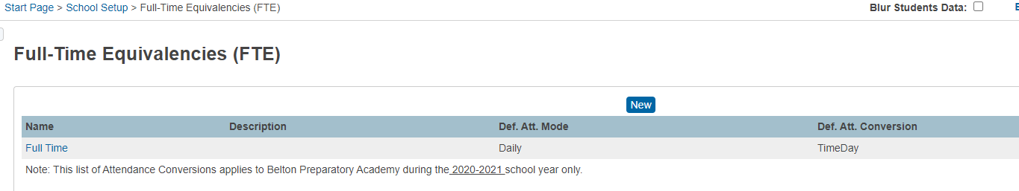
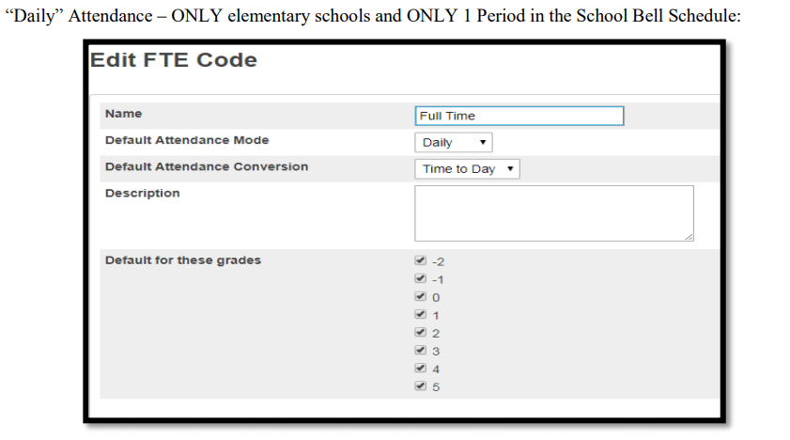
FTE for Grades K-5
Full-Time Equivalencies (FTE) – this is where schools will select the default attendance mode calculation.
Start Page > School Setup > Full-Time Equivalencies (FTE)
Elementary Schools (Grade K – 5) with exception of Charter Schools that serve grades K-6.

Slide 51
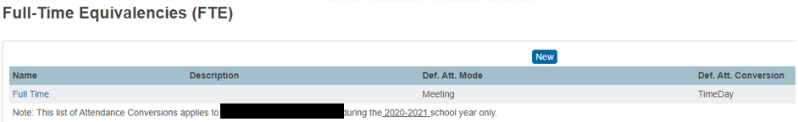
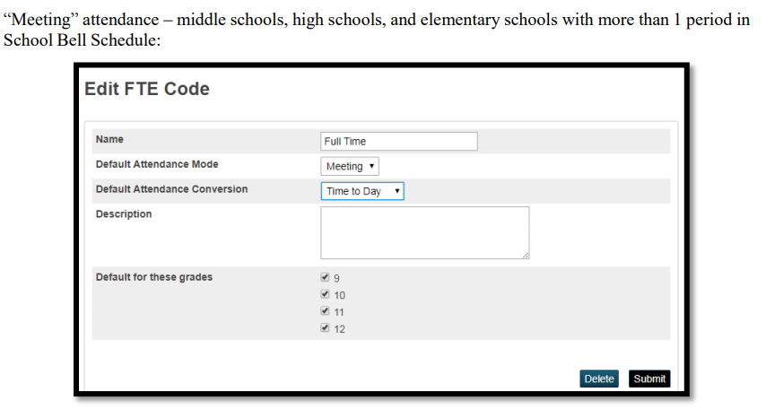
FTE Middle School, High School, and K -12th Grade Schools
FTE for Grades K-5
Middle and High Schools (Grade 6 – 12)
FTE: Middle School, High School, and K -12th grade schools:
Start Page > School Setup > Full-Time Equivalencies (FTE)

Slide 52
Navigating PowerSchool
Cantey Technology

Slide 53
About PowerSchool
Student Information System (SIS)
School Funding Based on Student Data
Mandatory in the State of South Carolina
Used to report District, State, and Federal Data
Used by State and Federal agencies to Collect Data
PowerSchool 23.5 and up contains New User Interface
PS 23.5 –-Coming Soon--

Slide 54




Browser Compatibility
Google Chrome - Recommended
Firefox Mozilla
Safari
Microsoft Edge

Slide 55
PowerSchool Data Life Cycle
PowerSchool
(School PS Admin)
On a nightly basis, data from PowerSchool is sent to Enrich servers.
After being collected, data from Enrich is sent to the SCDE.
Through the SUNS Plugin, basic student demographic info (when populated), will sync to the SUNS database. The plugin will try to locate or create a student’s SUNS number and then sync it back to the PS server.

Slide 56

PowerSchool Portal URLs
Administrators Portal (PowerSchool): https://cie.powerschool.com/admin/pw.html
Teacher Portal (PowerTeacher Pro): https://cie.powerschool.com/teachers/pw.html
Parents / Students Portal (Public): https://cie.powerschool.com/public/home.html

Slide 57
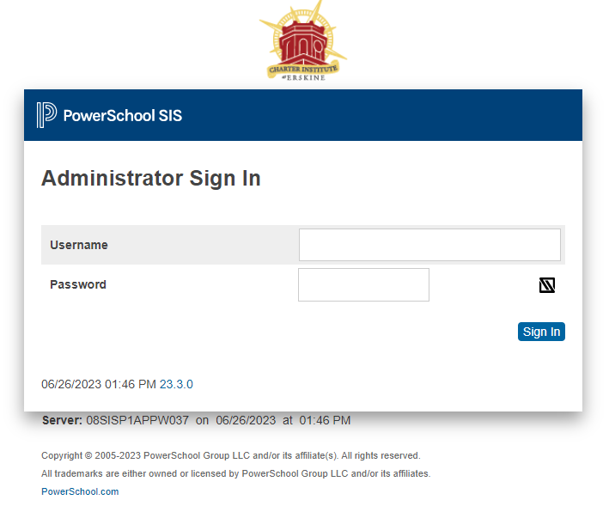
PowerSchool Login Page

Slide 58
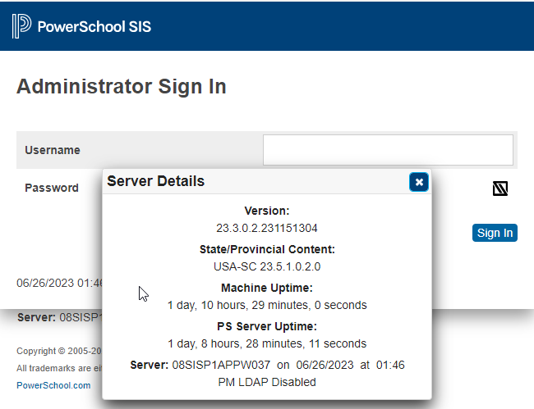
PowerSchool Login Page
Server Details – provides PS version, state reporting version, PT Pro version, Local Device (Machine) uptime, PS Server uptime
There is no reset password link.
If you cannot log into contact with Cantey support.
Email: help@canteytech.com.

Slide 59
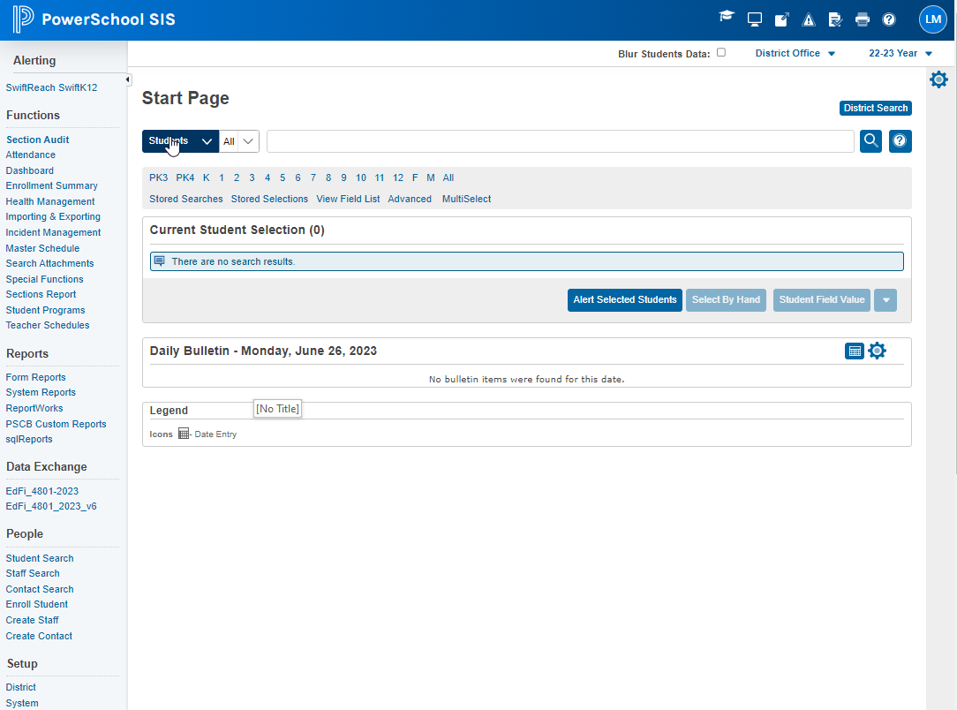
PowerSchool- Start Page

Slide 60



Navigation Bar
Question Mark/Help: Click to access PowerSchool online help.
SwiftK12 Admin: For those schools that purchased this product
Printer: Clicking this icon allows for a printer-friendly version of the page to be printed
User Initials: User settings and Sign-Out link. Signing Out is recommended every time you walk away from your computer.
Checked Paper with Lines: This icon will take you directly to the report queue.
Applications: Such as SwiftReach, etc.
Alerts: Such as an invalid login attempt

Slide 61


Navigation Bar
Terms: By default, the term appears when the server date falls within a scheduling term designated at the district level. Note: If the server date does not fall within a scheduling term, the term defaults to the Default Term When Between School Years setting.
This impacts attendance and schedule display on student record page.
If you click on the upside-down caret next to Terms a Calendar Date icon will appear.

Slide 62
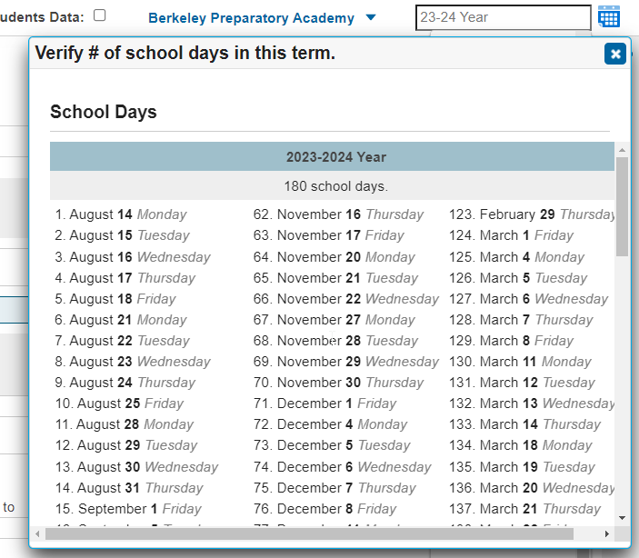
Navigation Bar
Terms: If you click on the Calendar Date icon another window will appear and display all in-session school days for the current term. The window is titled: Verify #of school days in this term. You can easily confirm if your school has a minimum of 180 in-session days for the school year.

Slide 63
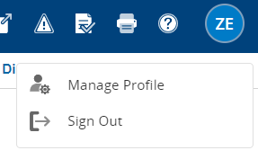
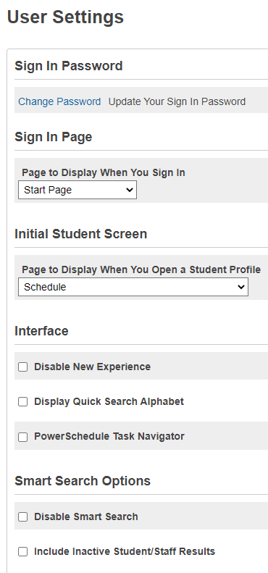
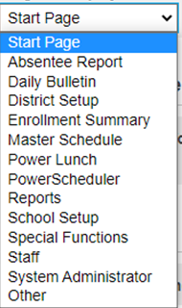
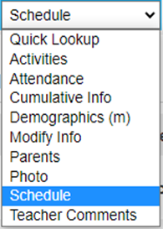
Manage Profile
Click on your User Initials to open Manage Profile.
User Details: Photo if one is available, Username, Name, Employee ID, Primary Email Address
Change Password: click to change password. You will need to know the old password.
Page to Display When You Sign In: Default/first page to display when you initially sign/log into PS.
Page to Display When You Open a Student Profile: The initial/default page that first displays when you select a student record/profile.

Slide 64
Manage Profile
  Interface:
    Display Quick Search Alphabet
    PowerSchedule Task Navigate
  Smart Search Options:
    Disable Smart Search
    Include Inactive Student/Staff Results
  Sign Out: The recommended way to sign-out of PS.

Slide 65
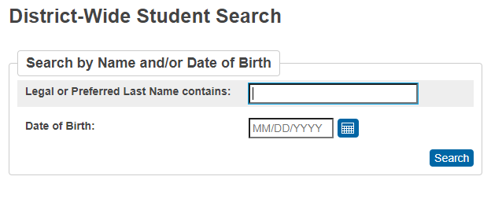
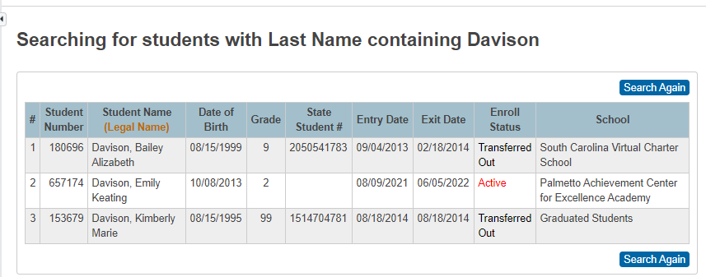
District Search
Before enrolling a new student into PowerSchool use the District Search button.
Use District search to ensure that you do not create a duplicate student record in PowerSchool.
If a student was ever enrolled in CIE/ PowerSchool database, they will appear in the list.
You can search by student last name and/or date of birth.
Displays students Enroll Status:
  Active
  Graduated
  Transferred Out
Displays students at any school within the district
Read Only
246812 Greene-Davis, 06/28/2006 11 1234567890 8/1/2019 6/1/2020 Transferred Apple Grove High School
Mary Sue Out
654321 Green, Billy 06/01/2003 99 6789043215 8/1/2020 6/1/2021 Graduated Graduated Students
Bob
135792 Greene, Sally 05/21/2009 8 9876543212 8/1/2022 6/1/2023 Active Apple Grove Middle School
Jane
Before adding/creating a new student into PowerSchool, always search for a student under District Search. This will ensure a duplicate account is not created for the student. If a student is listed or displays in the search submit a student’s record request to the school that they are located at. If a student is listed at Archive School, Duplicate Records, or at a school that has transferred to another district or closed open a ticket with Cantey Tech.

Slide 66
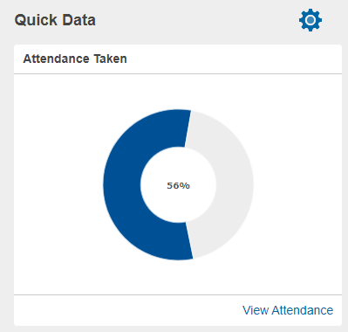
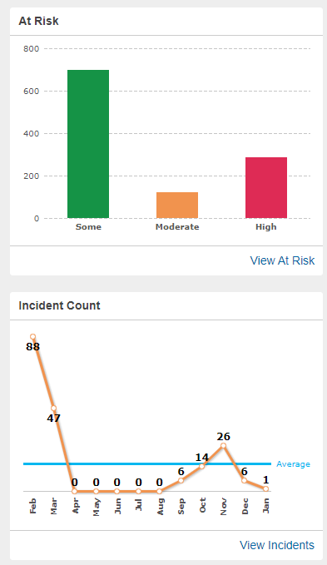

Quick Data
Attendance Taken - At a glance you can quickly see which teachers have taken attendance in PowerTeacher Pro. With graphical green checkmark, orange exclamation mark and red exclamation mark to indicate whether a teacher has completed attendance for the entire day, part of the day, or not at all, staff can quickly determine where follow-up is needed. Note: Only appears at the school level if you have the proper security permissions. Is only accurate when your school’s Bell Schedule and Sections are properly created and when your teachers take attendance in PowerSchool.
Quick Data Settings (Gear Icon ): enable (check)/disable(uncheck) display.
Incident Count – At a glance you can view total incident counts for your school by month. Note: Only appears if you have the proper security permissions.
At Risk - At a glance you can quickly view at risk student Grade and/or Attendance for your school. Note: Only appears if you have the proper security permissions.

Slide 67
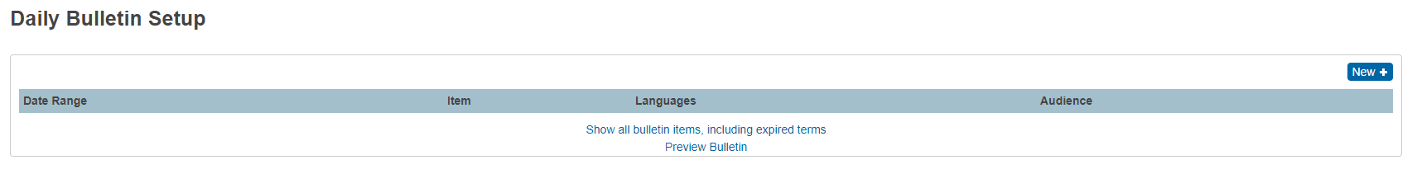
Daily Bulletin
Display announcements that can be viewed in PowerSchool SIS Admin portal, the PowerSchool SIS Student and Parent portal, and the PowerSchool SIS Teacher portal. Not all users at all schools have permission to create items for the bulletin, but everyone, including parents and students, can view the notices.
Public: Everyone can view this bulletin item, including those using the URL [your school]/bulletin/[your school number].html.
Teachers: Only those with permission to the PowerSchool SIS Teacher portal and the PowerSchool SIS Admin portal pages can view this bulletin item.
Admin: Only those with permission to the PowerSchool SIS Admin portal pages can view this bulletin item.
If the Email Address needs to be updated a ticket must be opened with Cantey Tech.
To add an announcement, on the Start Page click on the gear icon in the Daily Bulletin section.

Slide 68
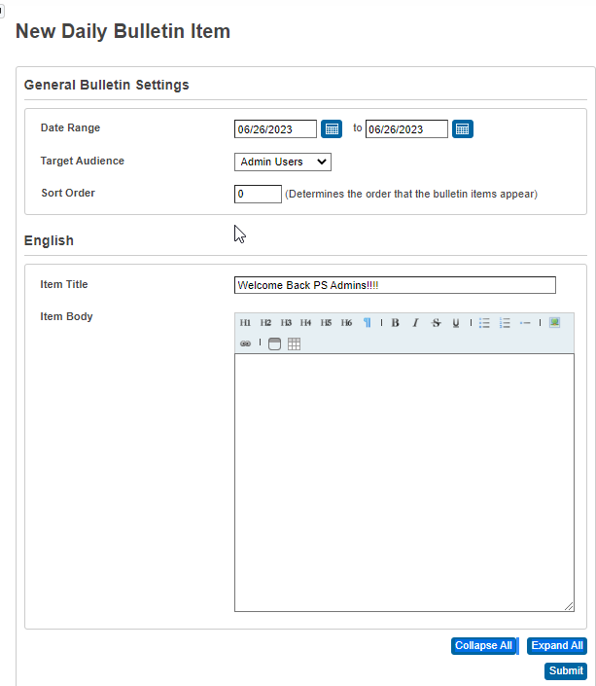
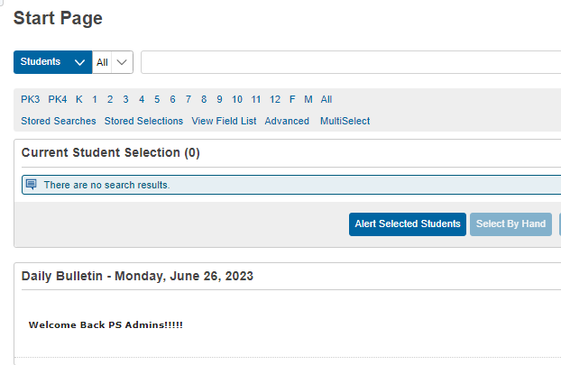
Daily Bulletin

Slide 69
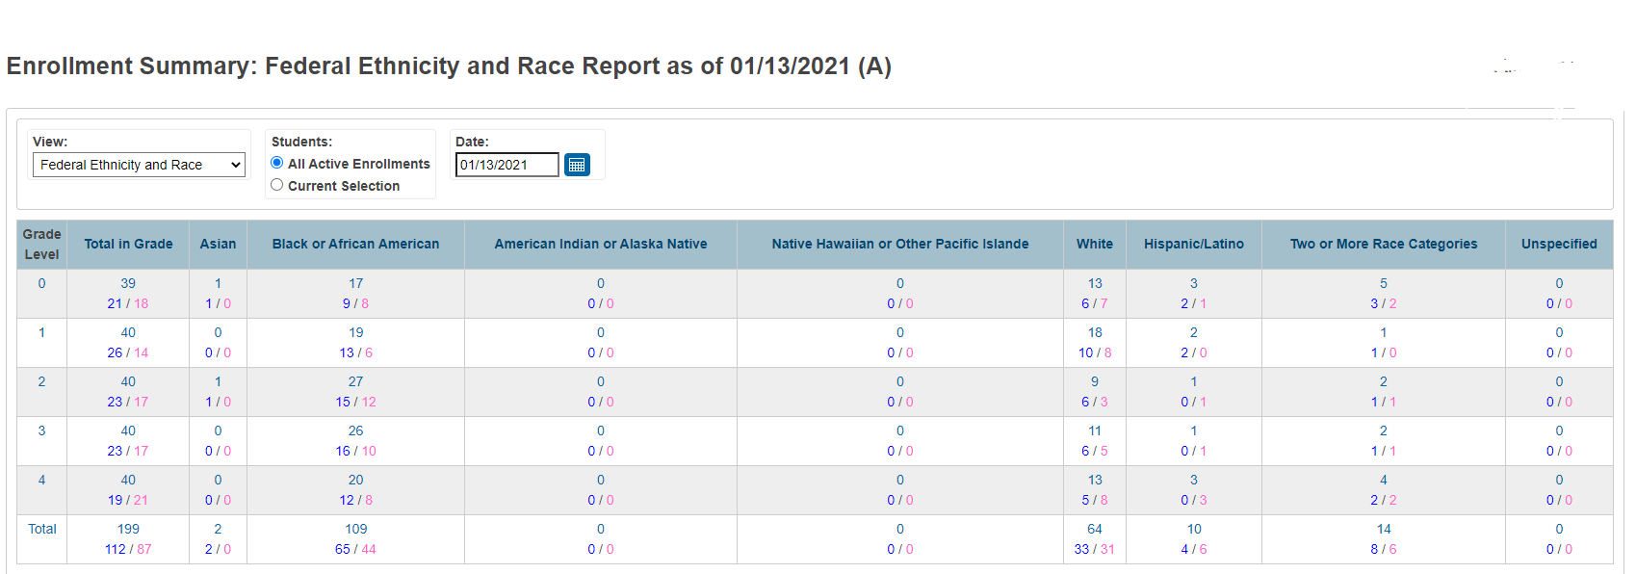
Enrollment Summary
Enrollment Summary: Use this report to use to see total count of student data for either Scheduling/Reporting Ethnicity or Federal Ethnicity and Race.
This report is broken down by Ethnicity, Grade Level and Gender.
This report is only as good and accurate as the data entered in PowerSchool.
On the Start Page click Enrollment Summary.

Slide 70
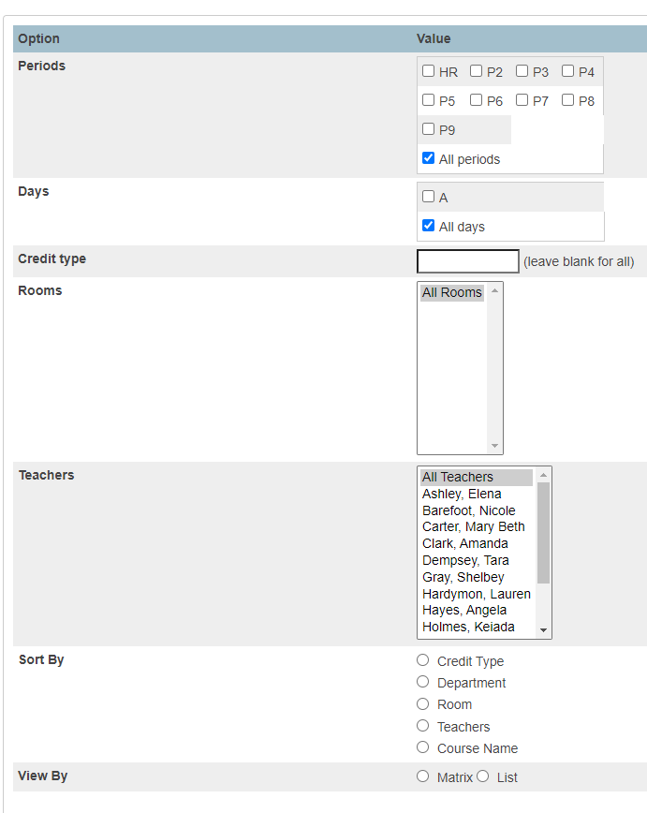
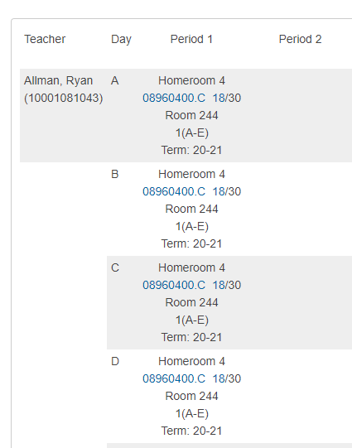
Master Schedule
Master Schedule: Use this page to display the schedule for all teachers in your school.
You can either view all meetings for all sections and teachers or select certain teachers, days, and periods.
The first time you access the master schedule, you must set your master schedule preferences.
Once master schedule preferences are set , you can view or modify them at anytime using the Show Preferences link (located at the bottom of the page.
On the Start Page click Master Schedule

Slide 71
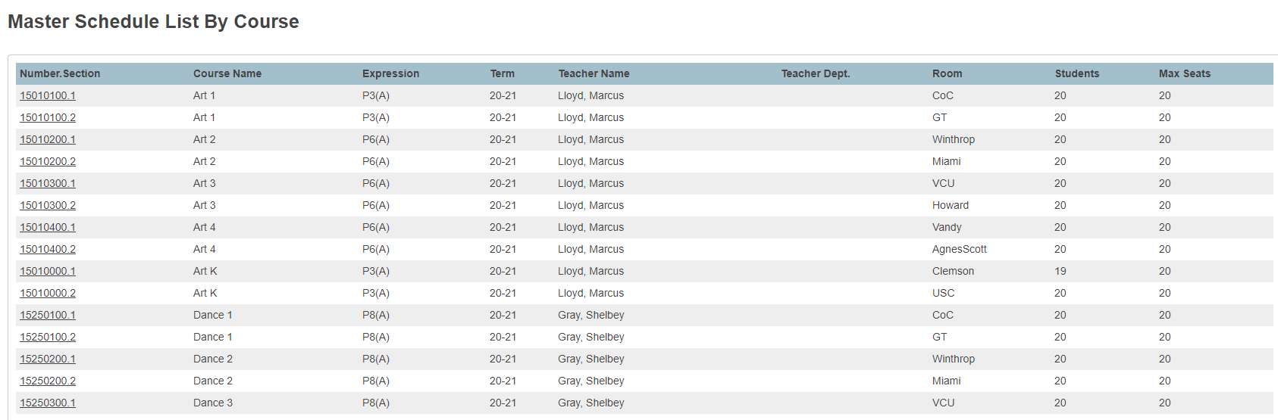
Master Schedule – List display

Slide 72
Questions???

Slide 73

New Staff Entry &
Assigning Login Credentials

Slide 74
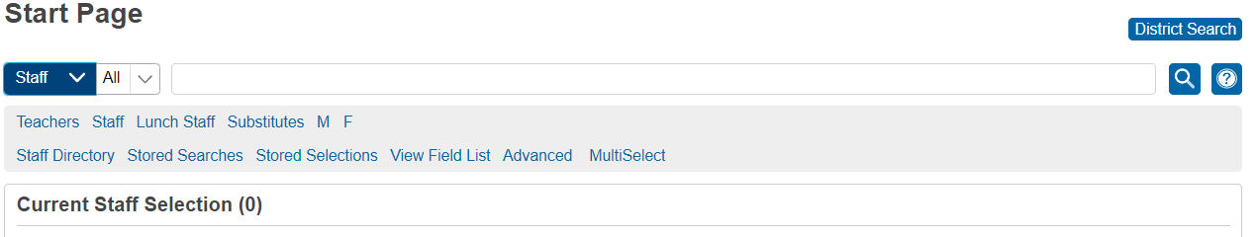
Entering New Staff
First search for staff. Ensure they were not previously entered in PowerSchool at your school.
To search if a staff person was previously entered in PowerSchool at your school enter the a /forward slash before typing in their name. Ex. /Doe, John
**Once no data is returned after searching for the staff member, proceed to creating a new staff entry.

Slide 75
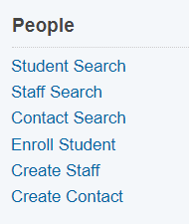
Create New Staff
Once no data is returned when searching for the staff member using the “/”
On the Start Page in the left navigation pane click Create Staff

Slide 76
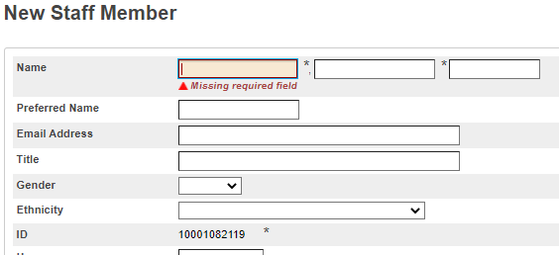
New Staff Member Page
Proceed to fill out the New Staff Member page:
Last Name*, First Name*, Middle Name*: Enter the staff members legal name as written on their birth certificate. Note: No initials for middle name unless there is an initial on the staff member's birth certificate.
Preferred Name: Enter the staff member's preferred name, such as a nickname. (if applicable)
Email Address: Enter the user’s school e-mail address.
Title: Enter staff members title (ex. Principal, Guidance Counselor, Nurse, Assistant Principal, etc.
Gender*: Must select the staff’s gender of Male (M) or Female (F).
Ethnicity*: Select the ethnicity that the staff member identifies as.
ID*: This is will be the unique number automatically assigned to the staff/teacher in that district PowerSchool database. This is not the teacher’s certification number or Educator ID. DO NOT CHANGE OR EDIT THIS NUMBER.

Slide 77
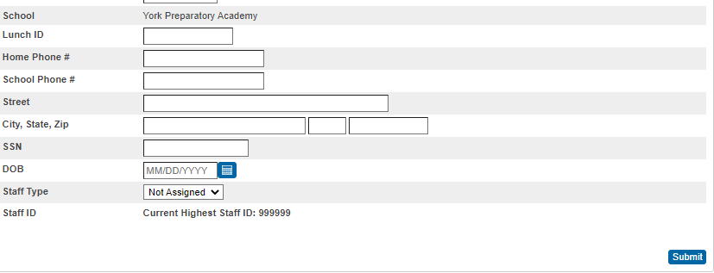
New Staff Member Page
Homeroom (optional/not required): Enter the user's homeroom number. **Will pull as a LevelData Validation error if not populated
School*: The staff member’s school name will display as read only.
Lunch ID (optional/not required): Only populate this field if your school uses PowerLunch in PowerSchool
Home Phone#: Enter the staff members home phone number (if available at the time). Format: 803-123-4567 or (803)123-4567
School Phone#: Enter the staff members school/office phone number (if available at the time). Format: 803-123-4567 or (803)123-4567
Your School’s Name

Slide 78
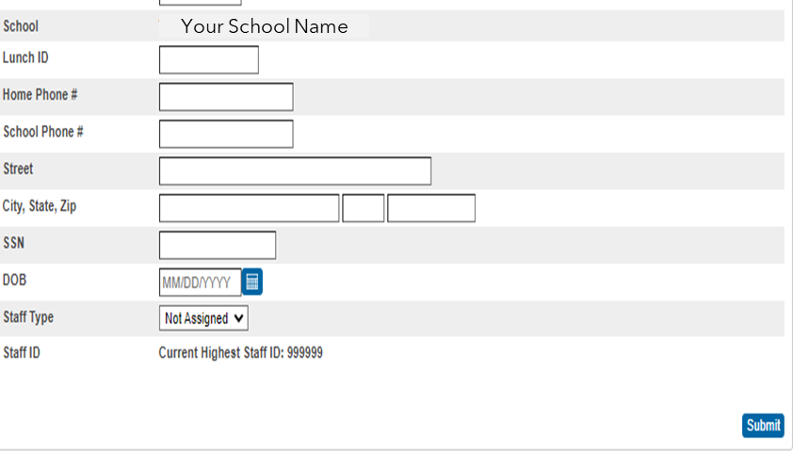
New Staff Member Entry Page
Street: Enter the staff members street address.
City, State, Zip: Enter the staff members city, state and zip code
SSN :(SCDE Recommends not to populate this field): This is optional because this is no longer collected by the SCDE.
DOB*: Staff members date of birth. Format: MM/DD/YYYY.
Staff Type*: We recommend only selecting “Teacher” for staff members who will be teaching a class.
All other staff members would be coded as Staff, Substitute, or Lunch Staff.
Staff Type*: Click Submit.

Slide 79
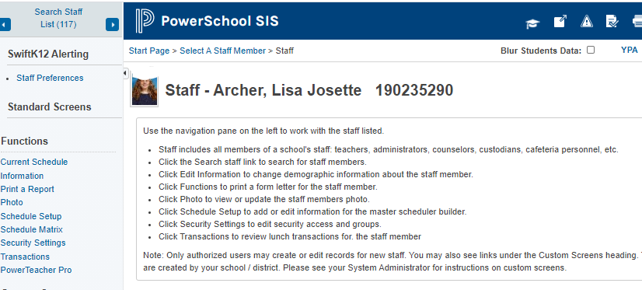
Accessing the Information Page
After the staff person has been entered into PowerSchool
  -Search and select the staff again then on the Information page

Slide 80
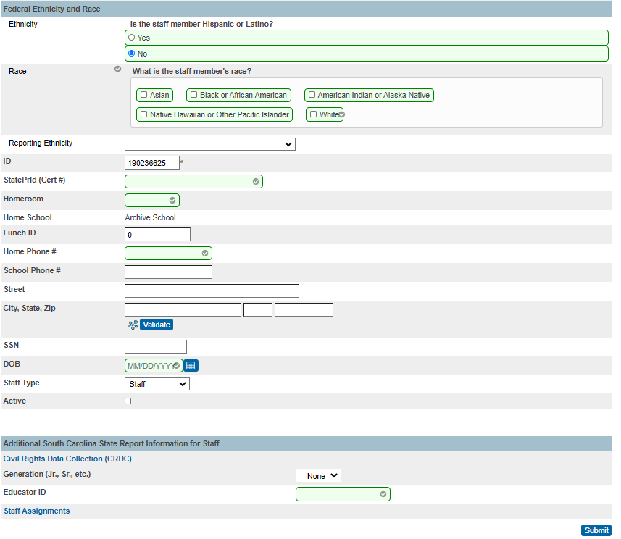
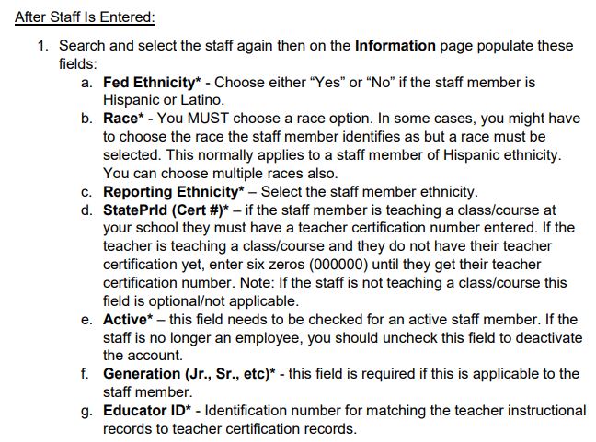
Populating the Information Page

Slide 81
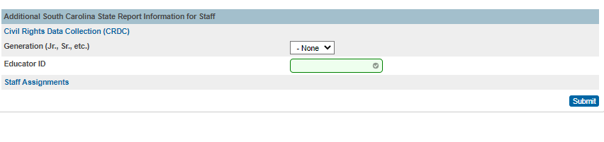
Populating the Information Page
Additional Information:
• The Teacher Certification Number (StatePrld (Cert #)) and Educator ID in most if not all cases will not be the same number.
Educator ID Portal: Teachers register/login to the SCDE-My Educator Portal obtain their Educator ID
• If a staff entry is assigned the “Teacher” staff type their classes will be
queried/validated during state reporting data collection.
• Contact your school’s human resource staff to obtain teacher’s StatePrld (Cert #) and Educator ID
• If your human resource staff is having an issue finding the teachers StatePrld (Cert #) use the SCDE Public Look-up.
Educator Certification Status: Public Lookup - https://ed.sc.gov/educators/certification/portal/

Slide 82
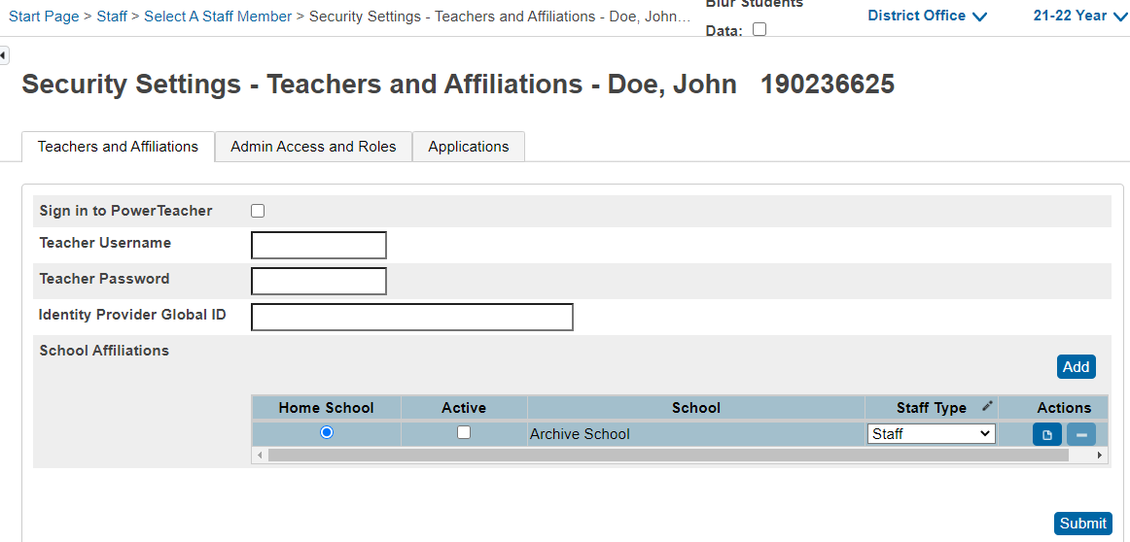
Setting Up Security for a Teacher
Follow these steps to provide access to PowerTeacher for new and existing staff members.
On the staff page menu, click Security Settings

Slide 83
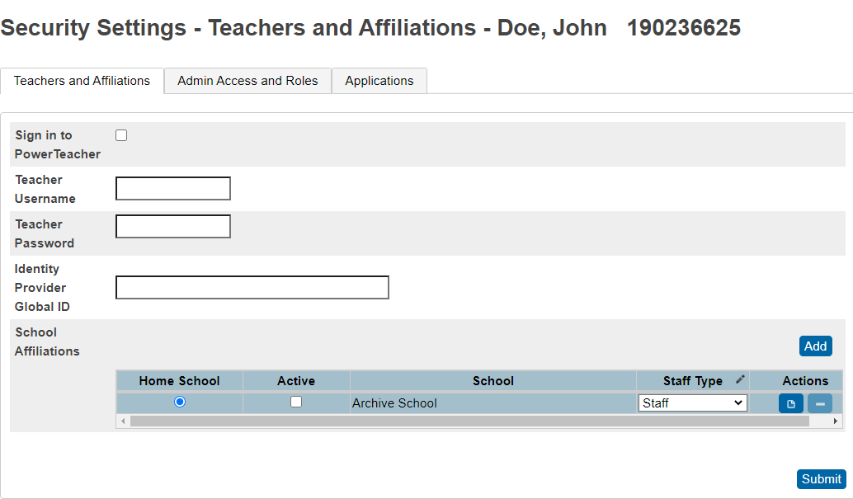
Setting Up Security for a Teacher
On the Teachers and Affiliations tab, Check this box to enable access to PowerTeacher Pro. If this is not checked the user will not be able to log into PT Pro.
Create the username for PT Pro credentials. The username will always start with your school number then what ever pattern specified by the PS Administrator. Ex (99FFlintstone)
Create Password. This will be the temporary password for the user. When the user first logs into PT Pro they will be asked to enter a new password. Note: If you must reset a user’s PT Pro account enter a temporary password here.
Identity Provider Global ID: N/A Leave blank
School Affiliations: Only select your school’s name. Click Add button to select the affiliated school name

Slide 84
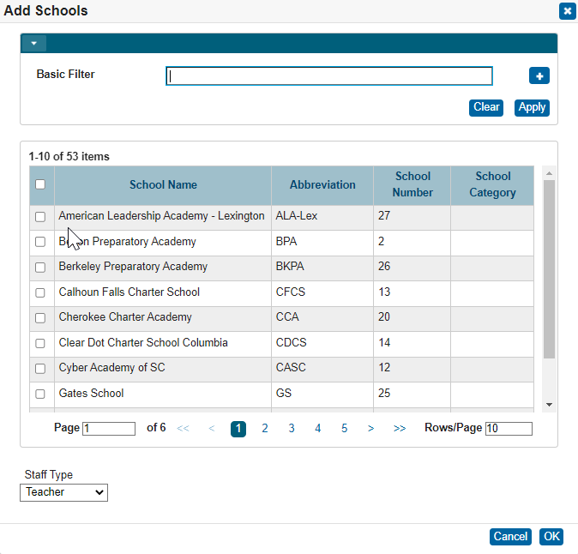
Setting Up Security For a Teacher
Search and check the box next to your school’s name.
Select the correct value for Staff Type (Not Assigned, Teacher, Staff, Lunch Staff, Substitute). Usually for PT Pro you will select “Teacher” for Staff Type. For a teacher to show up in sections they must have “Teacher” selected for Staff Type.
Click Ok.

Slide 85
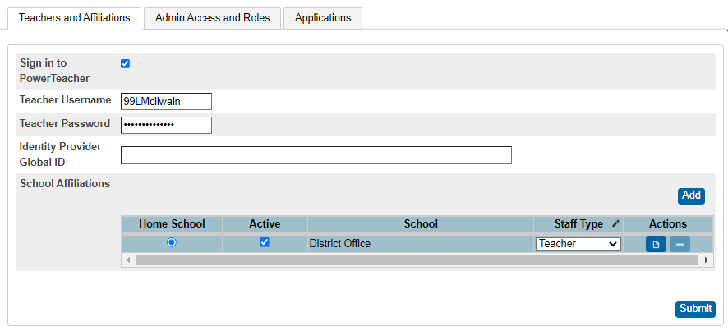
Setting Up Security For a Teacher
10. Click the Submit button to save all changes and before leaving the page.
Note: If you attempt leaving the page without saving you will get a warning message

Slide 86
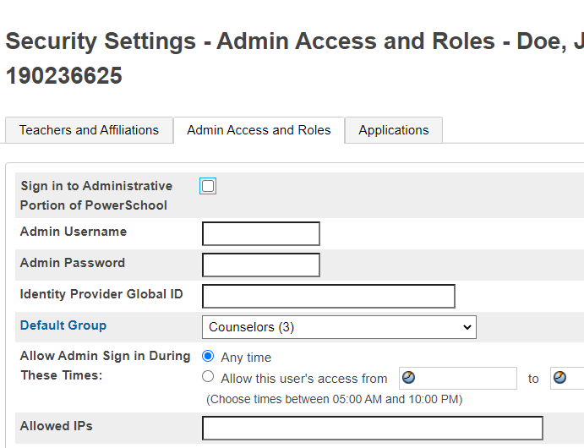
Setting Up Security for the PowerSchool Administrator Website
Setting Up Security for Office Staff Provide access to the administrative side of PowerSchool for new and existing staff members.
In the staff pages menu on the left, click Security Settings
Click the Admin Access and Roles Tab
Click the Check Sign into Administrative Portion of PowerSchool checkbox
Create a Username. Usernames always begin with your school number. The recommended syntax is school #, first name initial and last name, etc.
Admin Password: This will be the temporary password for the user. When the user first logs into PowerSchool they will be asked to enter a new password.
**Note: If you must reset a user’s PowerSchool account enter a temporary password here.

Slide 87
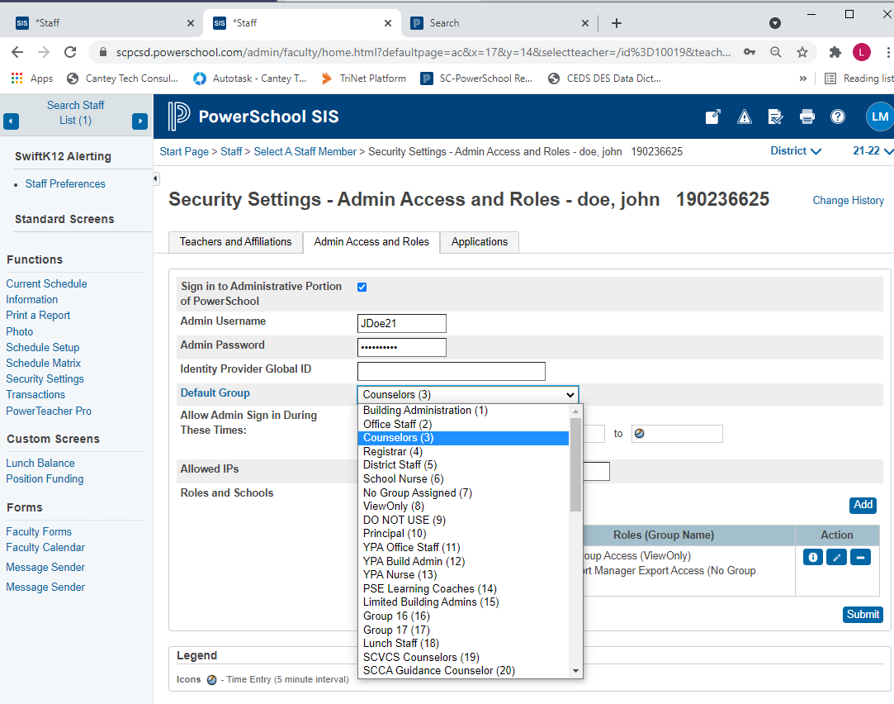


Setting Up Security for the PowerSchool Administrator Website
Default Group: The PS data entry employee should select the appropriate security group that the user would need to complete their daily task in PowerSchool.
**Note: DO NOT EVER SELECT “DO NOT USE (9)” security group for any reason.
This is in violation District Policy- which could result in severe consequences.

Slide 88
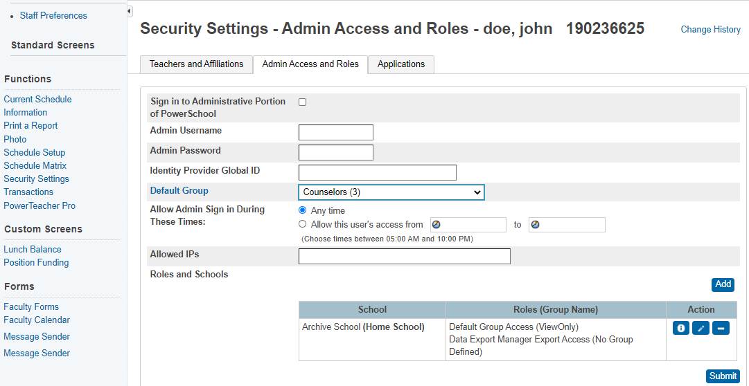
Setting Up Security for the PowerSchool Administrator Website
7. Allowed IPs: Not applicable at this time. Leave blank.
Identity Provider Global ID: Not applicable currently. Leave blank
8. Click Add to give the user access to a school

Slide 89
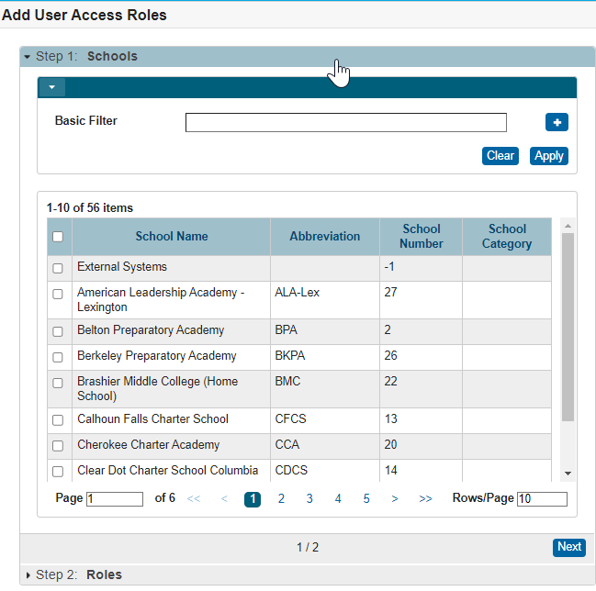
Setting Up Security for the PowerSchool Administrator Website
9. Schools - Search and check the box next to your school’s name.
10. Click the Next button.

Slide 90
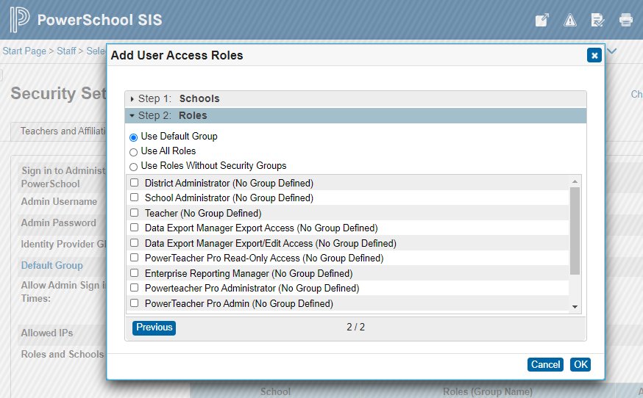
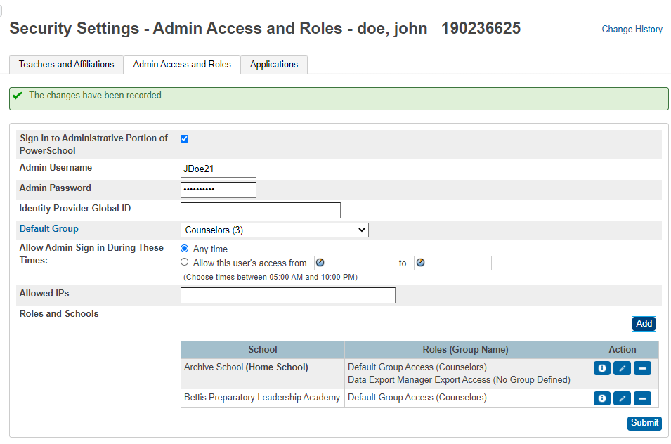
Setting Up Security for the PowerSchool Administrator Website
11. Choose a role. (Use the Default Group)
12. Click Ok.
13. You will then be back at Security Settings Page. Click Submit

Slide 91
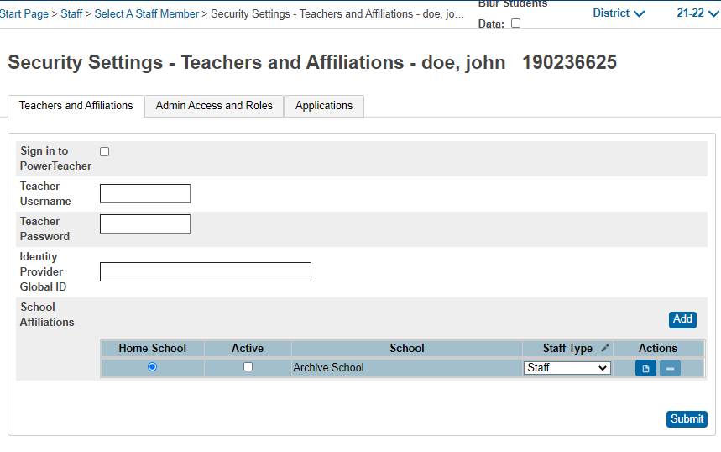
Removing System Access for a Teacher
Instead of deleting staff records and losing data when staff members leave, remove their access to PowerSchool.
1. On the Start Page, click Staff Search and search for the staff member
2. In the staff pages menu, click Security Settings
3. Select the Teachers and Affiliations tab, clear the “Sign in to PowerTeacher” check box
4. Click Submit
The staff member’s record is still active, but he or she cannot sign in to PowerTeacher.

Slide 92
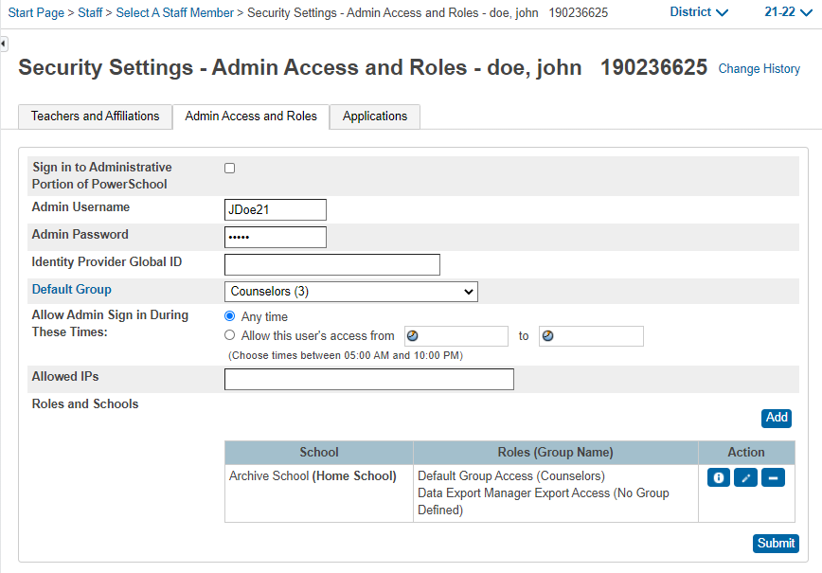
Removing Access for Other Staff
Instead of deleting staff records and losing data when staff members leave, remove their access to PowerSchool.
On the Start Page, click Staff Search and search for the staff member
In the staff pages menu, click Security Settings
On the Admin Access tab, clear the “Sign into Administrative Portion of PowerSchool” check box
Click Submit
The staff member’s record is still active, but he or she cannot sign-in to PowerSchool.

Slide 93
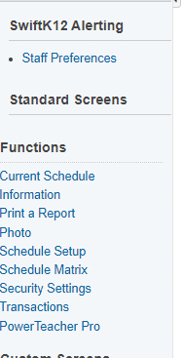
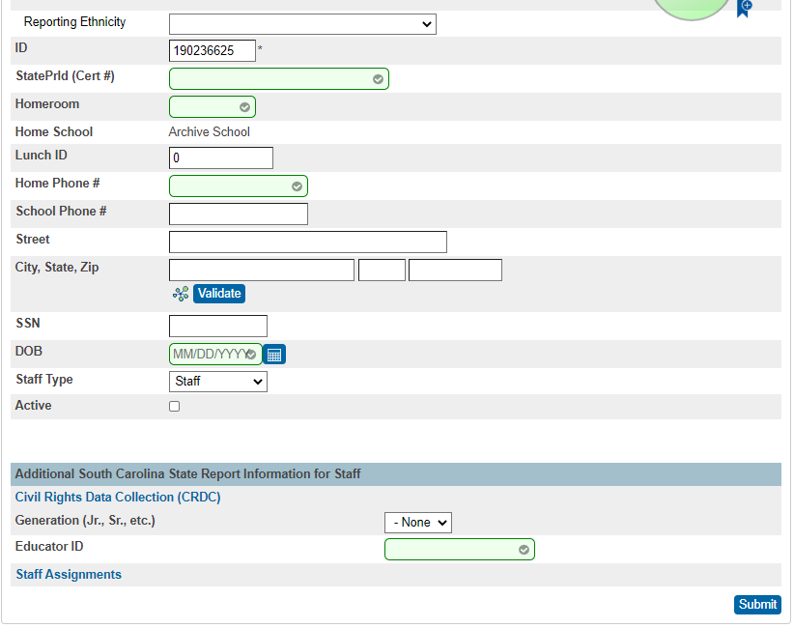
Deactivating Users in PowerSchool
Search for the User that needs to be made inactive.
Click information. The Staff Information page will open.
Scroll about 1/3 of the way down and find the "Active" checkbox.
Clear the “Active” Checkbox and click submit.

Slide 94

Questions, Comments or Concerns?

Slide 95
PowerSchool Basic Searches

Slide 96
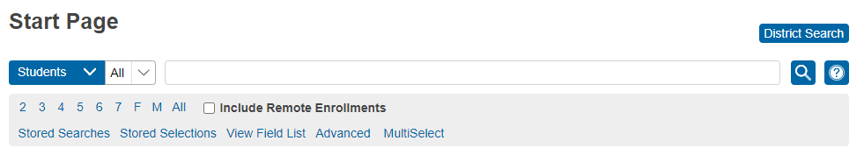
Basic Searches
Use the Student Search area on the Start Page to search for an individual student or groups of students.
When working with student records you will always begin with a search.
You must tell PowerSchool which records to retrieve to work with an individual student record or a group of students.
The most basic/common searches begin by typing (Student’s, Staff, Contacts) last name or the student’s student number

Slide 97

Basic Searches – View Field List
Use View Field List -To view a list of field names that can be used to perform a search
View Field List lists internal PowerSchool fields on the Student table.
Enter field names in the Search field exactly as they are written in the field list.
To view the Field List click View Field List on the Start Page.

Slide 98
Basic Searches – View Field List
The spelling of the field name is important; however, it is not case sensitive.
Placement of underscores (_) and periods (.) are important.
To verify the correct spelling of a field, click View Field List on the PowerSchool start page.

Slide 99

Basic Searches – View Field List
View Fields List: Displays a list of the student fields available in PowerSchool, including custom fields your district/school created and Database extension fields related to the Students table
There are 3 sections: Student Field Name, Student Search Code, Related Searches
Student Field Name: Lists all field names in the Student table and S_SC_STU Tables. There are 1,649 field names listed.

Slide 100

Basic Searches – View Field List
Student Search Code: These search codes can be used to target specific groups of students. They can be used individually to search for students, or they can be combined with other search codes or with fields from the field list.
Notes:
Cover student search codes

Slide 101
Basic Searches – View Field List
  How many students were active on January 10?
  *as_of=1/10/2022
  How many students have birthdays in November?
  *birthday>= 11/1; *birthday<= 11/30
  Finds students who are currently enrolled in fewer than six classes.
  *number_of_classes<6
Notes:
Cover student search codes

Slide 102

Basic Searches – Search Commands
Search Command: A search command is a line of text that you can use to command PowerSchool to perform a search.
The search command is comprised of three parts: a field name, a comparator, and a search argument or value. The command line should appear in this format: [field name][comparator][search argument]
  [Field Name]: PowerSchool stores student information in fields and those field contain values. Fields are tools that you can use to search and retrieve records.
  [Comparator]: Comparators are tools that you use to search and retrieve records by combining two or more criteria. A combination of comparators and fields are used in searches to narrow the results to a very small group of students at your school.
  [Search Argument]: search conditions or search values. What are you searching for?
For example, to find all students enrolled in your school whose first name is Kate, you would enter First_Name=kate in the Search field.

Slide 103
Using Comparators

Slide 104
Common PowerSchool Searches
Use / to retrieve inactive (transferred out) student records.
  EX: /last_name=Brown
Use # to return records that are not the field value.
EX: Last_Name#Brown
Use & to search with results.
EX: Gender = F (and press enter), then type &last_name=Brown (press hit enter)
Use ; to combine two searches.
EX: exitcode=W21;exitdate>8/20/2018
Use *as_of=8/20/23 to find all active students on August 20, 2023
Use /*as_of=8/20/23 to find all active and inactive students on August 20, 2023
Searching @- will list all active students with a hyphen in their first or last name Various Student Search Commands (PowerSchool Community) - https://help.powerschool.com/t5/PowerSchool-SIS-Knowledge-Base/Various-Student-Search-Commands/ta-p/15046

Slide 105

Basic Searches – Search Menu
Search Menu: Using the first drop-down list, you can search for Students, Staff, and Contacts. When performing a student search, you can search by names, fields, and stored searches. Staff and Contacts do not appear in the drop-down list for users who do not have security permissions.

Slide 106

Basic Searches – Field Menu
Fields Menu: Using the second drop-down list, choose from the preloaded fields without having to know or enter the field name in the search bar.

Slide 107

Basic Searches
Search Box: By default, Smart Search is enabled. As you begin to type, the search box immediately displays a drop-down of matching results.
Users can disable Smart Search if they do not want to use it. Note: This is located under Manage Profile.

Slide 108
Basic Searches
Current Selection: PowerSchool remembers the most recently selected group of students. Once established, the current student selection is accessible via the start page.
Your current selection is saved for you until you click the Clear All button or select the “x” for the criteria search you no longer want. Remember this since search results will be limited when multiple criteria are being used.

Slide 109

Basic Searches
Using any of the Quick Search buttons will only find Active Students unless “Include Inactive Student/Staff” results are enabled in your Smart Search options.

Slide 110

Basic Searches- Active vs Inactive
By default, Active students display in “blue” and Inactive students display in “gray”.
Using forward slash (“/”) in front of search commands adds all inactive results to active results that meet the search criteria.

Slide 111


Using MultiSelect
MultiSelect: This customization (3rd party plugin) allows the selection of multiple students or staff without selecting each student or staff by hand.
Copy & Paste (or type) the student/staff numbers, state student number, "Lastname, Firstname" or "Firstname Lastname" from any source ex. Excel or Word file.
MulitSelect is helpful when you already have a list of students or staff and would like to select them in PowerSchool.
**Note: This MultiSelect is not a core search function of PowerSchool so we cannot troubleshoot or fix any issues.
Notes:
Emphasize the affects of plug-ins and their updates

Slide 112

Questions?

Slide 113
Charter Institute Programs Office Presentation

Slide 114

The Charter Institute at
Erskine
PowerSchool and Finance
July 18, 2023

Slide 115

PowerSchool Fiscal Impact for FY23
State Aid to Classroom- $206,291,801.96
Education Improvement Act- $7,610,956.78

Slide 116
PowerSchool Reports
SC06 Membership reports- ensure schools are receiving appropriate state funding based on the Average Daily Membership report
SC28 Add-Ons reports- ensure schools are receiving appropriate funding for each of the Add-Ons categories

Slide 117
Weightings- State Aid to Classroom
Descriptions | Weight
K-12 base students (Primary, Elementary, High School) | 1.00
Students with Disabilities | 2.60
Pre-career and Career Technology | 1.20
Addl- B/M Charter School | 1.25
Addl- Virtual Charter School | 0.65

Slide 118
Weightings- Add-Ons
Descriptions | Weight
Gifted and Talented | 0.15
Academic Assistance | 0.15
Limited English Proficiency | 0.20
Pupils in Poverty | 0.50
Dual Credit Enrollment | 0.00

Slide 119

Funding Counts
Initial Funding
  Prior 135 Day Count using New Formula
5 Day Count
  All schools
45 Day Count
  All schools
135 Day Count
  All schools
  Final Count for the school year

Slide 120
New Funding Formula
Each school will receive its share of the total District funds based upon its proportion of total weighted pupils

Slide 121
New Funding Formula
Each school will receive its share of the total District funds based upon its proportion of total weighted pupils
Example:
School | WPU
School A | 453.35
School B | 753.19
School C | 517.26
School D | 1005.97
School E | 945.15
District TOTAL | 3,674.92

Slide 122
New Funding Formula
Each school will receive its share of the total District funds based upon its proportion of total weighted pupils
Example:
School | WPU | WPU %
School A | 453.35 | 12%
School B | 753.19 | 20%
School C | 517.26 | 15%
School D | 1005.97 | 27%
School E | 945.15 | 26%
District TOTAL | 3,674.92 | 100%

Slide 123
New Funding Formula
Each school will receive its share of the total District funds based upon its proportion of total weighted pupils
Example:
School | WPU | WPU % | Allocation
School A | 453.35 | 12% | $1,621,521.70
School B | 753.19 | 20% | $2,702,536.17
School C | 517.26 | 15% | $2,026,902.13
School D | 1005.97 | 27% | $3,648,423.83
School E | 945.15 | 26% | $3,513,297.02
District TOTAL | 3,674.92 | 100% | $13,512,680.84

Slide 124
New Funding Formula
Each school will receive its share of the total District funds based upon its proportion of total weighted pupils
What if?
School | WPU | WPU % | Allocation |  | WPU | WPU% | Allocation
School A | 453.35 | 12.34% | $1,666,967.95 |  | 465.12 | 12.62% | $1,704,786.17
School B | 753.19 | 20.50% | $2,769,479.63 |  | 753.19 | 20.43% | $2,760,637.88
School C | 517.26 | 14.08% | $1,901,965.02 |  | 517.26 | 14.03% | $1,895,892.87
School D | 1005.97 | 27.37% | $3,698,951.69 |  | 1005.97 | 27.29% | $3,687,142.54
School E | 945.15 | 25.72% | $3,475,316.55 |  | 945.15 | 25.64% | $3,464,221.37
District TOTAL | 3,674.92 | 100.00% | $13,512,680.84 |  | 3,674.92 | 100.00% | $13,512.680.84

Slide 125
New Funding Formula
Each school will receive its share of the total District funds based upon its proportion of total weighted pupils
What if?
School | WPU | Allocation |  | WPU | Allocation |  | Difference
School A | 453.35 | $1,666,967.95 |  | 465.12 | $1,704,786.17 |  | $37,818.22
School B | 753.19 | $2,769,479.63 |  | 753.19 | $2,760,637.88 |  | -$8,841.75
School C | 517.26 | $1,901,965.02 |  | 517.26 | $1,895,892.87 |  | -$6,072.15
School D | 1005.97 | $3,698,951.69 |  | 1005.97 | $3,687,142.54 |  | -$11,809.15
School E | 945.15 | $3,475,316.55 |  | 945.15 | $3,464,221.37 |  | -$11,095.18
District TOTAL | 3,674.92 | $13,512,680.84 |  | 3,674.92 | $13,512.680.84

Slide 126

Finance Team
  Dr. Missy Brakefield, Deputy Superintendent of Fiscal and Student Services
    MBrakefield@erskinecharters.org
  John Li, Chief Financial Officer
    JLi@erskinecharters.org
  Amanda Tucker, Director of Finance
    ATucker@erskinecharters.org
  Angelica Rodriguez, Assistant Director of Finance
    ARodriguez@erskinecharters.org

Slide 127

The Charter Institute at
Erskine

Slide 128
Student Services
Special Education, Section 504, Medical Homebound, ML

Slide 129

Student Services- Special Education & 504
EFA Coding - additional funding is generated for students with disabilities who qualify under IDEA. The code entered in PS for the student should match what is documented in Enrich
Collaboration between Special Education and PowerSchool coordinators is critical!
EFA- Education Finance Act
IDEA – Individuals with Disabilities Education Act

Slide 130


EFA Disability Coding
If a student’s identified disability changes midyear, the change must be reflected under the student’s EFA code in PowerSchool

Slide 131

Student Services- Special Education & 504
Instructional Setting
The primary identifier of students in the students with disabilities subgroup for the current year’s data.
The value should match what is in Enrich for each student
This determines sub-groups for
Testing / assessment

Slide 132


Student Services- Special Education & 504
504 Plan- Select the primary life function in which the student is most substantially limited according to 504 documentation in Enrich.
Leave this field blank if the student does not have a 504 Accommodation Plan.
Check Box if student is eligible for 504 services but does not have a
formal 504 Plan in place.

Slide 133
Student Services- Testing Accommodations Pre-Code
Ensures students receive access to correct assessment
Ensures student’s test is coded correctly for computer based and paper/pencil assessments. No bubbling required!
Ensures students receive correct accommodations per their IEP, 504, or ML Plan
Ensures schools are reimbursed correctly for the administration of PSAT, ACT, SAT, and Ready to Work

Slide 134
Student Services - Medical Homebound
Medical Homebound: Correlates to EFA coding. Medical Homebound student are coded as Homebound in Powerschool and must have been approved by the school leader. The dates of the Homebound are as listed on the approved school form. Work with the Medical Homebound contact at your school if you have specific student questions.
Homebased is for Special Education Students ONLY: In PowerSchool, attendance must be entered accordingly. Some student IEPs define Homebased instruction. Work with your SPED coordinator for student specific scenarios
  There is no EFA funding for Homebased Instruction

Slide 135



Student Services – Contact Information
Parent, Address, Phone Number and Email address are needed for state reporting.
Use this pathway

Slide 136
Student Services – Plan for Success
Each school needs a plan for gathering, entering and checking the data on a regular basis.
    Students come and go from the school.
    Students are identified and dismissed throughout the year
    Plans are updated and changed throughout the year
How will your school do this?
    Shared spreadsheet
    Weekly/Monthly meetings with relevant personnel
    SPED coordinator updates as needed
    Other ideas….

Slide 137

Student Services – MTSS
By law, all students in kindergarten and first grade must be screened three times a year. This PowerSchool question on the SC Student Information page should be answered for all kindergarten and first grade students.
Question: “Was this student identified as at risk of having a reading difficulty based on the universal screening process?”
Options:
1) Not Screened
2) Screened Identified
3) Screened Not Identified

Slide 138
Student Services – MTSS
Districts should use the universal screening vendor cutoff points to determine whether a student is at risk of having a reading difficulty, not district-set cutoff points.
If a student is identified as at risk of having a reading difficulty during any of the screenings, select screened, identified as at risk of having a reading difficulty.
  Example 1: If a student is screened in the fall and not identified as at risk of having a reading difficulty, but is screened again in the winter and identified as at risk, they should be coded as Screened, Identified.
  Example 2: If the screening in the fall indicates a student is at risk of having a reading difficulty but a second screening in the winter indicates they are not at risk, they should still be coded as Screened, Identified.
*This designation is based on feedback from the SCDE data office and legal office, and ensures that districts reduce their risk of not identifying students at risk of a reading difficulty simply because that status changes mid-year.
***Tip: Have a clear communication process with your MTSS coordinator after screening times.

Slide 139
Student Services – Multilingual Learners
Multilingual Learner Program: (Title III of ESEA)- Federal grant program to ensure that Multilingual learners (MLs) attain English language proficiency and meet state academic standards. Federal funding is provided through various grant programs to assist in providing adequate support.
Title III - Title III is responsible for the oversight of the language instruction of Multilingual Learners (ML) and immigrant students.
Please make sure that you work closely with your Title III Coordinator to ensure that PS data is correct, accurate, and completed as required.

Slide 140

Student Services – Multilingual Learners
Students enrolling for the first time at your school are identified as potential MLs through the Enrollment Survey (ES) Home Language Section beginning with the 2022-2023 school year. Students were previously identified using the Home Language Survey (HLS). This information should be completed in the SC Student Information section. This should only be completed upon initial enrollment in a SC public school.
This field will only populate when “Other” is selected.
These fields should be completed based on responses on the original HLS or ES. These should not be changed. Any response other than English indicates that the student needs to be screened as a potential ML student.
This information also comes from the HLS or ES but can be changed based on family preferences. All communication from the school should be sent in the indicated language.

Slide 141

Student Services – Multilingual Learners
If a language other than English is specified, the student should be referred to the Title III Coordinator. If the student does not have record of an English Language Proficiency Assessment, the student will need to be screened. While waiting on scores, the student should be coded as “AW.” No student should be coded as “AW” for more than 30 days.
Possible ELP Assessments are Alternate ACCESS, ACCESS for ELLs, WIDA MODEL, and WIDA Screener (K-12). The possible scores will auto-populate based on the type of assessment indicated.

Slide 142

Student Services – Multilingual Learners
English Proficiency Levels will need to be updated annually based on the latest results from the ACCESS assessment. For newly enrolled students, the entry will be based on the screener or any information gained from previous school records. This identifies which students will take ELP assessments and qualify for Title III-ML funding.
Further guidance is provided in the South Carolina Title III:
Proficiency Codes for Multilingual Learner Program (MLP)
2022-2023.

Slide 143

Student Services – Multilingual Learners
Birth Country must be coded correctly as well. It auto-populates to “(Blank)-United States” but should be changed if as student was born anywhere other than the 50 states, District of Columbia, or the Commonwealth of Puerto Rico. This field is one used for funding purposes. If the Birth Country is anything other than “(Blank)-United States” the U.S. School Entry Date must also be completed.

Slide 144

Student Services – Multilingual Learners
This information is prepopulated from the SC Student Information page and cannot be edited on the MLP page.
On the MLP page, the 30 Day Parent Notification date must be entered based on the date that parents are provided with notification from the MLP teacher or Title III Coordinator.
This only applies to those MLs coded as 1.0-6.0 or A1-A3. M1-M4 receive a monitoring or exit letter, but the date does not get entered.

Slide 145


Student Services – Multilingual Learners
The ML Program Service Delivery Models must be completed annually. Consult with the Title III Coordinator to complete this section. The First Record of MLP Services should also be completed for new enrollees.
If a student has a signed waiver for the current school year, the waiver field should be selected as well as the Waiver box on the SC Student Information page.

Slide 146
The Charter Institute at
Erskine
Federal Programs
July 18, 2023

Slide 147
Data Importance – Federal Programs
Ensures student counts and coding are accurate so SCDE can determine allocations
Ensures District of Residence information is accurate, which can impact funding state-wide
Ensures employees with salaries funded by federal funds are accurately reimbursed (ex. their schedule)
Ensures McKinney-Vento, Migrant, and Foster students are accurately identified
Notes:
Jeanie

Slide 148
National School Lunch Program Forms
Only schools participating in NSLP are to collect lunch forms.
These forms must be collected annually.
Forms should be collected beginning July 1.
Schools must work with their PowerSchool coordinators to ensure all information is entered.
Lunch information will not be used to determine Title I eligibility. The Institute will use the prior year’s 135th day Pupils in Poverty data beginning with the 2023-2024 school year.
Community Eligibility Provision (CEP) schools do not collect lunch forms.
Notes:
Jeanie - SCDE Office of Health and Nutrition send updated forms to contacts at the participating schools. Erskine does not handle the updated forms. Forms should be sent to school lunch contacts. Updated contact is forthcoming. CEP schools do not collect lunch forms.

Slide 149

District of Residence
All schools should collect District of Residence documentation for all students. Also referred to as Proof of Residence information.
It has to be collected each year.
District of Residence in PowerSchool impacts the amount of funding the Institute receives.
Must be entered in Powerschool by the 5th day.

Slide 150
Monitoring
The Institute Federal Programs department will audit documentation.
    Schools will be asked to provide copies of randomly selected students each year by November 15th.
It is highly recommended that schools conduct internal audits by randomly selecting documentation and verifying them to ensure compliance and accuracy of PowerSchool coding.

Slide 151

McKinney-Vento Coding
“Housing Status” must be cleared out at the beginning of each year and reestablished.
Start with students that were identified in the previous school year and see if situations have changed.
If Displaced by disaster or other are selected, PS will prompt you to fill out additional information.

Slide 152
ESSER Requirements - Tracking
Learning Loss Outcomes - Tracking students in PowerSchool to determine the impact of ESSER-funded interventions
Coded in Fall and Spring semesters.
Interventions will be grouped in large categories for coding in Powerschool.
Summer Learning
Afterschool Programs
Reading Intervention
Math Intervention
This is for reporting to the General Assembly and Education Oversight Committee as well as for federal data collection criteria.

Slide 153

Takeaways
District of Residence documentation is crucial!
Clear out “Housing Status” for MV students at the beginning of each year.
Set up STRONG processes for collecting information from families, determining the PowerSchool coding, and entering in PowerSchool.
    Your PowerSchool Coordinator is critical for this!
  Have clear roles and responsibilities to ensure all information is entered correctly and on time.

Slide 154

We’re Here to Support You!
Please reach out to the offices of Finance, Federal Programs Finance, and Federal Programs with any questions or concerns.
Jeanie Glover - Chief of Federal Programs
jglover@erskinecharters.org
Karen Cook - Executive Director of Federal Programs
kcook@erskinecharters.org
Kristy Cansler - Executive Director of Federal Programs, Finance
kcansler@erskinecharters.org
Sarah Shealy - Director of Federal Programs, Finance
sshealy@erskinecharters.org
Lacy Lucas - Assistant Director of Federal Programs
llucas@erskinecharters.org

Slide 155

Power School and
Assessment/Accountability

Slide 156
Power School
Assessment
Accountability

Slide 157
How does Power School affect…
Assessment
Accountability
Student demographics
Special Programs
Instructional Setting
Precode
Accommodations
Ordering Tests
9GR
Graduation process
G&T vs. High Achieving
No Show process
Dropouts process
Entry and Exit comments and codes

Slide 158
What assessments are impacted by PS?
Elementary School
myIGDIs
MAP/iReady/STAR
Middle School
MAP/iReady/STAR
High School
MAP/iReady/STAR
KRA
CoGat/IOWA
SC READY
WIDA ACCESS
SC Alt
SC READY
PSAT (Jr. Scholars)
WIDA ACCESS
SC Alt
EOC
SAT/ACT
Ready to Work
WIDA ACCESS
SC Alt
EOC

Slide 159
What parts of State Accountability are affected by PS?
Assessments
Student information funnels from PS to Enrich and must match exactly
Graduation Rate & CCR
A student’s 9GR and the correct procedures being followed for Dropout and Graduation directly affect cohort reporting and determines participation in CCR testing
Climate Surveys
The accuracy of a student’s enrollment determines if a student’s survey will count towards the report card.
Elem and Midd—from 80%-90% of rating
High—35%-45% of rating
High only—25% for Grad and an additional 25% for CCR (50% of rating)
If a teacher is not correctly entered into PS, he or she may not be able to participate in the required survey.
Elem and Midd—10% of rating
High—5% of rating
EVERY part of the SC State Report Card rating is impacted by Power School. Your success is critical to your school’s success!!

Slide 160

Break

Slide 161

Enrolling New Students

Slide 162
Before Enrolling Students
Before enrolling any student, it is necessary to ensure the student was not previously enrolled in your District.
Verifying that all students have no previous enrollment at your district eliminates the creation of Duplicate Students.
Duplicate students and ID’s cause issues with attendance, grade reporting, transcript issues, and incorrect program records.

Slide 163

Using District–Wide Student Search
The first step before enrolling a new student is to ensure the student was not previously enrolled in your District.
To perform a district-wide student search follow the following steps:
Log in to PowerSchool
From the Start Page Click on the District Search button

Slide 164

District-Wide Student Search
The District-Wide Student Search screen will appear.
Enter the student’s Last Name and/or and Date of Birth.
District Search Tips:
Enter only a few letters of the name – Try searching by just using a few letters of the last name instead of the full name.
Enter alternate spellings – Try searching using alternate spelling of the name. For example, instead of Greene, try Green.
Search by Birthdate- Try searching using the birthdate only or use it along with last name to refine your search.
The District Search Results page only displays student data that matches the search criteria input under District-Wide student search.

Slide 165

District-Wide Student Search Results
3. If the student is not found in the District Search, proceed to enroll the new student into PowerSchool. If the student is found in the District Search, STOP and do not proceed with enrolling the student. How to enroll existing student records will be covered in a separate training.

Slide 166

Enroll Student
4. On the Start Page in the left menu bar click Enroll Student

Slide 167

Enroll New Student Screen
Proceed to fill out the Enroll New Student’s Page:
Preferred Last Name, First Name, Middle Name: The Preferred name for this student. This can be different from the student’s Legal Name.
Legal Last Name, First Name, Middle Name*: The Legal Name printed on their birth certificate. Note: No initials for middle name unless it’s an initial on the student’s birth certificate.
DOB*: Student date of birth. Format: MM/DD/YYYY.
Preferred Gender: Must select the student’s preferred gender of Male (M) or Female (F).
Legal Gender*: Must select the student’s gender of Male (M) or Female (F).
* Indicates field is collected for SCDE data collections

Slide 168

Enroll New Student Screen
Student Number*: Leave Blank. After you click the submit button PowerSchool will assign this automatically to the student account/record in PowerSchool.
SSN (PII Security Risk): Leave this field blank – do not enter a Social Security Number.
Phone Number*: Enter the student contact number. Format: 803-123-4567 or (803)123-4567
* Indicates field is collected for SCDE data collections

Slide 169

Enroll New Student Screen
Enrollment Date*: Enter the student’s first day of school. Note: This date automatically defaults to the current date, so be careful.
Full Time Equivalency*: Select the default selection. Currently there should only be one choice available to select.
Grade Level*: Select the student’s grade level. Grade Level defaults to the lowest grade in your school, so be careful.
School Name (Read Only)
* Indicates field is collected for SCDE data collections

Slide 170

Enroll New Student Screen
Entry Code*: Most student’s you will select E (Eligible for State Funding). There are some factors when a student may not be eligible for state funding and that would be determined by the district or state. Out of State students are not eligible for funding.
Track: To select a value Tracks will have to be set up at the School first. This is used to group students to take attendance. Use of Tracks is uncommon.
District of Residence*: Select the district the student’s home address is located. Note: A charter school district should never be selected as a student’s District of Residence. No student resides in a charter school district.
School Name (Read Only)
* Indicates field is collected for SCDE data collections

Slide 171

Enroll New Student Screen
Information for Family Match:
Select Enroll without Linking or Copying Information: If you select this, proceed to the Home Address section of this page (next slide).
Search For Family Members to Link to and Copy Information from: If you know there are other students at your school living at the same household, select this option. If selected, you can choose one or all search criteria to narrow your search for the family members. You must click Submit to initiate the family search.

Slide 172

Enroll New Student Screen
Street*, Apt/Suite*: First enter the student’s street number and home address. In the next box enter the Apartment or Suite number if applicable. Do not combine these two fields into the first box.
City*, State*, Zip*: Enter the student’s city, state and zip of their home address.
Geocode (Validate Button): Click to validate student address. This is the latitude/longitude pair that represents the geographical location of the home address. Address validation is required for ALL students. When “No Geocode Found” error appears, verify the address is correct and ignore for now – you may be able to validate this address at a later date.
Click Submit: To save.
* Indicates field is collected for SCDE data collections

Slide 173
Additional Information
E (Eligible for State Reporting): Must be selected for the entry code of a PK3/PK4.
Reasons to select EEI (Ineligible for State Funding): There are some factors when a student may not be eligible for state funding and that would be determined by the district or state.
  Out of State students are not eligible for funding.
  Students (PreK 3/4 or other) only coming into the district once a week for speech, physical therapy, etc.
  Homeschooled students coming in to take PE
  High school seniors that are only taking the one class needed to graduate
  Children attending a special day-care facility housed at a school

Slide 174
Additional Information
Ensure that each student’s date of birth is correct in PowerSchool. This must be the date of birth on the birth certificate. If a birth certificate is not available, use an official document sanctioned by your district/school policies.
DO NOT ENTER a nickname in quotation marks beside the student’s name; instead, navigate to the Nickname field on the Demographics page so that it is a separate value.
Values that are entered under the Home Address section will automatically appear on the student’s Address page under Home Address (not Mailing Address).
The information provided in this training covers the MINIMUM requirements to enroll at new student in PowerSchool. Your school is responsible for entering all necessary data in PowerSchool for student records to be complete.

Slide 175
Questions?

Slide 176
EFA/EIA & High Achieving Coding in PowerSchool

Slide 177
Definitions and Purpose
EFA stands for Education Finance Act
  The South Carolina Education Finance Act (EFA) of 1977 is aimed towards equalization of public-school finance in South Carolina. It was enacted to achieve school finance reform and was designed to ensure that every child in each public school receives an educational opportunity that meets state standards.
  Foundation program for district and school operations
  Formula distributes state funds based on local property wealth and weighted pupil units
  EFA/EIA Classification Page, EFA Code Entry tab - Page in PowerSchool where EFA data is entered for each student.
  The Office of Finance uses only the primary EFA (Education Finance Act) classification code for EFA funding. Best practice is to enter all student-related EFAs by weight descended. The highest weighted classification must be the Primary EFA
EIA stands for Education Improvement Act
  The Education Improvement Act (EIA) of 1984 was South Carolina’s original blueprint for enacting a quality program of public instruction for current and future generations.
  EFA/EIA Classification Page, EIA Code Entry tab - Page in PowerSchool where EIA data is entered for each student.

Slide 178
EFA/EIA Initialization
The Charter Institute at Erskine runs the EFA/EIA initialization for all schools in the district shortly after End of Year Rollover is processed. All students will default to their grade level code as EFA Primary after initialization and will only get changed if they are special education, VOC, or are placed/removed from Homebound instruction.
The initialization must be run only ONCE every school year since this process does the following:
  assigns a default EFA code to all students except those in prekindergarten
  erases any EFA or EIA codes and dates that may have been entered for the currently selected school year prior to the initialization being run
  erases data from the self-contained checkbox for the currently selected school year prior to the initialization being run

Slide 179
SC Student Information Page
Instructional Setting for Special Education Pupils
  If a student is new to SPED and has an IEP, change their instructional setting to SE – Special Ed - Full Year.
    Do not change this value unless student is on an IEP.
If a student is not in SPED, their instructional setting should be Regular Ed (Blank) which is the default value.
If happens during the school year, choose which code is appropriate according to the time of year and circumstance
Note: 504 Students are coded on this page as well.
  Instructional Setting
  504 Plan
  504 Eligible Without a Plan (if applicable)
High Achieving
  G & T Qualified Field (required)
  Advance Placement ID (not required)
  IB Candidate Number (not required)
PowerSchool Location: Student Page > State/Province – SC > South Carolina Student Information Page

Slide 180
EFA/EIA Classification Information Page
EFA Code Entry Tab
Start Page > Student Selection > South Carolina State Information > EFA Code Entry
Start Page > Student Selection > South Carolina State Information > EFA History
  Only used for coding changes or exit during school year
EIA Code Entry Tab
Start Page > Student Selection > South Carolina State Information > EIA Code Entry
Start Page > Student Selection > South Carolina State Information > EIA History
  Only used for coding changes or exit during school year
PowerSchool Location: Student Page > State/Province – SC > EFA/EIA Classification Information Page

Slide 181

EFA Classification Information Page
Pupil EFA Classification Chart
PowerSchool Location: Student Page > State/Province – SC > EFA/EIA Classification Information Page

Slide 182
EIA Classification Information Page
Pupil EIA Classification Chart
Program/Grade Association | PowerSchool Coding
PreK3 | EC3 - 3 Year Olds
PreK4 | EC4 - 4 Year Olds
This applies to both full- and half-day programs.
PowerSchool Location: Student Page > State/Province – SC > EFA/EIA Classification Information Page

Slide 183
EFA PowerSchool Coding

Slide 184


EFA/EIA PowerSchool Coding: EFA/EIA Classification Information Page
Scenario 1: EFA Initial Entry
New Student PowerSchool Record was created with you after EFA/EIA Initialization process has been ran.
  Proceed to EFA Code Entry Tab
  Select Primary EFA from the Dropdown and Code Any Other Applicable Secondary EFAs in Descending Order
  Enter the Student’s Start Date.
    This date should match the student’s entry date, which can be found on the Student Transfer Info page and at the top of each student page.
  Click Submit
Completed Example:
    Example of Proper Special Ed Student EFA Coding
PowerSchool Location: Student Page > State/Province – SC > EFA/EIA Classification Information Page

Slide 185

EFA/EIA PowerSchool Coding: EFA/EIA Classification Information Page
Scenario 2: EFA Entry for Student Transfer from In-District School During School Year
In-District Transfer Student Re-enrollment was created in PowerSchool after EFA/EIA Initialization process has been ran. Student has transferred from another school within district.
  Proceed to EFA Code Entry Tab
  Select Primary EFA and Any Other Applicable Secondary EFAs in Descending Order
  Enter the Student’s Start Date with Your School.
    In order to populate a new record, at times with same EFA, you will have to select a new drop-down value and reselect the proper value. This will allow the Entry Date box to reopen to submit the new record.
  Click Submit
Note: Be sure that the previous school has entered a stop date for their initial EFA that matches the transfer info page Previous Enrollment Record.
Completed Example:
    Example of Proper Transfer Student EFA Coding When Student Has Transferred and Was in Attendance with Another In-District School
PowerSchool Location: Student Page > State/Province – SC > EFA/EIA Classification Information Page

Slide 186

EFA/EIA PowerSchool Coding: EFA/EIA Classification Information Page
Scenario 3: EFA Change During School Year
Student’s EFA Value requires change.
  Changes that may occur to initiate EFA change:
    Student enters Special Ed, Homebased, or VOC program during school year
    Students leaves/completes Special Ed, Homebased, or VOC program during school year
  Proceed to EFA Entry Tab
  Select Primary EFA and Any Other Applicable Secondary EFAs in Descending Order
  Enter the Student’s Start Date to new program
    This does not require you to enter a stop date for the previous EFA. Once you enter the new entry date, the previous EFA will close out and set the stop date to the date before. If the exit date is not the day before, enter the stop date on the EFA History tab by Editing the record in which a stop date needs to be added.
      Although similar in nature, not to be confused with transfer student EFA entry.
      Each EFA entry/exit is tied to an Enrollment School ID record. That is why it is important to code EFAs properly at your school.
  Click Submit
Note: Any Special Education changes will also need to be coded in the Instructional Setting field on the Student Information Page if/when applicable.
Completed Example:
    Example of Proper Change in Student EFA Coding
PowerSchool Location: Student Page > State/Province – SC > EFA/EIA Classification Information Page

Slide 187
EFA/EIA PowerSchool Coding: EFA/EIA Classification Information Page
Scenario 4: EFA Edits
Student is in your school and EFA Code or Entry/Exit Date is incorrect, needs to be changed, or stop date needs to be entered.
  Proceed to EFA History Tab
  Click Edit on the Record that needs to be changed.
  Select Primary EFA and Any Other Applicable Secondary EFAs in Descending Order and/or Enter the Student’s Proper Start or Stop Date
  Click Submit
Note: Any changes in EFA History should only be made for your school. If another school has made a mistake, please reach out to the school and send record back to correct. In the event the student has already been entered/enrolled in your school (made active), send in a help ticket with Cantey. Improperly coded EFA records can affect validation and funding reports.
PowerSchool Location: Student Page > State/Province – SC > EFA/EIA Classification Information Page

Slide 188
EIA PowerSchool Coding

Slide 189

EIA PowerSchool Coding: EFA/EIA Classification Information Page
Scenario 1: EIA Initial Entry
Student PowerSchool Record was created in PowerSchool after EFA/EIA Initialization process has been ran.
  Proceed to EIA Code Entry Tab
  Select Primary EIA
  Enter the Student’s Start Date.
    This date should match the student’s entry date, which can be found on the Student Transfer Info page and at the top of each student page.
  Click Submit
Completed Example:
    Example of Proper EIA Coding
PowerSchool Location: Student Page > State/Province – SC > EFA/EIA Classification Information Page

Slide 190
EIA PowerSchool Coding: EFA/EIA Classification Information Page
Scenario 2: EIA Changes/Edits
Student PowerSchool Record was created in PowerSchool after EFA/EIA Initialization process has been ran.
  Proceed to EIA History Tab
  Click Edit on the Record that needs to be changed.
  Select Primary EIA and/or Enter the Student’s Proper Start or Stop Date
  Click Submit
PowerSchool Location: Student Page > State/Province – SC > EFA/EIA Classification Information Page

Slide 191
EFA/EIA PowerSchool Coding
Note for PreKindergarten Students
Prek4 can have a SPED EFA as long as its for visual or hearing impairment.
At no time can PreK3 have an EFA.
PowerSchool Location: Student Page > State/Province – SC > EFA/EIA Classification Information Page

Slide 192
High Achieving PowerSchool Coding

Slide 193

High Achieving Code Entry PowerSchool Coding: High Achieving Tab
Scenario 1: Initial High Achieving Entry for Gifted and Talented Students
Student has started school with you and has been identified and is served in a Gifted and Talented course/program.
  Proceed to High Achieving Tab
  Click Add button
  Select High Achieving Value(s) applicable to student and the program(s) they are served in.
    Academic
    Artistic
  Enter Effective Start Date (typically matches student entry date)
  Select GT Academic Area
  Click Submit
Note:
Make sure to code all qualifying Gifted and Talented on the Student Information Page in the G & T Qualified field even if they are not served.
Completed Example:
    Example of G & T High Achieving Coding
Start Page > Student Selection > State/Province-SC > South Carolina State Information > High Achieving

Slide 194

High Achieving Code Entry PowerSchool Coding: High Achieving Tab
Scenario 2: Initial High Achieving Entry for Advanced Placement (AP) Students
Student has started school with you and has been identified and is served in an Advanced Placement course/program.
  Proceed to High Achieving Tab
  Click Add button
  Select AP – Advanced Placement
  Enter Effective Start Date (typically matches student entry date)
  Click Submit
Note:
Make sure to code all qualifying Advanced Placement on the Student Information Page in Advanced Placement ID field (if applicable and you have that data).
Completed Example:
    Example of Advanced Placement High Achieving Coding
Start Page > Student Selection > State/Province-SC > South Carolina State Information > High Achieving

Slide 195

High Achieving Code Entry PowerSchool Coding: High Achieving Tab
Scenario 3: Initial High Achieving Entry for International Baccalaureate (IB) Students
Student has started school with you and has been identified and is served in an International Baccalaureate (IB) course/program.
  Proceed to High Achieving Tab
  Click Add button
  Select IB - International Baccalaureate
  Enter Effective Start Date (typically matches student entry date)
  Click Submit
Note:
Make sure to code all qualifying International Baccalaureate (IB) on the Student Information Page in IB Candidate Number field (if applicable and you have that data).
Completed Example:
    Example of International Baccalaureate High Achieving Coding
Start Page > Student Selection > State/Province-SC > South Carolina State Information > High Achieving

Slide 196

High Achieving Code Entry PowerSchool Coding: High Achieving History Tab
Scenario 4: Making Changes or Entering a Stop Date for High Achieving Students
Student has started school with you and has been identified and is served in a High Achieving area, but one of the following is invalid (initial entry) or has changed since entry with school:
  Start or End Date Invalid
  Program Invalid
  Program Ending or Changing
Process
  Proceed to High Achieving History Tab
  Click Edit button
  Make Changes in High Achieving 1-4 field (if applicable)
  Change Effective Start Date (typically matches student entry date) (if applicable)
  Enter Effective End Date (if applicable)
    Two Scenarios to Add End Date:
      Program has ended
      Student has transferred out of your school
  Click Submit
Note: Any changes in High Achieving History should only be made for your school. If another school has made a mistake, please reach out to the school and send record back to correct. In the even the student has already enrolled in your school (made active), send in a help ticket with Cantey. Improperly coded High Achieving records can affect validation and funding reports.
Completed Example:
    Example of a High Achieving Student Who Has Transferred Out of Program or School
Start Page > Student Selection > State/Province-SC > South Carolina State Information > High Achieving History

Slide 197
Helpful EFA/EIA & High Achieving-Related Reports & Validation Reports
SC01 Data Verification Report
  This report flags EFA errors in student data that must be corrected prior to creating extracts for sending to the SCDE.
SC03 Cumulative Class List
  This report supports the Cumulative Class Report by listing each student participating in the EIA classification codes during the specific time period.
SC07 Membership and Attendance Worksheet Report
  This report supports the Membership and Attendance Report and contains running membership totals along with counts of new and dropped students and attendance counts by EFA classification code for each day in a specified date range.
SC27 Add-On Weightings List
  Generates SC Add-On Weightings List Report (must run SC24 prior)
SC31 High Achieving List
  Generates SC High Achieving List Report
EFA/EIA Query
  Query student data based on student EFA/EIA codes and other PowerSchool student data.
NOTE: The reports highlighted above are just a few tools to help you audit what the school has entered in the database for EFA/EIA and High Achieving. No one report can catch errors. It is up to you to validate your own data with your own processes.
Location of the Above Reports: System Reports > State Tab

Slide 198
EFA/EIA & High Achieving-Related Reports & Validation Reports
Potential Loss of EFA Funding
  Analyze the funding that a district could be losing if they do not assign student EFA codes in the correct order. The report only looks at students for whom EFA codes are assigned.
Location of Report: Home Page > Real Time Reports > Potential Loss of EFA Funding

Slide 199
EFA/EIA Resources
Education Finance Act of 1977 Page: https://ed.sc.gov/districts-schools/state-accountability/district-strategic-and-school-renewal-plans/education-finance-act-of-1977/
SCDE Funding Manual Page: https://ed.sc.gov/finance/financial-services/manual-handbooks-and-guidelines/funding-manuals/
2021 – 2022 FUNDING MANUAL (Latest As Of 06/29/2023)): https://ed.sc.gov/finance/financial-services/manual-handbooks-and-guidelines/funding-manuals/fiscal-year-2021-2022-funding-manual/
SCDE PowerSchool EFA/EIA Step-by-Step Guide for Running 45-Day and 135-Day Funding Reports: https://ed.sc.gov/finance/financial-services/manual-handbooks-and-guidelines/south-carolina-powerschool-efa-and-eia-guide-for-running-45-day-and-135-day-funding-reports/
FY 22 State EIA Expenditure Guidelines: https://ed.sc.gov/instruction/career-and-technical-education/cte-administration/cte-local-application/eia-expenditure-guideline/

Slide 200
PowerSchool Transfers

Slide 201
Agenda
State Board Regulation
Student Withdrawals
PowerSchool Transfer Out of School
PowerSchool Transfer To Another School

Slide 202
State Board Regulation

Slide 203
State Board Regulation
R43-273 Transfers and Withdrawals: Each student transferring or withdrawing shall be given a form showing name, date of birth, grade placement, and attendance record to present to the appropriate school official where he or she is enrolling. Appropriate additional data shall be furnished by the sending school when requested in writing by the receiving school, as soon as possible, but no later than ten business days upon receiving the written request, excluding weekends and recognized state holidays.
Maintain professional communication practices when requesting records from another school and when processing incoming requests for records from another school. Timestamp records request documents and be courteous when processing requests. Ten business days is the maximum allowed to process requests and more timely responses are appreciated by the school, parent/guardian, and student. When ten business days have elapsed with no response, a district superintendent or designee may become involved.
Remember to request a PowerSchool Transfer when requesting records for a student from an in-district school. Remember to process a PowerSchool Transfer when receiving records requests from an in-district school. Three days processing time for In-District PowerSchool Transfers is the expectation.

Slide 204
State Board Regulation
R43-273 Transfers and Withdrawals (Continued)
Kindergarten, Grades 1–6, and 7–8
A school must transfer a student’s disciplinary record of suspensions and expulsions to the public or private school to which the student is transferring when requested in writing by the receiving school, as soon as possible, but no later than ten business days upon receiving the written request, excluding weekends and recognized state holidays.
Schools may not withhold the transfer of records to a public or private school for fees owed by the student.
Grades 9-12
Accurate accounting records shall be developed and maintained for student transfers and withdrawals. Comprehensive transcripts shall be submitted directly to the receiving school when requested in writing, as soon as possible, but no later than ten business days upon receiving the written request, excluding weekends and recognized state holidays.
A permanent record of the transferred student shall be retained in the school from which the student is transferred.
The school of record must transfer a student’s disciplinary record of suspensions and expulsions to the public or private school to which the student is transferring as soon as possible, but no later than ten business days upon receiving the written request, excluding weekends and recognized state holidays.
Schools may not withhold the transfer of records to a public or private school for fees owed by the student.

Slide 205

Student Withdrawals

Slide 206
Student Withdrawals
Notice of Student Withdrawal can include:
Receiving notification from a parent/guardian, adult student, or responsible adult (Social Worker) that the student will no longer attend your school. Recommended: When received verbally, request the information be provided in writing and/or that a School Withdrawal form be completed. Ask for the date of withdrawal and next school be included.
Receiving an Official Request for Records from another school (in state, out of state, public school, private school, or home school). Official Requests for Records normally include a specific enrollment or start date at the next school.
Receiving a Letter of Enrollment from another school (common for home schools). Letters of Enrollment normally include a specific enrollment or start date with the home school.
Mandated Student Withdrawal takes place when:
An enrolled student accrues 10 consecutive unlawful absences and is not present on the 11th day.
Make every effort to obtain the name of next school.
Be prepared to send a complete set of records to the next school when requested.
All Student Withdrawals require a PowerSchool Transfer be completed as soon as possible.

Slide 207
Student Withdrawals
When a student is withdrawn, a PowerSchool Transfer is completed.
Returning and New Student No-Show’s: The SCDE requires attendance be recorded for the first ten days of school before processing the PowerSchool No-Show Transfer.
When the student accrues 3 consecutive unexcused absences, prepare to process Truancy. Truancy will only be processed if the student shows up for school within the first ten days. If that happens, the student is not a No-Show.
On the 11th day of absence, replace the absent attendance codes with blank (present) and complete the PowerSchool Transfer as a No-Show.
No-Show Student: A No-Show Student is one who does not show up for the new school year.
Returning Student No-Show: This student attended your school in the previous year, was enrolled on the last day of school before summer and was expected to return after summer but never shows up for the current school year.
New Student No-Show: This student went through the school’s enrollment process as a new student, but never shows up. This student has no prior enrollment history at the school.
Not Returning Student No-Show: This student attended your school in the previous year, was enrolled on the last day of school before summer but is not expected to return because the school already received withdrawal notification. This type of No-Show can be processed without coding 10 consecutive days of unexcused absences by using an optional additional step when completing the PowerSchool Transfer.

Slide 208
Student Withdrawals
When a student is withdrawn, a PowerSchool Transfer is completed.
Several PowerSchool fields are coded when performing a PowerSchool Transfer. A PowerSchool Transfer cannot be completed without knowing the information required to populate the below fields.
Exit Date & Date of Transfer: This is the day after the students last day in attendance at your school or. For No-Show Students, this is the first day of school. The Exit Date and Date of Transfer must be an in-session date.
Exit Code: The school selects the most appropriate Exit Code based on the reason for the transfer. For No Show Students, the Exit Code is always NS (No-Show).
Exit Comment & Transfer Comment: These comments should include the name and district to which the student is transferring and the initials of the person who completed the PowerSchool Transfer. Make every effort to populate this comment for students in 7th-12th grade.
Moved To District: This is the SC public school district to which the student is transferring and includes unique values to use for non-SC public school transfers.
Moved To School: This is the name of the SC public school to which the student is transferring and includes unique values to use for non-SC public school transfers.
Transfer School: This is only applicable to In-District Transfers and is the in-district school to which the student is transferring.
No-Show Reason: This field is required and applicable to No-Show Students only.
Moved To District & Moved To School:
Make every effort to obtain this information. Populate these fields for 7th – 12th grade withdrawals to prevent dropout status.

Slide 209

PowerSchool Transfer Out of School

Slide 210
PowerSchool Transfers
When a student is withdrawn, a PowerSchool Transfer is completed.
PowerSchool Transfers:
Out of District Transfer: PowerSchool Student Records cannot be transferred to an out-of-district PowerSchool system.
  When a student withdraws from your school and transfers to an out-of-district school, complete the PowerSchool steps to Transfer Out of School.
  The student record becomes inactive but remains in your PowerSchool and your school remains the owner of the inactive PowerSchool student record.
In-District Transfer: PowerSchool Student Records can be transferred to an in-district school.
  When a student withdraws from your school and transfers to an in-district school, complete the PowerSchool steps to Transfer Out of School AND to Transfer to Another School.
  The student record becomes inactive and is no longer accessible in your Powerschool as the transfer school is now the owner of the inactive record.

Slide 211





PowerSchool Transfers
Clear Non-Blank Attendance Codes: All non-blank attendance codes that exist after the students Exit Date/Date of Transfer must be cleared prior to performing a PowerSchool Transfer otherwise PowerSchool will not allow the Transfer to process.
Clear Non-Blank Attendance Codes:
From the PowerSchool Homepage Search and Select the Student.
From the vertical navigation, click on Attendance.
Click on the blue Change Meeting Attendance (Meeting) or Change Multiple Days (Daily) button.
Fill in the fields for From this Date, To this Date, and Meetings to Scan (meeting).
Leave the All radio button selected for Codes(s) to Scan and leave Present for Attendance Code to Set.
Leave the Overwrite radio button selected.
Review and then Submit.

Slide 212






PowerSchool Transfers
Stop Date the EFA/EIA: All withdrawn students must have the EFA/EIA stopped. For No-Shows, there should be no EFA code. For all other transfers, this date is the last day the student was in attendance at school.
Stop Date the EFA/EIA:
From the PowerSchool Homepage Search and Select the Student.
From the vertical navigation, click on State/Province – SC.
Then click on EFA/EIA Classification.
Click on the EFA History Tab to add an EFA stop Date (K5 – 12th) or click on the EIA History Tab to add an EIA stop Date (PreK 3 and 4).
Click the blue Edit Link.
Add the EFA/EIA Stop Date (the last day the student was in attendance or for No-Shows, the first day of school).
Submit.

Slide 213




PowerSchool Transfers
Add the Moved To District and Moved To School: All withdrawn students should have a value populated for both the Moved To District and Moved to School.
Add the Moved To District and Moved To School:
From the PowerSchool Homepage Search and Select the Student.
From the vertical navigation, click on State/Province – SC.
Click on SC-Student Information and scroll down to populate the Moved To District and Moved to School. The Moved to District Field must be populated for the Moved To School field to appear.
For No-Show Transfers, the No-Show Reason must also be populated. This field is directly above the Moved To District Field.
NOTE: To prevent dropout status for withdrawn students in grades 7 – 12, the Moved To District and Moved To School must be populated.

Slide 214



PowerSchool Transfers
Transfer Out Of School: All withdrawn students are Transferred Out Of School.
Transfer Out of School:
Search and Select the student from the Start page.
Then, from the left vertical menu of Student Screens, click Function in the left menu bar under the Enrollment header.
When the Functions screen opens, click Transfer Out Of School.
On the Transfer Student Out page, type a Transfer Comment. Typing a Transfer Comment is optional unless your school policy requires this field be populated. Check with your school for policy specifics.
Then, enter the Date of transfer. The Date of transfer is the day AFTER the students last day attending class. For No-Show students, this is the first day of school.

Slide 215

PowerSchool Transfers
Transfer Out Of School: All withdrawn students are Transferred Out Of School.
Next, select the correct Exit Code from the drop down. For No-Students, this is NS.
Then, leave UNCHECKED the checkbox for Check here if student(s) intend to enroll in school during next school year.
Last, click Submit.
This process completes transferring a student out of your school. The student’s record is now inactive and the student’s enrollment status is Transferred Out or Transfer Out Pending if the Transfer Date is in the future.
Exit Codes and Exit Code Descriptions are in the SCDE Student Information System Data Entry Manual. Search the linked manual for “Exit Code Table”.

Slide 216
PowerSchool Transfers
Optional Additional Step for Not Returning No-Show Students: When completing PowerSchool Transfers for Not Returning No-Show Students PRIOR to the first day of school, an optional additional step can be performed.
Student Enrollment Status appears at the top of most PowerSchool Screens.
PowerSchool Transfers for Returning Student No-Shows and New Student No-Shows are processed only when students have missed the first ten days of school. The enrollment status for these No-Show Students will change to Transferred Out.
PowerSchool Transfers for Not Returning No-Show students can be processed after the roll over and before school starts. When processed before the first day of school, the enrollment status for these No-Show Students will change to Transfer Out Pending because the Date of Transfer, which is the first day of school for all No-Shows, is a future date.
First Day
8/15/2022
Missed first 10 days of school
8/15/2022 – 8/26/2022
NS is processed on 8/29/2022 with Date of Transfer
8/15/2022
8/15/2022 is not a future date on 8/29/2022. Enrollment Status is Transferred Out.
To circumvent the status of Transfer Out Pending, there are optional additional steps you can take to trigger PowerSchool to, prior to the first day of school, change the enrollment status to Transferred Out.
NS is processed on 7/16/2022 with Date of Transfer
8/15/2022
First Day
8/15/2022
8/15/2022 is a
future date on 7/16/2022. Enrollment Status is Transfer Out Pending.
Roll Over Complete 7/15/2022

Slide 217


PowerSchool Transfers
Optional Additional Step for Not Returning No-Show Students: When completing PowerSchool Transfers for Not Returning No-Show Students PRIOR to the first day of school, an optional additional step can be performed.
Optional Additional Step for Not Returning No-Show Students:
Click on Functions then Transfer Out of School. For Date of Transfer, enter the CURRENT DATE and Submit.
Click on Transfer Info and then click on the Current Enrollment’s Entry Date.
Change the Exit Date to the first day of school and Submit.
The enrollment status at the top of the page changes to Transferred Out and the Not Returning No Show Student is properly No-Showed as of the first day of school.

Slide 218
PowerSchool Transfer Out of School

Slide 219

PowerSchool Transfers
Transfer to Another School: This process only applies to students transferring to another school in your district.
Transfer To Another School:
Search and Select the now inactive student from the Start page. Precede the name with a forward slash. EX:/Smith, John
Then, from the left vertical menu of Student Screens, click Functions.
Under Functions, click Transfer to Another School.
Next, select the correct school from the dropdown.
Last, click Submit.
This process completes the PowerSchool Transfer from your school to the next school. The student’s record is now inactive at the next school. The student’s record can no longer be searched by your school. Send to the receiving school’s PS Admin a courtesy email stating the in-district PowerSchool Transfer is complete.

Slide 220

PowerSchool Transfers
Re-Enroll in School: This process only applies for students transferred in PowerSchool to your school from another school in your district.
Re-Enroll in School:
Search and Select the inactive student from the Start page. Precede the name with a forward slash. EX:/Smith, John
Then, from the left vertical menu of Student Screens, under the Enrollment header click Functions.
Under Functions, click Re-Enroll In School.
When the Re-Enroll Student screen opens, populate the fields as you would when enrolling a new student in PowerSchool.
This process completes the PowerSchool Transfer from the previous school to your school. The student’s record is now active at your school. The student’s record can no longer be searched by the school previous school.

Slide 221
Questions?
When Seeking Help
Submit PowerSchool questions about student Transfers to help@canteytech.com and include all details necessary for The Cantey Team to identify, troubleshoot, and respond to your request for help. Please consult your District for questions specific to SCDE policies, manuals, and resources.
SC Archives & History – Records Retention Information: https://scdah.sc.gov/

Slide 222
Truancy and Chronic Absenteeism

Slide 223
Truancy

Slide 224
When is a Student Classified as Truant?
Once a student between the ages 6 – 17 has accumulated unexcused absences on three consecutive days or has accumulated a total of five or more unexcused absences during the academic year he/she is truant.
Only full-day unexcused absences contribute to truancy
Excused absences and suspensions do not affect truancy

Slide 225
Truancy Regulations
Link to Regulation:
  SBE Regulation 43-274:Student Attendance (Absences and Excuses) (sc.gov)
    State Board Regulation 43-274 Student Attendance
    State Laws regarding Attendance
      S.C. Code Ann. 59-65-10 to 59-65-280

Slide 226
Absence Types
Lawful Absences | Unlawful Absences
Absences caused by a student’s own illness Absences due to an illness or death in the student’s immediate family Absences due to a recognized religious holiday of the student’s faith Absences due to activities that are approved in advance by the principal Suspension is not to be counted as an unlawful absence for Truancy purposes | Absences of a student without the knowledge of his or her parents Absences of a student without acceptable cause with the knowledge of his or her parent

Slide 227

Student Truancy Tab
Start Page > Student Selection > State/Province-SC > Truancy

Slide 228

What is displayed on the Truancy Page?
List of the student’s unexcused absences
Section contains:
Total full day unexcused absences
Truancy Indicator (Is the student flagged as truant?)

Slide 229
School Level Truancy Reports
SC 40 Truancy Reports by Student
SC 41 Truancy School Detail Report

Slide 230

School Level Truancy Reports
On the Start page click System Reports.
Click on the State tab.
Click on the SC 40 Truancy Report by Student.
Click on the SC 41 Truancy School Detail Report.

Slide 231

SC 40 Truancy Report by Student
Report Description:
This report displays what is reflected on the Truancy Tab for each student.
Report is used for:
  Documentation for Parent Meetings
  Court Proceedings

Slide 232

SC 41 Truancy Report by Student
Report Description:
This report displays truant students at the school level that need to be coded in incident management as truant
Report is used for:
Verifying students are coded correctly in incident management as truant

Slide 233
Chronic Absenteeism

Slide 234
What is Chronic Absenteeism?
1. Chronically absent: Any student in grades K-12 who misses 50 percent or more of the instructional day for any reason for 10 percent (or more) of the enrollment period
2. A student is absent if he or she is not physically on school grounds and is not participating in instruction or instruction-related activities at an approved off-grounds location for the school day

Slide 235
Example A
Chronically absent: Any student in grades K-12 who misses 50 percent or more of the instructional day for any reason for 10 percent (or more) of the enrollment period.
  Example: Student has been enrolled for 30 days
    The student has missed 2 half days of instruction
    The student has missed 1 full day of instruction

Slide 236
Example B
The 10 percent is based on the individual student’s enrollment.
Calculation:
Total Days Absent ÷ Current Membership days × 100 = Absent Percentage
4 days absent ÷ 37 days enrolled × 100 = 10.81% Chronically Absent
4 days absent ÷ 41 days enrolled × 100 = 9.76% Not Chronically Absent
21 days absent ÷ 180 days enrolled × 100 = 11.66% Chronically Absent

Slide 237

Chronic Absenteeism Tab
Start Page > Student Selection > State/Province-SC > Chronic Absenteeism

Slide 238

How Students are Flagged as Chronically Absent
A student must be enrolled at a school for at least 10 membership days to be included in the calculation
A student will be flagged as a ‘Y’ (chronically absent) if attendance recorded in PowerSchool reaches or exceeds the 10 percent threshold of absent membership days. Absences will include excused, unexcused and/or out of school suspensions
A student is considered absent if not present 50% or more of the school day

Slide 239

Chronic Absenteeism Page
Total Days Absent ÷ Current Membership days × 100 = Absent Percentage
27 ÷ 180 × 100 = 15%

Slide 240

How to Access the Chronic Absenteeism Reports
On the Start page click System Reports.
Click on the State tab.
Click on the SC 38 Chronic Absenteeism Report.

Slide 241

SC 38 Chronic Absenteeism Report

Slide 242
SC 38 Chronic Absenteeism Report
The Chronic Absenteeism School Report displays the total number of absences per student broken down by attendance code category.
The student’s name, student number, membership days, absence categories, total number of absences and absence percentage will be listed on the report.
This report will only include students who were flagged at one point in the current school year as chronically absent.
Note: Inactive students will still display on the report, but their names will be enclosed inside parentheses.

Slide 243

Questions

Slide 244
5th Day Funding

Slide 245
Agenda
General Overview
Required Fields
PowerSchool Searches
Membership Reporting

Slide 246
5th Day : General Overview
Your District will require reports for 5th Day Data. Both reports are based data in PowerSchool on your school’s 5th in-session day.
What is the 5th Day? The 5th Day refers to YOUR school’s 5th in-session school day. The 5th in-session day at YOUR school may differ from the 5th in-session day at another school. YOUR school’s 5th Day Data is based on YOUR school’s 5th in –session day of school – not another school and not the district.
What is the 5th Day Count? Data from specific fields in PowerSchool is collected for 5th Day Reports. Membership Reports for Average Daily Membership (ADM) and Add-on Weightings are also included in the 5th Day Count.
The district does not have to turn in the final count for 5th day funding until all schools have passed their 5th in-session day; however, your school is responsible for your 5th day data on your school’s 5th day.
If it’s not in PowerSchool, it doesn’t Count. If it’s in PowerSchool wrong, then it’s wrong.

Slide 247
5th Day : General Overview
Lunch Forms and District of Residence Documents
Lunch Forms:
Each school issues, collects, and reviews Lunch Forms annually.
Lunch Forms are collected based on each school’s needs and Policies
The reviewing team at your school determines which students qualify for Free, Reduced, or Full Pay meals at your school (even if no meals are provided). The PowerSchool values – Free, Reduced, Full Pay – for each student are provided by the school’s review team to the PS Admin to code in PowerSchool in the LunchStatus field. This data is part of the collection for 5th Day Reporting.
Free and Reduced-Price School Meals Income Guidelines:
  https://ed.sc.gov/scdoe/assets/file/programs-services/177/documents/FREEANDREDUCEDPRICESCHOOLMEALSFAMILYAPPLICATIONBI-MON-BI-WK.pdf
District of Residence Documents:
All schools should require and collect District of Residence (DOR) documentation annually. DOR documentation must have the student’s home address listed (not a PO Box or alternate address).
Check with your District Office for allowable DOR documentation. Some acceptable documents include copies of phone and water bills, lease agreements, and affidavits. Sometimes this documentation is referred to as “Proof of Residency”.

Slide 248
5th Day : General Overview
Lunch Forms and District of Residence Documents
FAQ’s:
What if a family does not turn in a Lunch Form?
Code the LunchStatus field for all students residing in that household with Full Pay (P).
Do not carry over LunchStatus from the previous year. Remove the value (if not already blanked out) and select P for Full Pay.
What if a family does not provide District of Residence documents?
Ask again. Proof of Residence is required for student enrollment per the SCDE
No Excuses:
5th Day Reporting – be prepared for an audit by your district office.
Common School Excuses for missing or wrong data – These are not accepted!
  Not understanding how important the 5th day is and having each field correctly coded by then.
  Not going through all enrolled students and only going through the ones that turned in lunch forms and District of Residence documents.
  Not knowing fields are updated annually.
  Not understanding the State’s requirement to utilize PowerSchool.

Slide 249
5th Day : Required Fields
Several PowerSchool Fields are Pulled/Reported on for 5th Day
Student Number [Student_Number]
This is the student’s PowerSchool number. The number is unique to a district’s PowerSchool database. When a student is enrolled in PowerSchool, PowerSchool assigns that student a Student Number. Never change, edit or delete it. Never create your own student number.
If a Student Number were modified, that action could overwrite another student record from another school within the district.
The Student Number displays at the top of most student screens and on the Demographics page in the Student Number field.
Jackson, Chryse
655723
1357024680

Slide 250



5th Day : Required Fields
Several PowerSchool Fields are Pulled/Reported on for 5th Day
Fields on the Student Demographic’s Page: Each field MUST be populated.
Preferred Last Name [Last_Name]
Preferred First Name [First_Name]
Preferred Middle Name optional [Middle_Name]
Legal Last Name* [StudentCoreFields.PSCORE_LEGAL_LAST_NAME]
Legal First Name* [StudentCoreFields.PSCORE_LEGAL_FIRST_NAME]
Legal Middle Name* optional [StudentCoreFields.PSCORE_LEGAL_MIDDLE_NAME]
Date of Birth* [DOB]
Preferred Gender [Gender]
Legal Gender* [StudentCoreFields.PSCORE_LEGAL_GENDER]
* MUST be exactly as listed on the Birth Certificate.

Slide 251


5th Day: Required Fields
Several PowerSchool Fields are Pulled/Reported on for 5th Day
Fields on the Student Demographic’s Page: Each field MUST be populated.
Ethnicity [FedEthnicity] – Select Yes or No
Scheduling/Reporting Ethnicity [Ethnicity] – Select from dropdown
Race [RaceCode] Check each appliable option including students reporting as Hispanic or Latino.

Slide 252

5th Day: Required Fields
Several PowerSchool Fields are Pulled/Reported on for 5th Day
Fields on the Student Transfer Info Edit Page: Each field MUST be populated.
Entry Date [EntryDate] - The first day the student is supposed to attend school.
Entry Code [EntryCode] - States if the student is or is not eligible for South Carolina state funding.
Exit Date [ExitDate] - The last day the student is enrolled at the school for the current year.
Exit Code* [ExitCode] - Identifies the reasoning behind a student withdraw from school.
*Exit Codes for actively enrolled students remain blank until auto-populated during the Roll Over. Exit Codes for No Shows and students who withdraw during the school year are populated by you.
Full Time Equivalences [FTEID] - The FTE determines the daily attendance value a student receives for a scheduled day. The FTE value directly influences the attendance and membership results for all students.
Grade Level [Grade_Level]
District of Residence [DistrictOfResidence] - Select from the dropdown the school district in which the student currently resides. No student resides in a charter district. Be accurate – this impacts funding!

Slide 253





5th Day: Required Fields
Several PowerSchool Fields are Pulled/Reported on for 5th Day
Fields from the State/Province-SC Pages:
State Student Number/StateID/SUNS [State_StudentNumber] – Cannot be blank and is a unique state ID number that is assigned to all students throughout the state of South Carolina.
Migrant* [S_SC_STU_X.Migrant]- A migrant student is a student who is, or whose parent, spouse, or guardian is, a migrant agricultural worker.
Foster Home* [S_SC_STU_X.Foster_Home] - Indicate if a student resides in a foster home.
Primary Nighttime Residence* [S_SC_STU_X.Night_Residence] - To indicate if a student homeless.
* Only populate when applicable.
Field from the Lunch Student page:
Lunch Status [LunchStatus] – Update annually – do not use previous years’ status. Only use Full Pay, Reduced, or Free.

Slide 254



5th Day: PowerSchool Searches
Useful searches to help locate missing values for 5th Day
Searchable Fields and Codes:
Active Student with a blank Race value:
  Racecode not in B, W, I, A, P
  Race.FedCode not in B, W, I, A, P
StateID number is blank: State_StudentNumber =
Lunch Status is blank: LunchStatus =

Slide 255
5th Day: Membership Reporting
Membership Data for EFA/EIA and Add-on Weightings must be coded.
EFA/EIA and Add-on Weighting Coding for Membership Reporting DIRECTLY impact funding.
Students coded with one of the Exceptional Program values in the EFA Primary field must have an Individualized Education Plan (IEP) and be at least 5 years old before September 2nd of the current school year (with an exception for 4 year olds receiving visual- and/or hearing-related services). PreK3 students are not eligible for Exceptional Program funding.
Verify EFA/EIA Codes:
EIA Codes are for PreK 3 and 4 only. All PreK 3 and 4 must have an EIA code (EC3 or EC4).
All students in grades K5 – 12 must have a Primary EFA Code. PreK4 student may have an EFA code only when they are receiving IEP services for visual and/or hearing related services.
EFA/EIA Initializations are performed prior to the start of the school year and set all EFA/EIA codes to the grade level default.
  AFTER the EFA/EIA Initialization is complete, newly enrolled students will have blank EFA/EIA values which mean you must manually populate the applicable values.
  NO EFA/EIA codes automatically populate after the EFA/EIA Initialization is run.
Some students qualify for multiple EFA codes. This includes students with IEP’s, students enrolled in CTE course sections, and students receiving Home-based services. Primary EFA codes and applicable EFA Codes 2-10 must be manually updated for those students.
Verify with your schools SPED Coordinator, CTE Coordinator, and Homebound Coordinator that students qualifying for multiple EFA classifications have the highest weighted EFA as the Primary.
When applicable, use the EFA History and EIA History tabs to:
  Enter EFA/EIA stop/start dates as applicable for students who transfer out of school, who experience changes to their instructional setting, who have CTE schedule changes, and who are placed on or removed from Homebound.
  Delete EFA values for No Show students. No Show must have EFA values deleted.

Slide 256


5th Day: Membership Reporting
Membership Data for EFA/EIA and Add-on Weightings must be coded.
EFA and Add-on Weighting Coding for Membership Reporting:
EFA Codes and Weightings:
Default Grade Level EFA Codes are funded at 1:1
All Acceptable EFA Codes
The information provided for EFA Codes and Weight is from the SCDE Student Information System Data Entry Manual, updated May of 2023. PowerSchool coding guidance has not changed as of this date and time. Questions about leveling SPED EFA Code weighting can be directed to your district office.

Slide 257


5th Day: Membership Reporting
Membership Data for EFA/EIA and Add-on Weightings must be coded.
EFA and Add-on Weighting Coding for Membership Reporting:
Verify CTE Section Enrollment:
CTE Course Codes:
  Must be Valid - Follow the Activity Coding System
  Begin with the number 5 or 6
  Are not Transfer Course Codes: Transfer Course Codes contain “97” for the 3rd and 4th digits
  Are not LBA Course Codes: LBA Course Codes contain “99” for the 3rd and 4th digits (only exception is 0899 Study Hall)
  End in alpha characters: 7th and 8th digit must be credit bearing
Students with IEP’s who are also enrolled in a CTE Course Section must have the highest weighted EFA as the Primary. To clarify, in some cases, the CTE EFA “VOC” may be a secondary EFA.
CTE Section Enrollments must be for the current term to use a CTE EFA. Schools on block 4x4 cannot use a CTE EFA during Semester 1 when the student is not enrolled in CTE courses until Semester 2.
Verify CTE Section Enrollment using the All Enrollments student page.

Slide 258


5th Day: Running Reports
Reports to Run for the 5th Day. Information from the 5th Day Reports provide base line data for the beginning of the school year.
Start Page > System Reports > State
When all EFA codes are populated, on your 5th in-session day for your school, run reports. All schools run the SC01 and SC06.
First run the SC01 Data Verification Report. If errors report, fix those errors and rerun the SC01 until it reports error free. This report must be error free before running other reports.
Run the SC06 Membership and Attendance Report. DO NOT CREATE AN EXTRACT when you run this report for 5th day funding.
  Day: enter the number 5
  Self-Contained Only: select No from the dropdown
  Output Type: Report Only (default)
  Submit

Slide 259

5th Day: Membership Reporting
Reports to Run for the 5th Day. Information from the 5th Day Reports provide base line data for the beginning of the school year.
When the SC06 Report is complete, view the report, and review the ADM data.
Data in the grade level columns contain the total number of in-session school days per EFA Classification per grade level.
Data in the EFA Code Rows contain the total number of in-session school days per EFA Classification per grade level.
Data in the ADM column contains the total number of in-session school days per EFA Classification divided by the school day for which this report was run; in this case, the school day is the 5th day or 5.
Verify the ADM is correct and have the Principal/School Leader sign the SC06.

Slide 260

5th Day: Membership Reporting
Reports to Run for the 5th Day. Information from the 5th Day Reports provide base line data for the beginning of the school year.
Schools that serve PK-3 & PK-4 students must also run the SC02 Cumulative Class Report. Only run the SC02 after the SC01 Data Verification has zero errors.
DO NOT CREATE AN EXTRACT when you run this report for 5th day funding.
  Day: enter the number 5
  Output Type: Report Only (default)
  Submit

Slide 261

5th Day: Membership Reporting
Reports to Run for the 5th Day. Information from the 5th Day Reports provide base line data for the beginning of the school year.
When to Run Reports for the 5th Day.
When the SC02 Report is complete, view the report, and review the ADM data.
SC02 should only be run by schools that serve grades PK3 –PK4
Data in the grade level columns contain the total number of in-session school days per EIA Code per grade level.
Data in the EIA Code Rows contain the overall number of students enrolled with EIA values per EIA Classification per grade level.
Verify the Totals are correct and have the Principal/School Leader sign the SC02.

Slide 262


5th Day : Membership Reporting
Reports to Run for the 5th Day. Information from the 5th Day Reports provide base line data for the beginning of the school year.
When to Run Reports for the 5th Day.
All schools must populate Add-on Weighting data.
Academic Assistance: Academic Assistance Add-On Weighting is based on student performance on previous year state standardized tests. Schools receive additional funding for students whose scores indicate not meeting the grade level learning objectives on the assessments.
High Achieving: Students coded as High Achieving must be classified as academically or artistically gifted and talented, served in a gifted and talented class, and in grade levels three through twelve. Students coded as Advanced Placement (AP) and/or International Baccalaureate (IB) must be in grade levels nine through twelve and enrolled in an AP and/or IB course. Schools receive additional funding for students meeting these qualifications.
  Schools manually code this data in PowerSchool.
  Select a student > State / Province – SC > EFA/EIA Classification Information > High Achieving (tab) > Add (add the HA Codes).

Slide 263

5th Day: Membership Reporting
Reports to Run for the 5th Day. Information from the 5th Day Reports provide base line data for the beginning of the school year.
When to Run Reports for the 5th Day.
All schools must populate Add-on Weighting data.
LEP: Schools receive Add-On Weighting funding for students with values of 1.0 - 5.9, 6.0, or W. All proficiency codes for LEP students must be entered into the SIS within the first forty-five days of each school year. Schools manually code this data in PowerSchool. Select a student > State / Province – SC > SC Student Info > English Proficiency Levels (PL) and PL Progression.
Dual Credit: Students must be enrolled for at least 30 days in course section using an approved Dual Enrollment course code where ‘E’ is the 7th character. Because it’s the 5th day this number maybe zero.
Pupils in Poverty (PIP): The identification methodology incorporates a number socioeconomic related data elements from several sources, including National School Lunch Program, Social Economic Indicator (SEI), Supplemental Nutrition Assistance Program (SNAP), Temporary Assistance for Needy Families (TANF), Medicaid, and Direct Certification. SIS data in the following areas are incorporated as well: Migrant, Homeless (Primary Nighttime Residence), Foster_Home.

Slide 264

5th Day: Membership Reporting
Reports to Run for the 5th Day. Information from the 5th Day Reports provide base line data for the beginning of the school year.
When to Run Reports for the 5th Day.
When all Add-on-Weighting data are populated, on your 5th in-session day for your school, run reports. All schools run the SC24 and SC28.
First run the SC24 Add-On Weightings Update, leave all default values and submit.
After the SC24 is complete, run the SC28 Add-On Weightings Report as of Day 5. DO NOT CREATE AN EXTRACT when you run the SC28 Report for 5th day funding.
  Data in the grade level columns contain the total number of in-session school days per Add-on Weighting per grade level.
  Data in the Add-on Weighting rows contains the total number of in-session school days per add-on weighting per grade level.
  Data in the ADM column contains the total number of in-session school days per add-on weighting divided by the school day for which this report was run; in this case, the school day is the 5th day or 5.
  Verify the Totals are correct and have the Principal/School Leader sign the SC28.

Slide 265
5th Day: Membership Reporting
Reports to Run for the 5th Day. Information from the 5th Day Reports provide base line data for the beginning of the school year.
When to Run Reports for the 5th Day.
In addition to the SC01, SC02, SC06, SC24, and SC28 all schools should run, review, and archive the reports below. All reports are run as of your school’s 5th day.
SC03 Cumulative Class List (PreK 3 & 4 only): This report is helpful in troubleshooting SC02 EIA Code issues.
SC08 Master Classification: This report is helpful in troubleshooting SC06 EFA ADM issues.
SC27 Add-on Weightings List: This report is helpful in troubleshooting SC28 Add-on Weighting issues.
SC31 High Achieving List: This report is helpful in troubleshooting SC34 High Achieving issues.
SC34 High Achieving Report: This report provides totals by Classification and Grade for the school selected.
Best Practice is to run and archive the reports above. District Office may not require for all these reports to be submitted via LWS-Lets Work Smart

Slide 266
Any Questions?

Slide 267
Early Childhood PowerSchool Coding

Slide 268
Purpose
Early Childhood Education is a major strategic aim of the South Carolina Department of Education (SCDE). All children must be provided the opportunity to enter school prepared to succeed.

Slide 269
Procedure: Enrollment
Fields: Entry Code, Include in State Reporting, and EIA
All three- and four-year-old students in pre-kindergarten (PreK) classes must be enrolled with an Entry Code of E (Eligible for State Funding)
Must code: Include in State Reporting value of “Yes.”
All PreK3 and PreK4 students must have the appropriate EIA code, EC3 or EC4.
Location:
Entry Code: Student Selection > Transfer Info > Click Entry Date under Current Enrollment > Entry Code
Include in State Reporting: Student Selection > State/Province – SC > Include this student in State Reporting
(Note: Both fields are on the New Student Entry Page when creating a new student enrollment record.)
EIA Code: Student Selection > State/Province – SC > EFA/EIA Classification Information > EIA Code Entry Tab

Slide 270
Procedure: SC Student Information Page
Ensure the following fields are populated for PreK3, PreK4, & Kindergarten students:
English Proficiency Level
Language First Acquired
Language Spoken Most Often
Primary Home Language
Oral and Written Communication Languages
Transportation (if applicable)
Mode AM and PM (if applicable)
Location: Student Selection > State/Province – SC > South Carolina Student Information Page

Slide 271
Procedure: Sections
All Pre-K and K students are to be enrolled in appropriate course sections.
PreK3 or PreK4 students should be enrolled in one of the following:
  1750 – Half Day
  1751 – Full Day
Kindergarten Course Sections, please see the Course Activity Database: https://view.officeapps.live.com/op/view.aspx?src=https%3A%2F%2Fed.sc.gov%2Fdata%2Finformation-systems%2Fdata-dictionaries%2Fcourse-activity-codes%2F&wdOrigin=BROWSELINK
  Kindergarten Course Codes all start with “1” in the first digit of the 8-digit course code, not including Homeroom (0896) or any other Non-Instructional course code.
Location: School > Scheduling > Sections

Slide 272


Procedure: SC Early Childhood Page
Part 1: To Be Completed for PreK & Kindergarten Students Upon Entry
Part 2: To Be Completed for Pre-Kindergarten Annually
Location: Student Selection > State/Province – SC > Early Childhood

Slide 273

Procedure: SC Early Childhood Page
Part 3: To Be Completed for Kindergarten Students Only, Upon Entry
Part 4: To Be Completed for CERDEP Students Only / Dial 4 Scores
Location: Student Selection > State/Province – SC > Early Childhood

Slide 274
Resources
SCDE Early Learning Page: https://ed.sc.gov/instruction/early-learning-and-literacy/early-learning/
23-24 Early Childhood Student Registration Packet (English): https://ed.sc.gov/instruction/early-learning-and-literacy/cerdep/23-24-early-childhood-student-registration-packet/?previewid=8981A5E5-23D8-405C-A25BE4E3BF418FED
23-24 Early Childhood Student Registration Packet (Spanish): https://ed.sc.gov/instruction/early-learning-and-literacy/cerdep/2023-2024-early-childhood-student-registration-packet-spanish/?previewid=42EC9A9E-EBDF-460C-9231B2CE47E0044D
SCDE Student Information System Data Entry Manual: https://ed.sc.gov/data/information-systems/power-school/sis-documents/student-information-system-data-entry-manual/

Slide 275
Wrap-Up
Data Validations and Resources

Slide 276
Data Validations

Slide 277

Level Data
What is Level Data?
Level Data is a 3rd-party Plug-In Application that helps to ensure the cleanliness and accuracy of your data. The suite validates data in real-time, flagging any errors or inconsistencies that may exist.
This plug-in actively locates and calls-out errors in your records that make state reporting and other submissions so time-consuming. Users can easily fix multiple records at once before data is ever sent out of your district, saving up to 75% of the time spent on state reporting.

Slide 278


Level Data
Where do I find Level Data?
Page Validations
  On all pages when you navigate PowerSchool
  Pay attention to the yield (yellow) and warning (red) circles
    If you hover over a circle, it will let you know what the error is/could be.
Main Application
  Home Page > Level Data Apps: Data Validation

Slide 279
Level Data
When do I check Level Data?
Please check Level Data no less than one time a week and clear errors.
Recommendation: During high enrollment seasons, check it more often, daily even.

Slide 280

SCDE Data Quality Reporting
What is Data Quality Reporting?
Data Quality Reporting is the application used by the SCDE to validate data prior/during data collection periods.
DQR reports errors need to be corrected in PowerSchool.
  Student
  Activity Code
  Teacher
  State ID
  PowerSchool Setup
Unlike Level Data, Reports are not in “real time.”

Slide 281



SCDE Data Quality Reporting
Where do I find Data Quality Reporting?
1. Log into the ‘Application Web Portal’ (New Member Center): https://appportal.ed.sc.gov/my.policy direct link for the New Member Center or Application Web Portal’s login page.
  You can also go to the SCDE’s website at https://ed.sc.gov and click on the ‘Login’ link to reach the Application Web Portal’s login page.
2. Click on Report Portal
3. Login to SAS
4. Hover Over Data Quality
5. Click Data Quality & Reporting

Slide 282
SCDE Data Quality Reporting
When do I Check Data Quality Reporting?
There will be 4 reporting periods during the year: QDC1-QDC4.
  To find schedule: SCDE Data Collection Schedule
Because reporting is not in real time, you will have to wait usually overnight to see any updates after correcting an error in PowerSchool.
SCDE DQR User Manual Link to Resource

Slide 283
Section and School Enrollment Audit Reports
What are the Section & School Enrollment Audit Reports?
School Enrollment Audit is a report of possible school enrollment errors. Includes students with enrollment date overlap or misalignment.
Section Enrollment Audit is a report of possible section enrollment errors. Includes errors for student schedule dates.

Slide 284
Section and School Enrollment Audit Reports
Where are the Section & School Enrollment Audit Reports found?
From your Home Page
Go to System Reports
Under Membership and Enrollment Header, click School Enrollment Audit or Section Enrollment Audit

Slide 285
Section and School Enrollment Audit Reports
When do I check the Section & School Enrollment Audit Reports?
Check enrollment and section audits often, especially during high enrollment periods.
Must be cleared and maintained.
Having School Enrollment Audits may result in delay of student records being synced with Enrich.

Slide 286
Section and School Enrollment Audit Reports
How do I clear the Section & School Enrollment Audit Errors?
School Enrollment Audit
  To correct, see Student’s Transfer Info Page.
  Fix any invalid entry/exit dates for your school.
Section Enrollment Audit
  A link is provided in the error report to All Enrollments page for student.
  Next to the link (name in blue), there is information on the student’s entry and exit date from course. Under that, there is a listing of courses that are misaligned to those dates.
  Click the link and make entry and/or exit date changes in each course affected.

Slide 287
Resources

Slide 288
Resource Review
SC Department of Education: https://ed.sc.gov/
  Data & Reports > Information Systems
PowerSource: https://support.powerschool.com/login
PowerSchool Community: https://help.powerschool.com/
Charter Institute at Erskine PowerSchool Handbook: https://docs.google.com/document/d/12ZXDzB3mGIOWiNkPVWGC0mshv2nBPXXb/edit#
Charter Institute at Erskine PowerSchool Page: https://erskinecharters.org/powerschool-2/
Cantey Ticketing System: help@canteytech.com

Slide 289
PowerSchool Policy Questions?
Jason Jones
Executive Director of PowerSchool and It
Phone: 803-849-2354
jjones@erskinecharters.org

Slide 290

PowerSchool Support Questions?
Cantey EDU
Phone: 843-278-1827
help@canteytech.com

Slide 291

Open Forum

