Slide 1

Welcome Wizards
PS Admin SOY Training
WiFi Info:
Network: CAGUEST
Password: ComeOnIn

Slide 2




HOUSEKEEPING
Bathrooms are down hall towards elevators, turn right past the elevators.
Questions/Concerns—open floor. If it is something that may take longer, please see whoever is in the back of the room.
Conversation – please minimize unless it’s an open floor conversation.
Another office is next door; mind noise level.

Slide 3
Let’s Get Started!
Ready to Board the Hogwarts Express?

Slide 4
Welcome Wizards

Slide 5
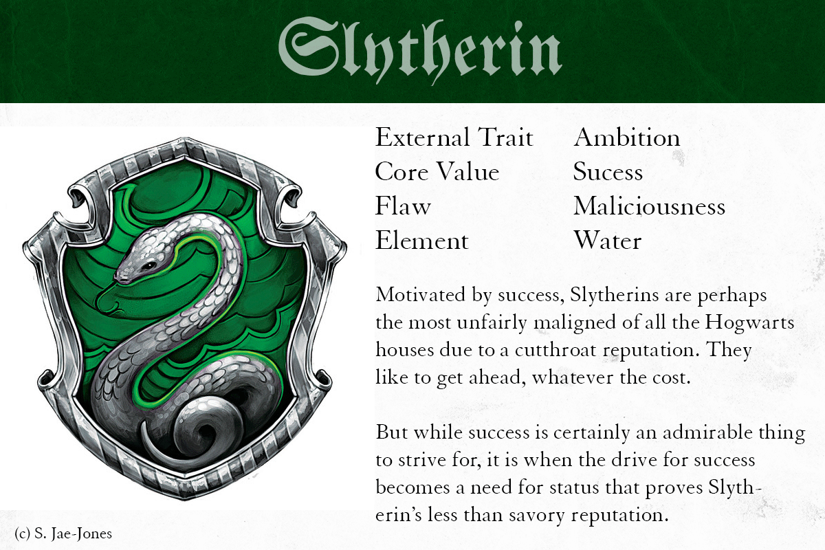

Slide 6


Slide 7
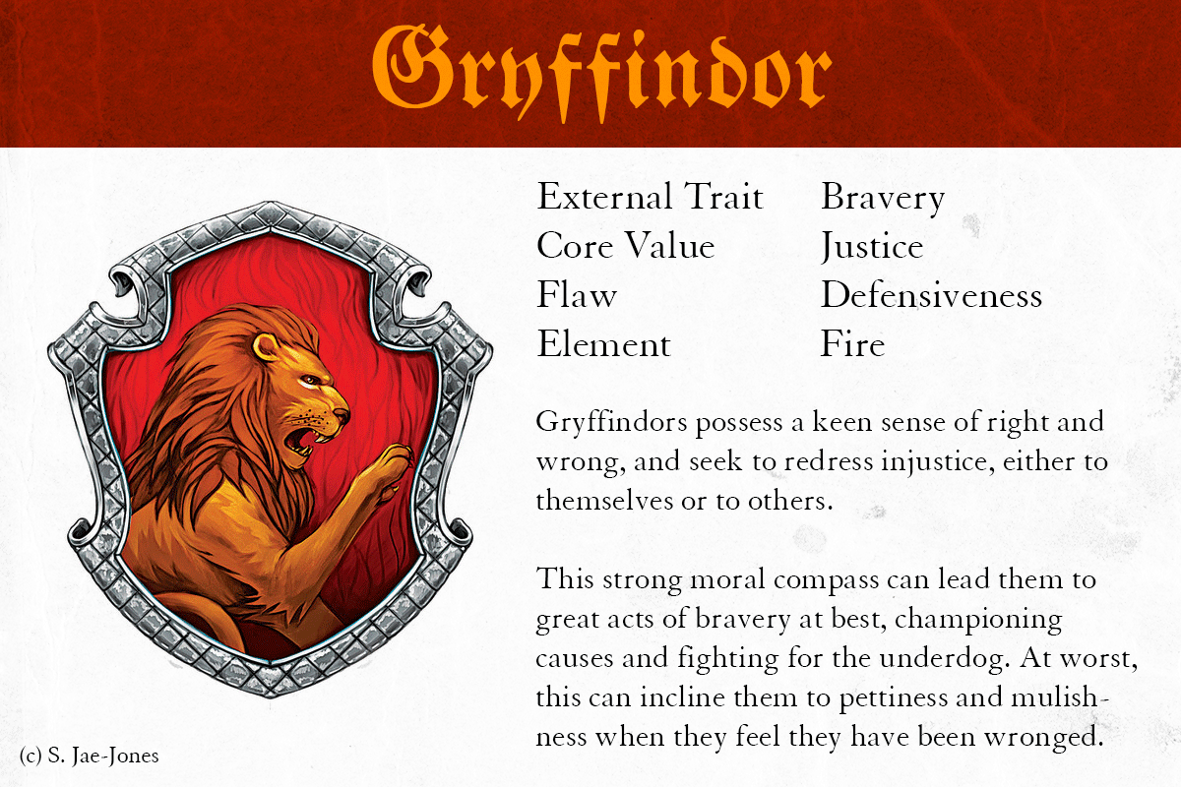

Slide 8
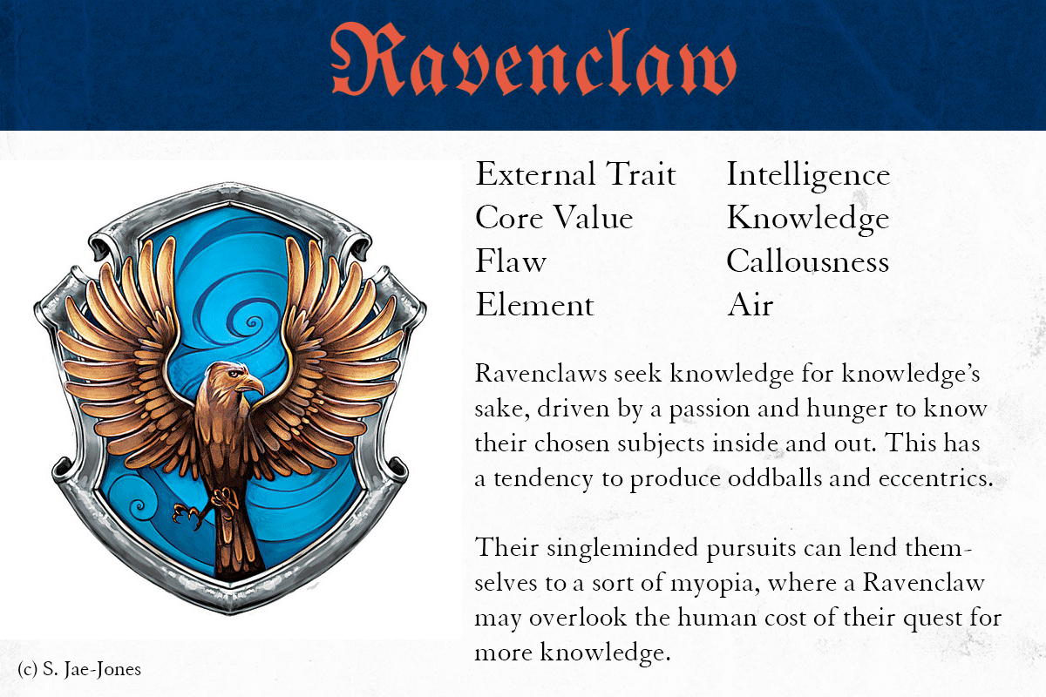

Slide 9
Start of Year
School Setup

Slide 10
Agenda
Years and Terms
Periods
Cycle Days
Bell Schedule
Calendar Setup
Attendance Setup
Final Grade Reporting Term Setup

Slide 11
01
Years and Terms
How to Set up Years and Terms

Slide 12
About Years and Terms
Start Page > School Setup > Years & Terms
Before building out a master schedule in PowerSchool, Years & Terms must be created
-Terms created on the Years & Terms page are “Scheduling Terms." Scheduling Terms define the length of the school year (2023-2024 Year Term) as well as the term-lengths from which you can select when creating sections offered during the school year (2023-2024, S1, Q1, etc.)
-Years & Terms impact many functions in PowerSchool, such as the Calendar Setup, creating Sections, Section Enrollments, and Storing Final Term Grades.
-Setting up school year and associated terms is instrumental, as student scheduling, attendance, and grading are all affected by a school’s terms.
-Classes offered during the school year, in your Master Schedule, dictate scheduling terms and are based on your school’s class lengths(s): Year-long classes, Block A/B classes, Block 4x4 classes, Semester-long classes, Quarter-long classes.
-Schools can choose to only create scheduling terms included in your school’s Master Schedule or create each term applicable to your school year.

Slide 13

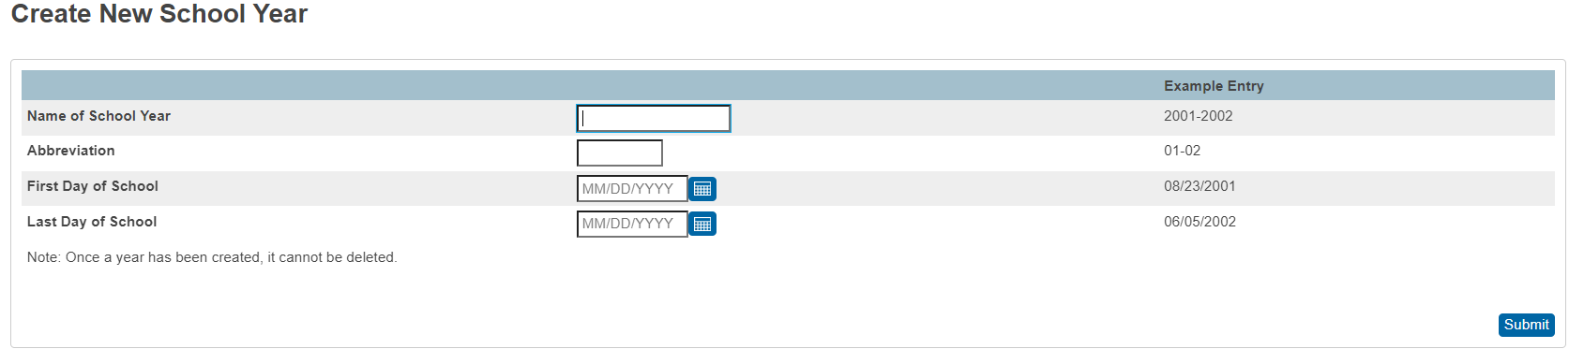
How To Setup the Initial Full Year Term
How to Set Up the Year Term
For the 23-24 school year, each school has their Years and Terms set up. Do not edit a term for your school for the 23-24 school year. You will create issues that only PowerSchool can correct!
From the PowerSchool Homepage, click on School under Setup.
Click on Years & Terms.
Click on the button labeled "New".
Populate the following fields:
  Name of School Year: Enter the two years comprising the school year, such as 2022-2023
  Abbreviation: Enter the year abbreviation, such as 22-23
  First Day of School: Enter the date for the first day of school.
  Last Day of School: Enter the date for the last day of school in the format MM/DD/YYYY.
  Verify that the dates are correct. Note: Dates for the YEAR Term cannot be changed after submitting!
Submit.

Slide 14
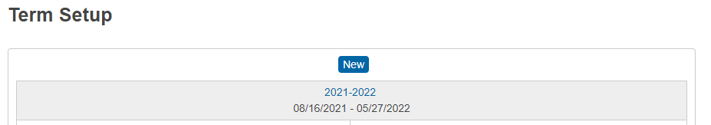
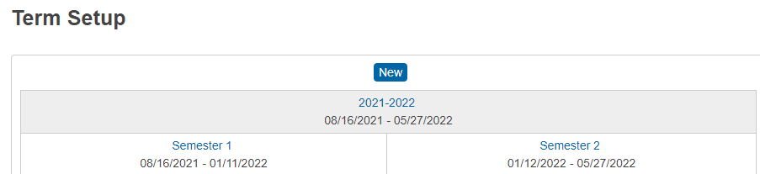
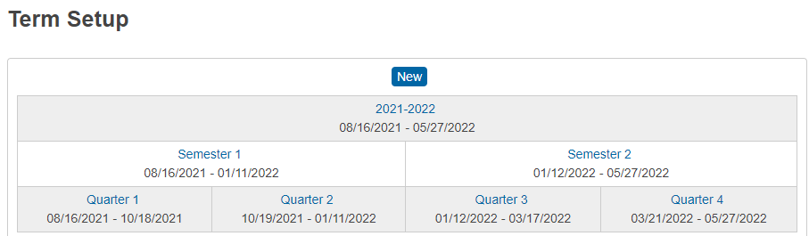
Before Creating Additional Terms
  Know what portion of the school year the term represents: For example, a quarter is typically 1/4 of the school year. A semester is typically 1/2. Verify that the dates are correct. Note: Dates cannot be changed.
  It is mandatory to create your Terms in this order: YEAR, Semester 1, Semester 2, Quarter 1, Quarter 2, Quarter 3, Quarter 4.
    All efforts must be made to create Terms in the correct order.
      A Cantey help ticket is REQUIRED when Terms are created out of order!
      A Cantey help ticket is REQUIRED that Cantey must then send to PowerSchool when the Year Term is wrong.
    Do not create duplicate Terms.
      A Cantey help ticket is REQUIRED when Terms are duplicated!
      A Cantey help ticket is REQUIRED that Cantey must then send to PowerSchool when the Year Term is duplicated.
YEAR Term must be created first.
Semester 1 & 2 Terms must be created next.
Quarter 1 – 4 Terms must be created next.

Slide 15

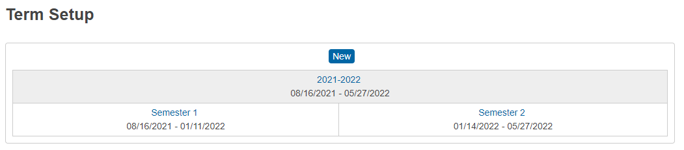


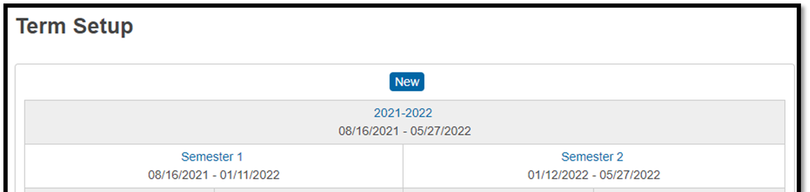
Before Creating Additional Terms
  Terms must be back-to-back and can have no gaps in between the end of one term and the beginning of the next term. Some schools have Seasonal Breaks between terms and your Board Approved Calendar will reflect those dates. In PowerSchool there can be no gaps between Terms in your Years & Terms.
  For Example:
  Invalid Term Dates with Gaps: S1 end date = 1/30/2022 S2 start date = 2/9/2022
  Valid Term Dates with no Gaps: S1 end date = 1/30/2022 S2 start date = 1/31/2022

Slide 16
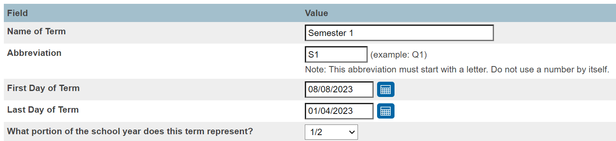
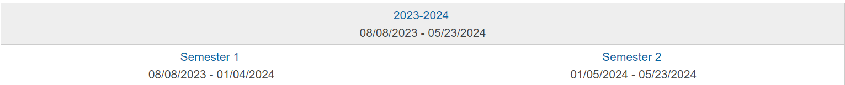
Creating Additional Terms
From the PowerSchool Homepage, click School then on Years & Terms.
Click on the Edit Terms link for the appropriate school year.
Click the "New" button at the bottom of the screen.
Name of Term: Enter the full name of the term, such as Semester 1. Do not include the name of the year, such as 2021-2022 Semester 1, only include the text Semester 1.
Abbreviation: Enter an abbreviation for the term, such as S1. The abbreviation must be unique among all terms belonging to the current school year.
First Day of Term: Enter the first day of the term. Term dates cannot overlap. If Semester 1 ends on 1/04/2024, then Semester 2 cannot start earlier than 01/05/2024.
Last Day of Term: Enter the last day of the term. Term dates cannot overlap even one day.
Submit and repeat until each Term is created.

Slide 17
02
Periods
How to Set up Periods

Slide 18

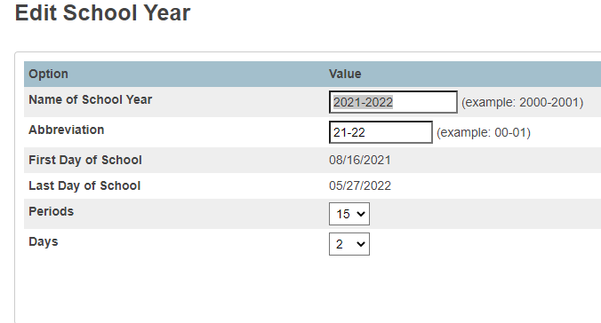
Periods: Selecting How Many Are Needed
The number of Periods needed to setup your Bell Schedule and create your Sections is selected from your schools Year Term.
PS Start Page > School > Years & Terms > Year Term.
Select from the Periods dropdown the number of Periods you will need to create a functioning schedule in PowerSchool.
Changing the number of Periods (decreasing or increasing) after school has started will result in associated data being permanently deleted or orphaned and is NOT recommended. Instead, it is HIGHLY RECOMMENDED to, during the summer, select more Periods than needed.
For elementary schools, think of Periods as placeholders rather than timeslots. For Homeroom, one Period is needed to define in the Bell Schedule and placeholder Periods are needed for each subject (core and related arts) to create sections.
For middle and high schools, defined Periods are required for each meeting or class.
Total up all Periods needed + 2 and make your selection.

Slide 19
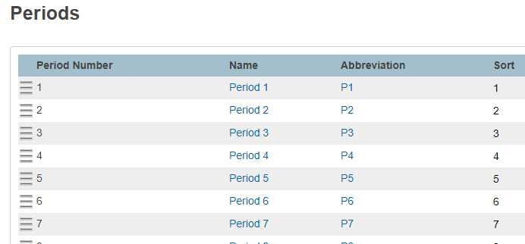
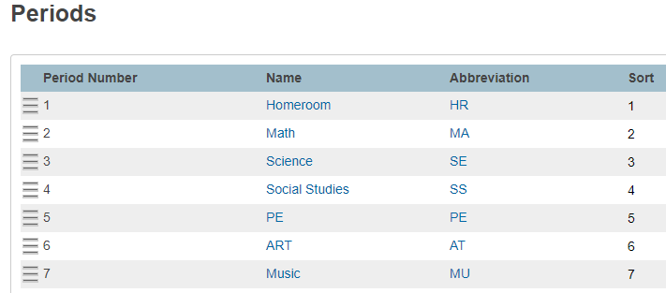
Periods: Renaming and Sorting
Periods can be named and sorted.
Start Page > School > Periods (under Scheduling header)
To Re-name a Period, click on the Period Name or Abbreviation
To sort the Periods, click and drag the three lines to create the desired order. The Period Sort impacts functions in PowerSchool including the order in which classes appear on Report Card Templates and Class Rosters (PDF) Reports.
Recommendation: Use naming conventions to easily identify which Periods are associated with which clusters (K-8 or K-12, or 6-8) or specific classes.
Before Renaming the Periods and Abbreviations After Renaming the Periods and Abbreviations

Slide 20
03
Cycle Days
How to Set up Cycle Days

Slide 21
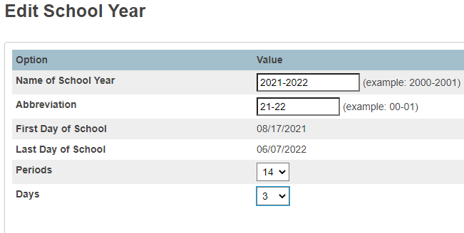
Cycle Days: Selecting How Many Are Needed
A Cycle Days are the number of differing Days included in your schools unique Master Schedule. Only one Cycle Day can be applied to each day in the PowerSchool Calendar.
The number of Cycle Days needed to setup your Calendar and create your Sections is selected from your schools Year Term.
PS Start Page > School > Years & Terms > Year Term.
Select from the Days dropdown the number of Cycle Days you will need to create a functioning schedule in PowerSchool.
Changing the number of Periods (decreasing or increasing) after school has started will result in associated data being permanently deleted or orphaned and is NOT recommended. Instead, it is HIGHLY RECOMMENDED to, during the summer, select the exact number of Cycle Days needed.
When student schedules are the same day after day, use one Cycle Day.
When student schedules differ from day to day due to daily or weekly rotations, use multiple Cycle Days to accommodate scheduling needs (this helps prevent create overlapping enrollments) for:
  Related Arts
  Exploratory Offerings
  VSC Classes
  Dual Enrollment Classes
  Credit Recovery Courses

Slide 22

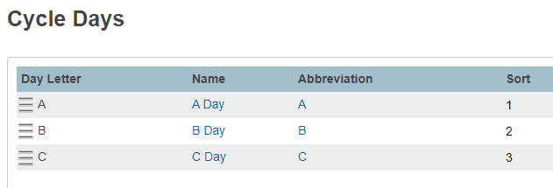
Cycle Days: Renaming and Sorting
Cycle Days can be named and sorted.
Start Page > School > Days (under Scheduling header)
To Re-name a Day, click on the Day Letter Name or Abbreviation
To sort the Days, click and drag the three lines to create the desired order. The Day Sort impacts functions in PowerSchool including the order in which classes appear on Report Card Templates and Class Rosters (PDF) Reports.
Recommendation: Use naming conventions to easily identify which Days are associated with which rotations (A Day, B Day C Day or Blue Day, Gold Day, or Leap Day).

Slide 23

Cycle Days: Simple Examples
No Cycle Days: Use A Day only
2 Cycle Day Rotation: Use A/B Day rotation to assign every other in-session day as an A or B day.
2 Cycle Day Assignment: Use A and B days to assign every Monday-Wednesday-Friday as an A day and every Tuesday-Thursday as a B Day.
5 Cycle Day Assignment: Use A-B-C-D-E Days to assign every Monday as an A Day, every Tuesday as a B Day, every Wednesday as a C Day, every Thursday as a D Day, and every Friday as an E Day.

Slide 24
Cycle Days: Complex Examples
2 Cycle Day Rotation and 5 Cycle Day Assignment Combined: Elementary Students are on a M-T-W-H-F assignment for Related Arts. Middle School Students are on an A/B rotation for Related Arts. Make the two differing schedules work utilizing 10 cycle days (A-J):
Week One
A Day | B Day | A Day | B Day | A Day
Monday (A) | Tuesday (B) | Wednesday (C) | Thursday (D) | Friday (E)
Week Two
B Day | A Day | B Day | A Day | B Day
Monday (F) | Tuesday (G) | Wednesday (H) | Thursday (I) | Friday (J)
2 Cycle Day Rotation, 3 Cycle Day Assignment, and 2 Cycle Day Assignment Combined: Related Arts are on an A/B Rotation and Sci and SS are on a M-W-F and T-H Rotation. Make the three differing schedules work utilizing 10 cycle days (A-J):
Week One
A Day | B Day | A Day | B Day | A Day
Monday (A) | Tuesday (B) | Wednesday (C) | Thursday (D) | Friday (E)
Sci | SS | Sci | SS | Sci
Week Two
B Day | A Day | B Day | A Day | B Day
Monday (F) | Tuesday (G) | Wednesday (H) | Thursday (I) | Friday (J)
Sci | SS | Sci | SS | Sci

Slide 25
04
Bell Schedules
How to Set up Bell Schedules

Slide 26

About Bell Schedules
SCDE Bell Schedule Setup Compliance:
The Bell Schedule is directly associated with Calendaring: Accountability (minute requirements), average daily attendance values (ADA), and average daily membership values (ADM). The Bell Schedule is not about scheduling students in classes.
Bell Schedules, as applicable for Meeting and/or Daily attendance, should be designed following SCDE procedures.
To identify students accurately for Chronic Absenteeism, the SCDE worked with PowerSchool to customize and implement procedures for Bell Schedule Setups.
These specific setups are “necessary for students to be flagged appropriately for Chronic Absenteeism so that accurate reports can be provided to school and district administrators, state and federal entities.” The outlined procedures recommend:
  One Homeroom Period defined for (DAILY) elementary school grade levels (PreK – 5th*).
  Each meeting/class Period defined for (MEETING) middle and high school grade levels (6th - 12th*).
* When a Charter (contract) states that 6th grade is included in an elementary program, 6th grade can be included in Daily.
General Information:
Periods included in the Bell Schedules indicate the start and end times for each defined Period. One Bell Schedule is assigned to each Calendar Cycle Day, and indicates which Periods are in session on a given day.
Returning schools will EDIT existing Bell Schedules that Roll Over from the previous school year.
New schools will create a Bell Schedule with defined periods using the Add button.

Slide 27
About Modified Bell Schedules
Schools can opt to create and utilize modified Full Day Bell Schedules to accommodate a half day, early release day, or delayed arrival day with the understanding that only ONE Bell Schedule is assigned per day in the PowerSchool Calendar.
Modified Bell Schedules are created in addition to the Regular Day/Full Day Bells Schedule.
Modified Bell Schedules must work with the assigned Cycle Days in the PowerSchool Calendar.
Modified Bell Schedules must work with the existing defined Periods in the Full Day/Regular Day Bell Schedule.
  Meeting Students (6th – 12th): Start and End Times must be adjusted for each defined Period to accommodate for the reduced time spent in classes on shortened school days.
  Daily Students (K – 5th): Start/End Times and Time In/Time Out must be adjusted for the one defined Period to accommodate for the reduced time spent at school on shortened school days.
Modified Bell Schedules are not required.
When a Modified Bell Schedule is not assigned in the PowerSchool Calendar on a half day, early release day, or delayed arrival day, the school is responsible for designing and implementing a plan for accurate Attendance submissions for all defined Periods.
Schools are responsible for making sure Modified Bell Schedules work appropriately in PowerSchool prior to the occurrence of a half day, early release day, or delayed arrival day. No Bell Schedule, including Modified Bell Schedules, can be adjusted after school starts.

Slide 28
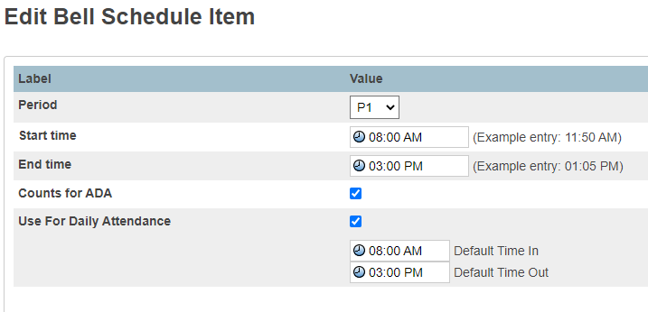
Elementary School Bell Schedule
Elementary Schools that take daily attendance will only define one period (Homeroom) in the bell schedule.
This period will be set up with the start time & end time matching the Default Time in and the Default Time Out.
Check BOTH Counts for ADA and Use For Daily Attendance.
The additional periods created for elementary grades (placeholder periods) will be used when setting up sections and are NOT defined in the Bell Schedule.

Slide 29
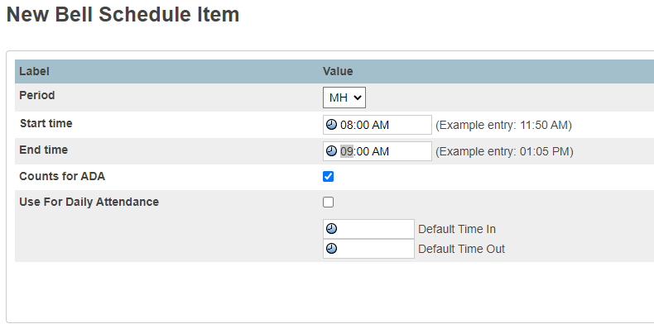
Middle and High School Bell Schedule
  For middle school & high school define a period for each class a student can take in a day.
  Add Start and End Times. Periods cannot have overlapping Start/End Times.
  Make sure that every defined period has “Counts for ADA” checked. Only Exception for SCDE Compliance: School choosing to define a period for “Lunch”.
  Do not check Use For Daily Attendance.
  Do not populate the Default Time In or Default Time Out.

Slide 30
K-8 and K-12 Bell Schedules
One period must be defined for Elementary Homeroom.
  This period is defined with the start time & end time matching the Default Time In and the Default Time Out.
  Check BOTH Counts for ADA and Use For Daily Attendance.
  The additional periods created for elementary grades (placeholder periods) are used when setting up sections and are NOT defined in the Bell Schedule.
All other defined periods in the Bell Schedule are for middle & high school grades.
  Define a period for each class a student can take in a day.
  Add Start and End Times. Periods in the student’s schedule cannot have overlapping Start/End Times.
  Make sure that every period (except Lunch) has “Counts for ADA” checked.
  Do not check Use For Daily Attendance.
  Do not populate the Default Time In or Default Time Out.
It is recommended to add a Homeroom or Advisory period specifically for Middle School Homeroom and High School Homeroom. Do not use the Elementary Homeroom Period for Middle or High School.

Slide 31
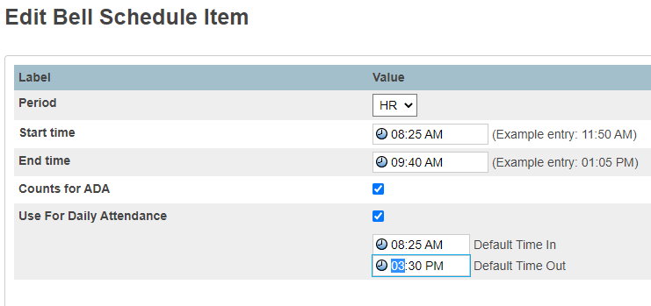
Returning Elementary School’s Bell Schedules
Returning Elementary Schools:
Edit Schedule > Period Abbreviation.
Then make any needed edits to Start & End Time and Default Time In & Default Time Out
Example of a Correctly setup Bell Schedule for Elementary
Example of an Incorrectly setup Bell Schedule for Elementary
Do not set up an Elementary Bell Schedule this way.

Slide 32
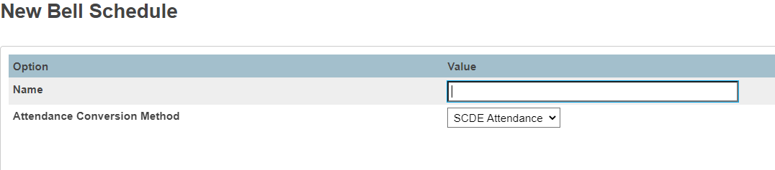
New Elementary School’s Bell Schedules
New Elementary Schools:
Bell Schedule > New
Type a Name for your Bell Schedule (ex: Regular Schedule)
Then Submit
Then click the blue Edit Schedule Link
Click New to Add your Elementary Homeroom Period
Populate Fields

Slide 33
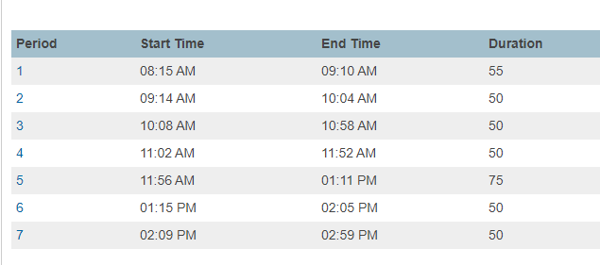
Returning Middle/High School’s Bell Schedules
Returning Middle and High schools:
Edit Schedule > Period Abbreviation
Then make any needed edits to Start & End Times

Slide 34
New Middle/High School’s Bell Schedules
New Middle/High Schools:
Bell Schedule > New
Type a Name for your Bell Schedule (ex: Regular Schedule)
Then Submit
Then click the blue Edit Schedule Link
Click New to Add your Middle and High School defined Periods
Populate Fields
Repeat for each needed defined Period

Slide 35
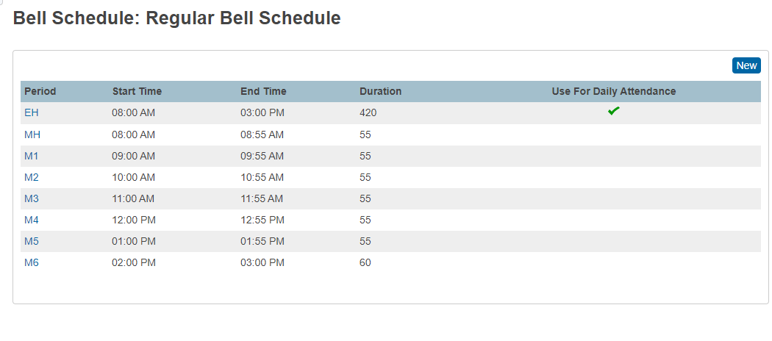
Returning K-8 & K-12 School’s Bell Schedules
Returning K8 and K-12 schools:
Edit Schedule > Period Abbreviation
Then make any needed edits to Start & End Times.

Slide 36
New K-8 & K-12 School’s Bell Schedules
New K8 and K-12 schools:
Bell Schedule > New
Type a Name for your Bell Schedule (ex: Regular Schedule)
Then Submit
Then click the blue Edit Schedule Link
Click New to Add your Middle and High School defined Periods
Populate Fields
Repeat for each needed defined Period

Slide 37
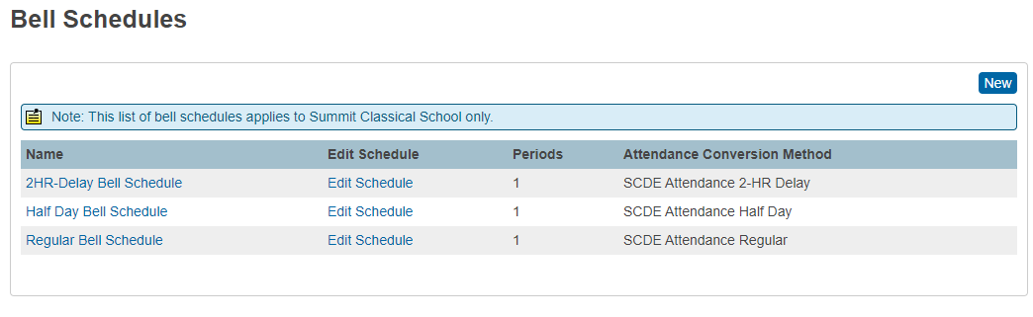
Creating Modified Day Bell Schedules
Schools can opt to create and utilize modified Full Day Bell Schedules to accommodate a half day, early release day, or delayed arrival day with the understanding that only ONE Bell Schedule is assigned per day in the PowerSchool Calendar.
Follow protocol and steps outlined in the previous slides when creating Modified Day Bell Schedules.
The below image is a common example for half-days with early dismissal or late arrival days (due to inclement weather).

Slide 38
05
Calendar Setup
How to Set up Your Calendar

Slide 39

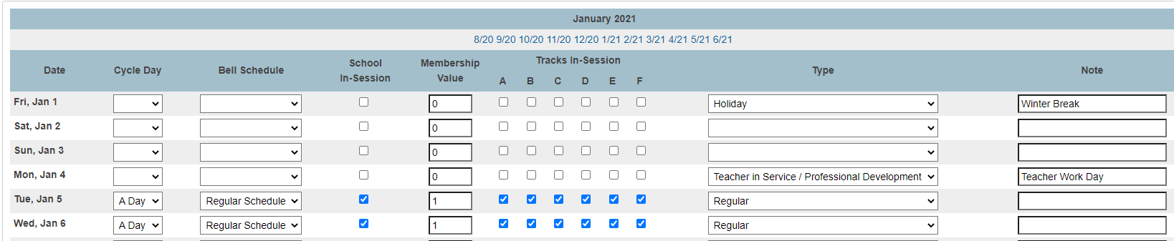
About the PowerSchool Calendar
For funding and accountability purposes, the number of days in each school’s calendar marked as “In Session” and “In Membership” must equal 180 after all makeup and forgiven days are accounted for. Operating outside of this specification could affect accountability and/or funding reports.
The PowerSchool Calendar must include:
An overall total of at least 180 in-session days
Cycle Day, Bell Schedule, School-In Session, Membership Value for all In-Session Days
When applicable, select the Type and add a Note (common for not in-session days).
Tracks are checked by default.
Contact your District with questions about makeup days that fall outside of your 180-day calendar.

Slide 40
Set Up Your PowerSchool Calendar
Blue Links for MM/YY appear at the top of the Calendar. Only one month can be setup at a time. Use the blue MM/YY links to move from month to month.
From the dropdown select a Cycle Day and Bell Schedule
Add a check when the day is an In-Session school day
Add a Membership Value of 1 for an In-Session school day and a Membership Value of 0 for not In-Session Days.
When applicable select the Type and add a Note (common for not in-session days).
Tracks are checked by default.
Submit and repeat for each month included in your Calendar until each month is complete and submitted.

Slide 41
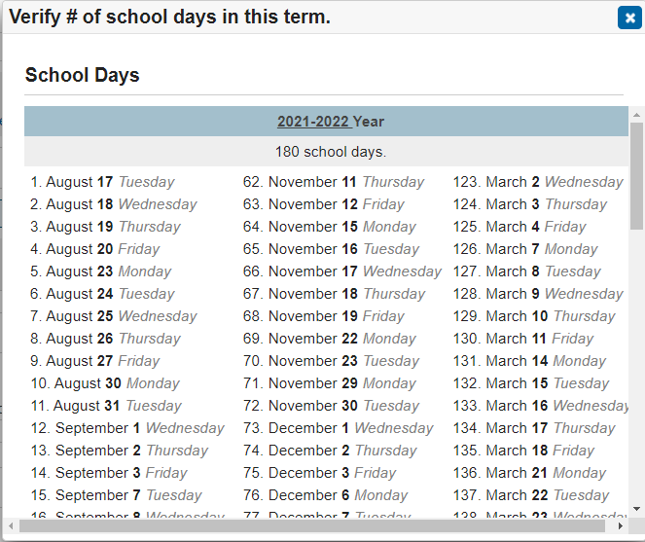
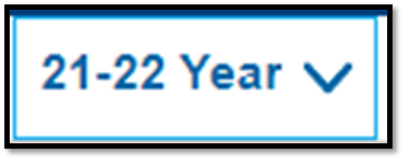

After PowerSchool Calendar and Years & Terms Setup
Check for minimum 180 in-session days. Most schools have 180 days in the school calendar; however, if your school runs a Year-long calendar, you may have more than 180 days.
Make sure the Term select from the upper right corner of the PowerSchool page in the Full Year Term.
There are two ways to verify the number of in-session days in your school calendar:
  Click on the calendar icon next the Year Term
  At the bottom of the calendar page, click on View the number of in session days in the term.
Verify the number of school days is at least 180. If not, go back to your calendar and make corrections.

Slide 42
06
Basic Attendance Setup
How to Set up Attendance

Slide 43

About Attendance
Per the SCDE:
  Elementary School (Grades K – 5) – can take daily attendance or meeting attendance. This is the decision of the school. Exception: Charter schools who charter states 6th grade is elementary.
  Middle School (Grades 6 – 8) – can only take meeting attendance.
  High School (Grades 9 – 12) – can only take meeting attendance.
  Kindergarten – 12th Grade Schools – Grades K – 5 (including the exception above) can be set up to take daily or meeting attendance. Grades 6 – 12 (middle school/high school) can only take meeting attendance.
  Schools are not allowed to take meeting and daily attendance for middle school and high school student. Only meeting attendance.
  Can only be the SCDE 35 approved attendance codes.
  School and districts are no longer allowed to use their own custom attendance codes

Slide 44
Attendance Codes
Code | Description | Present/Absent | Excused/Unexcused Absences | Detailed Descriptions
 | Present | Present | N/A | Student is present for the day. By default, a student is considered present.
SC-UNEX | Unexcused/Unverified | Absent | Unexcused | Student is absent with no excuse that applies to the school attendance policy.
SC-EX | Excused | Absent | Excused | Student is absent with an excuse that is outlined in the school attendance policy.
SC-PA | Principal Approved | Absent | Excused | Student is absent due to activities that are approved in advance by the principal.
SC-MED | Medical | Absent | Excused | Student is absent because of a medical issue and the school attendance policy is followed.
SC-FLU | Flu-Influenza | Absent | Excused | Student is absent because of Flu-Influenza and COVID-19. Note: COVID-19 will have to be entered into the attendance comments.
SC-PN | Parent Note | Absent | Excused | Student is absent from school and parents have sent a note with a valid explanation outlined in the school attendance policy.
SC-UEPN | Unexcused Parent Note | Absent | Unexcused | Student is absent from school and parents has sent a note, but the reason is not valid according to the school attendance policy or parent has reached the max number of parent notes accordingly to the school attendance policy.

Slide 45
Attendance Codes
Code | Description | Present/Absent | Excused/Unexcused Absences | Detailed Descriptions
SC-IMNZ | Immunization | Absent | Excused/Unexcused | Student is absent because they must get a valid South Carolina up to date immunization shot record sheet. The school must choose at the beginning of the year if this attendance code is an Excused or Unexcused (this should not be change).
SC-AH | Administrative Hearing | Absent | Excused | When a student is absent from school so they can attend a hearing pertaining to a disciplinary action when all interventions at the school level are exhuasted.
SC-ETRD | Excused Tardy | Present | N/A | When a student is tardy for school.
SC-BTRD | Bus Tardy | Present | N/A | When a student is tardy due to a bus route being late or a bus maintenance issue.
SC-UTRD | Unexcused Tardy | Present | N/A | A student is tardy with out an excuse or has been excessively tardy which is outlined by the school attendance policy.
SC-HMBD | Homebound | Present | N/A | A student must fill out a form and be approved by the district to assign them the Homebound attendance code in PowerSchool.
SC-HBSD | Homebased Instruction | Present | N/A | Homebased instructions has to be defined in a student EIP to use as an attendance code.
SC-FT | Field Trip/School Activity | Present | N/A | Student misses instructional time at school due to a sponsored school trip.

Slide 46
Attendance Codes
Code | Description | Present/Absent | Excused/Unexcused Absences | Detailed Descriptions
SC-REL | Religious | Absent | Excused | Student is absent due to a recognized religious holiday of the student’s faith.
SC-OSS | Out of School Suspension (OSS) | Absent | Excused | Student must serve a suspension off school property.
SC-WTHR | Weather | Absent | Excused | Student is absent from school due to inclement weather.
SC-LEG | Legal/Court | Absent | Excused | Student is absent from school to attend a judicial hearing or commitment.
SC-COL | College Visit | Present | N/A | Student gets principal approval to be absent from school to visit a secondary learning institution.
SC-REC | Attendance Recovery/Saturday Recovery | Absent | Excused | Student was absent for a high school credit course but meets the requirement to make up the credit hours.
SC-ONST | On Site Services | Present | N/A | Student is on school property, but they are not participating in their normal instructional learning/seat time. Ex. Testing in another room.
SC-ISS | In School Suspension (ISS) | Present | N/A | Student has to serve a suspension on school property but outside of normal instructional classes.
SC-BRV | Bereavement/Death in Family | Absent | Excused | Student is absent from school because they had to attend a funeral of a close relative.

Slide 47
Attendance Codes
Code | Description | Present/Absent | Excused/Unexcused Absences | Detailed Descriptions
SC-DSML | Dismissal | Absent | Excused/Unexcused | Student leaves school before the end of the day and attend less than 50% of the school day. The school must choose at the beginning of the year if this attendance code is an Excused or Unexcused (this should not be change).
SC-EDSM | Early Dismissal | Present | N/A | Student leaves school before the end of the day and attended 50% or more of the school day.
SC-UEDM | Unexcused Early Dismissal | Present | N/A | Student excessively leaves school before the end of the day and attended 50% or more of the school day.
SC-CKIN | Check-in | Present | N/A | This code should be used if a student leaves school for an appointment and returns to school. The student must have attended school for 50% or more of the school day.
SC-SKIP | Skip Code | Absent | Unexcused | This code should be used if the student is deliberately not attending class without parent or school approval.
SC-LATE | Late Arrival | Absent | Unexcused | This code should be used if a student is extremely late to school, without an excuse. The student attended less 50 percent of the school day.
SC-NURS | Nurse | Absent | Excused | This code should be used when the nurse sends a student home for the day based on DHEC exclusion list, and if the student must remain home the next day.
SC-VTP | Virtual Present Code | Present | N/A | This code should be used to record attendance for virtual instruction. This a present code, which should be entered on the days or class periods for which a student is expected to receive virtual instruction.
SC-COVD | COVID | Absent | Excused | Students who are not physically present due to COVID-19 (isolation or quarantine) and are physically unable to complete assignments should be considered absent and be coded using SC-COVD

Slide 48
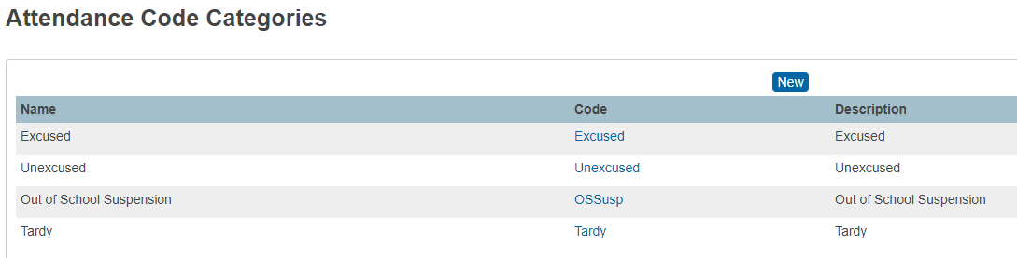
Attendance Categories
Attendance Code Categories
  Can only be the SCDE 4 approved attendance codes.
  School and districts are no longer allowed to use their own custom attendance codes categories

Slide 49
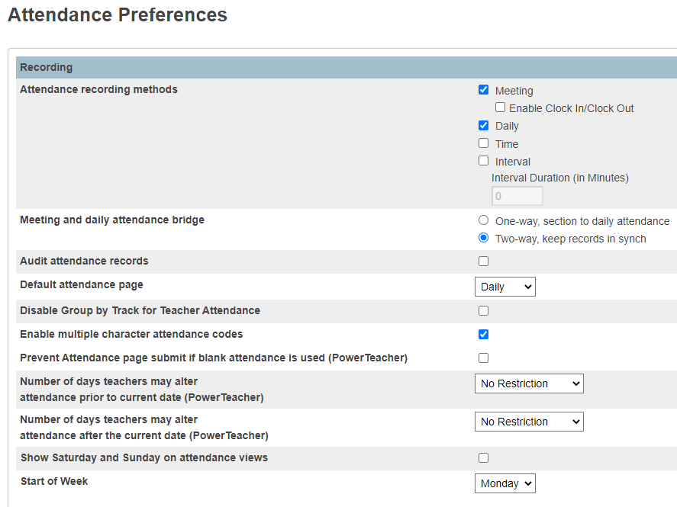
GENERAL ATTENDANCE PREFERENCES
Attendance Preferences are school and school year specific.
PS Homepage > School > Preference (under Attendance)
  For Attendance Recording Methods, check the Meeting and the Daily check boxes
  For Meeting and Daily Attendance Bridge, select the Two-way, keep records in synch radio box
  For the Default Attendance, select Daily for K5 schools; for K-8 or K-12 choose meeting from the dropdown
  For Enable multiple character attendance codes, check the box
Attendance Preferences continue.

Slide 50
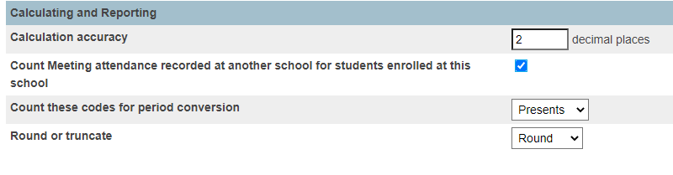
GENERAL ATTENDANCE PREFERENCES
PS Homepage > School > Preference (under Attendance)
  For Calculation Accuracy, type the number 2 (decimal places)
  For Count Meeting attendance recorded at another school for students enrolled at this school, check the check box.
  For Count these codes for period conversion, select Presents from the dropdown
  For Round or truncate, select Round from the dropdown
  Click Submit

Slide 51
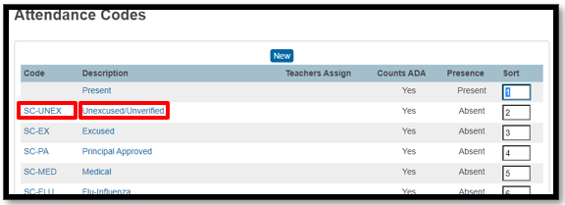
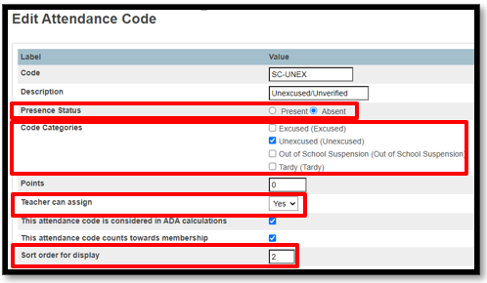
ATTENDANCE CODES
Verify Attendance Codes match SCDE Attendance setups:
PS Homepage > School > Attendance Codes (under Attendance)
Click on Code or Description to open the Edit Attendance Code page
Follow SCDE Attendance Setups to verify the setup for each attendance code for Sort, Presence Status, and Code Category.
  SC-PN, SC-DSML, SC-IMNZ require additional steps (coming up)
  SC-ETRD, SC-UTRD, SC-BTRD require additional steps (coming up)
For Teachers can Assign: Select YES from the dropdown when applicable for your school.

Slide 52
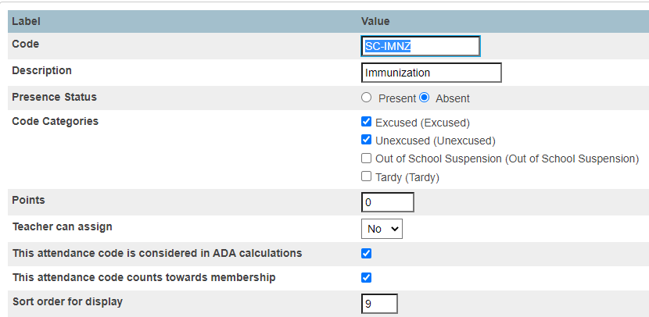
ATTENDANCE CODE SETUP: SC-IMNZ
SC-IMNZ (Immunization):
Both excused and unexcused Code Categories are checked by default.
Schools must check EITHER excused or unexcused. This is a school decision.
Click Submit
Choose only one and Submit

Slide 53
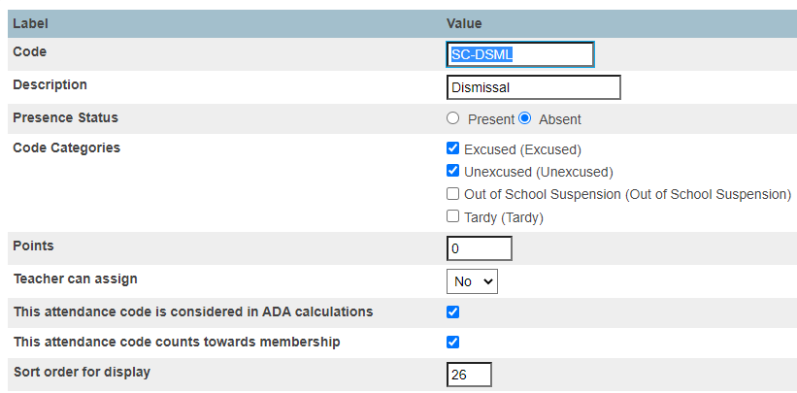
ATTENDANCE CODE SETUP: SC-DSML
SC-DSML (Dismissal):
Both excused and unexcused Code Categories are checked by default.
School must check EITHER excused or unexcused. This is a school decision.
Click Submit
Choose only one and save
Choose one and submit

Slide 54
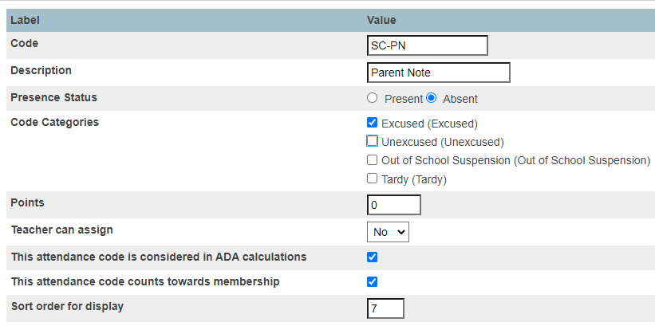
ATTENDANCE CODE SETUP: SC-PN
SC-PN (Parent Note):
Both excused and unexcused Code Categories are checked by default.
Schools must uncheck unexcused and only check excused. This is required.
Click Submit
Choose excused and Submit

Slide 55
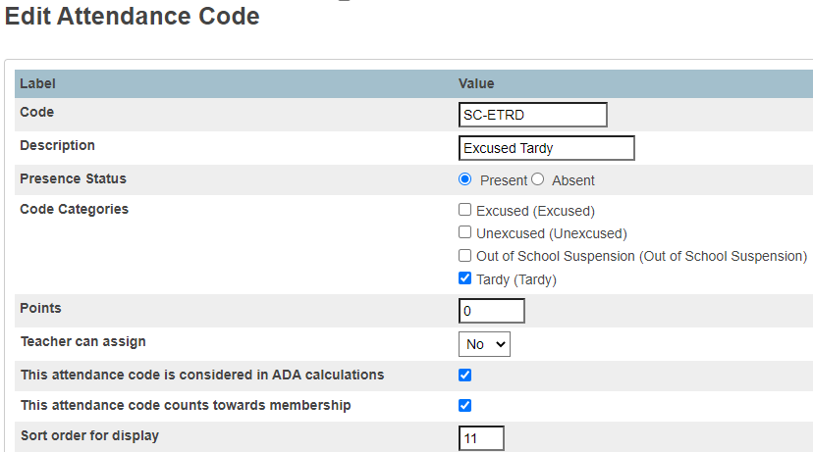
ATTENDANCE CODE SETUP: Tardy
SC-ETRD, SC-UTRD, SC-BTRD:
Schools must only select Tardy as the Code Category.
This is required.
Click Submit
Choose one and save
Choose Tardy and Submit

Slide 56
Adding Attendance Conversions
Attendance Code | Day Value
(Present) | 1
SC-UNEX (Unexcused/Unverified) | 0
SC-EX (Excused) | 0
SC-PA (Principal Approved) | 0
SC-MED (Medical) | 0
SC-FLU (Flu-Influenza) | 0
SC-PN (Parent Note) | 0
SC-UEPN (Unexcused Parent Note) | 0
SC-IMNZ (Immunization) | 0
SC-AH (Administrative Hearing) | 0
SC-ETRD (Excused Tardy) | 1
SC-BTRD (Bus Tardy) | 1
SC-UTRD (Unexcused Tardy) | 1
SC-HMBD (Homebound) | 1
Attendance Code | Day Value
SC-HBSD (Homebased Instruction) | 1
SC-FT (Field Trip/School Activity) | 1
SC-REL (Religious) | 0
SC-OSS (Out of School Suspension (OSS)) | 0
SC-WTHR (Weather) | 0
SC-LEG (Legal/Court) | 0
SC-COL (College Visit) | 1
SC-REC (Attendance Recovery/Saturday Recovery) | 0
SC-ONST (On Site Services) | 1
SC-ISS (In School Suspension (ISS)) | 1
SC-BRV (Bereavement/Death in Family) | 0
SC-DSML (Dismissal) | 0
SC-EDSM (Early Dismissal) | 1

Slide 57
Adding Attendance Conversions
Attendance Code | Day Value
SC-UEDM (Unexcused Early Dismissal) | 1
SC-CKIN (Check-in) | 1
SC-SKIP (Skip Code) | 0
SC-LATE (Late Arrival) | 0
SC-NURS (Nurse) | 0
SC-VTP (Virtual Present Code) | 1
SC-COVD (COVID) | 0
SC-KTST (Kindergarten Testing) | 1

Slide 58
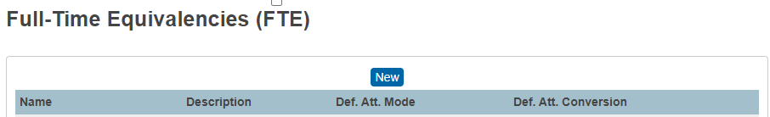
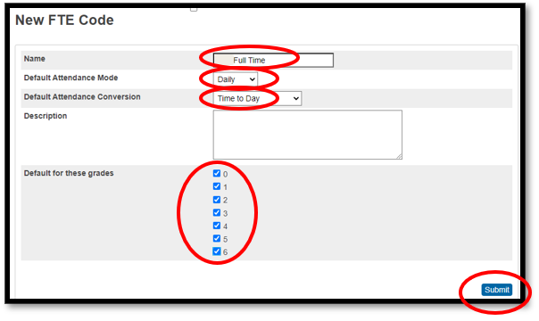
FTE CODE SETUP
Full-Time Equivalencies:
PS Homepage > School > Full Time Equivalencies (FTE) (under Attendance)
Full-time equivalencies (FTEs) determine the attendance value a student receives for instructional time and impacts attendance and membership reports.
  Click the blue New button
  The FTE Name is “Full Time” and is required for all students
  The Default Attendance Code is Daily for Elementary and Meeting for Middle School, High School, K-8 and K-12 Schools
  The Default Attendance conversion is “Time to Day” for all “Full Time” FTEs
  Add a check mark to all for Default for these grades
  Click Submit

Slide 59
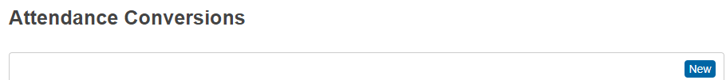
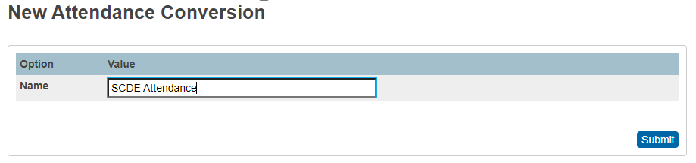
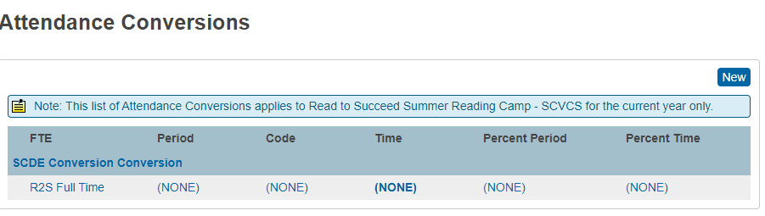
ADDING ATTENDANCE CONVERSIONS
Attendance Conversions:
PS Homepage > School > Attendance Conversions (under Attendance)
Attendance conversions are school and year specific.
  Click the blue New button.
  Name the New Attendance Conversion SCDE Attendance
  Click Submit
Period, Code, and Time should be defined for each “Full Time” SCDE Attendance Conversion.
SCDE Attendance

Slide 60
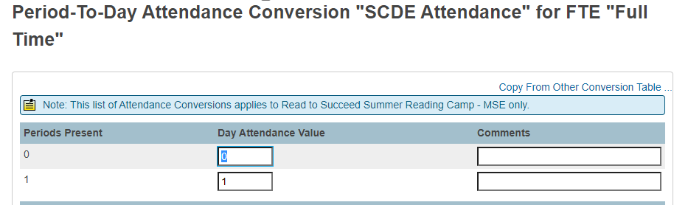
ATTENDANCE CONVERSIONS
Period - To – Day Attendance Conversions:
Period – To – Day should be defined for each “Full Time” SCDE Attendance Conversion
  Click on NONE under Period
  Under Day Attendance Value type 0 for the corresponding Periods Present “0”
  Under Day Attendance Value type 1 for the corresponding Periods Present “1”
  Click Submit
SCDE Attendance

Slide 61
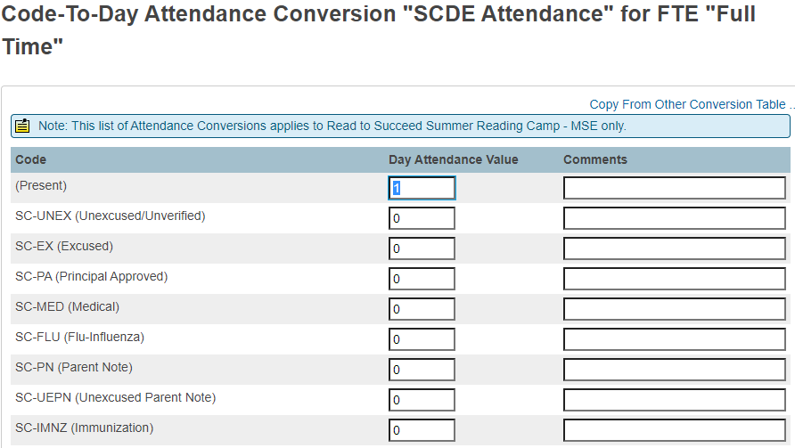
ATTENDANCE CONVERSIONS
Code - To – Day Attendance Conversions:
Code – To – Day should be defined for each “Full Time” SCDE Attendance Conversion
  Click on NONE under CODE
  Under Day Attendance Value:
    type a 1 for Present Attendance Codes
    type a 0 for Absent Attendance Codes
  Click Submit
NOTE: Type a value for all Attendance Codes, some may not be pictured.
SCDE Attendance

Slide 62
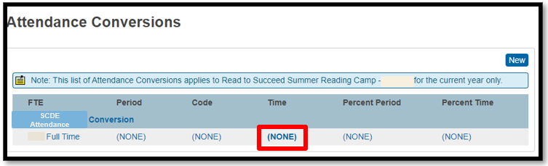
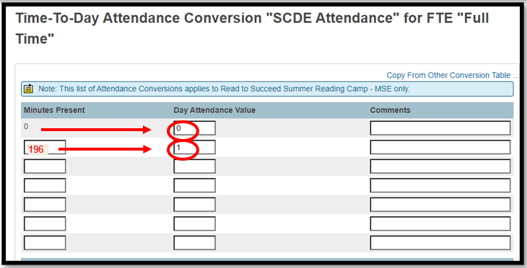
ATTENDANCE CONVERSIONS
Time - To – Day Attendance Conversions:
Time – To – Day should be defined for each “Full Time” SCDE Attendance Conversion
  Click on NONE under Time
  Type a 0 for Day Attendance Value for 0 Minutes Present (first row only)
  In the second row, type the numerical value that is equal to 1 minute more than half the number of minutes defined in the Bell Schedule in the Minutes Present field. Type a 1 for Day Attendance Value in the second row.
    EXAMPLE: If a Bell Schedule includes 390 minutes, the numerical value that is equal to 1 minute more than half the number of minutes defined in the Bell Schedule is 196. Round up if needed.

Slide 63
Attendance in PowerSchool
Attendance should be taken in PowerSchool for every student active at the school. By default, all students are “PRESENT” until an attendance code is entered.
Remember if a student is virtually present for instructional lessons you should enter the attendance code (SC-VTP Virtual Present Code) for the student's attendance.
For Middle School Grades & High School grades it is imperative that attendance be taken EVERY period. If even one teacher does not mark a student absent, Truancy data will be inaccurate and incomplete as it only captures Full-Day absences.

Slide 64
Attendance in PowerSchool
10-Days Consecutive Absent Days: Per the SCDE Pupil Accounting manual “A pupil shall be dropped from membership on the day when the number of unlawful days absent exceeds ten (10) consecutive days (the 11th day) or when the pupil leaves school because of transfer, death, expulsion, graduation, legal withdrawal, or for any other reason.” On the 11th day a student must be transferred out of PowerSchool.
Run the Consecutive Absences report and enter “10” for Number of Consecutive Days to Scan. System Reports > System tab > click Consecutive Absences

Slide 65
07
Final Grade Reporting Term Setup
How to Set up Final Grade Reporting Terms

Slide 66

Agenda
01
What
02
When
What are Final Grade Setups?
When are Final Grade Setups Established?
03
How
04
Where
How are Final Grade Setups Determined?
Where are Final Grade Setups Created?

Slide 67

What are Final Grade Setups?
Final Grade Setups are created annually before school starts to establish your school’s Grading Terms. When creating Final Grade Setups, you will define the begin and end dates of each grading term used at your school for the entire school year. Grading Terms are used by:
  Teachers within PowerTeacher Pro for creating assignments and finalizing Term Grades
  PS Admins within PowerSchool to store grades using the Permanently Store Grades Function
Final Grade setups are not interchangeable with Year & Terms.
  Oftentimes the Starting and/or Ending date of each Final Grade Setup term differs from that of your schools Years & Terms.
  Unlike Grading Terms, Years & Terms are Scheduling Terms.
  Years & Terms typically follow your schools public school calendar and Final Grade Setup Terms are internal terms for schoolteachers and PS Admins.
Final Grade Setups are required to utilize many grade-based reports and features including but not limited to Term Locks and Warnings, Honor Roll Reports, PowerSchool Report Cards, PSCB Custom Grading Reports, and System Individual Student Grading Reports more.

Slide 68
When are Final Grade Setups Established?
Final Grade Setups do not roll over as part of the End of Year Process and MUST be created annually.
Best Practice is for Final Grade Setups to be established in PowerSchool during the summer before school starts.
This allows teachers to, in PowerTeacher Pro, set up Traditional Grade Calculations before school starts which provides an opportunity for the PS Admin to edit the Final Grade Setups when Grading Terms do not properly align.
Waiting until after school starts to establish Final Grade Setups can cause issues for Teachers in PowerTeacher Pro and the PS Admin when attempting to store final term grades.
Attempting to correct mistakes by editing established Final Grade Setups after school starts is sometimes not an option and is not recommended.
Schools with special exam terms needed for courses that require State Mandated EOC Exams (EOC Courses, some Dual Enrollment Courses, and some PLTW courses) must have an Exam Grading Terms that properly aligns otherwise Traditional Grade Calculations cannot be used as intended for accurate grade computations.

Slide 69
How are Final Grade Setups Determined?
Elementary and Middle School (No EOC): Year-long Classes
Before creating Final Grade Setups, determine all Grading Terms that are needed and assign each Term a Begin Date and End Date that result in proper alignment.
Elementary Schools and Middle Schools that do no offer EOC courses will have minimal Final Grade Setups.
Middle Schools that offer EOC courses and High Schools will have a more complex Final Grade Setup.
When you proactively think about how the Grading Terms MUST align for Final Grades to properly compute, the process of creating Final Grade Setups is simplified regardless of whether a minimal or complex setup is needed.
See examples:
Grading Term |  |  | Begin | End
F1 |  |  | 8/15/2023 | 6/1/2024
 | S1 |  | 8/15/2023 | 1/15/2024
 |  | Q1 | 8/15/2023 | 11/1/2023
 |  | Q2 | 11/2/2023 | 1/15/2024
 | S2 |  | 1/16/2024 | 6/1/2024
 |  | Q3 | 1/16/2024 | 3/15/2024
 |  | Q4 | 3/16/2024 | 6/1/2024
Middle School & High School (EOC): Year-long Classes
Grading Term |  |  | Begin | End
F1 |  |  | 8/15/2023 | 6/1/2024
 | S1 |  | 8/15/2023 | 1/15/2024
 |  | Q1 | 8/15/2023 | 11/1/2023
 |  | Q2 | 11/2/2023 | 1/15/2024
 | S2 |  | 1/16/2024 | 5/30/2024
 |  | Q3 | 1/16/2024 | 3/15/2024
 |  | Q4 | 3/16/2024 | 5/28/2024
 | E1 |  | 5/29/2024 | 5/31/2024

Slide 70
How are Final Grade Setups Determined?
High Schools on a block 4 x 4 schedule OR block 4 x 4 plus Year-long combo schedule should consider including an Exam Term for both semesters regardless of whether or not EOC courses are included in each Term.
Course needs for student schedules can and do often change and it’s better to have the Exam Term available in the even it’s needed, after all.
See examples for 4 x 4 block only and 4 x 4 block plus Year-Long Combo
High Schools: 4 x 4 Block Only
High School (EOC): 4 x 4 Block plus Year-Long Classes
Grading Term |  |  | Begin | End
F1 |  |  | 8/15/2023 | 6/1/2024
 | S1 |  | 8/15/2023 | 1/15/2024
 |  | Q1 | 8/15/2023 | 11/1/2023
 |  | Q2 | 11/2/2023 | 1/12/2024
 |  | E1 | 1/13/2024 | 1/14/2024
 | S2 |  | 1/16/2024 | 5/29/2024
 |  | Q3 | 1/16/2024 | 3/15/2024
 |  | Q4 | 3/16/2024 | 5/26/2024
 |  | E2 | 5/27/2024 | 5/28/2024
 | E3 |  | 5/30/2024 | 5/31/2024
Grading Term |  | Begin | End
S1/F1 |  | 8/15/2023 | 1/15/2024
 | Q1 | 8/15/2023 | 11/1/2023
 | Q2 | 11/2/2023 | 1/12/2024
 | E1 | 1/13/2023 | 1/14/2024
S2/F1 |  | 1/16/2024 | 6/1/2024
 | Q3 | 1/16/2024 | 3/15/2024
 | Q4 | 3/16/2024 | 5/29/2024
 | E2 | 5/30/2024 | 5/31/2024

Slide 71

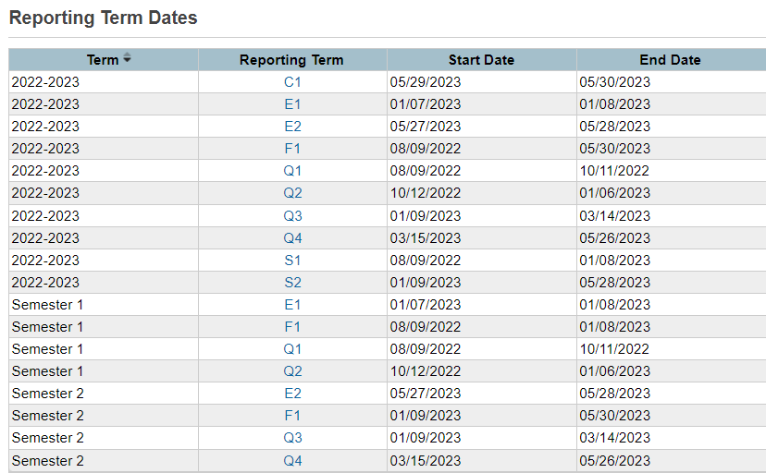
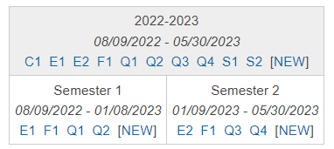
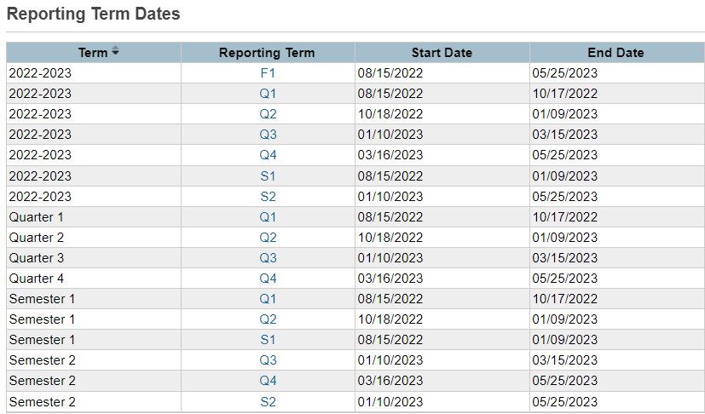
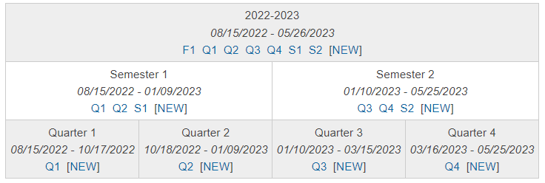
Where are Final Grade Setups Created?
PS Start Page > School > Final Grade/Reporting Term Setups (under the Grading header)
Schools with no Final Grade Setups created look like the image displaying only the Year Term, the begin and end date for the Year Term, and the word NEW linked in blue.
The order in which Final Grade Setups are created does not matter (contrary to the order in which Years & Terms are created).
Final Grading Terms must be created for each Term in which the Grading Term Exists.

Slide 72
Where are Final Grade Setups Created?
PS Start Page > School > Final Grade/Reporting Term Setups (under the Grading header)
Schools with no Final Grade Setups created look like the image displaying only the Year Term, the begin and end date for the Year Term, and the word NEW linked in blue.
The order in which Final Grade Setups are created does not matter (contrary to the order in which Years & Terms are created).
Final Grading Terms must be created for each Term in which the Grading Term Exists.

Slide 73
Thanks!
Questions or Concerns?

Slide 74





Creating Course Sections

Slide 75


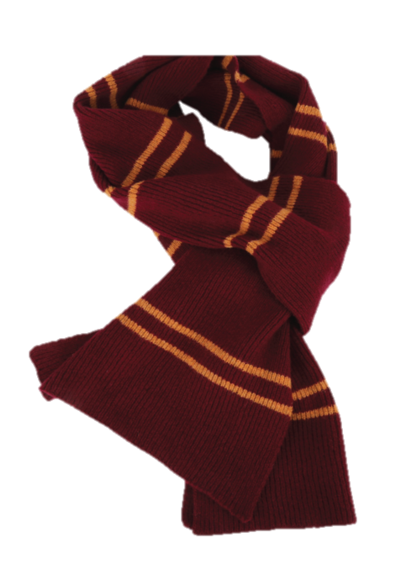
What is a Course Section?

Slide 76


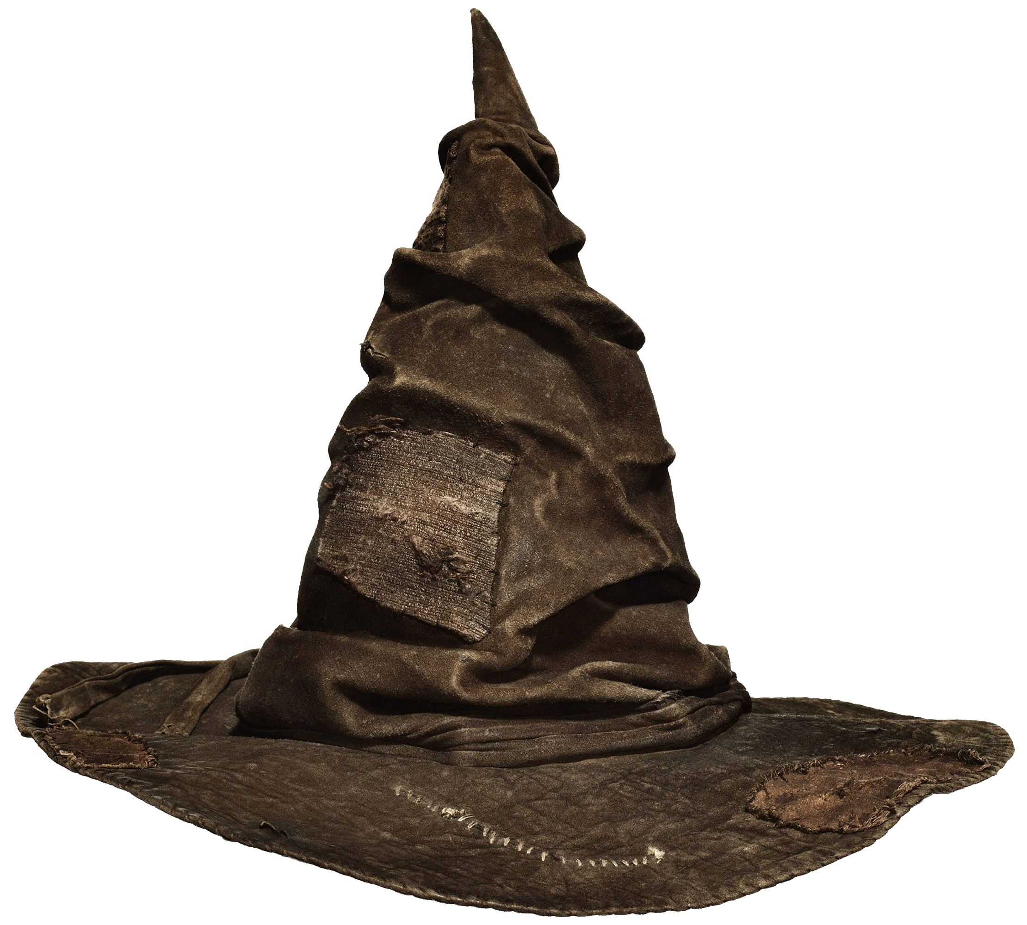
What is a Course Section?
A SECTION is an occurrence of a course, often called the class, in which the student is scheduled. Each course can have several sections that meet in different rooms at different times and are taught by different teachers.
Section are differentiated by the “Section Number”. Section numbers must be unique among sections of the same course for a given school year.
EXAMPLE 1: ELEMENTARY MATH
A school has an elementary Math course; however, because there are too many students for one class, there are two sections of Math.
Two different teachers instruct Math for 1 period each. Thus, the school has two sections of Math.
Each section has a different number, usually preceded by the same course number to indicate that it is part of the same Math course.
Each section has an associated schedule expression, which is the combination of periods and days in which this section is taught.
Ms. Brown’s 2nd Grade Class
Math P2(AB) 111000000.2A
Math
111000000
Mr. Green’s 2nd Grade Class
Math P2(AB) 11100000.2B

Slide 77
What is a Course Section?
A SECTION is an occurrence of a course, often called the class, in which the student is scheduled.
Each course can have several sections that meet in different rooms at different times and are taught by different teachers.
Sections are differentiated by the “Section Number”.
Section numbers must be unique among sections of the same course for a given school year.
EXAMPLE 2: HIGH SCHOOL ART 3
A school has a high school Art 3 course; however, because there are too many students for one class, there are four sections of Art 3.
One teacher instructs Art 3 for 4 periods. Thus, the school has four sections of Art 3.
Each section has a different number, usually preceded by the same course number to indicate that it is part of the same Art 3 course.
Each section has an associated schedule expression, which is the combination of periods and days in which this section is taught.
Art 3 P1(A) 350300CW.101
Art 3 P2(A) 350300CW.102
Art 3
350300CW
Art 3 P1(B) 350300CW.103
Art 3 P2(B) 350300CW.104

Slide 78

Before Creating Course Sections

Slide 79
Before Creating Sections
Important to know BEFORE creating sections:
Sections can impact reporting in PowerSchool for:
Attendance, Chronic Absenteeism, and Truancy
Honor Roll, GPA, and Class Rank
Grade Scales and Stored Grades
Maximum Class Enrollments
Validations
When scheduling students DO NOT OVERLAP their sections.
Section Term Lengths have specific start and end dates.
These dates are based on Years and Terms.
Students cannot have overlapping section enrollments.
  EX: Student Schedule P1(A) PE, P1(B) Art, P1(C) Music = OK
  EX: Student Schedule P1(A) PE, P2(A) Art, P3(A) Music = OK
  EX: Student Schedule P1(A) PE, P1(A) Art, P1(A) Music = Not OK
Cycle Day | P1
A Day | PE
B Day | Art
C Day | Music
Cycle Day | P1 | P2 | P3
A Day | PE | Art | Music
Before creating sections, these must be entered and/or setup in PowerSchool first:
Students
Teachers
Cycle Days
Periods
Years and Terms
Calendar Setup (recommended)
Cycle Day | P1
A Day | PE
 | Art
 | Music
Finalize the Master Schedule BEFORE creating sections!

Slide 80


Before Creating Sections
View, add, and edit course sections from the Sections Page.
Course Code and Course Title appear at the top.
Existing Sections appear in a table.
Courses with no Sections have no listing in the table.
Expressions, Section #, Term Length, Teacher Name, Room #, and Student Enrollment appear for each created section.
To view or edit an existing section, click the section number.
The New button appears in the upper right. To add a section, click the New button.
COURSE WITH NO SECTIONS CREATED
COURSE WITH SECTIONS CREATED

Slide 81
Before Creating Sections
View, add, and edit course sections from the Sections Page.
The last step to create a Course Section is to click the Submit Button. Before clicking the Submit button stop and review each selection for the course section. Make corrections, if necessary, when reviewing the course section selections.
***This is important, because when the Submit button is clicked, the Section is created, and cannot be deleted.
Next to the Submit button is a Delete Section button. Per PowerSchool, the Delete Section function is Password Protected. This password is not shared with schools.
Prior to enrolling students in sections, minimal adjustments can be made. After students are enrolled in sections, no changes can be made with one exception. The one exception pertains to staff changes and allows for Staff associated with the Section to be updated as needed. Sections created in error remain in the sections lists and on the teacher’s schedule.

Slide 82

Check Available Course List

Slide 83



Check Available Course List
Check Course Code Availability.
From the PS Homepage under the Setup header in the left vertical navigation click on School.
On the School Setup page, scroll to the bottom and under the Scheduling header click Courses.
When the Courses page loads, click the blue Manage Courses for this school link.

Slide 84

Creating Sections
Check Course Code Availability. Continued.
After the Available Courses page loads, two tabs are listed: Available and Unavailable. Check both tabs for your course code. First check the Available Tab then check the Unavailable Tab.
Note: Both the Available and the Unavailable Tabs can take several minute to load before the lists display.
When course codes are in the Available Tab, sections can be created. When course codes are in the Unavailable Tab, submit a ticket to help@canteytech.com to request the course code(s) be moved to the Available Tab.
NOTE: Only valid Course Codes are moved to the Available Tab. Using the ACM, verify the course code is valid before submitting a help ticket.

Slide 85

Creating Course Sections

Slide 86


Creating Sections
Access and Select a Course to Create a Course Section.
From the PS Homepage under the Setup header in the left vertical navigation, click on School.
On the School Setup page, scroll to the bottom and under the Scheduling header click Sections.
When the Sections page opens, all course codes in the Available Tab will appear in the left vertical navigation. Course code sort defaults to alpha order. To change the course code sort to numerical order, click the blue number link.
To create a course section, click on the course name for which you want to create the section.

Slide 87

Creating Sections
Access and Select a Course to Create a Course Section.
To create a section, click the blue New button in the upper right corner.
NOTE: The Edit Section page can take several seconds/minutes to load.

Slide 88

Creating Sections
Verify, Populate, and Select values to Create a Course Section.
The Course Number field may be editable. DO NOT modify the Course Number field. Instead, verify that the Course Name and Course Number are the course for which you intend to create the section.
Mark the expression. Select the checkboxes for the combination of cycle day(s) and period(s) on which this section meets.
NOTE: Multiple cycle days and multiple periods can be checked if needed; however, attendance codes can replicate when more than one period is selected in an expression.

Slide 89



Creating Sections
Add New Sections and/or Edit Existing Sections
From the dropdown, select the Term for the section. The selection defaults to the term displayed in the PowerSchool Term dropdown in the upper right of the page.
NOTE: The Terms in the dropdown and the associated Start and End Dates mirror the school setup for Years and Terms.
From the Staff dropdown, select the Lead Teacher of record for the class/section.
NOTE: To appear in the Lead Teacher Staff dropdown, the status of Teacher must be selected on the staff’s Information page.
The Teachers/Staff – Additional fields are optional, and only appear when the blue Add button is clicked. Select Additional Staff from the dropdown.

Slide 90

Creating Sections
Add New Sections and/or Edit Existing Sections
For Gradebook Type, select PowerTeacher Pro. This is mandatory.
The Room is optional. When using this field type a room number for the section.
The Section Number is mandatory.
NOTE: Section numbers must be unique among sections of the same course for a given school year, do not enter special characters, and between 1 – 3 characters is recommended.
Enter the Grade Level for section enrollment.
The Current Enrollment field is read-only and displays the number of students currently enrolled in the course section.
Enter the Maximum Enrollment number for the section. Students cannot be scheduled in a section when the maximum enrollment number is reached.

Slide 91


Creating Sections
Add New Sections and/or Edit Existing Sections
Leave the below fields blank unless:
  District Where Taught: class is taught in a different district
  School Where Taught: class is taught at a different school.
The Dependent Sections are optional and when used must be entered in course.section,course.section format (no space after commas). To expand the text box, click and drag the bottom right corner.
Dependent Sections continues.

Slide 92
Creating Sections
Add New Sections and/or Edit Existing Sections
Dependent Sections:
Dependent Sections are not teacher specific, but rather section-specific. Often used for elementary grade levels, dependent sections indicate that if a student is enrolled in one section, he or she will automatically be enrolled in each associated dependent section. Using this feature correctly can save time when enrolling students in sections.
EXAMPLE: The dependent sections of ELA, Math, Science, Social Studies, Art, Music, PE, Library, and Spanish for Mr. Brown’s class are entered in the Homeroom section for Mr. Brown. When a student is enrolled in Mr. Brown’s Homeroom section, the student is automatically enrolled in each associated dependent section.
Dependent Sections only work when the sections have already been created. In other words, if course.section,course.section, etc. is typed in the Dependent Sections field and the sections are not created, no automatic enrollment will take place.

Slide 93


Creating Sections
Add New Sections and/or Edit Existing Sections
The default and only value for Record Attendance Using Attendance Mode is Meeting.
For Record Attendance (only applicable if Record Attendance Using Attendance Mode includes Meeting), the recommend selection is Once for All Meetings.
NOTE: When a section expression includes more than one period per cycle day, an attendance code is entered once for all periods or entered for each period separately.
Selecting Once for All Meetings means the attendance code entered for one period in the expression will automatically replicate for each additional period in the expression. With this option, the attendance codes for each period in the expression will match.
Selecting Each Meeting Separately means an attendance code is entered separately for each meeting included in the expression. With this option, the attendance codes can be different for each period in the expression.

Slide 94

Creating Sections
Add New Sections and/or Edit Existing Sections
The Exclude From Attendance field is optional. ONLY check the checkbox to exclude the section from counting towards ADM/ADA for students.
NOTE: Selecting this option does not prevent attendance from being taken for this section.
The Exclude From Storing Final Grades field is optional. ONLY select the Exclude radio button for sections that are not graded so blank records are not stored with final grades.
EXAMPLE: If sections for Homeroom, Recess, and Lunch are not excluded from Storing Final Grades, a blank grade with a zero percent will be stored when using the Permanently Store Grades function.

Slide 95

Creating Sections
Add New Sections and/or Edit Existing Sections
When the Grade Scale is different from the Same As Course Value, from the dropdown, select the correct Grade Scale for the course section. It is the responsibility of the school to be knowledgeable about grade scales.
When Exclude from GPA is different from the Same as Course Value, select the radio box option to either Include or Exclude the grade from the GPA calculation. It is the responsibility of the school to be knowledgeable about when and when to not include/exclude from GPA.
When Exclude from Class Rank is different from the Same as Course Value, select the option to either include or exclude the grade from the class rank calculation. It is the responsibility of the school to be knowledgeable about when to exclude from Class Rank.
When Exclude from Honor Roll is different from the Same as Course Value, select the option to either include or exclude the grade from the honor roll calculation. It is the responsibility of the school to be knowledgeable about when to exclude from Honor Roll.

Slide 96

Creating Sections
Add New Sections and/or Edit Existing Sections
The below fields relate to PowerScheduler, are optional, and can be left blank or with the default values.
  Section Type
  House
  Team
  Close section at max
  Maximum Load Status

Slide 97



Creating Sections
Add New Sections and/or Edit Existing Sections
The Instruction Type cannot be blank. From the dropdown, select the appropriate Instruction for the section.
NOTE: Descriptions of Instruction Type are in the Student Information System Data Entry Manual.
The Single Gender check box is only checked when the section is created for enrollment of one gender only – all male or all female are the only options.
The Is this section a Homeroom dropdown must have “Yes” selected when the section is a homeroom. All non-Homeroom sections have “No” selected.

Slide 98

Creating Sections
Add New Sections and/or Edit Existing Sections
NOTE: Sections taught through VirtualSC must have the below fields populated – this includes sections for initial credit, second credit attempts, and Credit Recovery. Work with the School Counselor or other appropriate school personnel to obtain this information.
The VSP Teacher Name must be populated - Last and First Name are required. If not provided by VirtualSC, Middle Initial is optional.
The VSP Certification No. must be populated. All VirtualSC teachers are certified. Do not enter six zeros in this field.

Slide 99

Creating Sections
Add New Sections and/or Edit Existing Sections
The last step is to Submit the course section.
BEFORE clicking Submit, stop and review each selection for the course section. Make corrections, if necessary, when reviewing the course section selections. This is important, because when the Submit button is clicked, the Section is created, and cannot be deleted. PowerSchool displays a Delete Section button next to the Submit button. Per PowerSchool, the Delete Section function is Password Protected; this password is not shared with schools and is not used.
Prior to enrolling students in sections, minimal adjustments can be made. After students are enrolled in sections, no changes can be made with one exception. The one exception pertains to staff changes and allows for Staff associated with the Section to be updated as needed. Sections created in error remain in the sections lists and on the teacher’s schedule.
Click the blue Submit button to create the Course Section.
REMEMBER TO: Finalize the Master Schedule BEFORE creating sections!

Slide 100
Questions about Course Sections

Slide 101




PowerSchool Help
Email: Help@canteytech.com
Please do not hesitate to contact us!
Policy or Regs Assistance
Email: Jason Jones jjones@erskinecharters.org

Slide 102


The End
The End

Slide 103
Introduction to Object Reports

Slide 104
Agenda
Introduction
Editing Current Object Reports
Basic Steps to Create an Object Report

Slide 105
Introduction

Slide 106
Introduction
Objects reports are reports that the user can create. They are called Object Reports because you can create different objects in the reports such as text, boxes, lines, circles, logos, and pictures. You can create transcripts, labels, fees lists, report cards, and class lists in Object Reports. These reports pull information from PowerSchool.

Slide 107
Introduction: FAQs
What is the difference between Reports and Object Reports?
Reports are “canned” reports that are built into PowerSchool. Object Reports are completely customizable.
Who can create reports?
Users that have rights to edit in PowerSchool Admin can create reports. That means that teachers that only use PowerTeacher don’t have rights or access to create object reports.
How hard is it?
Creating your first Object Report is a challenge. Life Hack: The easiest way to create an Object Report is to copy/use one already created.

Slide 108
Basic Steps to Create an Object Report

Slide 109






Basic Knowledge to Create an Object Report
Notes:
~ is a tilde (til-duh)
^ is a caret (keh-ruht/carrot)

Slide 110
Create an Object Report Template
Go to System Management in Left-Hand Menu (from PowerSchool Admin Home Page)
Click Reports
Select Object Reports under System Reports Header
Click New

Slide 111

Create an Object Report Template

Slide 112
Create an Object Report Template
Field | Description
Title of this report | Enter the title of the report.
Table | Use the pop-up menu to choose one of the following tables for the report:
 | Students
 | Student Schedule
 | Staff
 | Log
 | Note: Selecting Log from the Table pop-up menu provides you access to the Log table from which you can select any field, including database extensions (legacy custom fields) that you want to include in the report. Each field you want to include in the log object report must be specified using the correct syntax to successfully display the data. The text that precedes the syntax (separated by a colon) can be modified (or deleted) based on your needs. For example, you could modify Name: ^([01]LastFirst) to appear as Student’s Last Name: ^([01]LastFirst).
Notes:
The next 3 slides are a side quest RE Log Entries

Slide 113
Notes on Log Object Reports
The SC Department of Education does not support the use Log Entries for Incident Management records.
The next few slides are for informational purposes only.
Some schools use Log Entries in addition to Incident Management.

Slide 114

Notes on Log Object Reports
The following are Log table student fields you can use in the report:
SSN is not a recommended field to have populated in the student demographics page due to PII.

Slide 115


Notes on Log Object Reports
The following are Log table discipline fields you can use in the report::
Notes:
End of Log Entry Side Quest

Slide 116
Create an Object Report Template
Field | Description
Default Font | Choose the font in which you want the report to print from the pop-up menu. The report prints in this font unless you include an HTML tag to specify another font within an object of the report.
Default Font Size | Choose the size in which you want the text of the report to print from the pop-up menu. The report prints in this font size unless you include an HTML tag to specify a different font size within an object of the report.
Default Text Line Height | Enter the default height of each line of text on the report. The line height determines the amount of space for each line of text in the object. Increasing the line height creates more space between each line of text.
Page Size | Choose from the pop-up menu the size of the paper on which you want to print this report. To enter a custom size, enter the horizontal and vertical page measurements in the Custom Size fields.
Margins (Inches) | Enter the size, in inches, of the left, top, right, and bottom margins for this report.
Orientation | To indicate the paper orientation of this report, use the pop-up menu to choose one of the following: Vertical (portrait) Horizontal (landscape)
Scale | Edit the percentage to scale the object report. The lower the percentage, the smaller the form letter scales relative to the size of the page.
This report available to | Select one of the following options to determine who can use this report: users at all schools on this PowerSchool system only users at [the selected school]
Teachers can print? | If you want teachers to be able to print this report, select the checkbox. Otherwise, deselect the checkbox.
Override Course Exclude Setting? | Select the checkbox to override the setting on the Course Setup page to exclude courses from inclusion in reports.
Notes:
The next 3 slides are a side quest RE Log Entries

Slide 117
Create an Object Report Template
Click Submit to save the information. The report you created appears on the Object Reports page.
To create and format objects on this report, click the report name on the Object Reports page. From this page, create all the objects you want to include on the report such as text, pictures, lines, boxes, transcript lists, and circles.
To create an object, click the type of object you want to create. For more information, see Objects on an Object Report. After you create an object, indicate the following information for that object:
  Number (sequence in which you created the object)
  Label (name you entered for the object)
  Object type (text, line, box, circle, transcript, fee list, picture, and sequence)
  Object info (pieces of information you defined for the object)
  Layer (position of the object, if it is layered with other objects)
  Page (page on which the object appears)

Slide 118
Objects on an Object Report
You can create many types of objects to include on an object report:
text objects
line objects
box objects
circle objects
transcript objects
standards objects
fee list objects
picture objects
sequence objects
You can create multiple objects on each object report and create the objects in any order. However, it is BEST PRACTICE for the objects to be listed on the Object Report page in order from top to bottom and from left to right.
For example, give a logo placed in the upper-left corner of the report the label of "A Logo," then give a horizontal line placed in the middle of the page the label "B line." In this example, the picture object for the logo would be listed first, followed by the line object.

Slide 119

Objects on an Object Report
Text Objects
Text objects are boxes that contain text. Specify if you want the box to be framed or unframed. Within a text object, you can include two types of text:
    Constant text, such as a title (for example, Official Transcript). The same title appears for all students.
    Variable text, such as PowerSchool field names or codes (for example, mailing_address). Different information appears for different students.
    For example, you can include the constant text Name: just before variable text first_name and last_name fields.
To create a Text Object, Click “Text” next to New Object in your object report.

Slide 120
Objects on an Object Report
Line Objects
Create line objects to include horizontal and vertical lines on your object report. Lines can separate information and make it easier to read. For each line you create, you define the location, thickness, and number of times it appears.
Define line objects as if they were printing on a graph. For each line, you define the X and Y coordinates in inches. The X coordinate is the horizontal point from the left margin at which you want the line to print. The Y coordinate is the vertical point from the top margin at which you want the line to print.
Note: If the line is horizontal, the number you enter for the starting and ending Y points are the same. If the line is vertical, the number you enter for the starting and ending X points are the same.
To create a Line Object, Click “Line” next to New Object in your object report.

Slide 121
Objects on an Object Report
Box Objects
Create box objects to include on your object report. These objects frame or shade information on the report.
To create a Box Object, Click “Box” next to New Object in your object report.

Slide 122
Objects on an Object Report
Circle Objects
Create circle objects to include on your object report. These objects can encircle information or images on the report.
To create a Circle Object, Click “Circle” next to New Object in your object report.

Slide 123
Objects on an Object Report
Transcript Objects
Create transcript objects to include a list of student historical grades and the courses in which students received the grades on your object report. By default, within a transcript object, the system lists historical grade information in chronological order and displays the most recent first.
Note: The option to create Legacy Transcript List objects is no longer available. However, existing legacy transcript list objects may be used for object reports. Use the new Transcript object for object reports going forward. To create new transcript objects, use Transcript, which is also available on the Object Reports page.
Note: If a course appears but is not desired on a report card or transcript-based object report, change the course preferences to Exclude on Report Cards/Transcripts. For more information, see New Courses and/or Student Historical Grades.
To create a Transcript Object, Click “Transcript” next to New Object in your object report.

Slide 124
Objects on an Object Report
Standard Objects
Create standard objects to include standards grades for each course.
To create a Standard Object, Click “Standard” next to New Object in your object report.

Slide 125
Objects on an Object Report
Fee List Objects
Include fee list objects on object reports. For example, include a fee list object to display course fee information per student.
Note: Fee search codes are designed for searches only. For more information, see Search for Students by Fees/Transactions.
To create a Fee List Object, Click “Fee List” next to New Object in your object report.

Slide 126
Objects on an Object Report
Picture Objects
Use picture objects to include on your object report. For example, include on transcripts a picture of your school's logo. Before creating a picture object, you must add the picture to your PowerSchool system.
To create a Picture Object, Click “Picture” next to New Object in your object report.

Slide 127
Objects on an Object Report
Sequence Objects
Include sequence objects to print a numbered sequence on an object report. The sequence object is designed to mimic a counter on a preprinted form. For example, use a sequence object on a scheduling form to track each form by its number in the sequence. Use only numbers for a sequence object and use a maximum of one sequence object per object report.
To create a Sequence Object, Click “Sequence” next to New Object in your object report.

Slide 128
Editing Current Object Reports

Slide 129
Editing Current Object Reports
Go to System Management in Left-Hand Menu (from PowerSchool Admin Home Page)
Click Reports
Select Object Reports under System Reports Header
Click the Name of the Object Report that you want to edit (this goes for new object reports that you have created)
Click Edit the main report parameters. The Edit Object Report page appears.
We will go over how to edit details of Object Report before import in the “Export an Object Report section

Slide 130
Use the following table to edit information in the fields:
Field | Description
Title of this Report | Enter/Edit the title of the report. The Table pop-up menu displays the table used for the report.
Default Font | Choose the font in which you want the report to print from the pop-up menu. The report prints in this font unless you include an HTML tag to specify another font within an object of the report.
Default Font Size | Choose the size in which you want the text of the report to print from the pop-up menu. The report prints in this font size unless you include an HTML tag to specify a different font size within an object of the report.
Default Text Line Height | Enter the default height of each line of text on the report. The line height determines the amount of space for each line of text in the object. Increasing the line height creates more space between each line of text.
Page Size | Choose from the pop-up menu the size of the paper on which you want to print this report. To enter a custom size, enter the horizontal and vertical page measurements in the Custom Size fields.
Margins (Inches) | Enter the size, in inches, of the left, top, right, and bottom margins for this report.
Orientation | To indicate the paper orientation of this report, use the pop-up menu to choose one of the following: Vertical (portrait) Horizontal (landscape)
Scale | Edit the percentage to scale the object report. The lower the percentage, the smaller the form letter scales relative to the size of the page.
This report available to | Select one of the following options to determine who can use this report: users at all schools on this PowerSchool system only users at [the selected school]
Teachers can print? | If you want teachers to be able to print this report, select the checkbox. Otherwise, deselect the checkbox.
Override Course Exclude Setting? | Select the checkbox to override the setting on the Course Setup page to exclude courses from inclusion in reports.

Slide 131
Exporting an Object Report

Slide 132

Before Exporting an Object Report
Ensure that you are allowed to use the report you are exporting
Make sure it is a quality report!
You can test this by running the report for a student to see how it looks: Student Selection > Click Printer Icon at Top of Page > Select Report > Submit

Slide 133

How to Export an Object Report
Find the report you would like to export: To do this, Go to System Management in Left-Hand Menu (from PowerSchool Admin Home Page)
Click Reports
Select Object Reports under System Reports Header
Find Report that you would like to Export and Select
Click Export this report as a template
The template should be in your Downloads folder
You can open in Notepad/Notepad++ or Similar and Edit Fields
Recommendation: Edit Title of Document before Import. It will be in the Report Header section of the document, see example:
Recommendation 2: Title should have your School Initials/Name and Year (i. e. “Hogwarts SC Final Transcript 2023-24”)

Slide 134
Importing an Object Report

Slide 135
Before Importing an Object Report
Be sure that your file is a .txt file or it will fail
Make sure it is a quality report!
Make sure you have edited and entered a new title within the report (see previous slides)

Slide 136
How to Import an Object Report
Find the report you would like to import: This can be a pre-saved or new report you have obtained (canned report)
Click Data and Reporting > Imports > Import Existing Report Template
Once imported, to find your report, go to Reports > Select Object Reports under System Reports Header > Find Report that you would like to Edit/Review and Select
Click Export this report as a template

Slide 137
Deleting an Object Report

Slide 138
Before Deleting an Object Report
Be sure that the file you are deleting is YOURS
Please do not delete a file you did not create or import
File deletion is permanent and cannot be reversed
Please ask before deleting if you are in any way unsure

Slide 139


How to Delete an Object Report
Find the report you would like to delete
To do this, Go to System Management in Left-Hand Menu (from PowerSchool Admin Home Page) > Click Reports > Select Object Reports under System Reports Header
Find Report that you would like to Delete and Select
Scroll to bottom and Click Edit the main report parameters
Click Delete (bottom right)
Click Confirm Delete

Slide 140
Resources
Object Reports: https://ps.powerschool-docs.com/pssis-admin/22.7/object-reports
Objects on an Object Report: https://ps.powerschool-docs.com/pssis-admin/22.7/objects-on-an-object-report
Custom Reports: https://ps.powerschool-docs.com/pssis-admin/22.7/custom-reports#id-(22.7)CustomReports-re_06a_custom_reports_html
Report Formatting: https://ps.powerschool-docs.com/pssis-admin/22.7/report-formatting#id-(22.7)ReportFormatting-re_05_run_print_save_html
SCDE Transcript Template Creation: https://ed.sc.gov/data/information-systems/power-school/sc-etranscripts/sc-standard-student-transcript/
Student Information System Data Entry Manual: https://ed.sc.gov/data/information-systems/power-school/sis-documents/student-information-system-data-entry-manual/

Slide 141
Questions?

Slide 142
help@canteytech.com

Slide 143
Updating or Editing a Report Card

Slide 144
Introduction
This presentation walks you through how to edit your report card parameters, i.e. term info or where the grades are pulled.

Slide 145

1. Find the report card template you need to edit:
Go to System Management
Go to Reports
Select Report Card Templates under System Reports Header
2. Select the Report Card that you need to update or edit
3. You will see the main parameters page:

Slide 146
1. To edit Main Parameters, you can edit any of the following:
  Template Name
  Printed Report Title
  Title Style
  Title Justification
  This Report Available to
  Teachers Can Print?
  Inactive
Hit Submit to Make Changes
2. To Edit Style, Heading, Schedule Listing, or Footer, click the Blue Hyperlink which will take you to the edit page.

Slide 147
Style Hyperlink
This will take you to the Fonts page where you are able to add “New” Fonts or select what is there.
You do not need to use the Style Hyperlink unless you are adding a new font.

Slide 148

Heading Hyperlink
This will take you to the Heading page where you are able to edit, in detail, the heading for your report card.
Example Heading:

Slide 149
Schedule Listing Hyperlink
This will take you to the Schedule Listing page where you are able to edit Report Card parameters like:
  Course Name
  Teacher Info
  Grade (Where data is pulled from)
  Tardies/Absences
  Column Titles, Size, Alignment

Slide 150

Schedule Listing Hyperlink

Slide 151

Footer Hyperlink
This will take you to the Footer page where you are able to edit the Footer in detail.

Slide 152
Live Walkthrough

Slide 153
Questions or Concerns?

Slide 154
Quick Student Export

Slide 155
What is Quick Student Export?

Slide 156
What is Quick Student Export?
Quick Export is used to export Student data for the current student selection. In addition to allowing administrators to export data from the Students table, data from related tables may also be exported via Quick Export using various Data Access Tags.

Slide 157
How do I Use the Quick Student Export Function?

Slide 158
How do I use the Quick Student Export Function?
1. Login to the PowerSchool Admin portal.
2. From the Start Page, make a student selection.
3. Select Quick Student Export from Functions
or –
Navigate to Start Page > Data & Reporting> Exports > Quick Student Export
Enter the fields you'd like to export, and how you'd like the records to be delimited.

Slide 159
Helpful Hints for Populating Fields for Export

Slide 160


Helpful Hints for Populating Fields for Export
Recommendation: Leave “Column Titles on 1st Row” Checked
Click “Fields” to see all Student Table fields.
  You can click on these to select them for your report.
Click “Contact DATS” for all Contact-Related fields.
  You can select the relationship and then the contact-related field for that relationship type

Slide 161
Helpful Hints for Populating Fields for Export
Use the Student Information System Data Entry Manual to locate Tables and DATs
Link: https://ed.sc.gov/data/information-systems/power-school/sis-documents/student-information-system-data-entry-manual/
Ctrl+F to find page or field you need
Table is broken down by:
  Display Name ( in PowerSchool )
  Table
  Field Name
  Description
  Accepted Values

Slide 162


Helpful Hints for Populating Fields for Export (SIS Data Entry Manual Info)
Example:
  Work Based Learning Page in PowerSchool: Employee Size
  Table Name + Field Name = Field (i. e. S_SC_STU_WBL_X.WBL_EmpSizeCCR)
This is important for importing or student field value changes; values other than what is here is invalid and will cause validation issues & errors on error reports. If a value has a “ – “, the value for import/student field value changes should be the value before the “ – .“ (i. e. L would be the value entered, not L – 500 + Employees)
PowerSchool Page Field is Found On
Display Name
Field Name to be Edited/Changed/Imported Into; Can search by this value
Table that Field is Found in
Description of what is entered into field.

Slide 163


Helpful Hints for Populating Fields for Export
Example Continued:
Go to Home Page > Click “View Field List”
Start Typing Table Name or Field Name to Find Field Needed for Export

Slide 164
How do I use the Advanced Contact DAT Generator?

Slide 165

How do I use the Quick Student Export Function?
For more advanced contact data or additional options, use the DAT generator by clicking Contact DATS and then “Here”:

Slide 166


How do I use the Quick Student Export Function?
This will bring you to a Student Contacts DAT Builder
You can select multiple selections by holding down Ctrl+Clicking selections.

Slide 167

How do I use the Quick Student Export Function?
Select Next & Make Selections:

Slide 168

How do I use the Quick Student Export Function?
Select Next & Make Selections:

Slide 169

How do I use the Quick Student Export Function?
Select Next & Click “Build DAT”
This will populate fields needed for:
  Quick Export –or-
  List Students Function –or-
  Report
  You can hit “Copy” for Quick Export for this example.

Slide 170

How do I use the Quick Student Export Function?
Go back to Quick Student Export
Paste into field:
Hit submit to run custom report.

Slide 171
Resource for Core Contact DATs
How to Pull Core Contacts from PowerSchool

Slide 172
Example Exports

Slide 173
Example: Basic Demographic Export
Go back to Quick Student Export
Copy + Paste the Following:
Student_number
State_Studentnumber
LastFirst
Grade_Level
Gender
DOB
StudentCoreFields.PSCORE_LEGAL_LAST_NAME
StudentCoreFields.PSCORE_LEGAL_FIRST_NAME
StudentCoreFields.PSCORE_LEGAL_MIDDLE_NAME
StudentCoreFields.PSCORE_LEGAL_GENDER
EntryDate

Slide 174
Example: GPA Export
Go back to Quick Student Export
Copy + Paste the Following:
SchoolID
^(schoolname)
enroll_status
Student_Number
State_StudentNumber
prevstudentid
Last_Name
First_Name
Middle_Name
DOB
Grade_Level
^(*gpa method="simple" type="cumulative" term="S1")
Interchangeable Field. Example: Q1, S2, F1, etc.

Slide 175
Example: Class Rank Export
Go back to Quick Student Export
Copy + Paste the Following:
Last_Name
First_Name
Middle_Name
StudentCoreFields.PSCORE_LEGAL_LAST_NAME
StudentCoreFields.PSCORE_LEGAL_FIRST_NAME
StudentCoreFields.PSCORE_LEGAL_MIDDLE_NAME
Grade_Level
^(*gpa method=“sc_ugp_ugp_round”)
^(*classrank method=“SC_GPA_UGP_Round” result=“rankoutof”)

Slide 176
Questions?

Slide 177
Exploring PowerSchool Core Data Access Tags

Slide 178
What are Data Access Tags?
Data access tags, or DATs, are a special variety of PowerSchool codes that retrieve information from one or more PowerSchool database tables. Many DATs have special naming conventions along with specific rules on how to use the DAT.

Slide 179

Data Access Tag Usage
DATs function in the following report types:
Form Letter
Mailing Labels
Object Report: Text Object
Report Card Header
Report Card Footer
**Note that some DATs will also function in the following reports and PowerSchool pages:
List Students Group Function - usually used with student information DATs.
Quick Export – usually used with student information DATs.
GPA Student Screens page – usually used with GPA and Credit DATs.
AutoSend

Slide 180
Data Access Tags
Grades – both stored and standards-based grades
GPA calculation
Honor Roll
Daily Attendance & Memberships
Periods Attendance
Scheduling
Student info
School Info
Decode
For more information on Data Access Tags Click here:
DAT Supplement Guide

Slide 181
Contact Information DATs
Using the *contact_info data access tag (DAT) you can add certain contact information to Object Reports, Report Cards, Mailing Labels, and Form Letters by formatting various expressions.
DATs can also be used to export data through traditional export tools such as Quick Export and AutoSend.

Slide 182
Before Getting Started
The *contact_info DAT is always run from the student's perspective.
The DAT starts with a list of contacts for each student, ordered based on the priority order than can be seen on the Students Contact page.
Each contact can have several addresses, emails, or phone numbers that are sorted in ascending priority order for each category. These contact items have attributes such as "Type" than can be used to filter the list.
The items in the remaining filtered list are assigned a temporary index for reference within the DAT. For example, when a contact has 2 phones with type "Home" and 2 phones with type "Work", if the DAT has filtered to only Home phones then then index 2 will reference the second "Home" phone even if it started out as the 3rd phone number in the unfiltered list.
If an expression resolves to nothing, an empty string is returned. For example, a request to display the 3rd Home phone in a list of 2.
If an expression is not allowed to return a field due to the user's Field Level Security role restrictions, a string of five asterisks is returned (*****).

Slide 183
Default (No Arguments Form)
For the quickest results in calling the *contact_info DAT in PowerSchool, use ~(*contact_info).
Doing so, returns the student's first contact's prefix, first name, middle name, last name, and suffix, , such as Dr. Herman Webster Mudgett Sr..

Slide 184
Commonly Used Contact DATs
Examples:
Contact Names: ^(*contact_info;WHICH-PERS=1;VAL=lastfirst)
Contact Name and Relationship: ^(*Contact_info;WHICH-PERS=1;CAT=demo,rel;VAL=lastfirst,relationship)
Contact Name and Email address: ^(*Contact_info;WHICH-PERS=1;CAT=demo,email;VAL=lastfirst,email)
Contact Name and Mailing Address:
  ^(*Contact_info;WHICH-PERS=1;CAT=demo,addr;VAL=lastfirst,street,city,stateprovince,postalcode)
Contact Name and Phone Numbers:
  ^(*Contact_info;WHICH-PERS=1;CAT=demo,phone;VAL=lastfirst,phone)

Slide 185
Commonly used Contact DATs (cont.)
Examples:
Contact Name, Relationship, Phone Number, Email address, and Mailing Address:
^(*Contact_info;WHICH-PERS=1;CAT=demo,rel,phone,email,addr;VAL=lastfirst,relationship,phone,type,email,street,city,stateprovince,postalcode)
Here is an example of the above DAT but with formatting for ALL contacts of the student that are access accounts and exported in column format for excel:
^(*Contact_info;MAX-PERS=all;WHICH-PERS=all;CAT=demo,rel,phone,email,addr;VAL=lastfirst,relationship,phone,email,street,city,stateprovince,postalcode;CAT-DELIM=tab;FLAGS=Dataaccess)

Slide 186
Contact DATs Cheat Sheet
Last Name | ^(*contact_info;max-pers=all;which-pers=1;cat=dem;;val=Lastname;which-val=1)
First Name | ^(*contact_info;max-pers=all;which-pers=1;cat=dem;val=Firstname;which-val=1)
Phone Number | ^(*contact_info;max-pers=all;which-pers=1;cat=phone;val=phone;which-val=1;)
Phone Specific - Home | ^(*contact_info;max-pers=all;which-pers=1;cat=phone;val=phone;type=home;which-val=1;) ^(*contact_info;max-pers=all;which-pers=1;cat=phone;val=type;which-val=1;)
Phone Specific - Work | ^(*contact_info;Max-Pers=all;which-pers=1;cat=phone;val=phone;type=work;which-val=1;) ^(*contact_info;Max-Pers=all;which-pers=1;cat=phone;val=type;which-val=1;)
Email Address | ^(*contact_info;max-pers=all;which-pers=1;cat=email;val=email;which-val=1;)
Mailing Street | ^(*contact_info;max-pers=all;which-pers=1;cat=addr;val=Street;which-val=1;)
Mailing City | ^(*contact_info;max-pers=all;which-pers=1;cat=addr;val=city;which-val=1;)
Mailing State | ^(*contact_info;max-pers=all;which-pers=1;cat=addr;val=stateprovince;which-val=1;)
Mailing ZipCode | ^(*contact_info;max-pers=all;which-pers=1;cat=addr;val=postalcode;which-val=1;)
Click here to view the complete Contact DATs Cheat Sheet

Slide 187

Let’s go live!!!

Slide 188

Other Magical DATs

Slide 189
Grades – Traditional Stored and Standards
Format: ^(stored.by.course.number;coursenumber;storecode;field) – Based on course name.
Example:^(stored.by.course.number;302400CW;F1;grade) – Can also pull multiple courses in one DAT
Format: ^(stored.by.course.number;coursenumber;storecode;earnedcrhrs) – or potentialcrhrs
Example: ^(stored.by.course.number;302400CW;F1;earnedcrhrs) – or potentialcrhrs
Format: ^(*std.info.desc;XX) – Description for standard XX
Example: ^(*std.info.desc;SSS.6)
Format: ^(*std.info.course;XX) – Comma separated list of course numbers associated with the standard.
Example: ^(*std.info.course;ABC.6) – Pull a list of all courses associated with standard ABC.6

Slide 190
SC Transcript DATs
SC Transcript DATs:
^(*gpa method="SC_GPA_4.0_Round")
^(*gpa method="SC_GPA_UGP_Round")
^(*potential_credit_hours)
^(*credit_hours)
~(*classrank method="SC_GPA_UGP_Round" result="rankoutof")

Slide 191
Daily Attendance & Membership DATs
^(*DA;MM/DD/YYYY;MM/DD/YYYY) – Displays the daily attendance total for the specified date range.
^(aggmemdays;date;date) – Displays the aggregate number of membership days for the date range.
^(*DABS;term) – Returns the total number of daily absences (within a term)

Slide 192
Period Attendance DATs
Format: ^(per.att;XX;Y;TT;__)
XX – period expression
Y – Attendance Code/List, or Category
TT – Term or Date Range
Example: ^(per.att;1(A);SC-UNEX;S1)

Slide 193
Scheduling
Format: ^(*period_info;XX;__)
XX = Section Expression (as seen on Quick Lookup or Section page)
^(*period_info;1(A);current_grade) - returns current grade for the section
^(*period_info;1(A);current_section_teachers) – Returns all currently listed teachers for a section.

Slide 194

Student Info.
^(age)
^(age;long)
^(he/she) – case sensitive
^(him/her)
^(His/Her) – case sensitive
^(son/daughter)
^(Fee_GetStudentBalance)

Slide 195

School Info
^(schoolabbr)
^(schoolname)
^(yearabbr)
^(termname)

Slide 196
Other DAT’s-Useful in Creating Form Letters
^[letter.date]
^[time]
^[pagenumber]

Slide 197

Reminders and Wrap Up

Slide 198



Agenda
Staffing Reminders
Coding Civil Rights Data Collection
Read to Succeed
Clean-Up

Slide 199

Staffing Reminders

Slide 200

Staffing Reminders
Audit Staff in PowerSchool
Please audit your staff and remove any staff that are no longer employed with your school.

Slide 201

Removing System Access for a Teacher
Instead of deleting staff records and losing data when staff members leave, remove their access to PowerSchool.
1. On the Start Page, click Staff Search and search for the staff member
2. In the staff pages menu, click Security Settings
3. Select the Teachers and Affiliations tab, clear the “Sign in to PowerTeacher” check box
4. Click Submit
The staff member’s record is still active, but he or she cannot sign in to PowerTeacher.

Slide 202

Removing Access for Other Staff
Instead of deleting staff records and losing data when staff members leave, remove their access to PowerSchool.
On the Start Page, click Staff Search and search for the staff member
In the staff pages menu, click Security Settings
On the Admin Access tab, clear the “Sign into Administrative Portion of PowerSchool” check box
Click Submit
The staff member’s record is still active, but he or she cannot sign-in to PowerSchool.

Slide 203


Deactivating Users in PowerSchool
Search for the User that needs to be made inactive.
Click information. The Staff Information page will open.
Scroll about 1/3 of the way down and find the "Active" checkbox.
Clear the “Active” Checkbox and click submit.

Slide 204
Coding Civil Rights Data

Slide 205

Civil Rights Data Collection
Best Practice is to code as you go.
Student Data
Teacher Data
Sections Data

Slide 206

Civil Rights Collection
Student Data that should be populated and accurate for CRDC
  Basic Demographic Information
  Incidents in Incident Management
  All Enrollments
  Transfer Info to include entry and exit dates, exit code and grade level.
  Was the student retained – Retained Reason
  Make sure Race, Ethnicity and Scheduling/Reporting Ethnicity are populated correctly.
  Instructional Setting needs to populated correctly.
State/Province – SC > Civil Rights Data Collection (CRDC)
  Populate the CRDC page with “Yes” if the statement applies to the student for those enrolled in the course sections that CRDC asks about.
Distance education courses must meet all of the following criteria: (1) be credit-granting; (2) be technology delivered via audio, video (live or prerecorded), the Internet, or other computer-based technology (e.g., via district network); and (3) have either (a) the instructor in a different location than the students and//or (b) the course content developed in, or delivered from, a different location than that of the students.

Slide 207


Civil Rights Data Collection
Teachers – Scroll to the bottom of the teacher’s Information page and click Civil Rights Data Collection (CRDC)
Check a box if it applies to the teacher.

Slide 208

Civil Rights Data Collection
Sections that should have CRDC fields populated:
  Algebra I, Algebra II, Biology, Calculus, Chemistry, Computer Science, Geometry, Physics, General Mathematics, Advanced Mathematics, Advanced Placement and single-sex sections.
Start Page > School > Section > if teaching one of the courses above, click the course name > scroll to the bottom of the page and click Civil Rights Data Collection (CRDC) > Populate School Questions

Slide 209
Read to Succeed

Slide 210

Read to Succeed Reminders
Make sure attendance has been taken in PowerSchool
Go to student Read to Succeed page in PowerSchool & Enter the Post-Summer Camp Data:
  Post-Assessment Tool
  Post-Assessment Score
  Progress Towards Proficiency Level
  Post Summer Reading Camp Promotion Status

Slide 211

Clean Up and Validation

Slide 212
Data Validations

Slide 213

Level Data
What is Level Data?
Level Data is a 3rd-party Plug-In Application that helps to ensure the cleanliness and accuracy of your data. The suite validates data in real-time, flagging any errors or inconsistencies that may exist.
This plug-in actively locates and calls-out errors in your records that make state reporting and other submissions so time-consuming. Users can easily fix multiple records at once before data is ever sent out of your district, saving up to 75% of the time spent on state reporting.

Slide 214


Level Data
Where do I find Level Data?
Page Validations
  On all pages when you navigate PowerSchool
  Pay attention to the yield (yellow) and warning (red) circles
    If you hover over a circle, it will let you know what the error is/could be.
Main Application
  Home Page > Level Data Apps: Data Validation

Slide 215
Level Data
When do I check Level Data?
Please check Level Data no less than one time a week and clear errors.
Recommendation: During high enrollment seasons, check it more often, daily even.

Slide 216

SCDE Data Quality Reporting
What is Data Quality Reporting?
Data Quality Reporting is the application used by the SCDE to validate data prior/during data collection periods.
DQR reports errors need to be corrected in PowerSchool.
  Student
  Activity Code
  Teacher
  State ID
  PowerSchool Setup
Unlike Level Data, Reports are not in “real time.”

Slide 217



SCDE Data Quality Reporting
Where do I find Data Quality Reporting?
1. Log into the ‘Application Web Portal’ (New Member Center): https://appportal.ed.sc.gov/my.policy direct link for the New Member Center or Application Web Portal’s login page.
  You can also go to the SCDE’s website at https://ed.sc.gov and click on the ‘Login’ link to reach the Application Web Portal’s login page.
2. Click on Report Portal
3. Login to SAS
4. Hover Over Data Quality
5. Click Data Quality & Reporting

Slide 218
SCDE Data Quality Reporting
When do I Check Data Quality Reporting?
There will be 4 reporting periods during the year: QDC1-QDC4.
  To find schedule: SCDE Data Collection Schedule
Because reporting is not in real time, you will have to wait usually overnight to see any updates after correcting an error in PowerSchool.
SCDE DQR User Manual Link to Resource

Slide 219
Section and School Enrollment Audit Reports
What are the Section & School Enrollment Audit Reports?
School Enrollment Audit is a report of possible school enrollment errors. Includes students with enrollment date overlap or misalignment.
Section Enrollment Audit is a report of possible section enrollment errors. Includes errors for student schedule dates.

Slide 220
Section and School Enrollment Audit Reports
Where are the Section & School Enrollment Audit Reports found?
From your Home Page
Go to System Reports
Under Membership and Enrollment Header, click School Enrollment Audit or Section Enrollment Audit

Slide 221
Section and School Enrollment Audit Reports
When do I check the Section & School Enrollment Audit Reports?
Check enrollment and section audits often, especially during high enrollment periods.
Must be cleared and maintained.
Having School Enrollment Audits may result in delay of student records being synced with Enrich.

Slide 222
Section and School Enrollment Audit Reports
How do I clear the Section & School Enrollment Audit Errors?
School Enrollment Audit
  To correct, see Student’s Transfer Info Page.
  Fix any invalid entry/exit dates for your school.
Section Enrollment Audit
  A link is provided in the error report to All Enrollments page for student.
  Next to the link (name in blue), there is information on the student’s entry and exit date from course. Under that, there is a listing of courses that are misaligned to those dates.
  Click the link and make entry and/or exit date changes in each course affected.

Slide 223
Questions?
help@canteytech.com

