Slide 1






Working with Student Contacts
Cantey Tech

Slide 2

Agenda
Overview/Migration
Interface
Data Clean-Up Options

Slide 3

Student Contacts
Overview/Migration

Slide 4
What are - Student Contacts?
Student Contacts is PowerSchool’s system for tracking Student Contact information.
This system allows a single contact to be linked to multiple students (regardless of school or relationship) which in turn simplifies the process of managing the contact’s data.
Student Contacts ties everything together in a single system while allowing for backward compatibility with PowerSchool’s legacy contact data. (Mother, Father, Guardian and/or Emergency Contacts)

Slide 5
What type of Contacts can be Tracked?
Student Contacts includes 11 initial relationship types.
Additional types may exist based on existing Emergency Contact Rel. Types
Additional types can be added at the district's discretion.
Relationship types are not limited to a single contact. (i.e., Students can have more than one Mother, Father, Stepmother, Stepfather, etc.)
*Relationship Types are different from Original Contact Types.
Initial Relationship Types include:
Mother Father
Sister Brother
Aunt Uncle
Grandmother Grandfather
Friend Neighbor
Other

Slide 6
Contact Data can include:
Student Contacts allows for multiple entries for each contact value.
  Phone Numbers
    Phone Types include Daytime, Home, Work and Mobile.
    Numbers can be prioritized and/or set as Preferred for use in an Emergency situation.
  Email Addresses
    Email Types include Current or Additional
    Email address can be set as Primary.
  Street Addresses
    Address Types include Home or Mailing.
    Addresses allow for a Start/End date so address history can be retained.
Contact’s student association can be flagged as:
- Has custody - Lives With
- School Pickup - Emergency Contact
- Receives Mail
Contact records have a Starting/Ending date.
Email Preferences for Parent Access Accounts are linked through the Parent Contact Screen.

Slide 7

Student Contacts
Interface

Slide 8
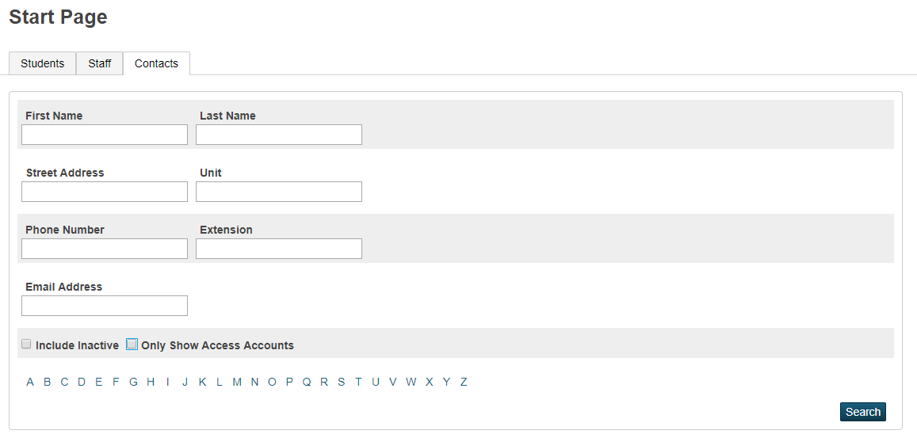
Contacts Tab
New Search Fields
*Use to only search for Parent Access Accounts
(Works like old “Parents” tab)
Use to include inactive Contacts in returned list!

Slide 9
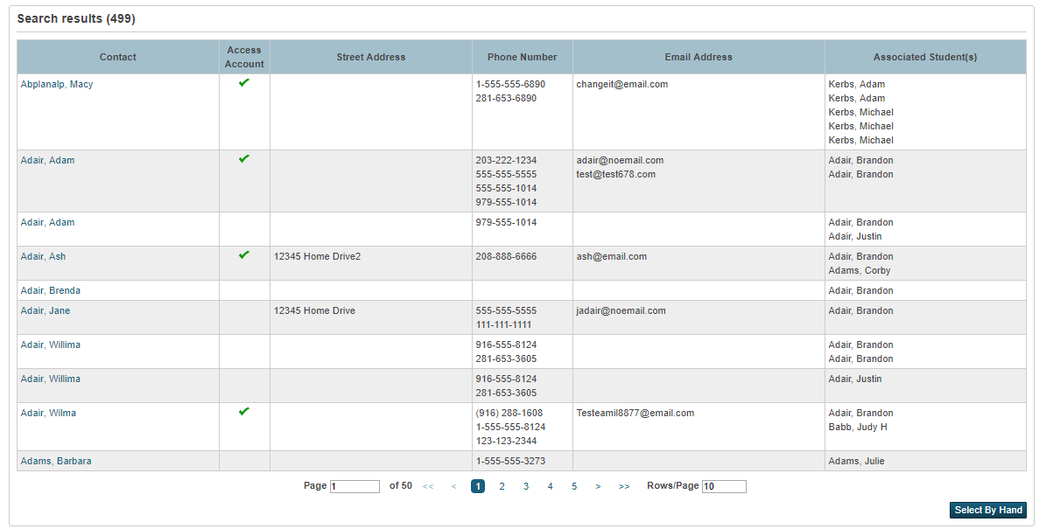
Contacts Tab – Search Results

Slide 10
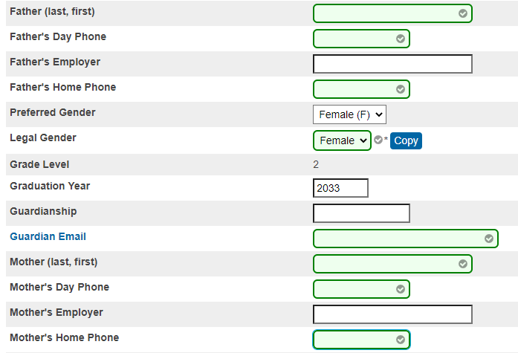
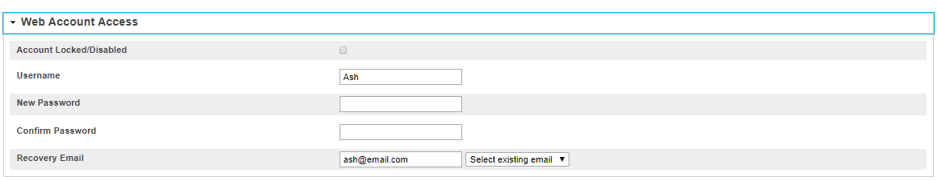
Contact View - Demographics and Web Access

Slide 11
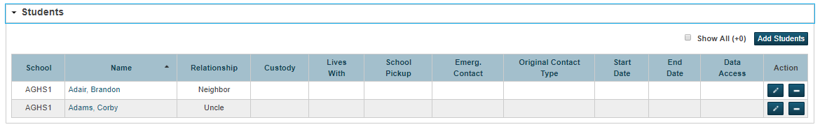
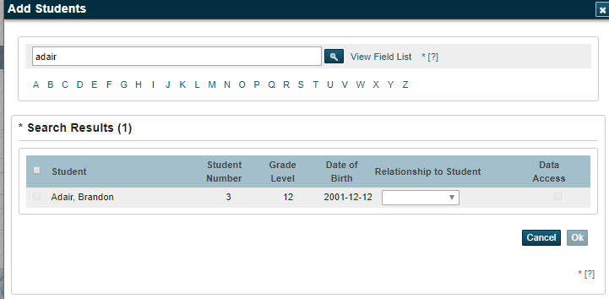
Contact View – Students 1

Slide 12
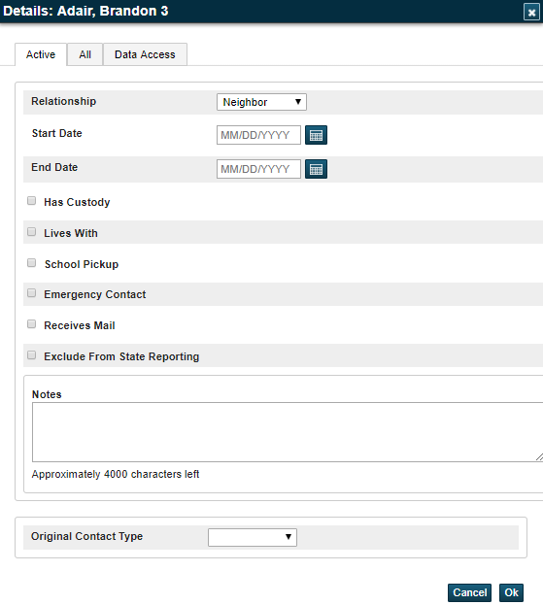
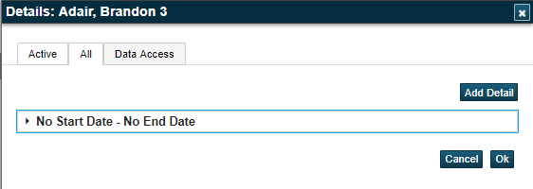
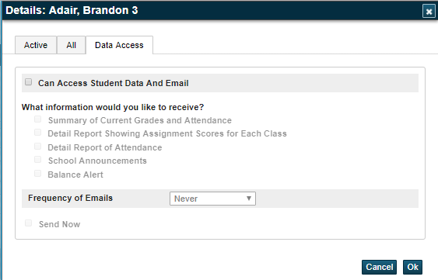
Contact View – Students 2
Lists historical Contact info
Web Account Access
Must be setup for this section to be enabled.

Slide 13
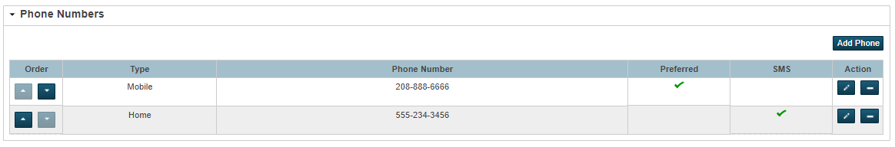
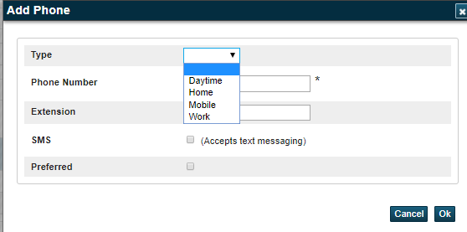
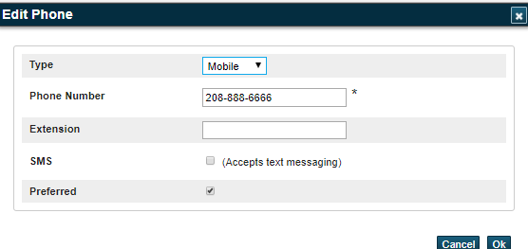
Contact View – Phone Numbers
Prioritize order of phone numbers
Set preferred #

Slide 14
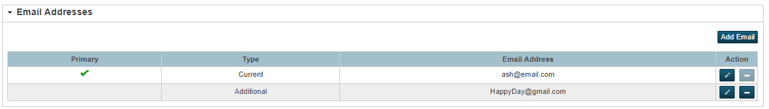
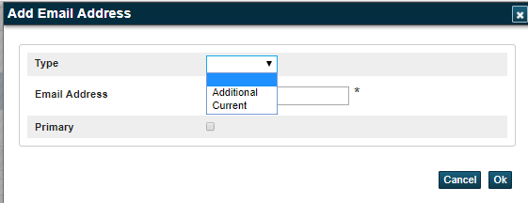
Contact View – Email Addresses

Slide 15
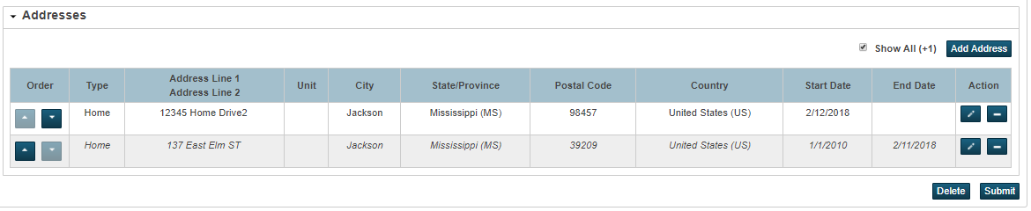
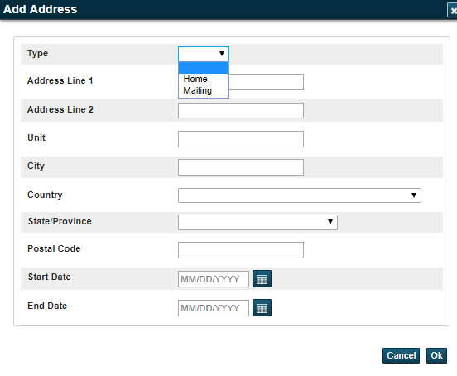
Contact View – Addresses

Slide 16
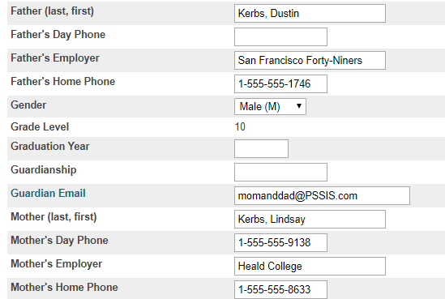
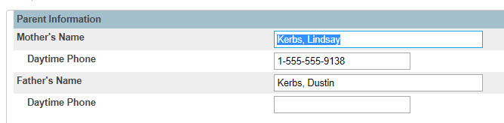
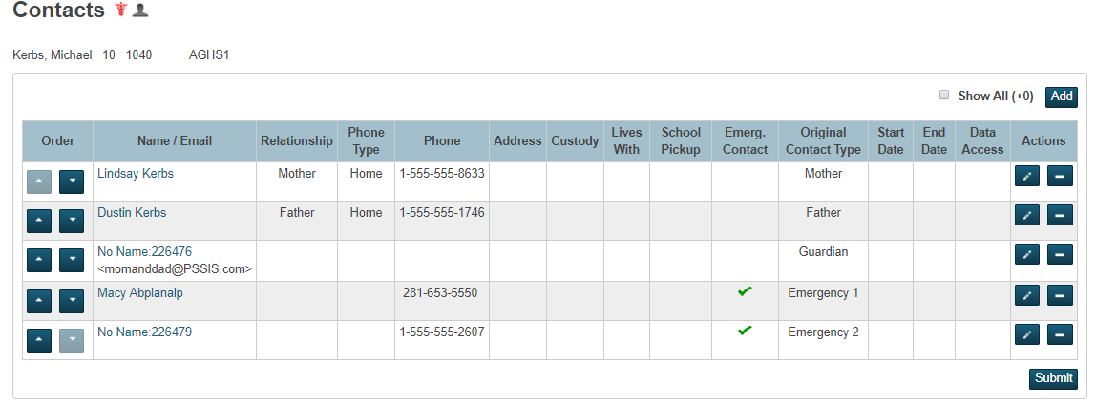
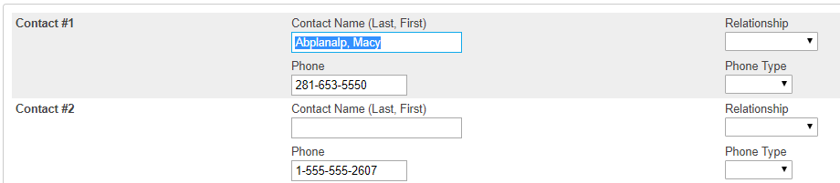

Student View – Contacts

Slide 17

Student Contacts
Data Cleaning Considerations when moving from Legacy data

Slide 18
Considerations/Complications
Backup your data!
2. It is Recommend that you create an Export File of Legacy Contact Data.
Fields exported should include:
Student_number
Lastfirst
Grade_level
schoolid
Mother
Mother_home_phone
Motherdayphone
Mother_employer
Father
Father_home_phone
Fatherdayphone
Father_employer
Guardian_LN
Guardian_FN
Guardianemail
Emerg_Contact_1
Emerg_1_rel
Emerg_Phone_1
Emerg_1_ptype
Emerg_Contact_2
Emerg_2_rel
Emerg_Phone_2
Emerg_2_ptype
Emerg_Contact_3
Emerg_3_rel
Emerg_3_Phone
Emerg_3_ptype

Slide 19
Considerations/Complications (con’t)
3. Is there a specific order you need Contacts to be listed?
The order of contacts can be important when using the DAT code of ^(contact_info). In
order to maintain consistency with reporting it is recommended that you establish the
order in which contacts are listed for each student.
4. Do you need to maintain your Legacy Contact Fields?
If Yes:
A. Do NOT merge guardian Email with other contact records – this will delete the
guardianemail field.

Slide 20
Considerations/Complications (con’t)
B. Do NOT change the Phone Type from Home or Daytime for Mother or Father
Records. These types sync back to the Mother/Father Home Phone and Day Phone
fields. Changing the Phone Type will remove the phone numbers from the legacy
fields.
Note: Phone fields may not contain more than 40 characters.
C. If more than one Home or Daytime phone number is entered under the new
Contact structure only the first one listed will sync back to the legacy fields.
D. Are parents also listed as emergency Contacts 1, 2 or 3?
If so, and you merge records, keeping Mother or Father as the Original Contact
Type it will erase the data in the Emergency Contact Legacy fields.

Slide 21
Considerations/Complications (con’t)
5. Overlapping Original Contact Types
If a contact has one or more original contact types (Mother, Father, Guardian, Emergency Contact) you will need to decide which contact type to retain.
During the consolidation process you will need to remove the duplicate role.
Once removed that data will no longer exist in the Legacy fields.
EX: If a contact is listed as both Mother and Emergency Contact 1, and you retain the Original Contact Type of Mother, the data from both roles will be consolidated into the new contact, however, the data associated to the role of Emergency Contact 1 will be deleted from the legacy fields

Slide 22
Considerations/Complications (con’t)
6. Multiple Parent Access Accounts?
If multiple Parent access accounts exist for a contact, decide which to keep.
When selecting accounts to consolidate, the first one selected will default to the Master Record.
When multiple records are being merged and there is more than one Parent Access account you must set the Parent Access Account you wish to keep as the Master Record.
Always verify through the Review screen that the correct account is set as the Master Record. Once consolidated PS will retain the Master record (Parent Access Account) and delete the other accounts.
7. Email addresses
Email addresses must be configured appropriately. And there are no blank
spaces at the end of the email address.

Slide 23

Student Contacts
Manual Consolidation

Slide 24
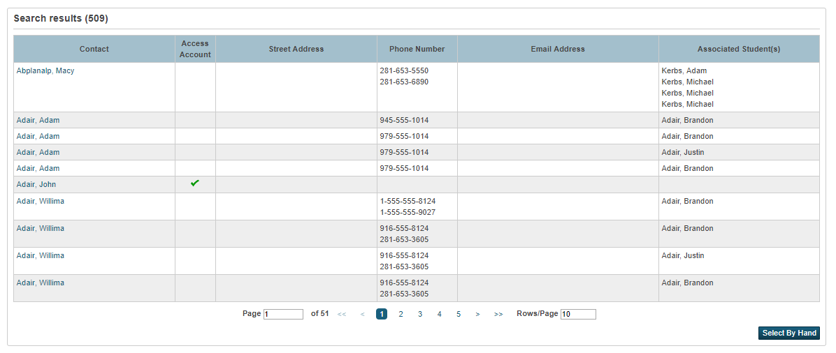
Search for Duplicates

Slide 25
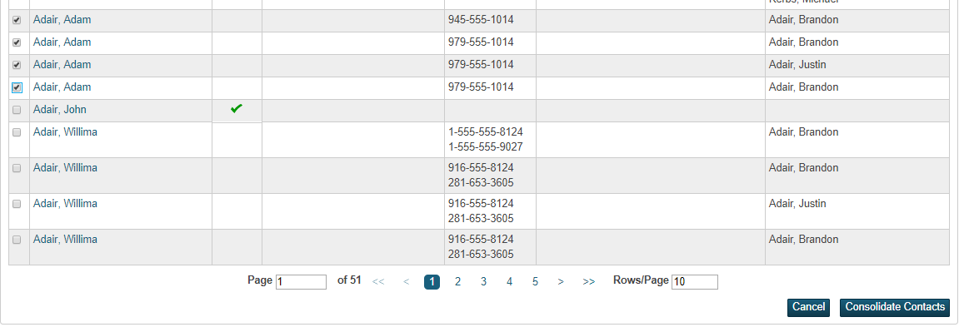
Select Records to Merge

Slide 26
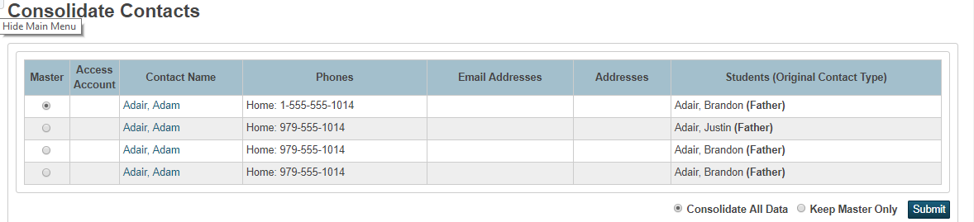
View/Edit before Consolidation
Modify any “bad” data prior to consolidating!
Used 99% of the time

Slide 27
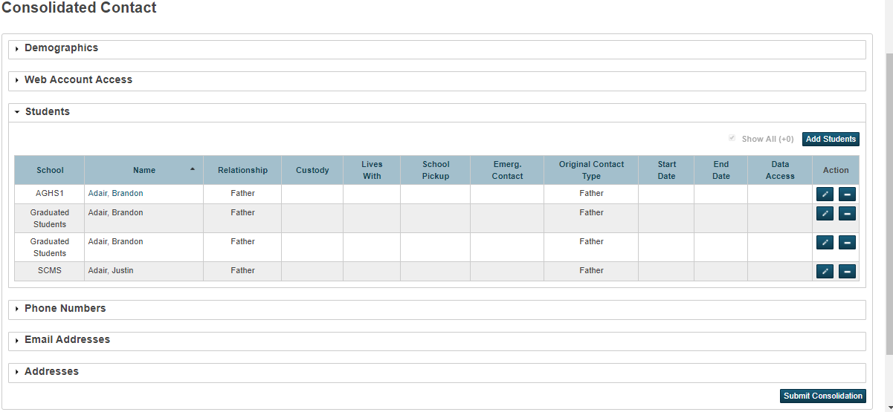
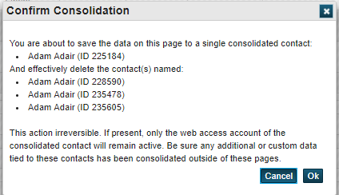
Consolidate!

Slide 28
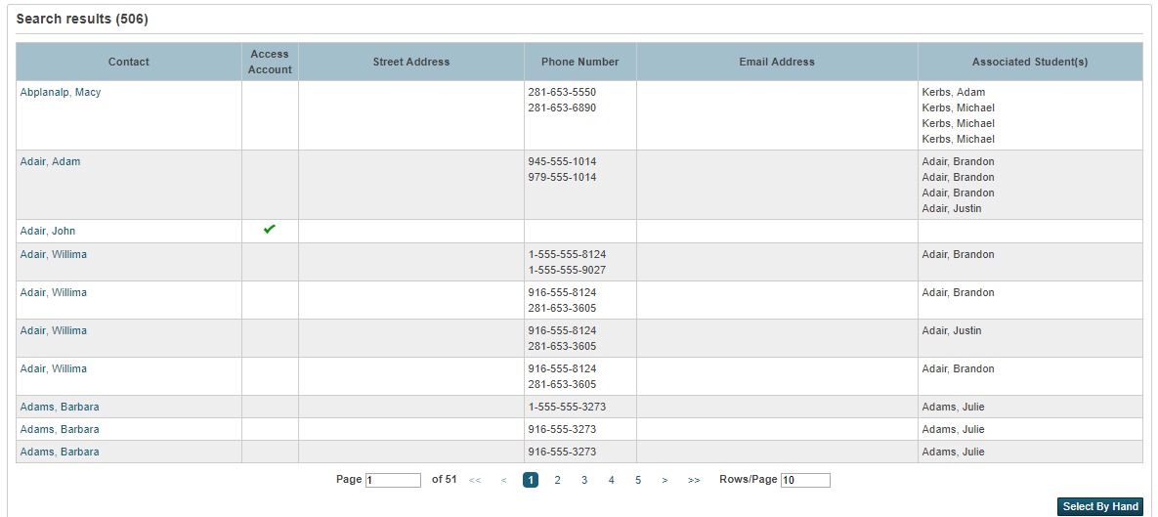
Merged Records

Slide 29
Student Contact KB Articles
Getting Started with Student Contacts – KB# 79790
Student Contacts FAQ – KB# 79788
Student Contacts Lab – KB# 8603
Student Contacts Known Issues – KB# 79789
Student Contacts Import Template – KB# 83233
Student Contacts: Original Contact Name Changes in Custom Pages – KB# 79792

Slide 30
Q & A

