Slide 1

March 2023
PS Admin Monthly Webinar
Jenn Roach

Slide 2
Agenda
Institute Insights: Announcements, Celebrations, Reminders
Duplicate Student Process
Parent/Student Portal (demo of available features & settings at the school level)
Chronic Absenteeism & Truancy
Day 135 Reporting
QDC3
End of Term (Q3)
End of Year Prep
CTE coding for placement of last year’s students (10 months is April)
DOTS Info and Live Walk-Through
Live Demos/Walk-Throughs

Slide 3
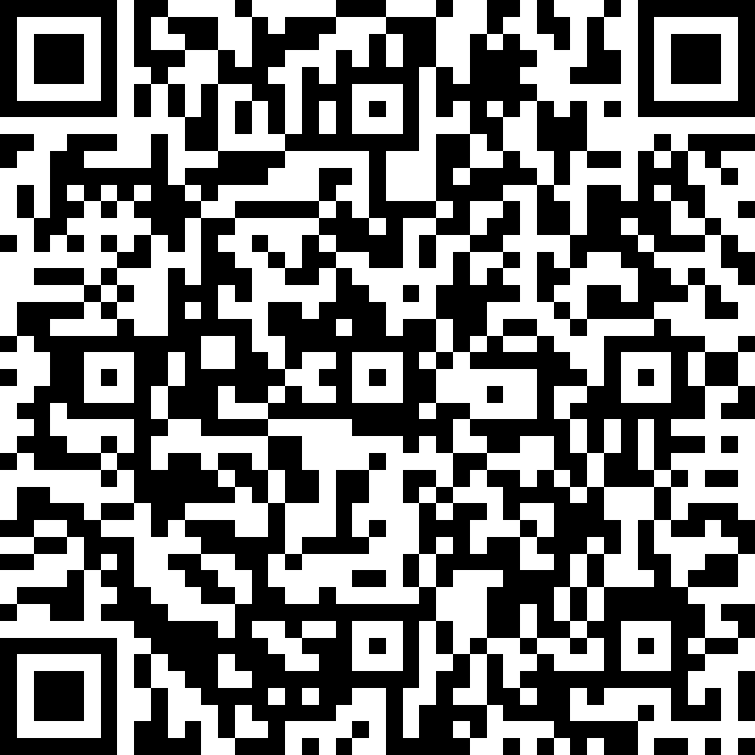
Institute Bulletin: Announcements, Reminders, Celebrations
Send any announcements, reminders, and celebrations in by the 2nd Tuesday of each month. Send to Jenn Roach (jennifer.roach@canteytech.com) after deadline.
  Staffing Updates
  Celebrations
Urgent matters need to go to Jason Jones - jjones@erskinecharters.org and/or help@canteytech.com
Link to Form: https://forms.office.com/r/GPC8pESruk

Slide 4

Institute Bulletin: Celebrations

Slide 5
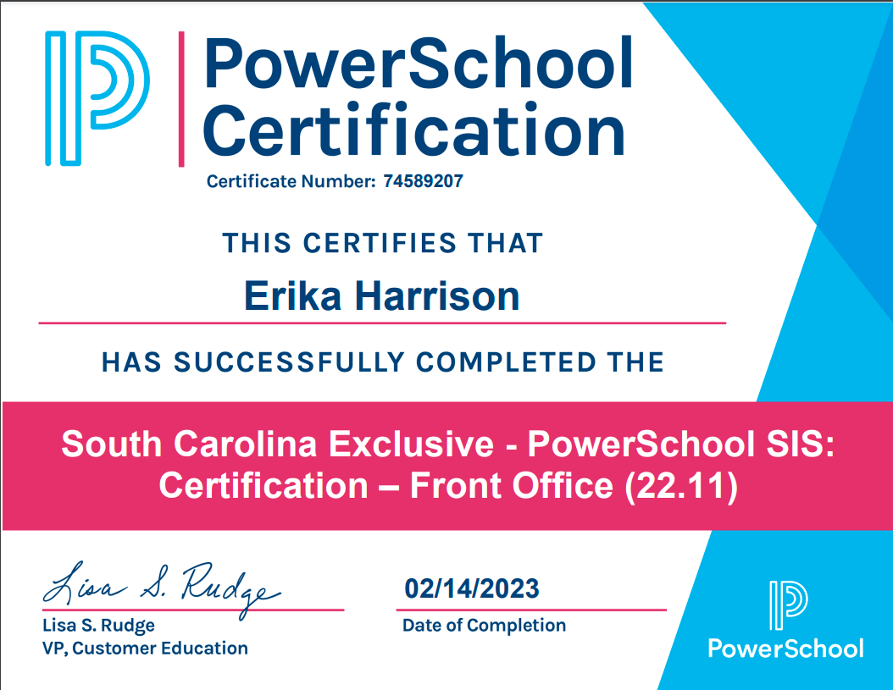
Institute Bulletin: Celebrations
Notes:
Is anyone planning to participate?
Cantey/Jason will be attending PSUG

Slide 6

Institute Bulletin: Celebrations
  Gray Collegiate is the 2023 2A State Champions for both Girls and Boys Basketball!!
  https://gcaathletics.org/2023/03/06/basketball-sweeps-state-championships/
Renee Hewitt of Gray Collegiate Academy says…
Notes:
Is anyone planning to participate?
Cantey/Jason will be attending PSUG

Slide 7
Institute Bulletin: Celebrations
Welcome Kimberly Bonilla to Mevers School of Excellence!
Notes:
Is anyone planning to participate?
Cantey/Jason will be attending PSUG

Slide 8
Institute Bulletin: Training Opportunities
PowerSchool Role Based Certification
  Available Seats!!
  3 (1/2 Days) of Training
  Certification Exam
The form is here: https://erskinecharters.formstack.com/forms/2022_2023_powerschool_role_based_certification_signup
Please make sure your participant can sign into the support page for powerschool located here: https://support.powerschool.com

Slide 9
Institute Bulletin: Training Opportunities
PowerSchool University: https://support.powerschool.com/psu/main.action
  June 25-29, 2023 Anaheim, California
  July 23-27, 2023 Nashville, Tennessee
  July 9-13, 2023 PSU at EDGE (Orlando, FL)
  PSU Remote Plus (Virtual) August 2-4 & August 9-11, 2023
  To Register: https://support.powerschool.com/psu/register/step1.action
PSUG Southeast
  May 14-18, 2023 in Myrtle Beach
  4 Day Event (Like National Event)
  https://easyregpro.com/e/2023-southeast-psug-event/evt_home

Slide 10
Institute Bulletin: Training Opportunities
PowerSchool PowerScheduler Office Hours
Join us for PowerSchool SIS 2023 Office Hours. Register now to connect with PowerSchool Support experts and peers to find the solutions to your pain points. These hour-long sessions are a great way to learn some insider tips for using your PowerSchool SIS solution.
In addition, our experts will be answering your questions in real-time through our live Q&A forum to provide you with quick and personalized responses.
Register for Free to attend these hour-long sessions
Date | Time | Topic | Link
 | 11 AM |  | Register Now
 |  | PowerScheduler: Committing the Schedule
Tuesday, April 11, 2023

Slide 11
Level Data Training Opportunities
Level Data Holds Monthly Webinars to discuss tabs within their Validation Tool
Register to Attend
  State Data Validation Suite Walk-Through
  RealTime Reports Walk-Through
  Mass Address Validation
  Unlimited Contacts Workshop + Q&A

Slide 12
135 Day Preparation or Reporting Walkthrough
Sign up for a 1:1 with Cantey Tech for either/both!
https://calendly.com/jennroach1/135-day-reporting-prep-reports

Slide 13

Duplicate Student Accounts

Slide 14
Duplicate Students: Prevention
When enrolling students, be sure to check District Search prior to entry.
If student found during district search, request PowerSchool record to transfer to your school & use re-enroll function.

Slide 15
Duplicate Students: Resolution
Send records request to (each) school that has duplicate record
Sending school will transfer the inactive student to the school with current ownership of student record
The last school of enrollment is the owner of the students’ records and responsible to merge all historical data into one student record. This may or may not be the most current record. RECOMMENDATION: The student record to keep or make active should be the one with the most historical and/or accurate data. Use that as the master record.

Slide 16
Duplicate Students: Resolution
All records that must be merged, including but not limited to the list below:
  Demographics
  Historical Grades
  Transfer/Enrollment History
  Attendance (If Applicable)
  Test History
  Student Schedule
  Lunch Status

Slide 17
Duplicate Students: Resolution
When the records are at one school and they have been properly merged, the records that are to be removed will have the words “Duplicate – Active/Current [Student Number]” in the Exit Comments section.
The duplicate student record should be done like a No Show (NS) so that the enter date and the exit date are the same and the exit code is NS.
  An entry in the Exit Comment should be made denoting this record as a duplicate. I.e. “Duplicate Student; see record # xxxxxxxxxx” (where xxx is the active student number).
  The active or current PowerSchool number must be entered into the Exit Comment
  The duplicate record is to be made inactive and transferred out of the current school.
Transfer that duplicate student record to the Duplicate Records School.

Slide 18

Public Portal (Parent/Student Portal)

Slide 19
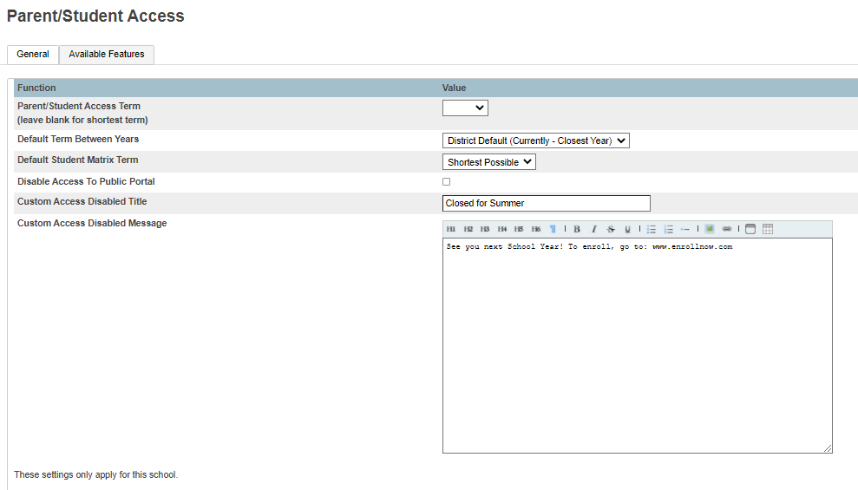
Parent/Student Portal
Home > School > General: Parent/Student Access
https://cie.powerschool.com/admin/schoolsetup/parent_student_settings_general.html

Slide 20
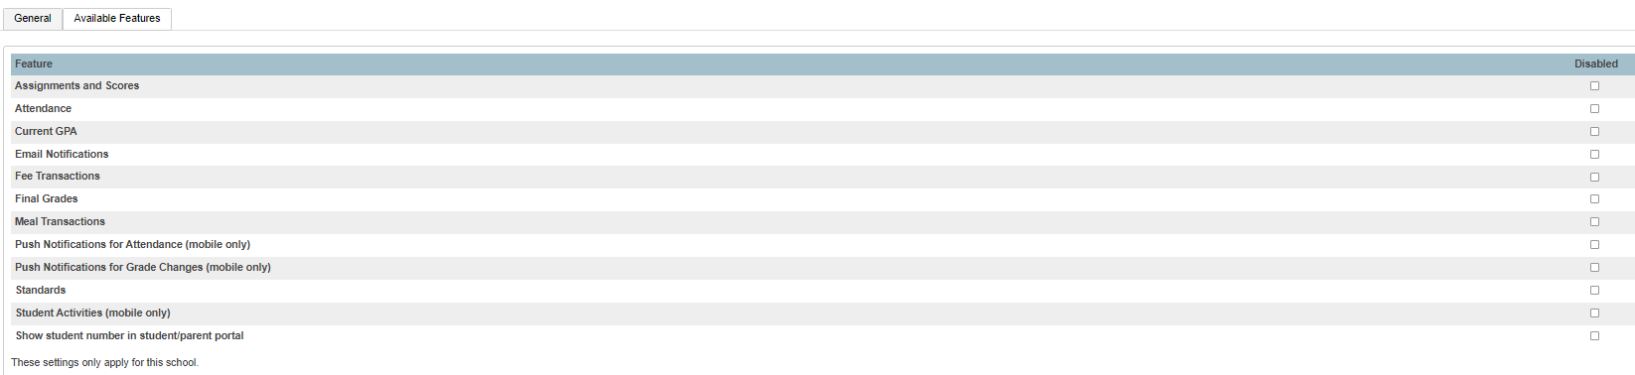
Parent/Student Portal
https://cie.powerschool.com/admin/schoolsetup/parent_student_settings_general.html
Home > School > General: Parent/Student Access

Slide 21
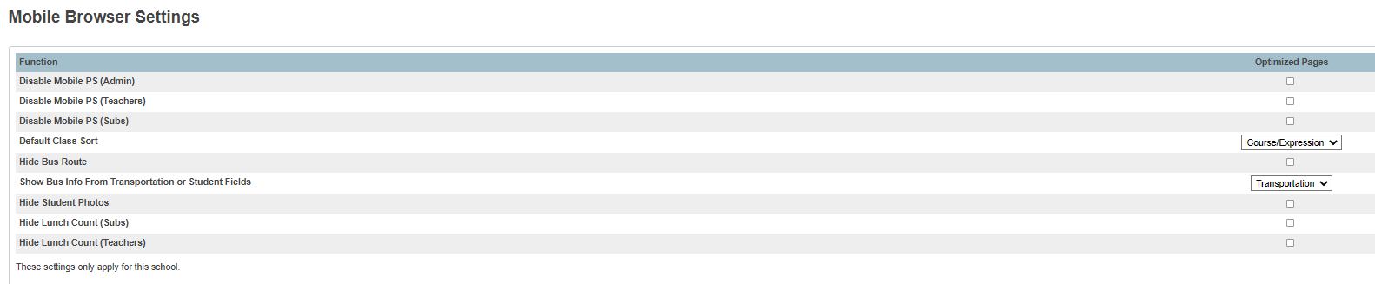
Parent/Student Portal
https://cie.powerschool.com/admin/schoolsetup/mobile_browser_settings.html
Home > School > General: Mobile Browser Settings

Slide 22

Chronic Absenteeism & Truancy

Slide 23
Incident Management
All Truancy and Disciplinary Incidents must be in PowerSchool through Incident Management
  Log Entries are not sufficient for reporting truancy/discipline
  Having No Truancies and/or Disciplinary Incidents in Incident Management is a red flag.
SCDE Incident Management Resources:
Incident Management Training 101 (2.22MB PPTX)
  PowerSchool Incident Management Frequently Asked Questions
  PowerSchool Incident Management-Discipline Incidents Step by Step Guide/Coding Behavior Incident Guide
  PowerSchool Incident Management-Truancy Incident Step by Step Guide/Coding Truancy Incident Guide
  PowerSchool Incident Management-User Training and Reference Guide (SEP 2021)
Truant: A student between the ages 6– 17 who has accumulated unexcused absences on three consecutive days or has accumulated a total of five or more unexcused absences during the academic year.
Habitual Truant: A “habitual” truant is a child age 12 to 17 years who fails to comply with the intervention plan developed by the school, the child, and the parent(s) or guardian(s) and who accumulates two or more additional unlawful absences.
Chronically Absent: Any student in grade K-12 who misses 50 percent or more of the instructional day for any reason for 10 percent (or more) of the enrollment period.

Slide 24
Truancy Reports
Before Running Truancy Reports: Submit Attendance, Reconcile Attendance, Update Attendance Codes
Submit Attendance Every Day:
  Daily or Meeting, per requirements
  Typically Recorded initially at the Teacher Level in PowerTeacher
Reconcile Attendance Weekly:
  If teachers are attempting to update attendance codes and the allowable time period has expired preventing teachers from updating codes, contact your schools Attendance Clerk or PS Admin.
Update Attendance Codes:
  Update Attendance Codes as applicable to reflect tardies, early dismissals, absence notes, suspension codes, homebound, homebased, etc.
  Lawful Absence Attendance Codes will not contribute to absence counts for Truancy Reports – this includes ISS and OSS attendance codes.
NOTE: For schools taking Meeting Attendance (MS/HS), it is mandatory that attendance be taken EVERY period. If even one teacher does not mark a student absent, Truancy data will be inaccurate and incomplete as it only captures Full-Day absences.

Slide 25

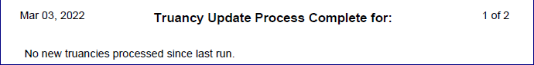
Truancy Reports
Refresh Attendance Views and Run Truancy Update Process
Attendance codes update over night. Wait until the next day to run updates or to force an immediate update, Refresh Attendance:
  PS Homepage > Attendance > Functions (tab) > Refresh Premier Attendance Data Views
  The results of this report open in your Browser, not a PDF.
Run the Truancy Update Process. (District Level Function) Runs Nightly
  PS Homepage > System Reports > State (tab) > Truancy Update Process.
  Run for whole school to capture all updates
  New truancies processed during the update process will appear on the report.
  If no new truancies processed during the update, the following statement appears:
Bookmark the Link: Reg. 43-274: Student Attendance

Slide 26
Truancy Reports
SC40 Truancy Report by Student
  Most schools use the SC 40 Reports for documentation purposes
  All students meeting the unlawful absences criteria populate on this report – including students who do not meet the age criteria populate when the unlawful absences are met.
  Recommended to use this report when meeting with Parents/Guardians for Attendance Intervention Meetings.
  Report lists all FULL DAY UNLAWFUL ABSENCES.
  Present Attendance Codes and Lawful Attendance Codes do not contribute to full Day Unlawful Absences.
  Report lists other schools within your district at which the student was previously truant.
  Report does not list full day unlawful absences from previous schools. Full Day Unlawful Absences are listed for the current school only.
Where in PowerSchool:
PS Homepage > System Reports > State (tab) > SC40 Truancy Report by Student

Slide 27
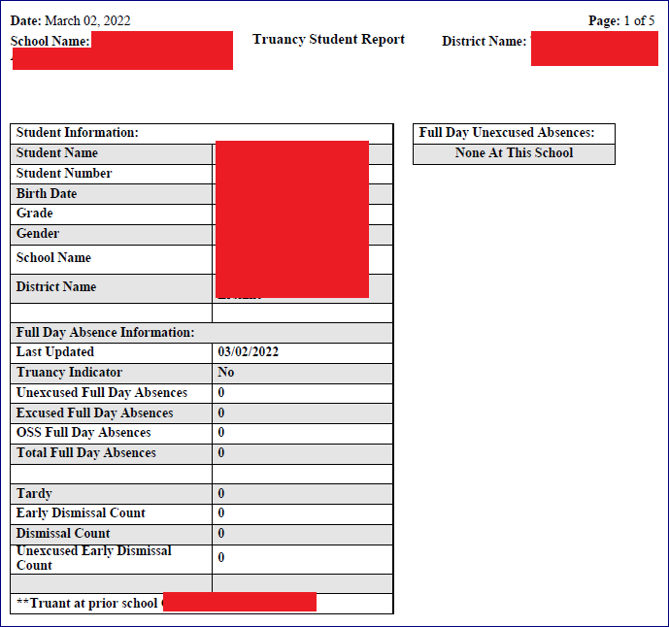
Truancy Reports
View Truancy Reports
SC40 Truancy Report by Student with no truancies at current school but with truancies at previous school.

Slide 28
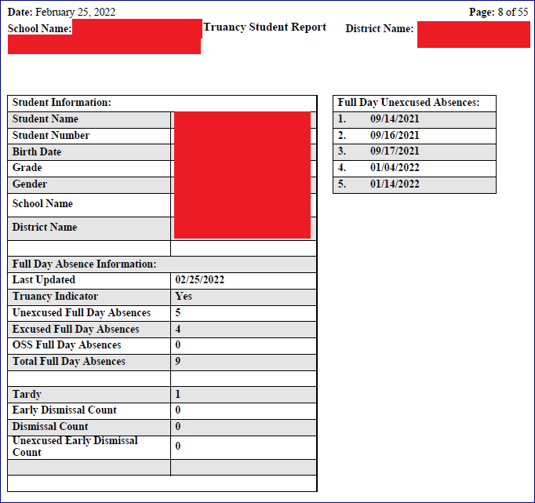
Truancy Reports
View Truancy Reports
SC40 Truancy Report by Student with truancies at current school but with no truancies at previous school.

Slide 29
Truancy Reports
Run Truancy Reports
SC41 Truancy Report by School.
  All students meeting the unlawful absences criteria AND age criteria populate on this report.
  Recommended to use this report when coding Truancy incidents in PowerSchool Incident Management.
  Report lists a count for FULL DAY UNLAWFUL ABSENCES in multiple Truancy Categories.
    3 consecutive full day unlawful absences
    5 non-consecutive full day unlawful absences
    7 non-consecutive full day unlawful absences
    10 or more non-consecutive full day unlawful absences
  Present Attendance Codes and Lawful Attendance Codes do not contribute to full Day Unlawful Absences.
  Parenthesis around a student name is your visual indicator that the student is inactive at your school AND truant prior to withdrawal.
  NOTE: Withdrawing a student does not negate the requirement for a Truancy Incident in Incident Management.
Where in PowerSchool:
PS Homepage > System Reports > State (tab) > SC41 Truancy Report by School
Bookmark the Link: Reg. 43-274: Student Attendance
Notes:
Attendance Conversions set up with the 50% of the minutes in the day (Time to Day) is for Average Daily Attendance
Being absent from ALL meetings where attendance is required contributes to full day absences for Truancy
- must be excluded from section and must be excluded from ADA in the bell schedule

Slide 30
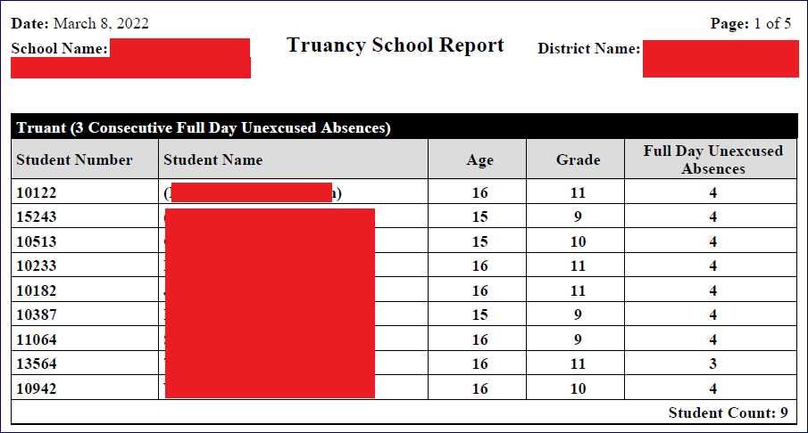
Truancy Reports
View Truancy Reports
SC41 Truancy Report by School.

Slide 31
Chronic Absenteeism Reports
  SCDE Chronic Absenteeism Resource Page: https://ed.sc.gov/districts-schools/student-intervention-services/chronic-absenteeism/
Home Page > System Reports > State Tab >
Run first: (District Level Function); Runs Nightly
SC37 Chronic Absenteeism Update Process
Then:
SC38 Chronic Absenteeism School Report

Slide 32
Truancy/Chronic Absenteeism
If you are Unable to Run Truancy Reports. This is the result of several possibilities:
1. Schedule has been set up incorrectly
2. Attendance has been set up incorrectly
3. Attendance is being taken incorrectly (Attendance vs. Meeting)
Inability to run Truancy Reports does not exempt schools from reporting Truancy incidents in Incident Management.

Slide 33

135th Day Funding

Slide 34

Data Quality Reports (SAS)

Slide 35
Data Quality Reports (SAS)
DQR – SCDE’s Data Quality and Reporting Web Application
Delivers validation reports from SCDE to District and School Level Users
Login through SCDE Membership Center
  Need an account to view reports
  Contact help@canteytech.com Reports are not in Real Time like Level Data

Slide 36
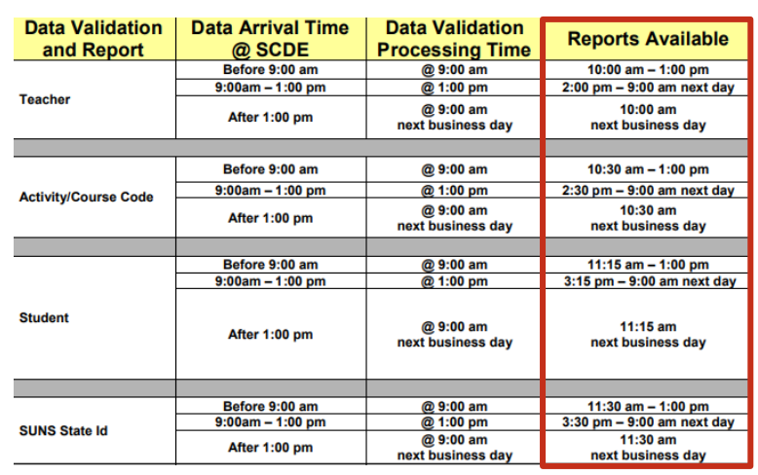
Data Quality Reports (SAS)
The following schedule indicates when PowerSchool data collected via the Enrich Data Collection tool will process and validation reports will become available.

Slide 37
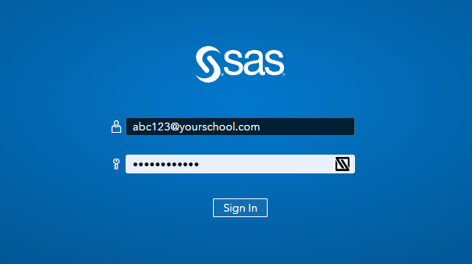
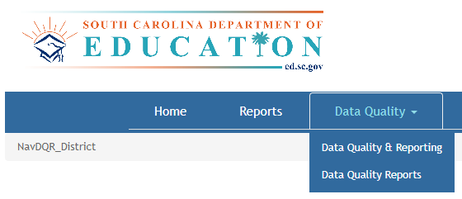
Data Quality Reports (SAS)
Login Here: https://appportal.ed.sc.gov/my.policy
Go to Report Portal & Login to SAS
Hover over the Data Quality Tab & Click Data Quality & Reporting

Slide 38

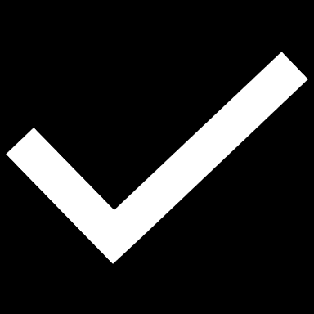
Level Data Validations
LEVEL DATA STATE VALIDATIONS
Level Data ON PAGE Validations

Slide 39
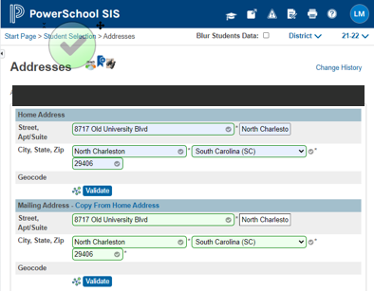
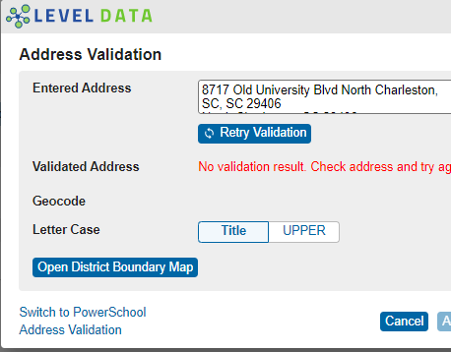
Level Data On Page Validations

Slide 40
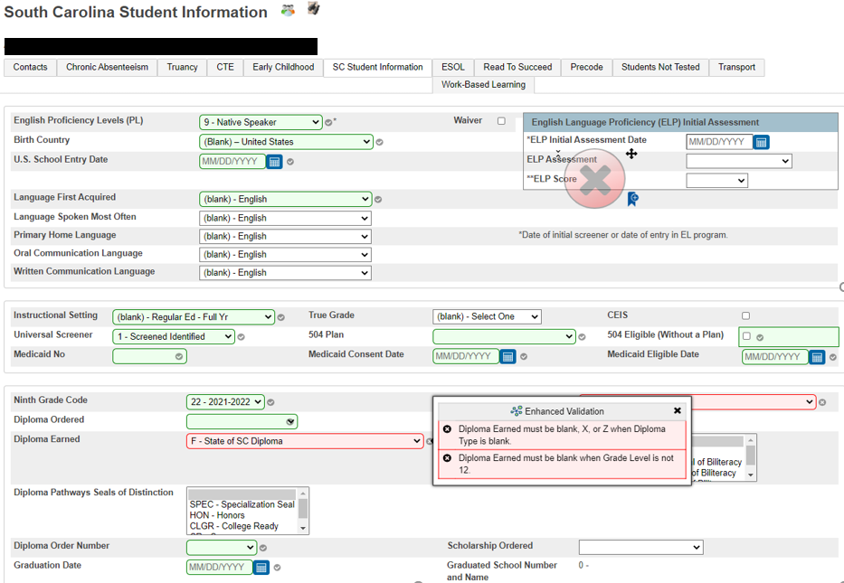
Level Data On-Page Validations

Slide 41

Level Data State Validations

Slide 42
Level Data State Validations
LD State Validations — actively locate and identify errors in your PowerSchool data that make state reporting and CRDC submissions difficult.
Notes:
In a nutshell LD validations are like the staples easy button

Slide 43
135th Day Funding
135th Day Reports Due in LWS March 31, 2023
FIRST - Run Refresh Premier Attendance Views Data. On the Start Page click Special Functions > click Attendance Functions > click Refresh Premier Attendance Views Data
Run Refresh Premier Attendance Views Data in order for membership, absences, and ADM to calculate correctly on the report. Run for all students at the school.
Run Reports: Start Page > System Reports > State tab > Under Legacy Reports header
SECOND - Run SC01 Data Verification before any of the other Legacy Reports
Once SC01 Data Verification is error free, you can then run reports SC02-SC09
After you run SC01-SC09 reports, archive/save & store (both hard copy and electronic recommended). Note: Multiple staff members should know where these reports are stored.

Slide 44
135th Day Funding
SC09 Cumulative Class from Extract - The Cumulative Class from Extract allows for the creation of the Cumulative Class Report based on prior report extracts for the currently selected school year and currently selected school. The report will be the data that was generated when the extract was originally created. Report extracts may or may not be ones that are required by the SCDE for state funding. The list of report extracts is sorted by School Name, Day Number, and the Date/Time the report extract was created. Note: After you have selected an extract for funding, go to the Cumulative Class Report from Extract. You will look on this page to ensure the ‘Y’ is displayed beside the extract that you want SCDE to use to calculate your funding.
SC09 Membership & Attendance from Extract – SC09 Membership & Attendance from Extract allows users to select a previously generated report extract for reprinting the SC06 Membership & Attendance Report for the currently selected school year and the currently selected school. The report will be the data that was generated when the extract was originally created. The report will include the date/time each extract was created. Report extracts may or may not be ones that are required by the SCDE for state funding. The list of report extracts is sorted by School Name, Day Number, the Self-contained indicator, and the Date/Time the report extract was created. Note: After you have selected an extract for funding, go to the Mem & Att Report from Extract to ensure the ‘Y’ is displayed beside the extract you want SCDE to use to calculate your funding

Slide 45
135th Day Funding
Select EFA/EIA Funding Extract – Make sure that the extract that your school wants sent to the SCDE is selected (choose the correct extract based on Date/Time created)
Note: You should NOT make a change to your selection after the SCDE has finalized funding.
Cumulative Class Report – only needs to be run and extracted for schools with PreK-3 and PreK-4 students.
Every school MUST run and extract the Membership and Attendance Report.

Slide 46
Add-On Weightings

Slide 47
Add-On Weightings
Academic Assistance [Standardized Test Performance Level] – students who score as Not Met/fail/low (a value of ‘1’ which means “Not Met” or “Below Basic”) on selected standardized state test. This file is imported into PowerSchool. The SCDE generates this file to be imported. The district admin will notify you when the file has been imported into PowerSchool.
Note: You may want to wait until this file is imported into PowerSchool before running your 135th day Add-on Weightings reports so you do not have to run them multiple times, but this is an option.
High Achieving – Gifted and Talented – Academic (GTA), Gifted and Talented – Artistic (GTR), Advanced Placement (AP), International Baccalaureate (IB). GTA/GTR students must be STATE-IDENTIFIED ~and~ SERVED in a GT/Honors Program. Use the first day of the school year as the effective start date. Grades 3 – 12 for GTA & GTR. Grades 9 – 12 for AP & IB.

Slide 48
Add-On Weightings
Poverty – Pupils in Poverty (PIP), defined using Directly Certified, Direct Certification Extended, SNAP/TANF, Homeless, Migrant, Runaway, Foster:
S_SC_STU_X.Migrant, S_SC_STU_X.Night_Residence, S_SC_STU_X.Foster_Home *Identifed in PowerSchool
LEP - Limited English Proficiency ESL value scores of 1-5, 6.0, W, X. Each new LEP student must be evaluated within the first 10 days of school. All proficiency codes must be entered into PS for LEP students ASAP to indicate proficiency levels of the English language.
Dual Credit – Student must be enrolled at least 30 days in an approved Dual Enrollment course where ‘E’ is the 7th character of the Course Number
Run Reports: Start Page > System Reports > State tab > Under Add-On Weightings header

Slide 49
Add-On Weightings
RUN FIRST- SC24 Add-On Weightings Update. Run this report to update all changes.
SC28 Add-On Weightings Report – create extract for the 135th day.
SC30 Add-On Weightings Select Funding Extract - This page lists 135th day Add-On Weightings Totals extracts created for this school for the selected school year. Please select one to be used for state funding.
Note: A change to your selection should NOT be made after the state data collection has ended.
SC28 Add-On Weightings Report & SC30 Add-On Weightings Select Funding Extract - Print and archive/save this report (hard copy/electronically). Make sure that multiple staff members know where these two reports are located.

Slide 50
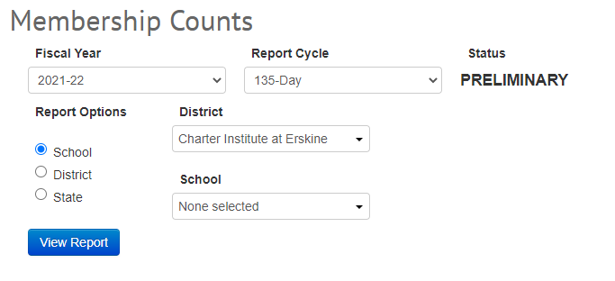
Verify Membership Counts on SCDE
https://ed.sc.gov/finance/financial-services/student-data/membership-counts/

Slide 51

QDC3 Data Collection

Slide 52
QDC3 Data Collections
QDC3 is data collection to meet state and federal requirements.
QDC3 School Deadline: Friday, April 14, 2023 (Final SCDE Deadline is April 24, 2023 Noon)
Student Basic Demographics
Contacts – Contact 1 REQUIRED; Contact 2
Early Childhood – Pre-K and Kindergarten students
Homeless Student Information / Primary Nighttime Residence and Unaccompanied Youth (if applicable
South Carolina Student Information
SCDE Student Information System Data Entry Manual 22.02.00 - https://ed.sc.gov/data/information-systems/power-school/sis-documents/student-information-system-data-entry-manual/
SC Career & Technology Education (CATE) – https://ed.sc.gov/instruction/career-and-technical-education/performance-accountability/cte-data-collection-and-reporting/2022-23-srpg/
Work-based Learning - https://ed.sc.gov/instruction/career-and-technical-education/career-guidance/work-based-learning/wbl-implementation-guide-2022/

Slide 53
End of Term

Slide 54
End of Term Reminders (Q3)
Store Quarter 3 Grades
Run 3rd Quarter Report Cards
Run Honor Roll (optional)

Slide 55

Store Quarter 3 Grades

Slide 56
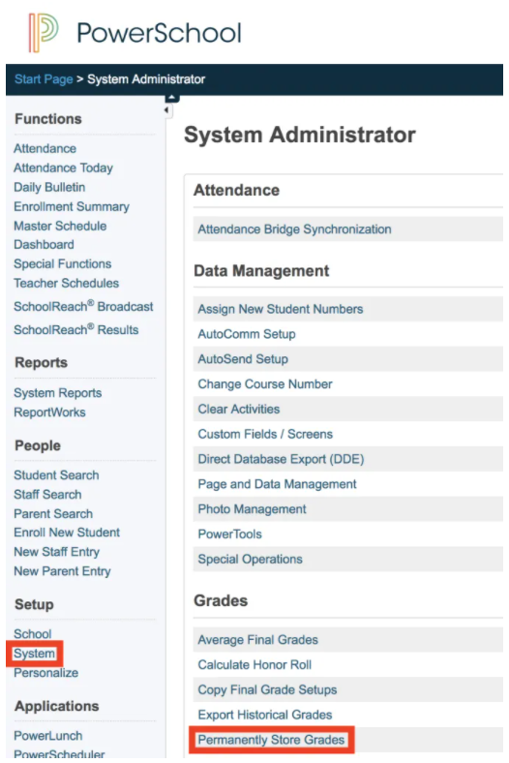
Storing Grades for Q3
Due March 31, 2022
Step 1:
Navigate to Home Page>
System (Setup) > Permanently Store Grades

Slide 57
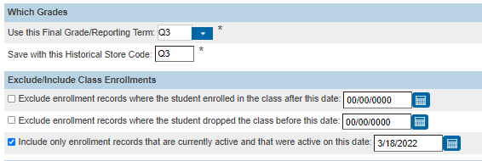
Storing Grades for Q3
Step 2:
Use correct Term
Exclude/Include Class Enrollments check the “Include only enrollment records that are currently active and that were active on this date” and enter in a date 2-3 days before the end of quarter 3 (this step is recommended by PowerSchool).
Note: Do not use the same store code twice in one year unless you wish the system to overwrite all stored grades for term.

Slide 58
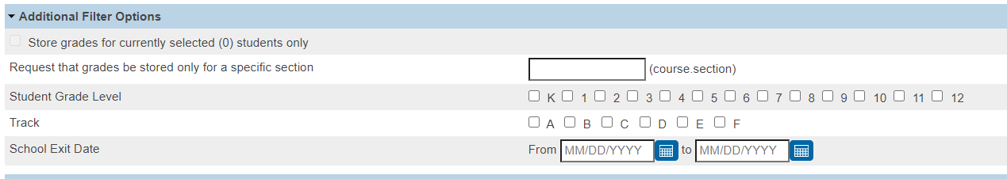
Storing Grades for Q3
You can store grades of a selected number of students.
You can store grades for students in a specific course section by enter the course and section numbers, separated by a period. For example, enter 08960100.01 for Homeroom 1, Section 1.
You can store grades by individual grade levels.
d. You can store grades by Track days. (do not check this option)
e. You can store grades for students that were enrolled at your school thru a certain date range.
Step 2:
Additional Filter Options**

Slide 59
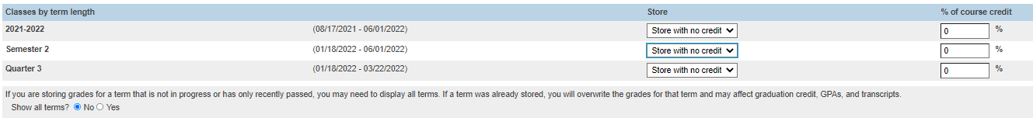
Storing Grades for Q3
Do not store (default) – This will store no grades and no credit for that term
Store with no credit - This will store grades and automatically enter 0% under % of course credit.
Store with credit - This will store grades and you will have to enter the percent of credit you want stored for that term.
Classes by Term
Show All Terms
Show All Terms – Default is Set to “No”
Use Store without Credit - If storing for quarter grades
Use Store with Credit - If storing for term end grades

Slide 60
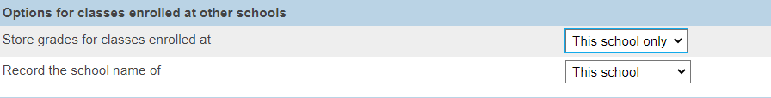
Storing Grades for Q3
Options for classes enrolled at other schools:
  This School Only
  This School

Slide 61
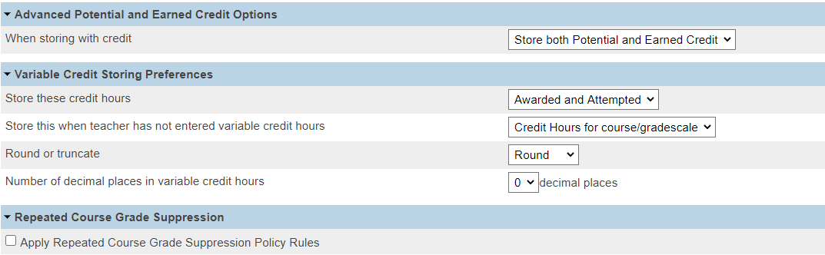
Storing Grades for Q3
Last Three Sections
  Leave Default

Slide 62
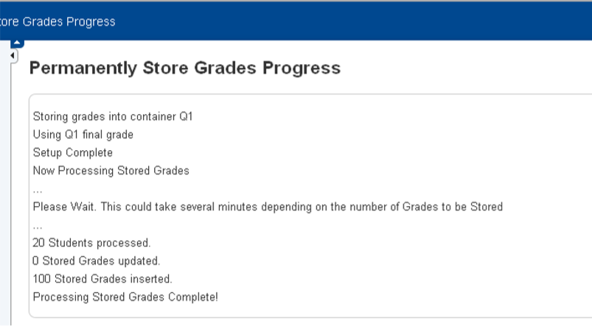
Storing Grades for Q3
Double check all that you have entered
Submit
After submittal and a successful store, your screen will look like this:

Slide 63
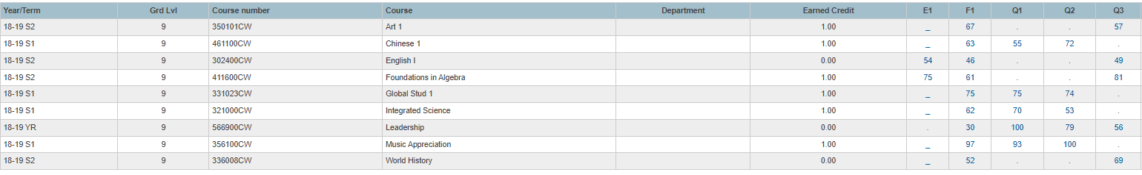
Storing Grades for Q3
Verify Your Grades Were Stored
  Spot check students in their Historical Grades
  Check Term/Year

Slide 64
Storing Grades Resources:
PowerSource / PowerSchool Community Articles
How to Permanently Store Grades - https://help.powerschool.com/t5/PowerSchool-SIS-Knowledge-Base/How-to-Permanently-Store-Grades/ta-p/14226
How to Permanently Store Grades for a single section - https://support.powerschool.com/article/67018?from=search

Slide 65

End of Year Preparation

Slide 66
End of Year Preparation
Clear Errors in:
  Level Data
  (System Reports) : School Enrollment Audit & Section Enrollment Audit
  SAS Reports (SCDE)
Transcript Updates & Audit (as necessary)
Create 2023-24 Years and Terms based on your Board Approved Calendar – Create a ticket with Cantey: help@canteytech.com
Start Entering/Updating Next Year Grade Level & School (Scheduling Setup)
  Pre-Registered Students Next Year Grade Level should be the same grade as their entry grade

Slide 67
End of Year Preparation
Prepare for Retained Students (enter data on SC Student Info Page)
Make sure all CRDC data is entered before EOY rollover
New Grade level must be requested prior to EOY
PowerScheduler – Get started now; must be committed before EOY Rollover (June 23, 2023 Commit Date)

Slide 68

CTE Coding

Slide 69
CTE Coding Reminder
Placement of Last Year’s Graduates that were CTE Completers
  April 2023 is 10 months
CTE Data Reporting Deadlines
  Placement Data Collection April 7, 2023
  CTE Data Collection QDC 4 June 23, 2023
School districts and career centers are required by South Carolina law (S.C. Code Ann. § 59-53-160) and by State Board of Education Regulation 43-234 to survey their CTE completers ten months after graduation to determine their placement status regarding employment, postsecondary education, or military service. The survey records should contain sufficient information to allow for the verification of all reported placements.
2022-23 Career and Technical Education (CTE) Student Reporting Procedures Guide

Slide 70
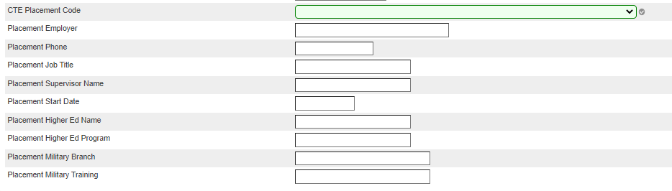
CTE Coding Reminder
Home Page > Choose Graduate School > Student Selection > State/Province – SC > CTE Page

Slide 71
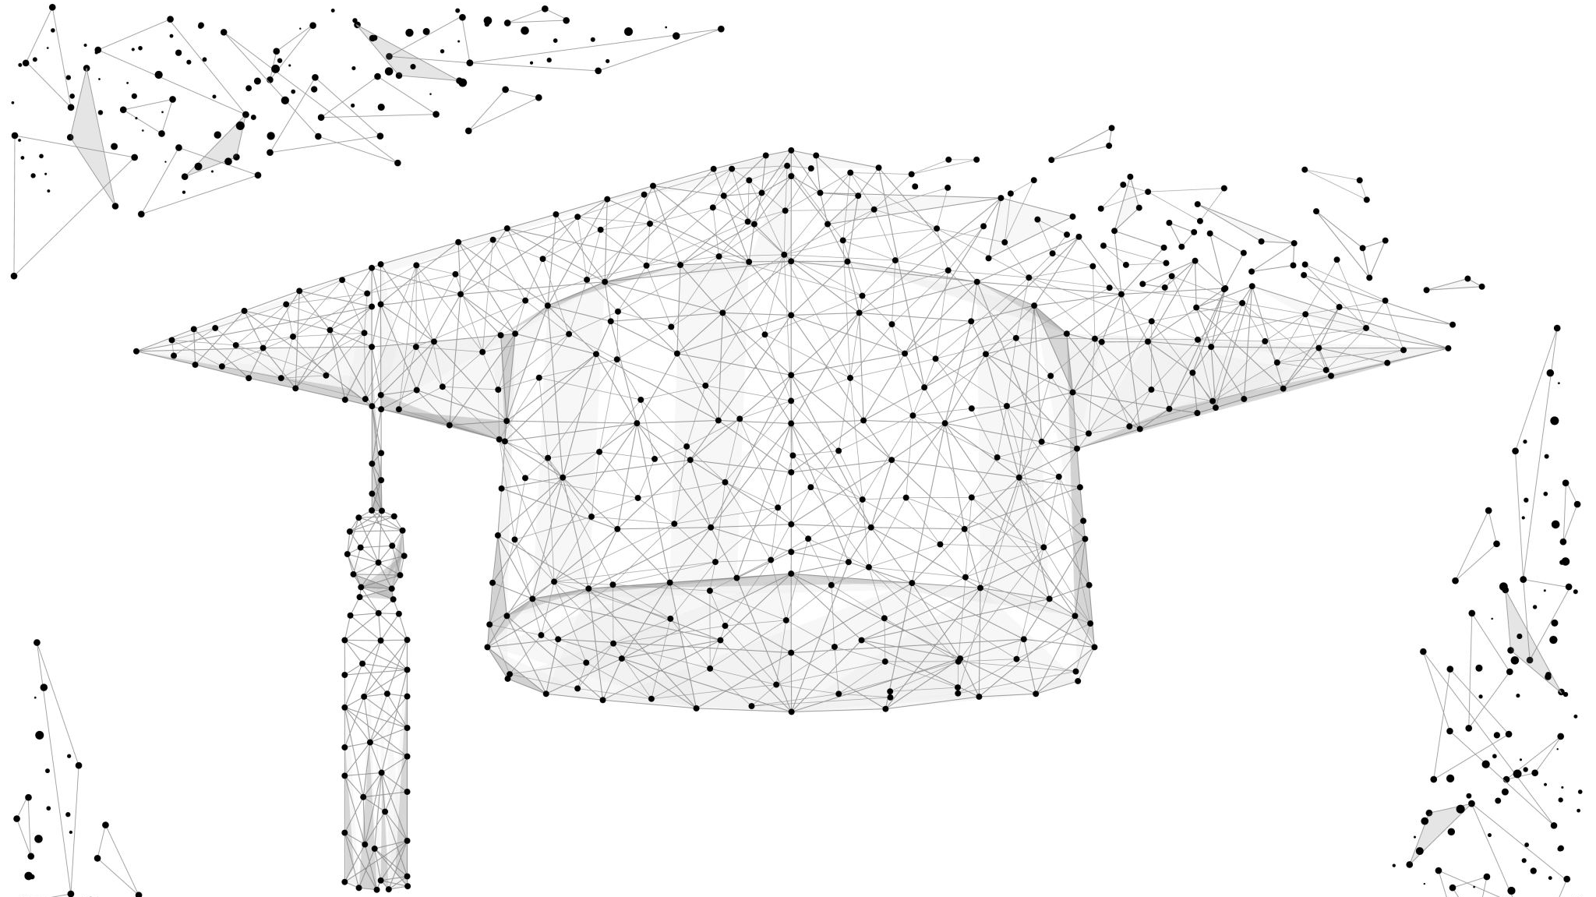
Diploma Ordering Tracking System (DOTS) – Spring Graduates

Slide 72
Diploma Ordering Tracking System (DOTS) – Spring Graduates
PowerSchool Requirements
Exit/Graduation Dates Between: Jan 26, 2023 through Jun 14, 2023
Student in Grade Level = 12
Diploma Ordered must be set to F.
Diploma Type must be set to F.
Diploma Earned must be set to F after the student officially graduates.
Home Page > Student Selection > State/Province – SC > Student Information Page
https://appportal.ed.sc.gov/

Slide 73
Diploma Ordering Tracking System (DOTS) – Spring Graduates
Step 1: Type https://appportal.ed.sc.gov/ in the URL. Under Web Applications, select Diploma Order Tracking System.
Verify Information
Step 2: Under Diploma Orders select Verify School Information. Review your school’s information for accuracy. If the school address or name of your principal is incorrect, please contact the administrator at the District Office in charge of the District Entity Information Management System (DEIMS). This is Jason Jones (jjones@erskinecharters.org)
    Contact Information – Enter the name and email address of the primary contact for diplomas at your school.
Step 3: Once all school information is verified, select Verify Information then Continue.

Slide 74
Diploma Ordering Tracking System (DOTS) – Spring Graduates
Step 4: From the homepage, select Order Spring Batch Diplomas. Below Diploma Status select Update Graduation Date -- select your graduation date from the calendar. The graduation date on both transcripts and diplomas must be the 180th day.
Step 5: Review your diploma order list to ensure that all projected graduates are listed and all names are spelled correctly. If a student(s) is not listed, review what is coded in PowerSchool and make changes if necessary (refer to PowerSchool Requirements). If no errors are detected in PowerSchool and the student(s) is not listed in DOTS, check to see if the student is a transfer and the sending school has not released the student. Also, be sure the student was not erroneously listed as a verified graduate in a previous semester.
Step 6: To edit a student’s name, select the Edit icon to the far right of the respective student. Once the information is updated, select Save.
**Special characters can be typed or pasted into name fields, if necessary.
Step 7: Once all order information has been entered and verified for accuracy, select Approve. If this is the first time placing an order for the main Spring Batch, select All Students. If additional students are added to the Spring Batch Order during the ordering period and you have already placed an order, select Not Yet Ordered.

Slide 75
Diploma Ordering Tracking System (DOTS) – Spring Graduates
Notes & Things to Consider:
Ordering period is 1/26/2023-6/14/2023.
Spring Batch Diploma Orders
For 2023 are students that are expected to graduate between January 26, 2023 and June 14, 2023. However, students who graduate before the Spring graduation date are still considered Early Graduates and must be excluded from class rank.
A confirmation email will be automatically sent to the submitter, principal and print vendor (Jostens).
Standard processing time, including shipping and delivery, is four weeks from the order date.

Slide 76
Live Walk-Through
Running State Reports
SAS Reporting and Clean-up
Level Data Clean-up
System Report Errors
Enrollment
Contacts Migration
Working with Student Contacts.pptx
Handout: Consolidating Contacts - Primary Workflow.pdf
Section
Running the 45 Day and 135 Day Funding Reports Cheatsheet & Checklist_03152023.pdf

