Slide 1
Dropout Data Reporting
Aveene R. Coleman
Office of Student Intervention Service

Slide 2
Dropout Data Reporting
Dropout
The State Board of Education defines dropout as a student who leaves school for any reason, other than death, prior to graduation or completion of a course of studies and without transferring to another school or institution.
Link to Dropout Policies and Procedures Document:
https://ed.sc.gov/districts-schools/school-safety/discipline-related-reports/dropout-data/

Slide 3
Dropout Data Reporting
School Year
October 1, 2018—September 30, 2019
This means, for example, that a student who dropped out of school in March of 2019 then returned in August of 2019, but dropped out again on September 21, 2019, will be reported in the 2018–19 count.
Grade level
7th grade to 12th grade

Slide 4
Dropout Data Reporting
Determine Grade levels
Dropouts should be counted in the grade for which they fail to enroll in the fall.
For example, a student who drops out without completing the 9th grade and does not return after the summer is a 9th grade dropout.
A student who completes the 9th grade and is expected to enroll in the 10th grade but does not enroll after the summer ends is a tenth-grade dropout.

Slide 5
School Leavers (Dropouts)
The student who
enters an educational program that provides an alternative certification to a high school diploma such as adult education or a GED program that does not track students or report dropouts to the State Department of Education
PowerSchool
Exit Code W23 Transfer/Adult Education and Dropout Reason 23 Transfer to Adult Education and Dropout Date or
Exit Code W36 Dropout and Dropout Reason 23 Transfer to Adult Education and Dropout Date

Slide 6
School Leavers (Dropouts)
The student who
has been emancipated by the courts but has not graduated from high school and is not currently enrolled
PowerSchool
Exit Code W36 Dropout
Dropout Reason 41Emanicpated by Courts
Dropout Date

Slide 7
School Leavers (Dropouts)
The student who
has reached the age of twenty-one without having graduated from high school or completed an approved program
PowerSchool
Exit Code W36 Dropout
Dropout Reason 38 Because of Age
Dropout Date

Slide 8
School Leavers (Dropouts)
has not re-enrolled for the current school year and whose educational status was unknown as of October 1 of the current school year
PowerSchool
Exit Code NS No Show
Dropout Reason 20 Status Unknown
Dropout Date
*Make sure the Dropout Date is populated.

Slide 9
School Leavers (Dropouts)
The student who is residing in the district but is not attending school because of disciplinary action:
he or she was suspended and given the option to return, but has not returned even though the disciplinary period has ended
PowerSchool Code
Exit Code W36 Dropout
Dropout Reason 42 Suspended/Did Not Return
Dropout Date

Slide 10
School Leavers (Dropouts)
he or she has been expelled with no option to return
PowerSchool Code
Exit Code W36 Dropout and Dropout Reason 33 Expelled Did not Return and Dropout Date or
Exit Code W33 Dropout and Dropout Reason 33 Expelled Did not Return and Dropout Date

Slide 11
Dropout Information
Dropouts
Students who enroll in Job Corp
Students who transfer out of state without a record request
Students who transfer out of state status unknown
Students who are emancipated by the courts who are not enrolled in school
Students who do not complete the GED or high school Diploma
Students who are in Adult Correctional facilities

Slide 12
School Leavers (Not Dropouts)
The student who has a special education certificate and is
a student with a disability who has completed the requirements of an IEP (individualized education program
a severely disabled student who has reached the age of twenty-one, or
a severely disabled student who has entered a residential or day care facility

Slide 13
School Leavers (Not Dropouts)
The student who was in membership only during the summer term following the prior school year (i.e., was not in membership during the prior regular school year)
The student who is deceased
The student who has moved out of the United States and whose enrollment status is unknown
The student who transfers to and has membership in
another public school, in or out of state of
a private school, in or out-of-state.

Slide 14
School Leavers (Not Dropouts)
The student who is residing in the district but is not attending school because of temporary or long-term illness
The student who is residing in the district but is not attending school because of disciplinary action:
he or she has been suspended or expelled and given the option to return, but the disciplinary period is still in effect
he or she was suspended or expelled and has transferred to another district

Slide 15
School Leavers (Not Dropouts)
The student who has transferred to an institution that does provide a state- or district-approved educational program leading to a high school diploma or alternative certification (e.g., youth correctional institutions, technical colleges, special state schools or districts, homebound instruction, home schooling, charter school, alternative school program)

Slide 16
School Leavers (Not Dropouts)
The student who has enrolled in a full-time higher education program without having been awarded a high school diploma
The student who has not re-enrolled in school but is expected to return late because of extenuating circumstances (e.g., seasonal or migratory work)

Slide 17
School Leavers (Not Dropouts)
The students who leaves and elementary/secondary school and enrolls in an adult education or GED program during the 2018–19 school year and has obtained a completion credential (i.e., a state high school diploma or a GED diploma) by October 1, 2019 PowerSchool Tracking Codes- Exit code
W38 Adult Education Diploma Tracking
W40 Adult Education GED Tracking
Adult Education Entry Date
GED Earned or Adult Education Diploma
* The school district must track these students.

Slide 18
Dropout Information
Students that should not be included in dropout data file
Graduates
GED Completers
Students who receive a special education certificate
Students who transfer out of state/in state
Students enrolled at DJJ
Students who are home schooled

Slide 19
Dropout Information
Students that should not be included in dropout data file
Exchange students
Students who are not in school due to temporary or long-term illness
Students who are enrolled in a charter schools/Alternative School program
Students who receive homebound instruction

Slide 20
Verifying Student Status
Formal Notice
Request a transcript or other written documentation from the receiving school to verify that a student has transferred. The date your school receives the documentation should be recorded, along with the address of the school to which the student has transferred.
Notes:
It is not necessary for you to verify that the student is attending the new school after you receive a transcript or other written documentation

Slide 21
Verifying Student Status
Responsible Adult
Any notification from a responsible adult will verify a student’s status. “Responsible adults” include parents or guardians, school officials, and any other adult with responsibility for the student (e.g., attendance supervisor, social worker, medical doctor, corrections official).
If an inappropriate adult or student reports that a student has dropped out of school, such a statement does not constitute verification.

Slide 22
Verifying Student Status
School Records
It is important that each school keep records that document the verification of a student’s status. Since a student who drops out during a particular school year is not reported as a dropout until the fall of the following school year, careful records must be maintained so that an accurate count can be obtained.
It is best, therefore, to seek a written form of verification, such as a copy of the transcript or a letter from the parent or guardian.

Slide 23
Reporting Dropouts
Students who dropout during the 2018-2019 school year but are re-enrolled by October 1, 2019 are not reported as dropouts.
Students who dropout multiple times in a school year are reported only once for a single school year

Slide 24
Reporting Dropouts
Alternative Schools/Career Technology students
These students should only be reported when they dropout of school.
They must be reported with their home school data.
Charter/Virtual Charter Schools
Charter School Dropouts must be reported.
If the Charter School does not have any dropouts, include the name of school on the “No Dropout List”.

Slide 25
Accurate coding of a Dropout
W36 + dropout reason + dropout date
No show dropout + dropout reason + dropout date
Withdrawal code + dropout reason + dropout date

Slide 26
Accurate Coding of Dropout
Example 1: Coding Adult Education/GED Students
Exit code W23 Transfer/Adult Education and Dropout Reason 23 Adult Education and Dropout Date
Example 2: Coding “No Show” students
Exit code NS No show student and Dropout Reason 20 and dropout date-(the date should be first day of school for the district or school)

Slide 27
Dropout Data Collection Timeline
Date | Actions
September 9–20, 2019 | Early Dropout Data Validation
October 1– November 4, 2019 Your school district’s 45th day | Deadline for Dropout Data Submission
November 13–29, 2019 | Early Validation Correction and Review period for PowerSchool/Adult Education Dropout Data
December 2, 2019–December 16, 2019 | Deadline for Final Submission of PowerSchool/Adult Education Dropout Data
December 19, 2019 | Deadline for Dropout Data Verification Form Submission

Slide 28
Dropout Data Updates
Reminder:
A student who enrolls in a school-operated program for high-risk students is not a dropout, even if the program is preparing the student to take the GED examination

Slide 29
Reporting Dropouts-Adult Education Tracked Dropouts
District Adult Education Dropout Data Report
Every school district must report students who have dropped out of an adult education program
Students who dropped out of an adult education program between October 1, 2018, and September 30, 2019, must be reported utilizing the PowerSchool system.
Students who were enrolled in an adult education program and were being tracked by a district during the 2018–19 school year must be coded in PowerSchool as either W38 (Adult Education Diploma Tracking) or W40 (Adult Education GED Tracking).

Slide 30
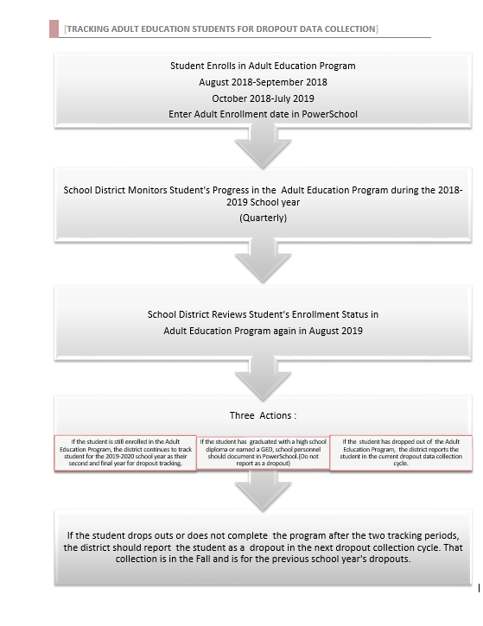

Slide 31
Reporting Dropouts-Adult Education Tracked Dropouts
Students who were tracked during the 2017-2018 school year should be coded in PowerSchool. (Please note that the online tool is no longer available for this process. All data will be reported utilizing the PowerSchool system.)
Please follow the instructions below to ensure that the students are correctly coded:
Run a PowerSchool query to identify the students coded with the W38 (Adult Education Diploma Tracking) and W40 (Adult Education GED Tracking) during the 2017-18 school term.
Enter the dropout reason code and a dropout date and then the Adult Education entry date and exit date in the appropriate field on the South Carolina Student Information page (see the graphic below). NOTE: The dropout date must fall between October 1, 2018–September 30, 2019.

Slide 32
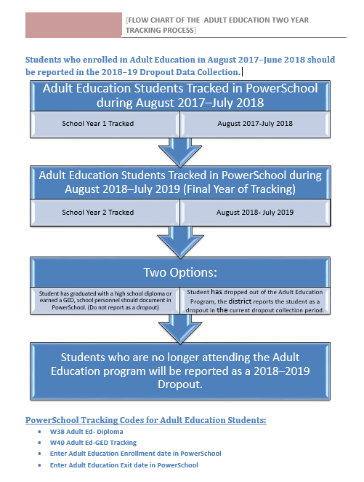

Slide 33
Reporting Dropouts
Selecting the Exit Code W36 in PowerSchool
Selecting the Dropout Reason Code in PowerSchool
Entering a Dropout Date in PowerSchool

Slide 34
Reporting Dropouts
Selecting the W38 Adult Education Diploma Tracking in PowerSchool
Selecting the W40 Adult Education GED Tracking in PowerSchool
Selecting the Adult Education Entry Date and Exit Date
GED Earned
Adult Education Graduation Date

Slide 35
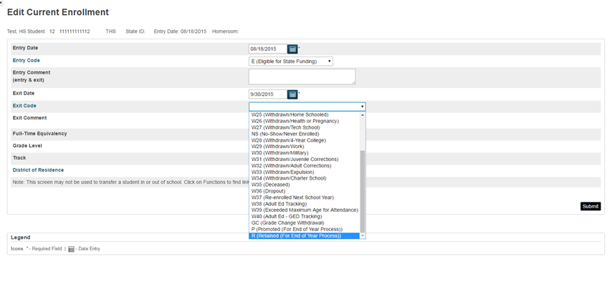
Dropout Data Coding Information

Slide 36
Dropout Reporting
Accurate coding of a Dropout
W36 + dropout reason + dropout date
No show dropout + dropout reason + dropout date
Withdrawal code + dropout reason + dropout date
Adult Education Dropout
W38 (Adult Education Diploma Tracking) and W40 (Adult Education GED Tracking)
Dropout reason code + dropout date + Adult Education entry date+ exit date

Slide 37
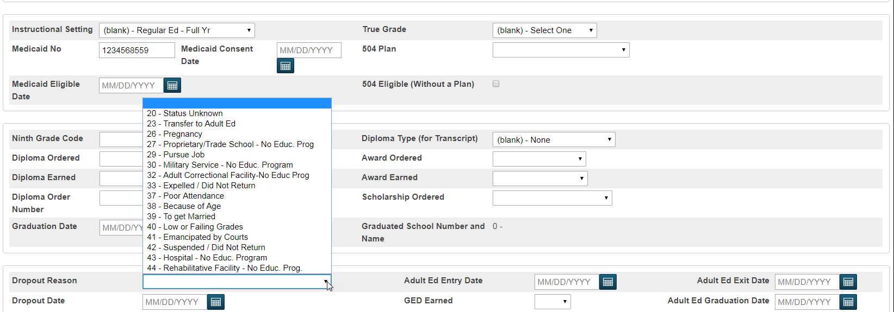

Slide 38
Dropout Reporting
Ensure that the following fields are completed for each student:
student’s grade level
student’s full legal name
student’s number
student’s SUNS (State ID) number
student’s ethnicity
student’s gender
student’s date of birth
student’s free/reduced meals status
student’s English proficiency
student’s migrant status
homeless
EFA codes
exit code
dropout reason code
dropout date
Instructional setting

Slide 39
Dropout Information
Dropout Data Report 2017–2018
Reports will be available by soon:
https://ed.sc.gov/districts-schools/school-safety/discipline-related-reports/dropout-data/

Slide 40
Common Dropout Errors
Student(s) with duplicate SUNS ID numbers
Student(s) with incorrect student ID numbers
Student(s) listed in more than one school in your district
Student(s) listed in more than one school district
Student(s) with missing race information
Student(s) with missing gender information
Student(s) with missing birth date information
Student(s) with missing grade information
Student(s) with missing dropout reason
Student(s) with missing dropout date

