Slide 1
Chronic Absenteeism Reporting 2019-20
Aveene R. Coleman
Student Intervention Services

Slide 2
Chronic Absenteeism and Truancy
Chronic Absenteeism | Truancy
Chronically absent: Any student in grade K-12 who misses 50 percent or more of the instructional day for any reason for 10 percent (or more) of the enrollment period. • All types of absences contribute to chronic absenteeism: – Excused Absences – Unexcused Absences – Suspensions • A student is absent if he or she is not physically on school grounds and is not participating in instruction or instruction-related activities at an approved off-grounds location for at least half the school day. | Truant: A student between the ages 6– 17 who has accumulated unexcused absences on three consecutive days or has accumulated a total of five or more unexcused absences during the academic year. • Only full-day unexcused absences contribute to truancy. • Excused absences and suspensions do not affect truancy

Slide 3
Chronic Absenteeism
The 10 percent is based on the individual student’s enrollment
40 days enrolled= 4 days absent
90 days enrolled= 9 days absent
130 days enrolled= 13 days absent
180 days enrolled =18 days absent

Slide 4
Chronic Absenteeism
Chronic absenteeism reporting will include the following absences:
Excused Absences
Unexcused Absences
Suspensions

Slide 5
Chronic Absenteeism
Data will be reported at the school level
Grade Levels- K-12 (no age exemptions)
Students must be enrolled at least 10 days at any time during the school year to be reported as chronically absent
Data will be reported by:
  Gender
  Ethnicity/Race
  Disability Status
  504 Status
  LEP Status
  Homeless Status

Slide 6

Chronic Absenteeism
2016-17 South Carolina Chronic Absenteeism Data
13 % of students were reported as chronically absent
114, 580 students were reported as chronically absent
2017-18 South Carolina Chronic Absenteeism Data
13 % of students were reported as chronically absent
110,121 students were reported as chronically absent

Slide 7
Chronic Absenteeism
How should a student who enrolled at two schools, who is chronically absent at both during a school year be reported?
  Students are reported once at each school. Example: If a student is enrolled in school A for half the school year (90 days) and school B for the other half of the school year (90 days). The student is counted at both school A and B as chronically absent.
How should a student who is absent that attends school part-time be reported?
  The absence for a part-time student should be based on the student’s schedule instead of the school day. For example, if a student attends school normally for 4 hours daily, then an absence would be counted when a student is out of school two or more hours.

Slide 8

Attendance Awareness Campaign 2019
https://awareness.attendanceworks.org/

Slide 9


Slide 10
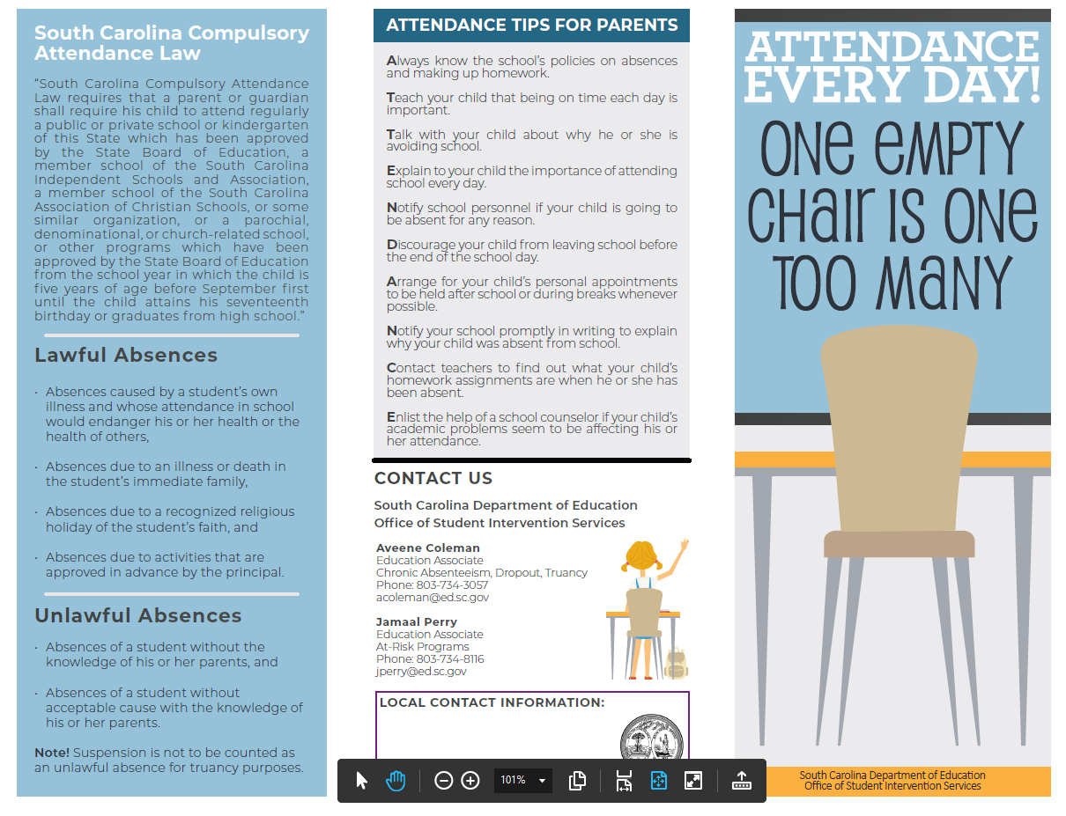

Slide 11
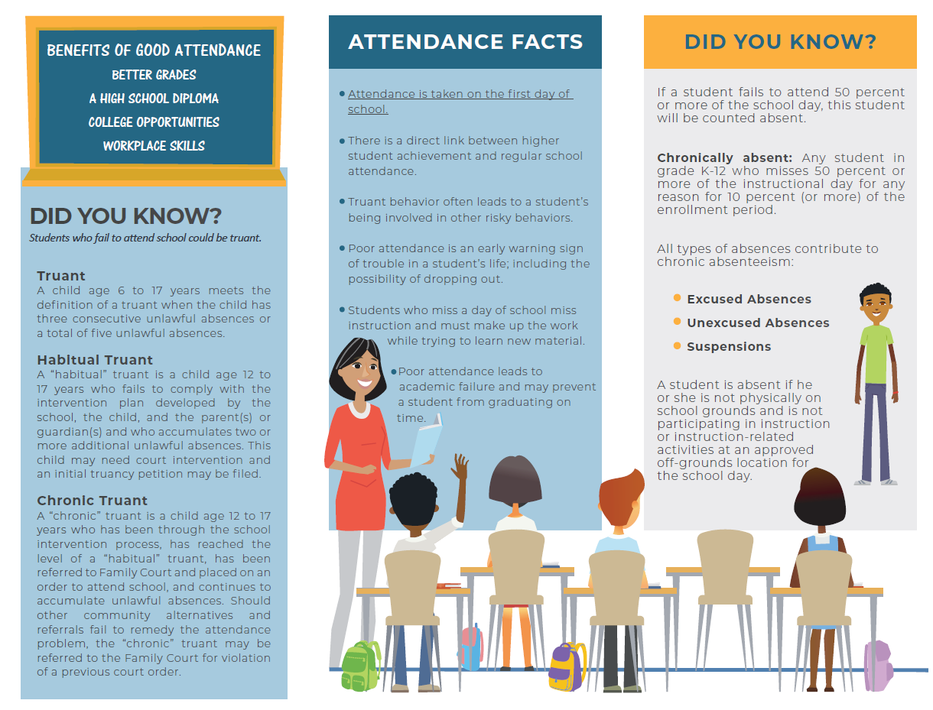

Slide 12
Chronic Absenteeism Updates
No new Attendance Codes
A request for a Nurse code to replace the LICE code
Updated SC 38 Chronic Absenteeism to select the Alternative School Program students
Updated Language
No Changes to Attendance Setup

Slide 13
Attendance Codes
  Make sure the following codes are included in 2019-20 School year attendance drop down
  Unexcused Parent Note (Absent) – Unexcused
  Skipping Class Code (Absent Code)-Unexcused
  Late Check In or Late arrival (Absent Code)-Unexcused

Slide 14
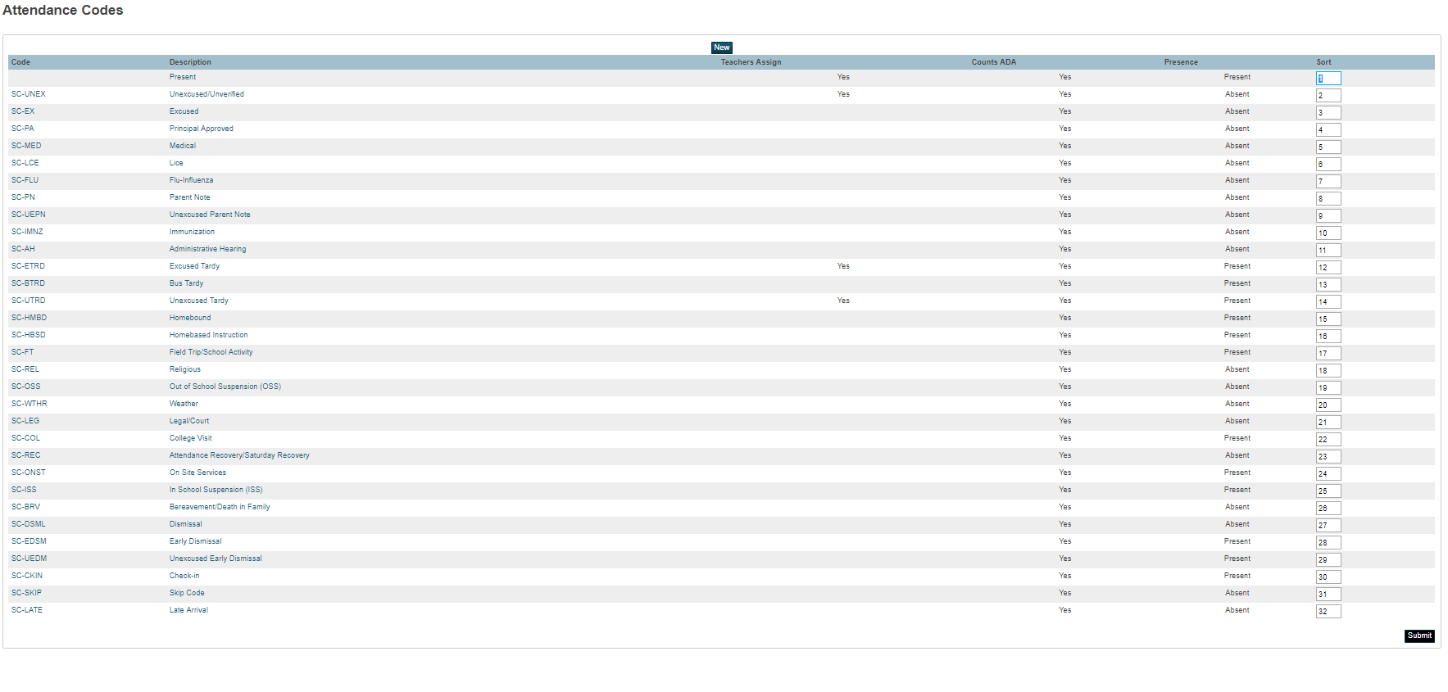
Standardized Attendance Codes

Slide 15
SCDE Standardized Attendance Codes
Description | Presence Status | Code | Code Category
Present | Present | blank | Present
Unexcused/Unverified | Absent | SC-UNEX | Unexcused
Excused | Absent | SC-EX | Excused
Principal Approved | Absent | SC-PA | Excused
Medical | Absent | SC-MED | Excused
Lice | Absent | SC-LCE | Excused
Flu-Influenza | Absent | SC-FLU | Excused
Parent Note | Absent | SC-PN | Excused
Unexcused Parent Note | Absent | SC-UEPN | Unexcused
Immunization | Absent | SC-IMNZ | Excused/Unexcused
Administrative Hearing | Absent | SC-AH | Excused
Excused Tardy | Present | SC-ETRD | Tardy
Bus Tardy | Present | SC-TRD | Tardy
Unexcused Tardy | Present | SC-UTRD | Tardy
Homebound | Present | SC-HMBD | Present
Homebased Instruction | Present | SC-HBSD | Present
Field Trip/School Activity | Present | SC-FT | Present

Slide 16
SCDE Standardized Attendance Codes
Description | Presence Status | Code | Code Category
Religious | Absent | SC-REL | Excused
Out of School Suspension (OSS) | Absent | SC-OSS | OSSusp
Weather | Absent | SC-WTHR | Excused
Legal/Court | Absent | SC-LEG | Excused
College Visit | Present | SC-COL | Present
Attendance Recovery/ Saturday Recovery | Absent | SC-REC | Excused
On Site Services | Present | SC-ONST | Present
In School Suspension (ISS) | Present | SC-ISS | Present
Bereavement/Death in Family | Absent | SC-BRV | Excused
Dismissal | Absent | SC-DSML | Excused/Unexcused
Early Dismissal | Present | SC-EDSM | Present
Unexcused Early Dismissal | Present | SC-UEDM | Present
Check-In | Present | SC-CKIN | Present
Skip | Absent | SC-SKIP | Unexcused
Late | Absent | SC-LATE | Unexcused

Slide 17
Attendance Codes
Early Dismissal (SC – EDSM) - this code should be used if the student has attended 50% or more of the school day and is leaving early. This is a present code.
Dismissal (SC–DSML) - this code should be used if a student has attended less 50 percent of the school day. This is an absent code.
Check-In (SC-CKIN)-this code should be used if a student leaves school for an appointment and returns to school. The student must have attended school for 50% or more of the school day. This is a present code.
Skipping Class Code (SC-SKIP)- this code should be used if the student is deliberately not attending class without parent or school approval. This is an unexcused absent code.
Late (SC-LATE)-this code should be used if a student is extremely late to school, without an excuse. The student attended less 50 percent of the school day. This is an unexcused absent code.

Slide 18
Chronic Absenteeism
*Daily – Elementary School (1 period in Bell Schedule).-If a student leaves early, arrives late, or returns the time in and time out must be entered.
Meeting – Middle School, High School, Elementary School with more than 1 period in Bell Schedule. Attendance should be taken in every period. If the student leaves early, arrives late, or returns the attendance should be updated. The time in and time out can be entered in the Time comment section only.

Slide 19
Chronic Absenteeism- Daily Attendance Schools
Students attending 50% or more of the school day Attendance Codes (Daily Attendance)
Present
SC-EDSM*
SC-ETRD*
SC-UTRD*
SC-CKIN*
SC-FT
SC-HMBD, SC HBSD, SC ISS
* Time and Time out is entered
Students attending less than 50 percent of the school day (Daily Attendance), but attended some portion of the school day.
Enter any absent Attendance Code + Time in and Time out
SC- DSML
SC-EX or SC UNEX
SC-MED
SC-LEG
SC-PN or SC UEPN
SC-LATE

Slide 20
Taking Daily Attendance
Entering an attendance for a student
Find and select the student.
Click on the Attendance page of the selected student.
On the Daily page for the Date you need to enter an attendance code, click on the character (M,T,W,H,F) of the day.
Select the appropriate Attendance Code from the drop down.
Leave Time In and Time Out blank.
Click Submit to save.

Slide 21
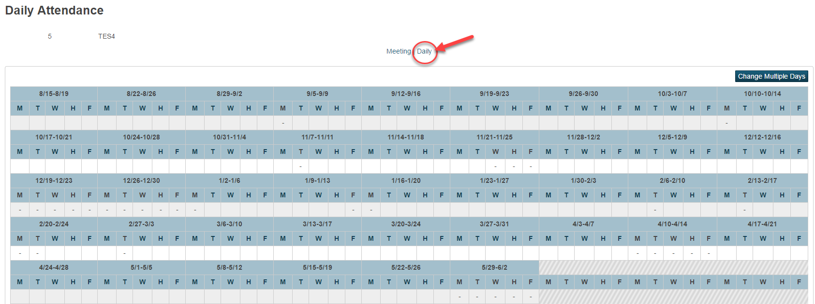
Entering Daily Attendance

Slide 22
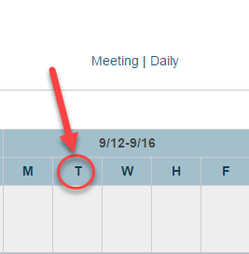
Entering Daily Attendance
To enter attendance, click on a day (M,T,W,H,F).

Slide 23
Entering Daily Attendance
Populate the fields below on the "Daily Attendance" page, then submit the page:
    Attendance Code - Select the appropriate attendance code.
    Comment - Enter a comment.
Recommended: Enter attendance codes that would benefit from additional detailed information (such as On Site Services, etc...)

Slide 24
Entering Daily Attendance
  Time In: Enter the time that the student arrived at school.
  Time Out: Enter the time that the student left school.
  Exclude from Total Time Calculation: Mark the box to exclude this attendance record from affecting the time attendance calculation for the day (optional).
  Time Comment: Enter a time comment if above is checked (optional).

Slide 25
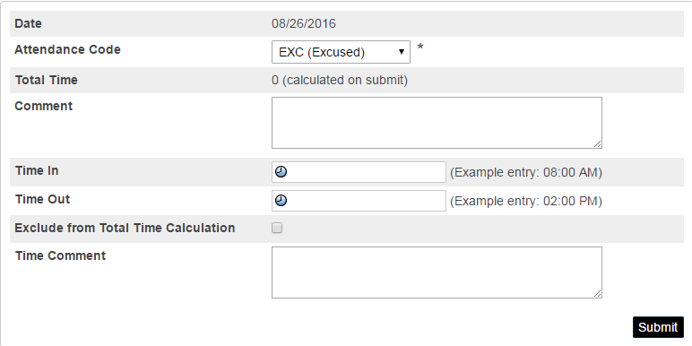
Entering Daily Attendance

Slide 26
Daily Attendance Scenarios
Scenario 1: Entering an attendance for a student that has been absent for the entire day.
Find and select the student.
Click on the Attendance page of the selected student.
On the Daily page for the Date you need to enter an attendance code, click on the character (M,T,W,H,F) of the day.
Select the appropriate Attendance Code from the drop down.
Leave Time In and Time Out blank.
Click Submit to save.

Slide 27
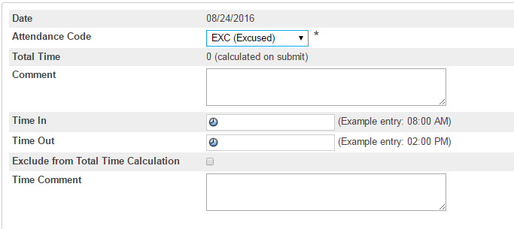
Daily Attendance Scenarios

Slide 28
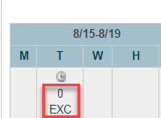
Daily Attendance Scenarios
A zero (0) will display above the Attendance Code when an absence Attendance Code is selected.

Slide 29
Daily Attendance Scenarios
Select the appropriate Attendance Code from the drop down.
Enter the Time In for when the student arrived at school.
Then enter the Time Out for when the student left school.
Click Submit to save.

Slide 30
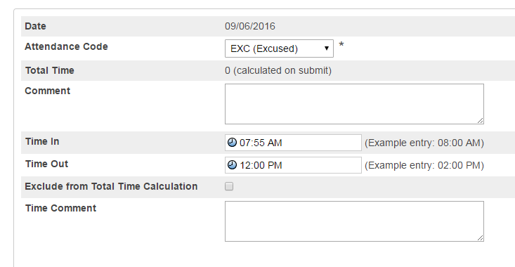
Daily Attendance Scenarios

Slide 31
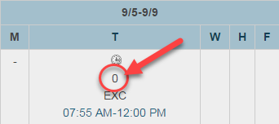
Daily Attendance Scenarios
When you enter a Time In and Time Out, the Attendance Code will display with zero (0) minutes above the attendance code.
The time out that was entered will display below.
Notes:
07:55 AM -12:00 PM Time In and Time Out reflects the amount of time the student was in instruction

Slide 32
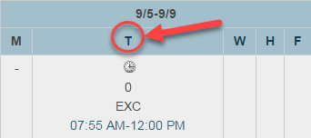
Daily Attendance Scenarios
To verify how many minutes were calculated for that day click on the day.

Slide 33
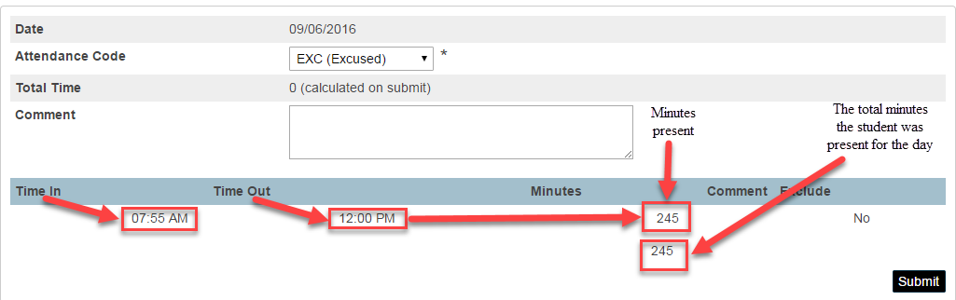
Daily Attendance Scenarios
The “Edit Daily Attendance” will open and the minutes the student was present for that day will appear.

Slide 34
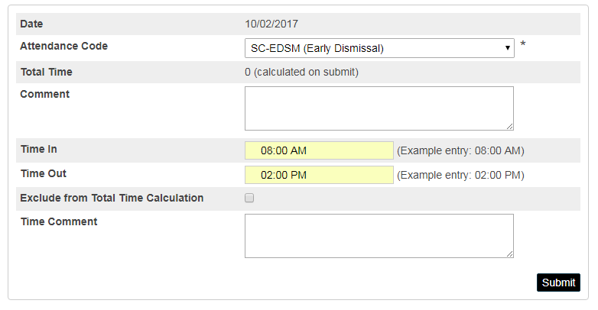
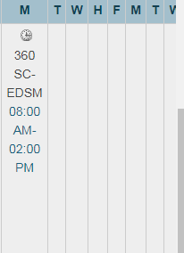
Chronic Absenteeism-Daily Attendance-Early Dismissal
Scenario 2: Entering an attendance code for a student who leaves school early, but attend 50 percent of the day.

Slide 35
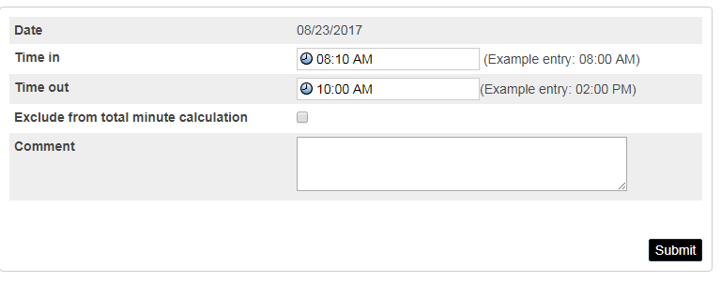
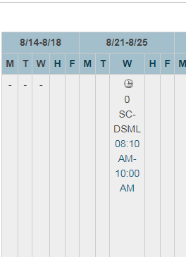
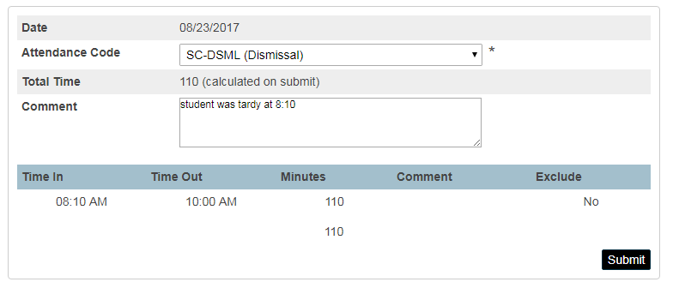
Chronic Absenteeism-Daily Attendance-Dismissal
Scenario 2: Entering an attendance code for a student who leaves school early, but did not attend 50 percent of the day.

Slide 36
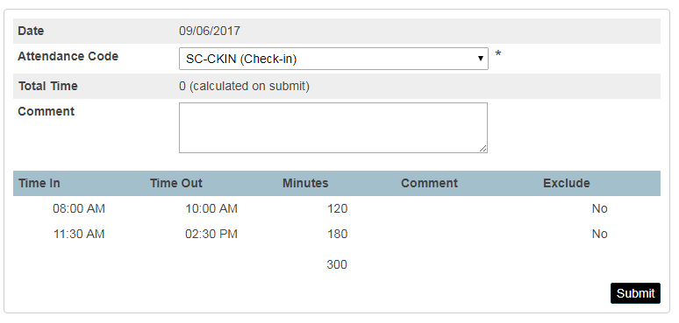
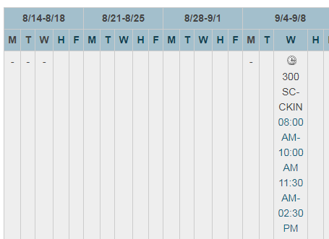
Chronic Absenteeism-Daily Attendance-Check-in
Scenario 2: Entering an attendance code for a student who leaves school for a medical appointment and returns. This student attend 50 percent of the day.

Slide 37
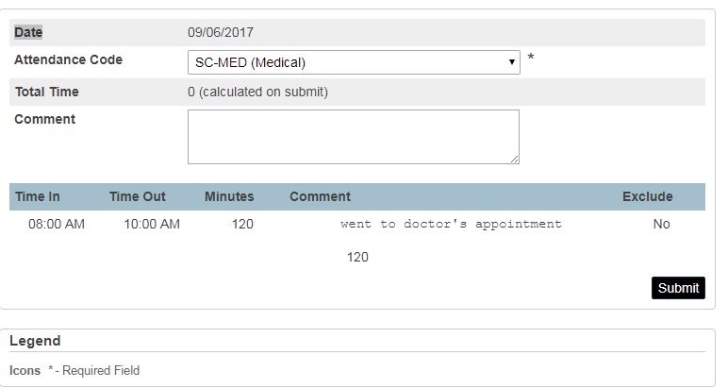
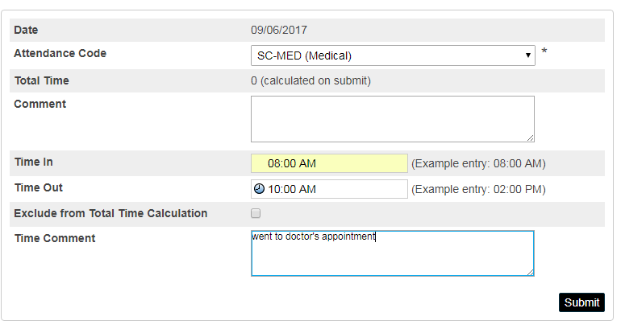
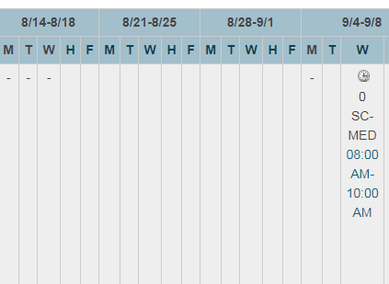
Chronic Absenteeism-Daily Attendance-Medical
Scenario 2: Entering an attendance code for a student who leaves for a medical appointment, but did not attend 50 percent of the day.

Slide 38
SC48 Daily Attendance Validation Report
SC 48 Daily Attendance Validation Report flags students who are coded with a present code who did not attend 50 percent of the school day.
The SC 48 Daily Validation Reports flags the following present codes listed below:
    Excused Tardy-SC-ETRD
    Bus Tardy-SC-TRD
    Unexcused Tardy-SC-UTRD
    Check-In-SC-CKIN
    Unexcused Early Dismissal-SC-UEDM
Schools must correct the information display on SC48 Daily Attendance Validation Report by entering an absent code. This report should be corrected before submitting the final chronic absenteeism data.

Slide 39
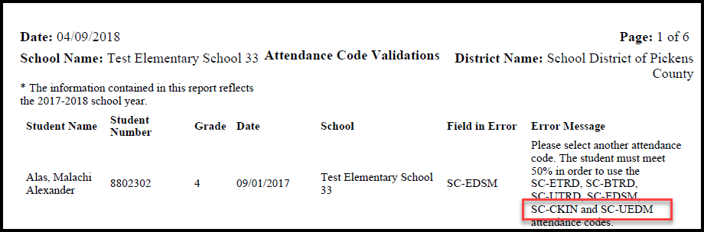
SC48 Daily Attendance Validation Report Changes
SC48 Daily Attendance Validation Report Changes.
Check-in and Unexcused Early Dismissal added to this report.
Note: This validation report is ONLY for schools that take daily attendance only. (Elementary Schools with 1 period in their Bell Schedule)

Slide 40
Chronic Absenteeism (Meeting Attendance)
Meeting Attendance:
The following scenario is based on a high school bell schedule of 423 minutes.
  A student is present if he/she are in instruction for 212 (211.5 rounded up) minutes, if a student is scheduled for 423 minutes.
  Attendance must be taken each class period.
The Chronic Absenteeism reports looks at the entire minutes in the bell schedule for a school day, then looks at the individual student’s schedule for a school day. See table below:

Slide 41
Chronic absenteeism (Meeting Attendance)
CA-Present
CA-Absent
Student | Scheduled minutes | Number of minutes | Present or Absent
Student A | 360 minutes | 180 (50% of the student’s schedule) | Present
Student B | 400 minutes | 200 (50% of the student’s schedule) | Present
Student C | 423 minutes | 212 (50% of the student’s schedule) | Present
Student | Scheduled minutes | Number of minutes | Present or Absent
Student A | 360 minutes | 179 (Not 50% of the student’s schedule) | Absent
Student B | 400 minutes | 199 (Not 50% of the student’s schedule) | Absent
Student C | 423 minutes | 211 (Not 50% of the student’s schedule) | Absent

Slide 42
Entering Meeting Attendance
Middle Schools and High Schools will have to take attendance every period (meeting).
  Select a student from the Start Page.
  Click Attendance on the student's screen.
  Select Meeting from the top of the page.

Slide 43
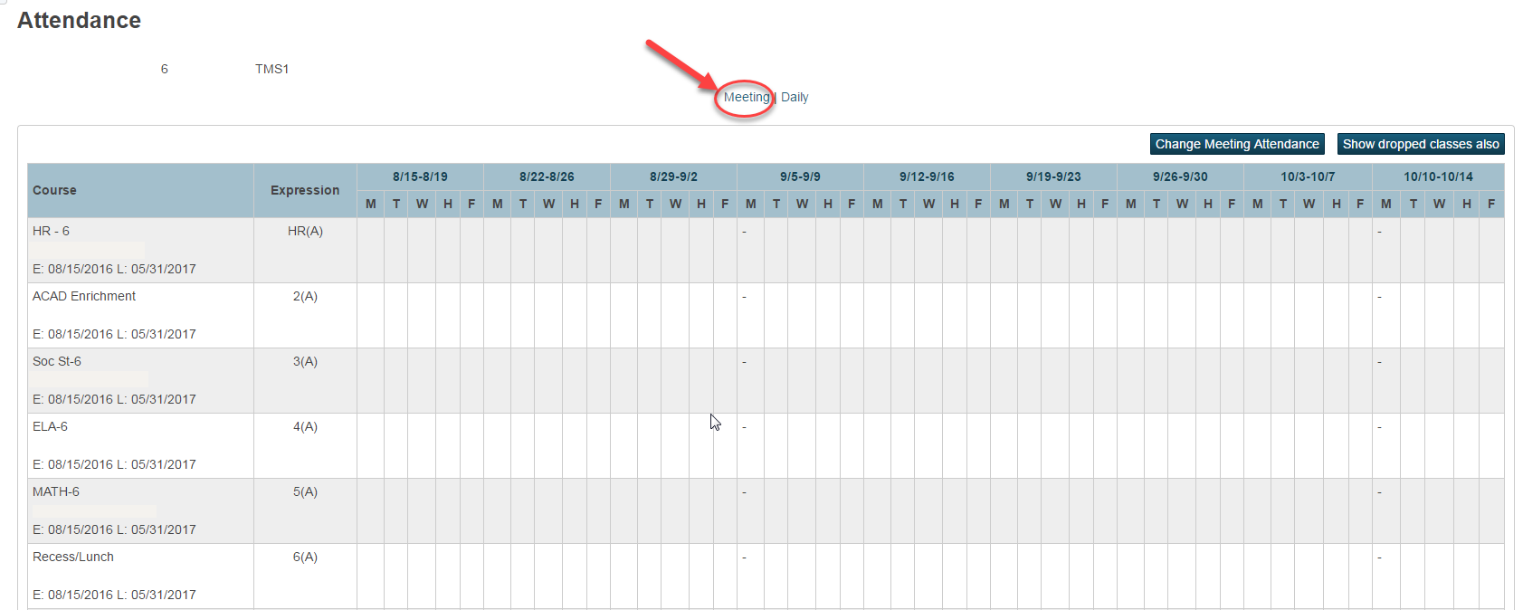
Entering Meeting Attendance

Slide 44
Entering Meeting Attendance
The Meeting attendance screen displays seven weeks across the top of the page and the student's active enrollments along the left hand side, listed according to expression.
To enter attendance, click on a week (9/5-9/9).
Note: If the appropriate week is not listed, change the term at the top of the page to a term with a date range that includes the week.

Slide 45
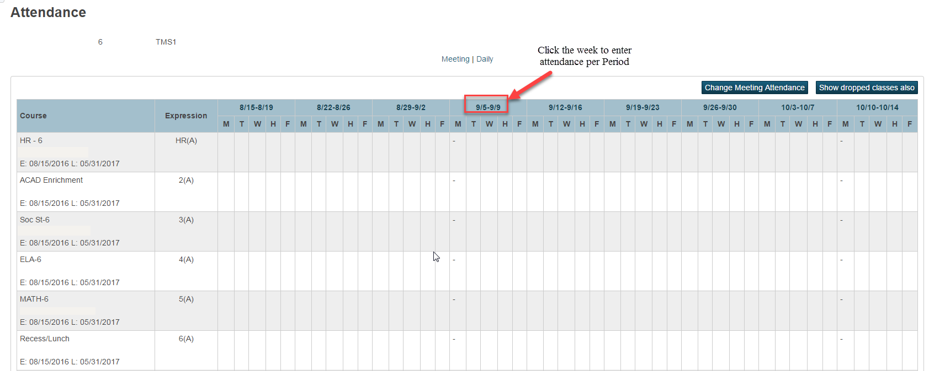
Entering Meeting Attendance

Slide 46
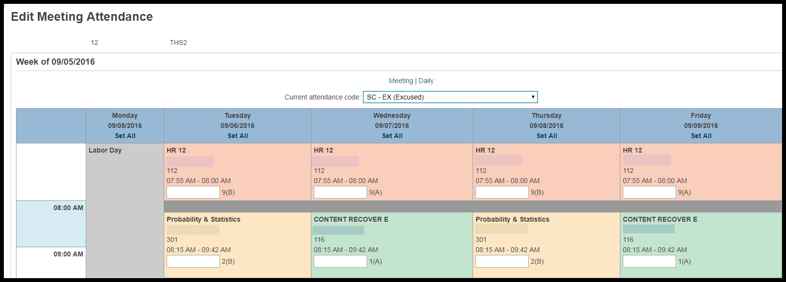
Entering Meeting Attendance
Select an attendance code from the "Current attendance code" drop-down.

Slide 47
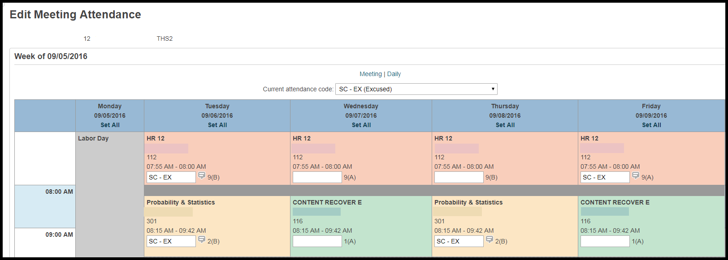
Entering Meeting Attendance
After selecting the “Current attendance code,” click in each expression box for each period the student needs an absence attendance code.

Slide 48
Entering Meeting Attendance
Click Submit to save changes
Note: When taking meeting attendance, there is no field to enter Time In and Time Out. Enter Time In and Time Out in the comments.

Slide 49
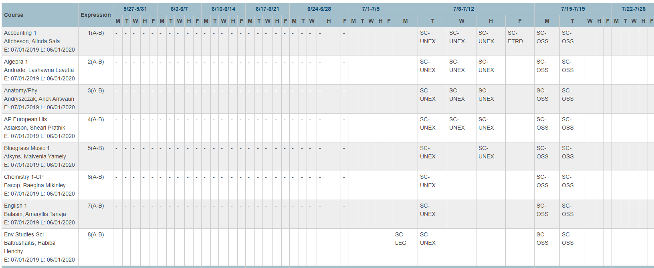
Meeting Attendance

Slide 50
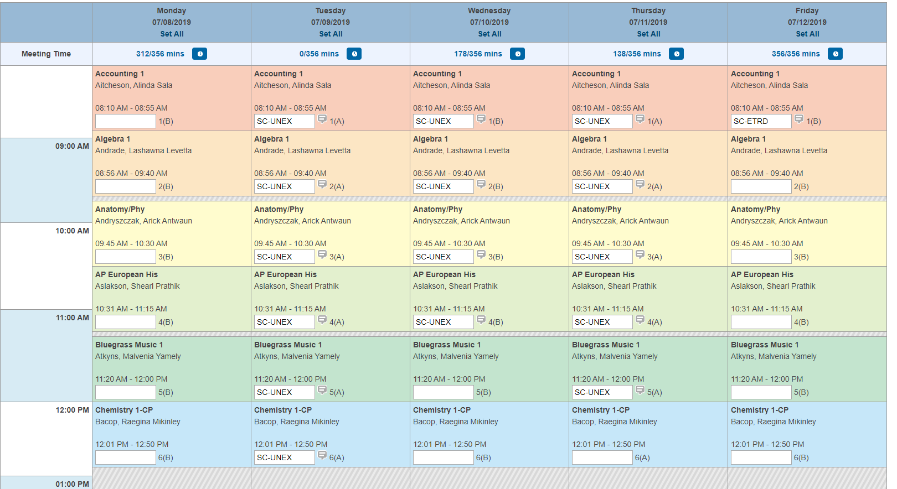
Meeting Attendance

Slide 51
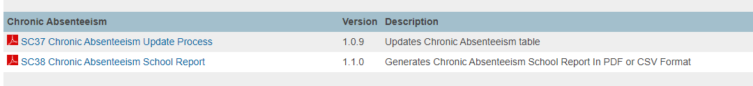
Customized Chronic Absenteeism, Attendance Reports
On the Start page click System Reports.
Click on the State tab.
    Chronic Absenteeism
    Attendance

Slide 52
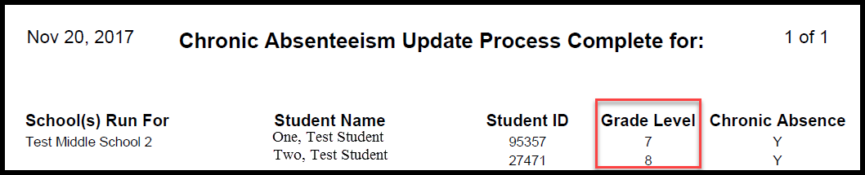
SC 37 Chronic Absenteeism Update Process
The Chronic Absenteeism Update Process will flag students identified as chronically absent. The student must meet the following requirements to be flagged as “Y” for chronically absent:
A student must be enrolled at a school for at least 10 membership days to be included in the calculation.
A student will be flagged as a ‘Y’ (chronically absent) if the attendance recorded in PowerSchool reaches or exceeds the 10 percent days absent of membership days. Absences will include excused, unexcused and/or out of school suspensions.
A student is considered absent if not present 50% or more of the school day.

Slide 53
Chronic Absenteeism
Reminders
Please make sure the following steps are followed before submitting data to SCDE:
  Run the SC 37 Chronic Absenteeism Update Process for all schools in the district.
  Run the SC 38 Chronic Absenteeism School Level Report (pdf version) for all schools in the district.
  Review the school membership days at the top of the SC 38 Chronic Absenteeism School report to ensure the information is updated to the current collection cycle
  Review the report to ensure that the students are reported accurately.
  Review the entry and exit dates for students identified to ensure that this information is correct.
  Review the reports to ensure that “No Show” students are not reported.
  Compare the ADT reports to SC 38 Chronic Absenteeism School Level Report (pdf version) for all schools in the district.

Slide 54
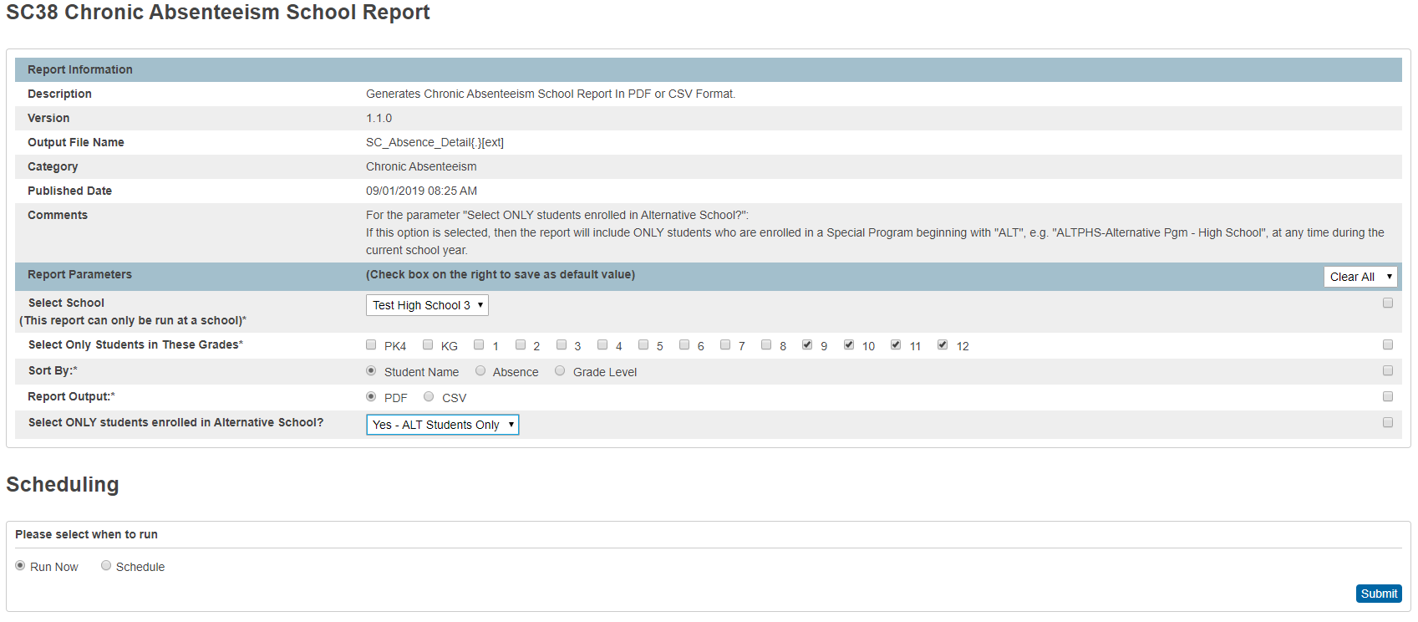

SC38 Chronic Absenteeism School Report
Select Alternative Students Only was added to the input page.

Slide 55
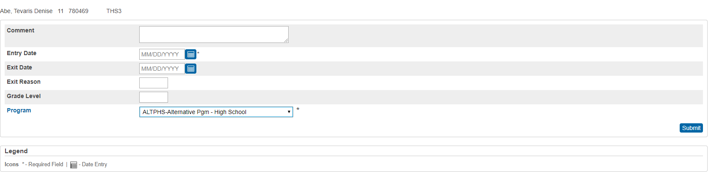

SC38 Chronic Absenteeism School Report
Make sure all Alternative School Program students are coded under the special program field with an entry date

Slide 56
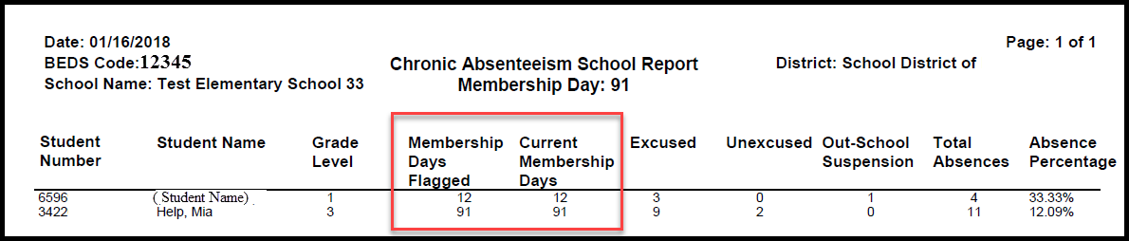
SC38 Chronic Absenteeism School Report
Notes:
Output of the report
Parenthesis around a student’s name identify them as being inactive students.

Slide 57
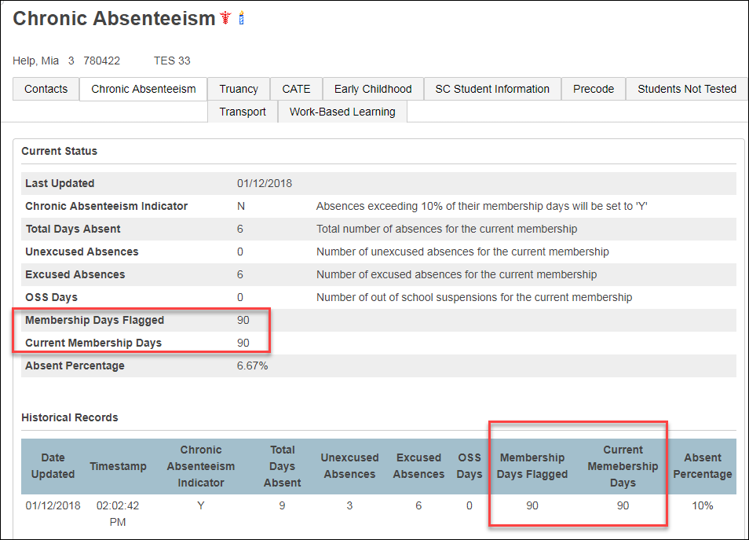
Chronic Absenteeism Page
Calculation- Total Days Absent/Current Membership days X 100= Absent Percentage
6/90 X 100=6.67%

Slide 58
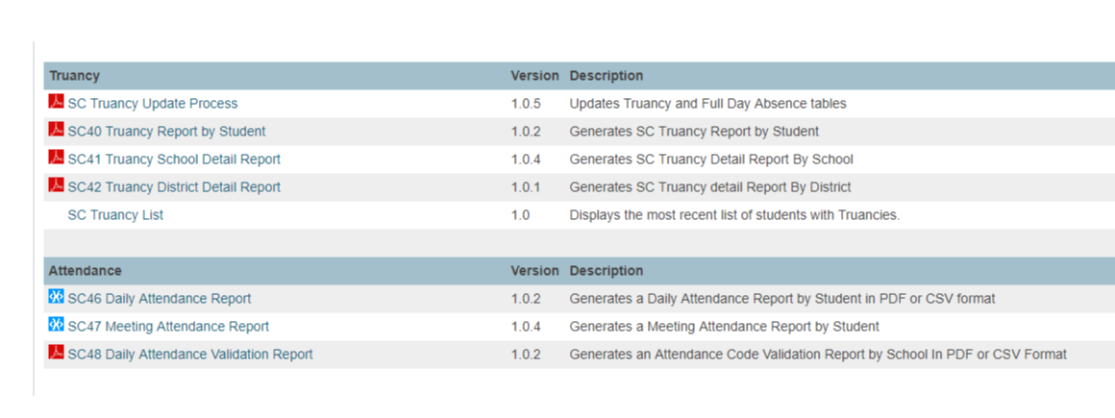
SC 46 Daily Attendance &
SC 47 Meeting Attendance

Slide 59
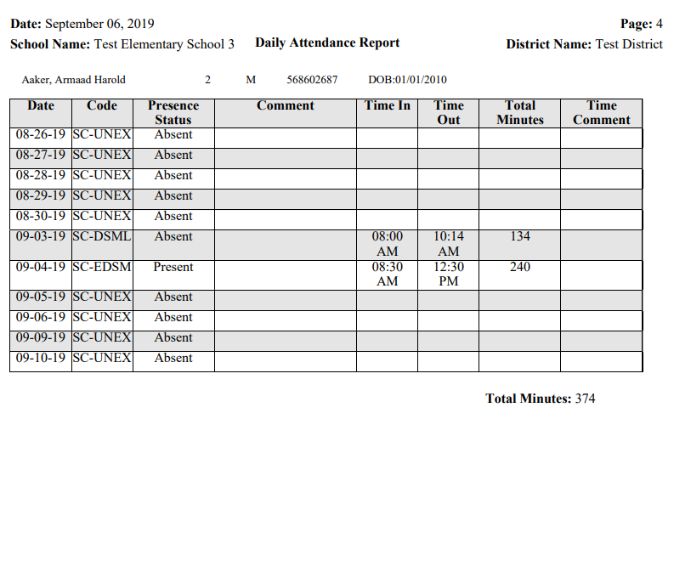
SC46 Daily Attendance PDF Report

Slide 60
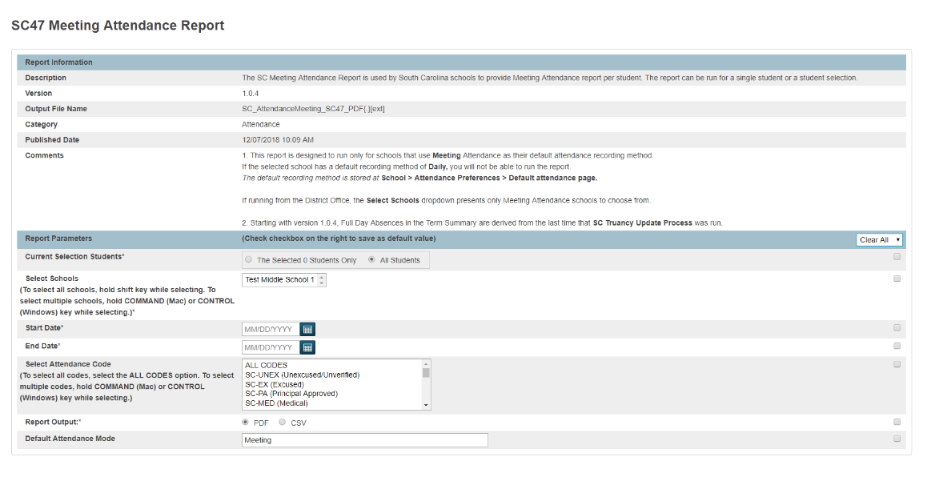
SC 47 Meeting Attendance Report

Slide 61
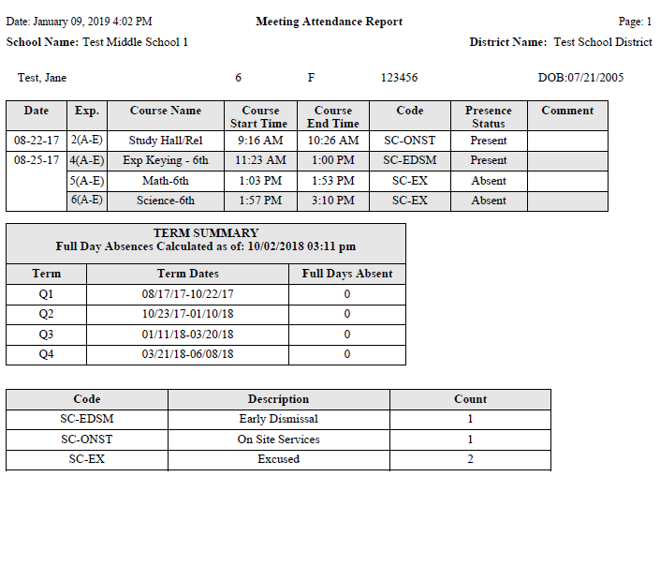
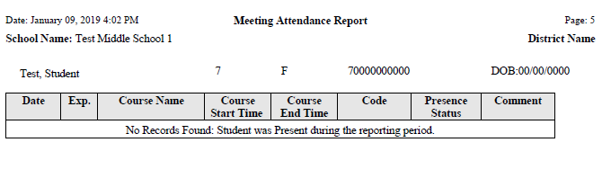
SC 47 Meeting Attendance Report

Slide 62
Chronic Absenteeism
  Monitoring Attendance Data
  Ensure that Attendance is taken and entered daily
  Provide School Level Reports Weekly
  Establish a School Level Attendance Team
  Identify Attendance Interventions at School Level
  Implement Interventions
  Review Outcomes of Interventions

Slide 63
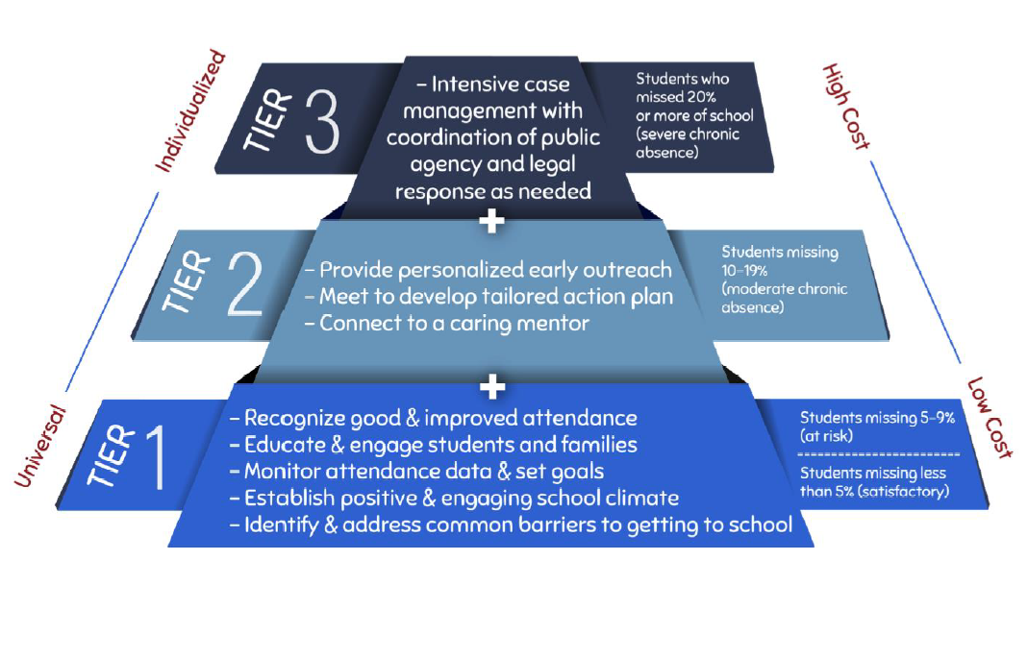
Chronic Absenteeism
Source: http://www.attendanceworks.org/

Slide 64
Create your own Tiered System of Supports For Improving Attendance
Source: http://www.attendanceworks.org/

Slide 65

Chronic Absenteeism
https://www.future-ed.org/wp-content/uploads/2019/07/Attendance-Playbook.pdf

Slide 66

Every Student, Every Day

Slide 67
Source/Resources
http://www.attendanceworks.org/
http://www2.ed.gov/datastory/chronicabsenteeism.html?src=pr#intro
http://www2.ed.gov/about/inits/ed/chronicabsenteeism/index.html
www.ed.sc.gov
http://new.every1graduates.org/nsaesc/
http://absencesaddup.org/

