Slide 1

The Charter Institute at Erskine
Human Resources
Collaboration Workshop
August 1, 2019

Slide 2

Objectives
Recognize the Charter Institute at Erskine’s Background and Mission
Understand Compliance Regulations/Requirements such as Zero Tolerance, FMLA, Immunization Requirements, TB Testing, Employee Handbooks, Employee File Retention, Administrative Leave, and School Safety
Identify shared responsibilities between Institute Human Resources and Schools relative to processing PCS, Insurance Benefits, and Insurance Billing
Explain the job posting process, applicant selection process, and hiring best practices
This Photo by Unknown Author is licensed under CC BY

Slide 3
BEAT THE CLOCK!!! Word Scramble
F
U
B
J
Q
N
Z
A
S
T
E
K
O
I
W
Y
L
R
D
C
V
G
M
X
H
P

Slide 4


BEAT THE CLOCK!!! Word Scramble
One of the most important documents for completion is the …
OFRM SPC

Slide 5
BEAT THE CLOCK!!! Word Scramble
At a minimum, all vacancies should be posted to…
hsColos’ ewebsit

Slide 6
BEAT THE CLOCK!!! Word Scramble
Each school should have an………..handbook
EPEYELOm

Slide 7
BEAT THE CLOCK!!! Word Scramble
Only eligible employees are entitled to take…….leave
LAFM

Slide 8
BEAT THE CLOCK!!! Word Scramble
References and ……….checks should be done on all perspective employees…
kbacdnugro

Slide 9
BEAT THE CLOCK!!! Word Scramble
……manages insurance programs for SC Public workforce
APEB

Slide 10

The Charter Institute at Erskine (The Institute)
Who Are We?
What Do We Do?
When Did We Start?
Where Are We Located?
How Will We Do It?

Slide 11
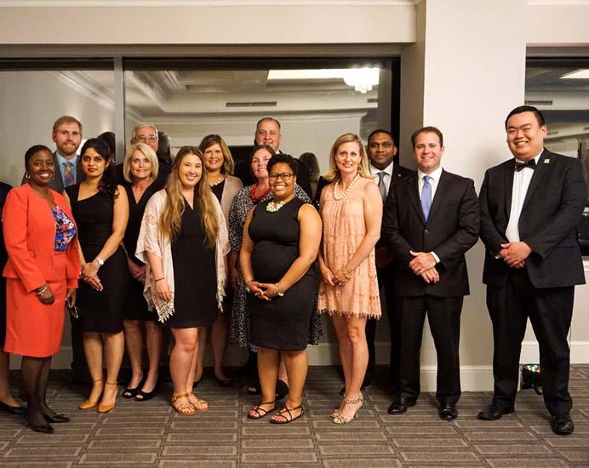
Who Are We and What Do we Do?
Who Are We?
A Charter School Authorizer reviews applications for new charters, grant charters, and oversees the accountability and public supervision of schools in the Institute
Our Mission
To empower families and local communities through the establishment and competent operation of high-quality charter schools throughout South Carolina.
Our Team
Highly Experienced and Competent Educational Leaders
Understands Unique Needs of Public Charter Schools
Combined 67 Years of Direct Classroom Experience

Slide 12
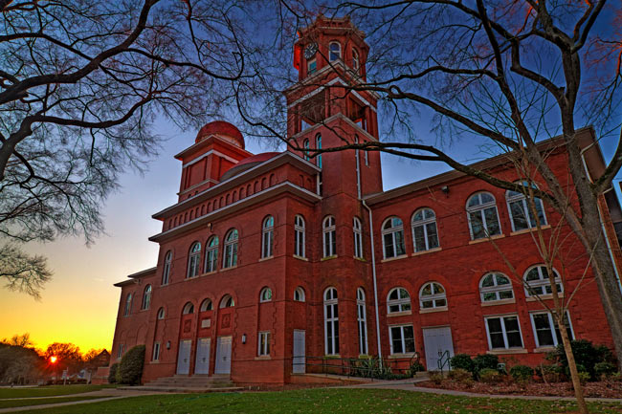
When Did We Start?
Erskine College sponsored The Charter Institute at Erskine in May 2017
The Institute began sponsoring Charter Schools during the same time period
Sponsorships were approved by the Department of Education.

Slide 13

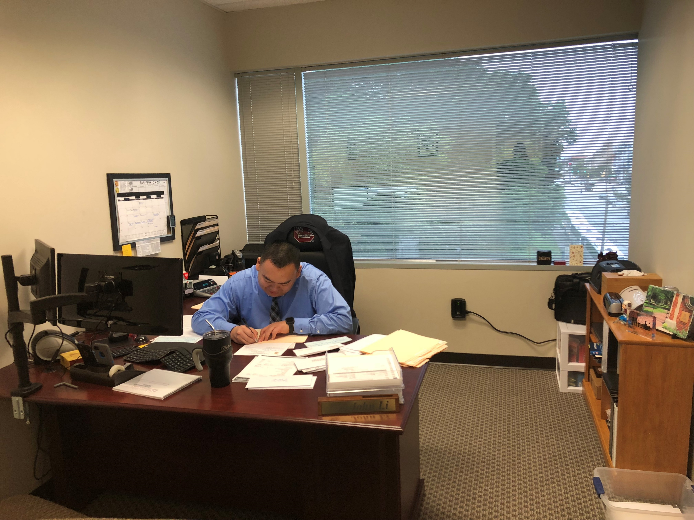


Where Are We Located
New Office located at 1201 Main St, Columbia, SC 29201
Centrally Located:
    Anew cross from Statehouse
    1201 Main Street, Columbia, SC 29201, Suite 300
    Centrally Located:
      Across from Statehouse
      Two blocks from SC Department of Education
The Charter Institute at Erskine

Slide 14
How Will We Do It?
High-quality customer service to the schools
Technical assistance to schools in several areas of operations such as:
  Student Services
  Federal Programs Procedures and Finance
  School Services
    State and Academic Programs
  Communications
  Finance
  Human Resources
  Accountability and Test Data Analysis
  PowerSchool Oversight and State Reporting/Collections

Slide 15

SC Department of Education Compliance
PCS – Professional Certified Staff Requirements
  PCS Form Importance
  PCS Form Completion PCS Form
Teacher Certifications and Renewals
  Renewals/Extensions
  Add-Ons
  Name/Address Changes
  Class Changes
  Additional Information here
Required Vaccinations
  Back-to-School Immunization Toolkit

Slide 16

Job Posting Requirements
In order to comply with the Equal Employment Opportunity Act, and be in line with State job vacancy posting requirements
Post all vacant positions. Exceptions Include:
  You promote an employee one organizational level above the employee's current level;
  An employee is reassigned to another position;
  The school leader/board determines that an emergency exists requiring the vacancy to be filled immediately;
  An employee, in lieu of a Reduction in Force, is moved to a vacant position; or
  An employee is demoted to another position for disciplinary or performance reasons.
Notices should be posted for at least five (5) workdays prior to the close of the application period.
I
This Photo by Unknown Author is licensed under CC BY-NC-ND

Slide 17

Job Posting Process
The description of the job responsibilities;
Entry salary or salary range;
Name of school and location where vacancy exists;
Description of the application process;
Minimum training and experience requirements and any preferred qualifications for the position;
The opening and closing dates for applying for the position;
Normal work schedule and whether the position is full-time or part-time; and
A statement certifying that the employer is an equal employment opportunity employer.

Slide 18
Job Posting Process – Cont.
All vacancies should be posted on your school’s website and the Public Charter School Alliance of SC, if a member.
All administrative vacancies should be posted on the Institute’s website and any other preferred venue. Options are:
  The SC Association of School Administrators
  CERRA – for Certified Vacancies - Director of Human Resources and Benefits will post positions to this site on your behalf
**Important Reminder
The South Carolina Charter Schools Act requires that at least one administrative staff must be certified or experienced in the field of school administration. Ensure one of your staff meets this qualification.

Slide 19

Job Applicants
When an applicant expresses interest in a position, review resumes/application to ensure that he/she meets the basic or preferred qualification
Interview the Most Qualified Prospective Employees
  Telephone Screening
  In person Interview type:
    Panel
    Hiring Manager and/or Human Resources
    Second Interviews
Develop Standard Interview Questions
  Behavioral Interview Questions
  Illegal Questions
This Photo by Unknown Author is licensed under CC BY-NC-ND

Slide 20

Job Applicants - Cont
Selection Process
Select Most Qualified Applicant
Check References and Perform Background Checks
The Job Offer
  Verbal offers should be followed by a written letter of offer contingent upon acceptable background check
  Offer letters should state that the position is at-will and may be broken by either party with no explanation
Negotiate Salary Details and Start Date
Notify applicants not selected
This Photo by Unknown Author is licensed under CC BY-SA-NC

Slide 21
Workplace Compliance
Employee Handbook Inclusions
Employee Files
TB Testing
Administrative Leave
Family Medical Leave Act (FMLA)
Sexual Harassment Policy – Zero Tolerance
School Safety Plans

Slide 22

Employee Handbook
Given to all school employees
Signature page acknowledging receipt
Should include, at a minimum:
  Mission Statement
  EEO Statement
  Leave and Holiday Guidelines
  Pay Guidelines
  Zero Tolerance
  Travel Reimbursement
  Confidentiality Expectations
Notes:
The Institute receives calls constantly from employees of the schools asking questions that should be answered in their handbook.

Slide 23
Employee Handbook – Cont.
  Ethics
  Performance Reviews
  Social Medial Policy
  Sexual Harassment Policy
  Reporting Suspected Violations
  Grievance Policy
  Progressive Discipline Process
  Benefits
Notes:
The Institute receives calls constantly from employees of the schools asking questions that should be answered in their handbook.

Slide 24
Employee Files
What Should and Shouldn’t Be Included
General Personnel Files
All Job-related Documentation
  Hiring Records
    Resumes
    Employment Applications
    Background Checks
    Offer Letters
  Performance reviews
  Emergency Contact Information
  Disciplinary Actions
  Job Descriptions
Medical Records
The Americans with Disabilities Act (ADA) prohibits employers from including medical information in an employee's general personnel file.
Medical records must be maintained separate from the personnel file
Medical Records include:
  Medical Leave
  Reasonable Accommodations
  Workers Compensation
  Self-Identification under the ADA
  Any other medical related form

Slide 25

Employee Files - Continued
Confidential/Sensitive Information
Information which should never be accessible to managers and supervisors include:
Birthdate and marital status
Dependent information
Social Security number
Immigration status/national origin
Race, Gender, Religion
Sexual Orientation
Criminal history
This Photo by Unknown Author is licensed under CC BY

Slide 26
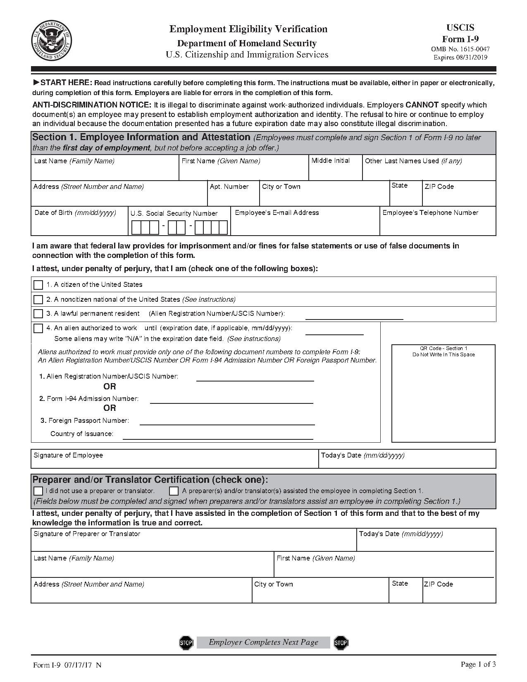

I-9 Form Completion and E-Verify
I-9 Forms
An employee must complete Section 1 of Form I-9 by his or her first day of work.
The employer must complete Section 2 of Form I-9 by the end of the third business day
I-9 forms must be kept in a separate file
Employers must retain an employee's completed Form I-9 for as long as the individual works for the employer.
Once the individual's employment has terminated, the employer must determine how long after termination the Form I-9 must be retained, which is either three years after the date of hire or one year after the date employment is terminated, whichever is later.
E-Verification
Federal and SC law requires employers to verify the legal status of all new hires through E-Verify within 3 days from the date of hire
SC Law requires employers report newly hired employees on SC New Hire within 20 days from their first day at work.
Links
E-Verify : https://www.e-verify.gov/employers
SC New Hire: https://newhire.sc.gov/

Slide 27

TB Testing
TB Testing Requirements for Schools/Childcare Employees Include:
One single Tuberculin Skin Test (TST) or Interferon-Gamma Release Assays (IGRAs)
Documentation of screening must be documented on DHEC 1420 School Employee Certificate of Evaluation for Tuberculosis form
Test Screenings must be completed within twelve months before hire for those new to working in schools or child care centers.
Potential employees and health care providers may get a blank copy of the DHEC 1420 Here.

Slide 28

Administrative Leave
Administrative leave is a temporary leave from a job assignment, with pay and benefits. It may be granted for the following reasons:
Physical attack or accidental injury while in the course of employment. The leave may not exceed 180 calendar days, per incident. Workers Compensation Claims must be filed.
To allow individuals to improve themselves academically and to engage in research to foster their effectiveness as teachers and scholars.
To remove an employee from the workplace pending the outcome of a personnel/HR investigation.
This Photo by Unknown Author is licensed under CC BY-SA-NC

Slide 29
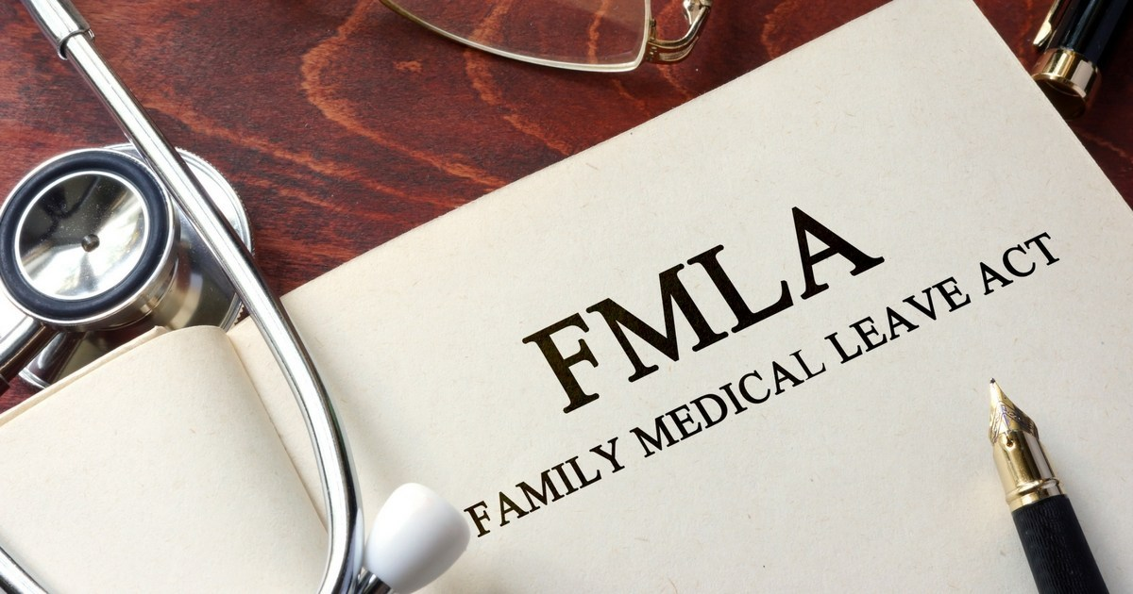
FMLA
The Family and Medical Leave Act (FMLA) entitles eligible employees of covered employers to take unpaid, job protected leave for specified family and medical reasons.
Regulations
https://www.dol.gov/whd/regs/compliance/whdfs28.htm

Slide 30
FMLA Continued
COVERED EMPLOYERS
The FMLA only applies to employers that meet certain criteria. A covered employer is a:
Private-sector employer, with 50 or more employees in 20 or more workweeks in the current or preceding calendar year, including a joint employer or successor in interest to a covered employer;
Public agency, including a local, state, or Federal government agency, regardless of the number of employees it employs; or
Public or private elementary or secondary school, regardless of the number of employees it employs.

Slide 31

FMLA Continued
ELIGIBLE EMPLOYEES
Only eligible employees are entitled to take FMLA leave. An eligible employee is one who:
Works for a covered employer;
Has worked for the employer for at least 12 months;
Has at least 1,250 hours of service for the employer during the 12- month period immediately preceding the leave; and

Slide 32
FMLA Continued
Employer Notification Requirements under the Family and Medical Leave Act
All covered employers must display a general notice about the FMLA (FMLA poster). Additionally, covered employers who have employees who are eligible for FMLA leave must:
Provide employees with general notice about the FMLA;
Notify employees concerning their eligibility status and rights and responsibilities under the FMLA; and
Notify employees whether specific leave is designated as FMLA leave and the amount of time that will count against their FMLA leave entitlement.
Detailed information: https://www.dol.gov/whd/regs/compliance/whdfs28d.htm

Slide 33
FMLA Continued
FMLA Forms are provided at: https://www.dol.gov/whd/fmla/forms.htm
These are quick links to the two most common ones you’ll need:
WH-380-E: FMLA Certification of Health Care Provider for Employee’s Serious Health Condition
WH-380-E Form & Instruction
WH-380-F: FMLA Certification of Health Care Provider for Family Member’s Serious Health Condition
WH-380-F Form & Instruction

Slide 34

Websites
There are typically two primary purposes for any school website
One is to provide timely, engaging, and current information to your current parents, students, staff, and community.
The second purpose is to attract new students (through their parents or guardians) and to recruit quality staff.
Ensure the following is done:
Review website to ensure all sponsor links and references are changed to the Charter Institute at Erskine
Remove outdated information
Update information as needed
This Photo by Unknown Author is licensed under CC BY

Slide 35

Sexual Harassment Policy - Zero Tolerance
Our Position
The Charter Institute at Erskine will not tolerate or condone sexual harassment in the workplace. Sexual harassment is considered a major offense which may result in disciplinary action or dismissal of the offending employee.
What is it?
Unwelcome sexual advances, requests for sexual favors or other sexual conduct, either verbal or physical, constitutes sexual harassment under the following circumstances:
The harasser requires the employee to submit to the conduct as an explicit or implicit condition of employment, status or promotion.
The harasser uses the employee’s submission to, or rejection of, the conduct as a basis for an employment decision.
The harassment substantially interferes with an employee’s work performance or creates an intimidating, hostile or offensive work environment.
This Photo by Unknown Author is licensed under CC BY-ND

Slide 36
Sexual Harassment Policy - Zero Tolerance
Continued
The employee’s submission to, or rejection of, the conduct is the basis for any decision affecting benefits, services, honors, programs or other available activities.
Process to follow:
An employee who feels that he/she is being harassed should immediately report such incident to the immediate supervisor of the accused employee, the School Leader, Director, or the Director of Human Resources.
Nothing in Institute policy requires the employee alleging sexual harassment to present the matter to the person who is the subject of the complaint.

Slide 37
Sexual Harassment Policy - Zero Tolerance
Continued
The Institute will promptly and thoroughly investigate all complaints of sexual harassment.
All complaints will be confidential and only those persons necessary for the investigation and resolution of the complaint will be given information about it.
The person who is the subject of the complaint has the right to appeal any and/or all disciplinary actions.
The request for an appeal must be submitted to the School Leader in writing within 10 days of any action taken.

Slide 38
Sexual Harassment Policy - Zero Tolerance
Continued
The School Leader or his/her designee will arrange a meeting within 10 days of receipt of the appeal. The School Leader or his/her designee may, at his/her discretion, hear witnesses and evidence directly.
After following the above procedure, an employee may request a Board review of the appeal. This request must be made in writing within five (5) days of receipt of the decision of the School Leader or his/her designee.
The appeal will take place during the next available Board meeting. The Board decision will be final.
The Institute prohibits retaliation or reprisal in any form against an employee who has filed a complaint of sexual harassment.

Slide 39

School Safety Plans
2018 was by far the worst year on record for gun violence in schools
A database, going back to 1970, shows there were more incidents and more deaths in 2018 than any other year on record.
s

Slide 40

What Should You Do?
Develop a School Safety Plan
Visit the SC Department of Education Safe Schools Resource Site by clicking here
Resources Include, but are not limited to:
  Active Shooter Characteristics
  What We Know About Active Shooters
  How to Respond to Active Shooters

Slide 41

State Insurance Benefits
Public Employee Benefit Authority (PEBA)

Slide 42
PEBA manages insurance programs for South Carolina's public workforce. The largest program, the State Health Plan, is a self-funded health insurance plan. That means your premiums are not paid to an insurance company, but instead are held in a trust fund. Your claims and the Plan's administrative expenses are paid from this trust fund.
The best source for information is PEBA’s website at:
https://www.peba.sc.gov/insurance.html
There are links to the various forms and documents that will be used frequently on the Institute’s HR website. It is always best to use the form linked to PEBA’s website when completing enrollment for a new employee to ensure that the most current form is being used.

Slide 43
State Insurance Benefits - Cont
Eligibility
All full-time employees, which are those working 30 hours or more a week are eligible and must be offered coverage.
All part-time teachers working at least 15 hours or more a week are eligible and must be offered coverage.
Their spouses and children (limited to certain coverages for certain ages) are eligible for coverage.
EVERY ELIGIBLE EMPLOYEE MUST COMPLETE A NOTICE OF ELECTION FORM, EVEN IF THEY ARE JUST REFUSING ALL COVERAGE!

Slide 44
PEBA Insurance Forms
The most commonly used forms and documents are listed below:
Active Notice of Election (For Full-Time Employees): https://www.peba.sc.gov/assets/activenoe.pdf
Active Part-Time Teachers Notice of Election: https://www.peba.sc.gov/assets/parttimenoe.pdf
Tobacco Certification Form: https://www.peba.sc.gov/assets/tobaccouse.pdf
Premiums for Full-Time Employees: https://www.peba.sc.gov/assets/activemonthlypremiums.pdf
Premiums for Part-Time Teachers: https://www.peba.sc.gov/assets/parttimeteachersmonthlypremiums.pdf
2018 Insurance Benefits Guide: https://www.peba.sc.gov/assets/2018ibg.pdf
Insurance Summary: https://www.peba.sc.gov/assets/insurancesummary.pdf

Slide 45
PEBA Presentations
PEBA has training options for presenting information to employees regarding their insurance choices.
2019 Insurance Orientation and Education
2019 Health and wellness: Your benefits resources
Both PowerPoint presentations are located here: https://www.peba.sc.gov/iresources.html
Additional Perks for our insurance can be found at:
https://www.southcarolinablues.com/web/nonsecure/sc/Member+Home/Member+Perks/ and
https://www.southcarolinablues.com/web/nonsecure/sc/Member+Home/Live+Healthy/

Slide 46

Things to Remember
When helping new employees with their insurance enrollments, be sure to remember the following:
No corrections or markings of any kind will be accepted on the Notice of Election forms
All employees enrolling in health coverage must also complete a tobacco certification form
If ensuring a spouse or children, enrollee must have a copy of their marriage license, affidavit of common-law marriage, or child’s long-form birth certificate. No other document is accepted.
New enrollees may select up to three times their salary for Optional Life in increments of $10,000
New enrollees may select either $10,000 or $20,000 in Dependent Life Spouse coverage. Those are the only two options when they initially enroll. They may apply for more with additional paperwork

Slide 47
Insurance for Transfers
Employees that are transferring from another school district or state entity need to contact their former employer and tell them to transfer their benefits to your Group #.
The former employer will normally send information to the HR office of the new district when they make the transfer, but this may be confusing now that you each have your own Group #, so if you do receive coverage information for an employee, please be sure to forward it to the Institute’s HR office.
After the former employer has entered the transfer information in PEBA’s system, I will go in and accept the transfer. I need the employee’s SSN, date of hire, annual salary, and email address. The employee will then log on at MyBenefits and acknowledge the change and then I can finalize it.

Slide 48
Insurance and MoneyPlus Billing Statements
Each month when your funding arrives, the cost of your insurance and MoneyPlus items will be deducted from your funding before you receive it. You and/or your accountant will be sent detailed lists showing the amounts for each employee’s insurance choices and the amounts for any MoneyPlus accounts, so you will have the documentation for the deductions. Keep in mind that the billing sometimes runs a month or two behind depending on when the information hits their billing cycle.
The MoneyPlus deductions may include the following:
The administrative fee for pretax premiums
Medical Spending Accounts
Health Savings Accounts
Dependent Care Spending Accounts

Slide 49

Common Law Marriage
Common law marriage was defined as longtime couples who publicly held themselves out to be married but did not have a marriage license. The South Carolina Supreme Court recently ruled to prospectively abolish common law marriage, effective July 24, 2019. As a result:
  Effective July 24, 2019, citizens can no longer enter into a common law marriage in South Carolina
  Effective July 24, 2019, a subscriber cannot cover his spouse unless he is married and has a marriage license on file
  Existing common law marriages remain valid and have not been impacted
  As a result of this ruling, the Common Law Marriage Affidavit is no longer available on PEBA's website
  A subscriber whose common-law spouse was covered by PEBA-administered insurance benefits prior to July 24, 2019, and for whom an affidavit is on file with PEBA, is not impacted by this ruling.

Slide 50

This Photo by Unknown Author is licensed under CC BY-SA-NC

Slide 51
Thank you for coming!

